Slide 1
float* solanum

Slide 2
float* solanum
Declare solanum as…

Slide 3
SECTION 1

Slide 4
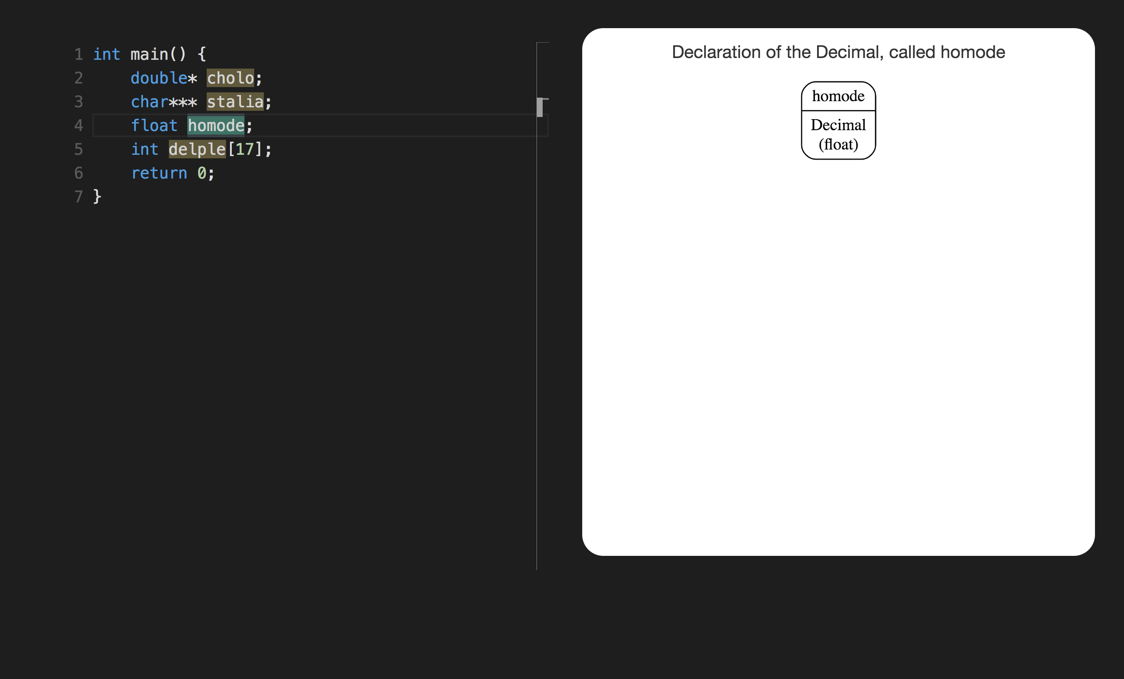

Slide 5
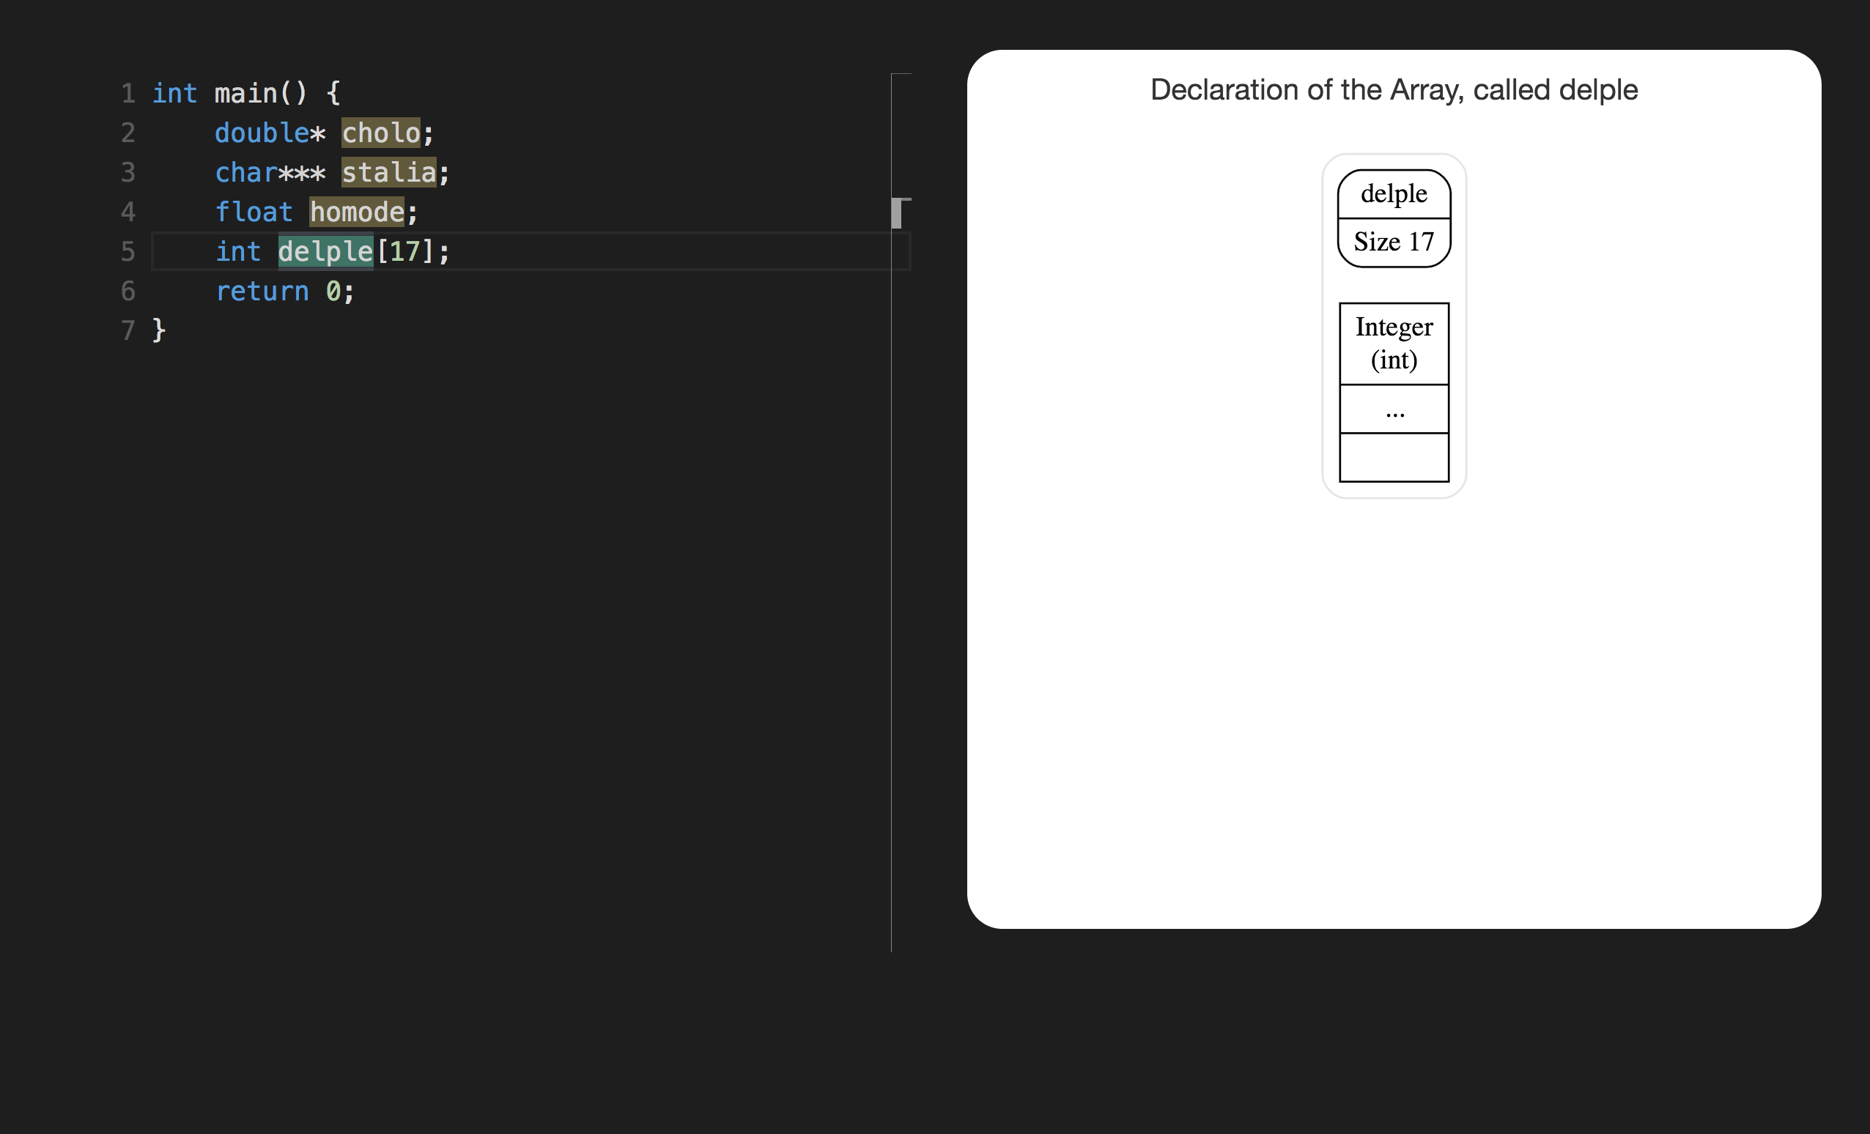

Slide 6
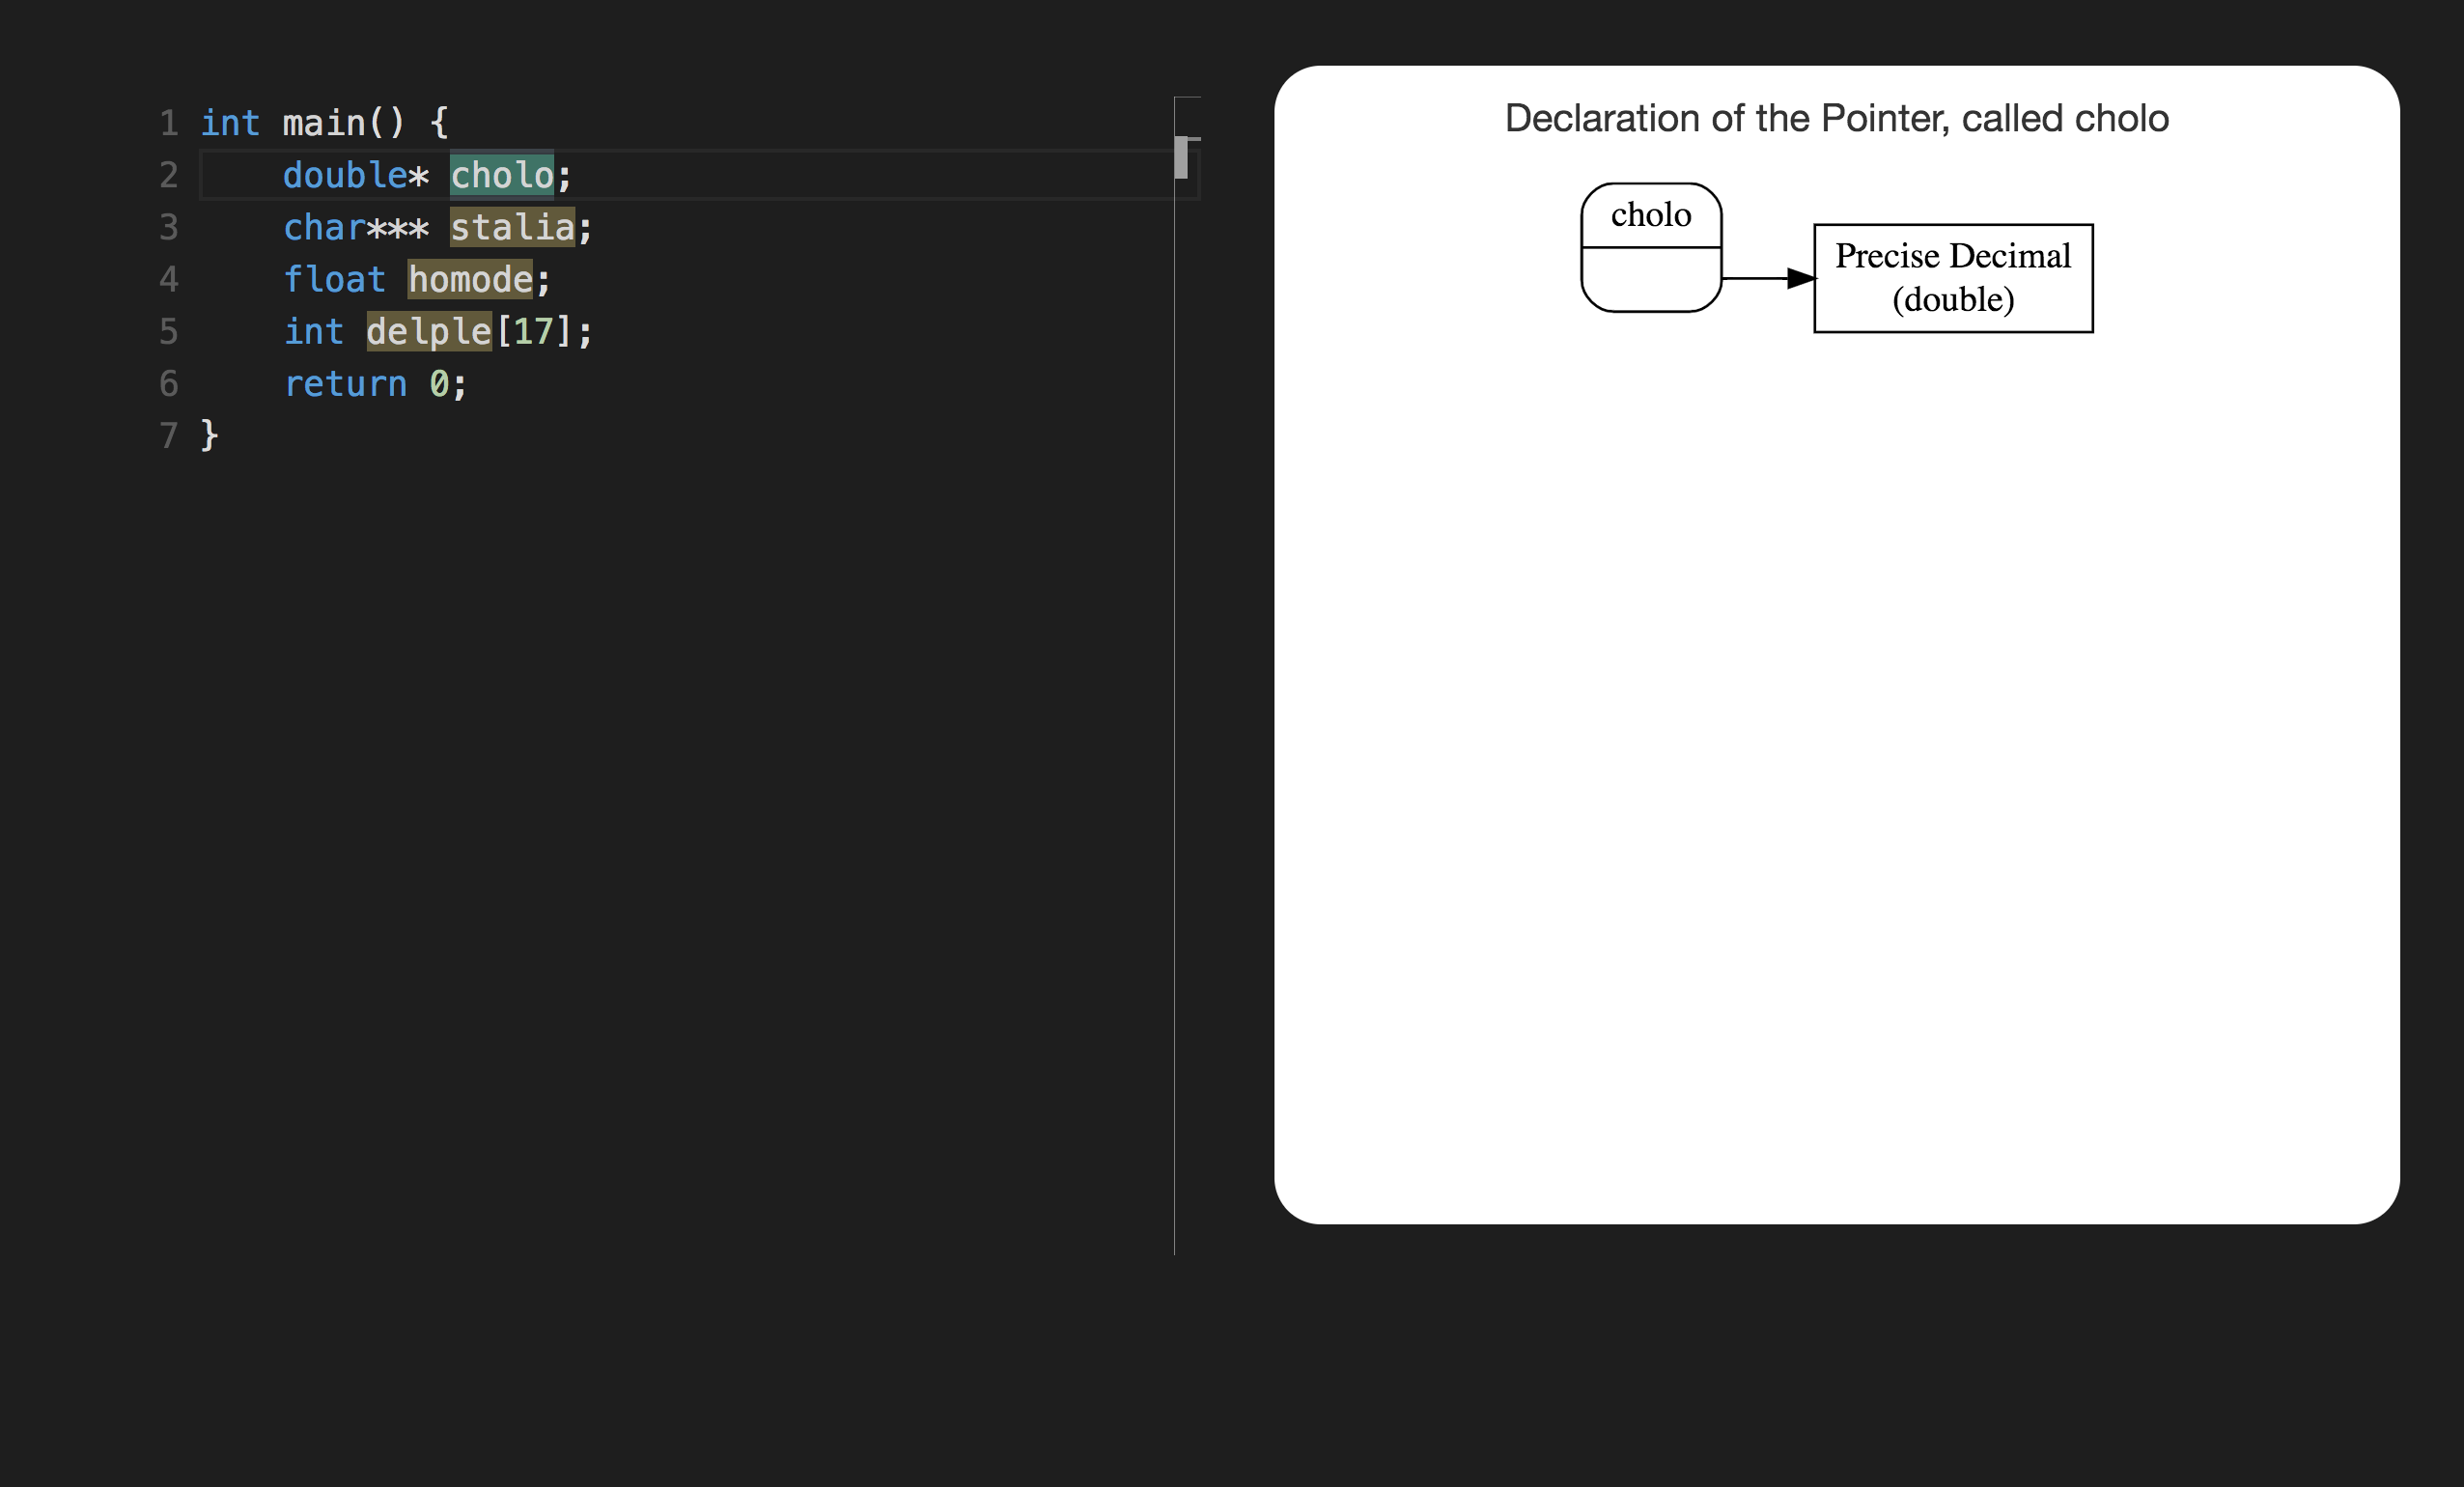

Slide 7
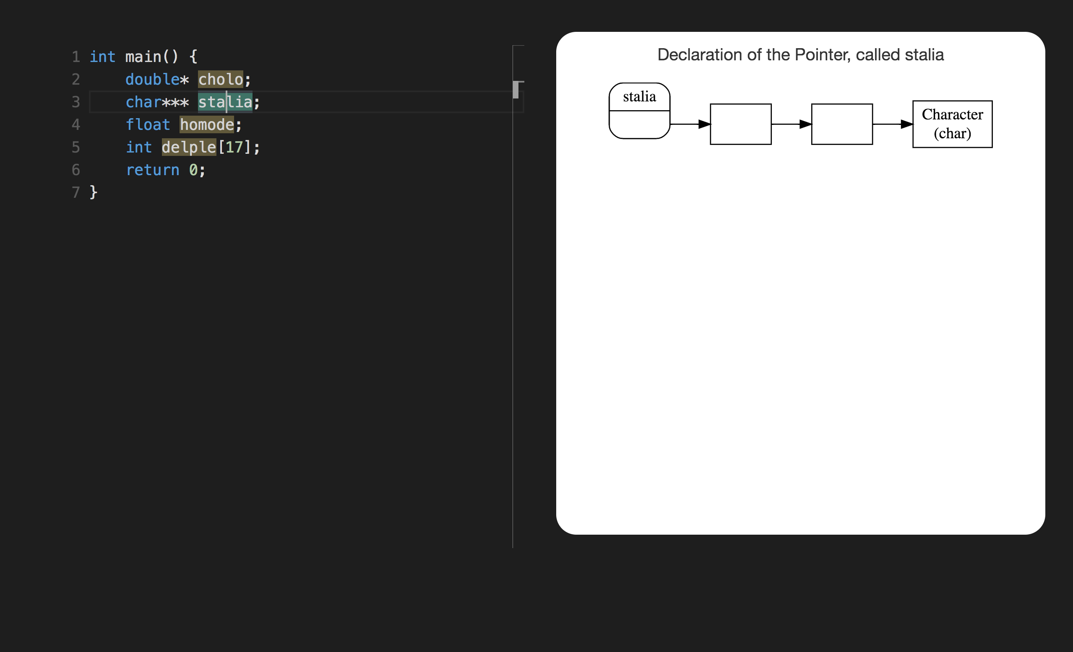

Slide 8
SECTION 2

Slide 9
void para(int*)

Slide 10
char* aspa(float)

Slide 11
int stim(float saxo, int ator)

Slide 12
char expa(double, int)

Slide 13
int stal()

Slide 14
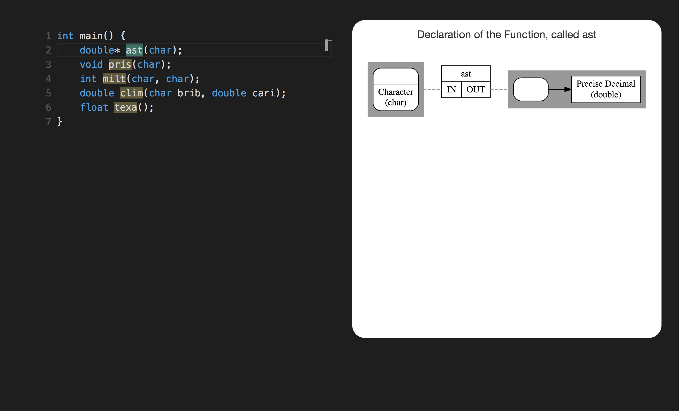

Slide 15
int indo(int*)
declare indo as
function (pointer to int) returning int

Slide 16
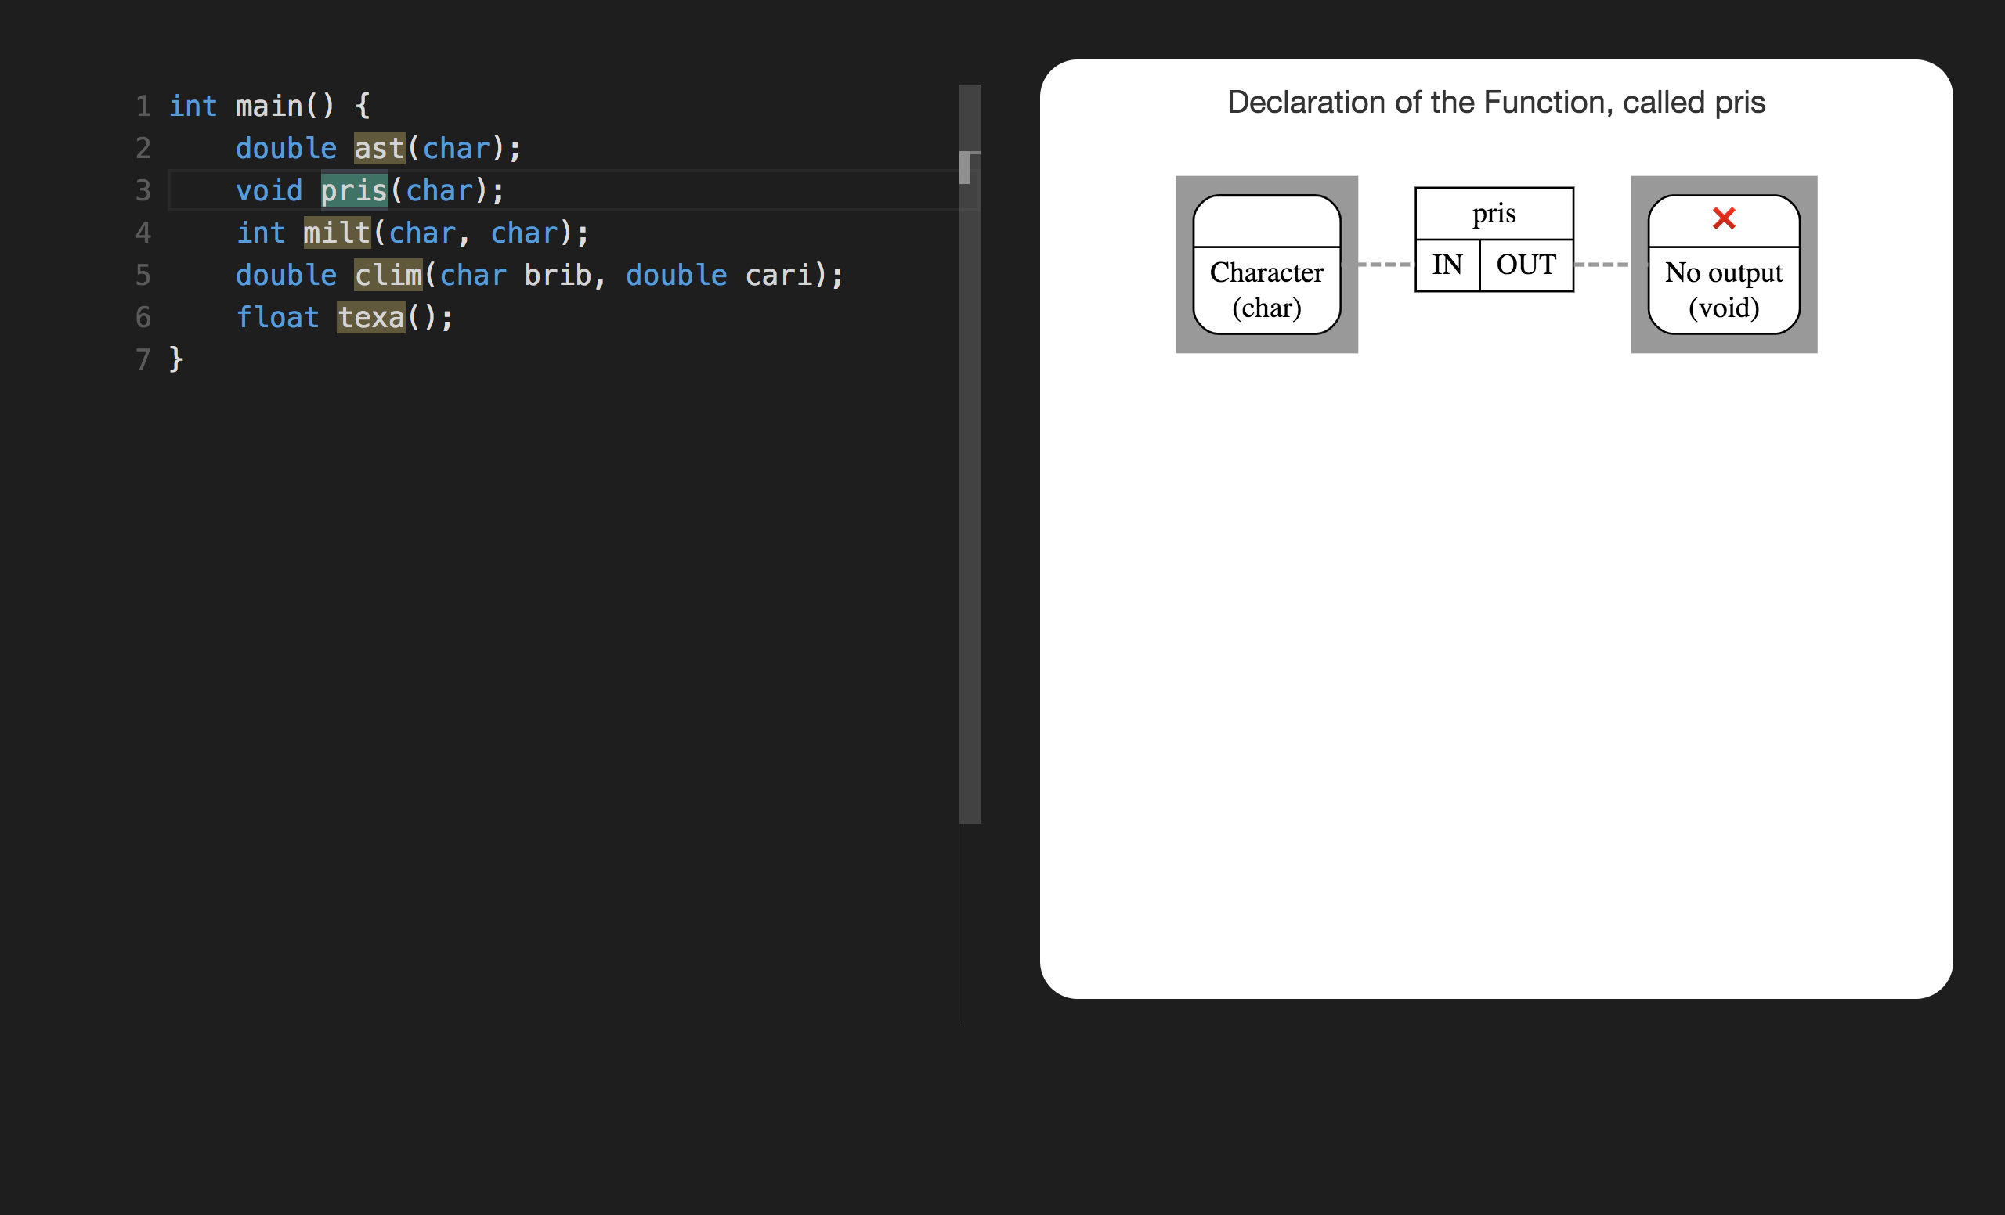
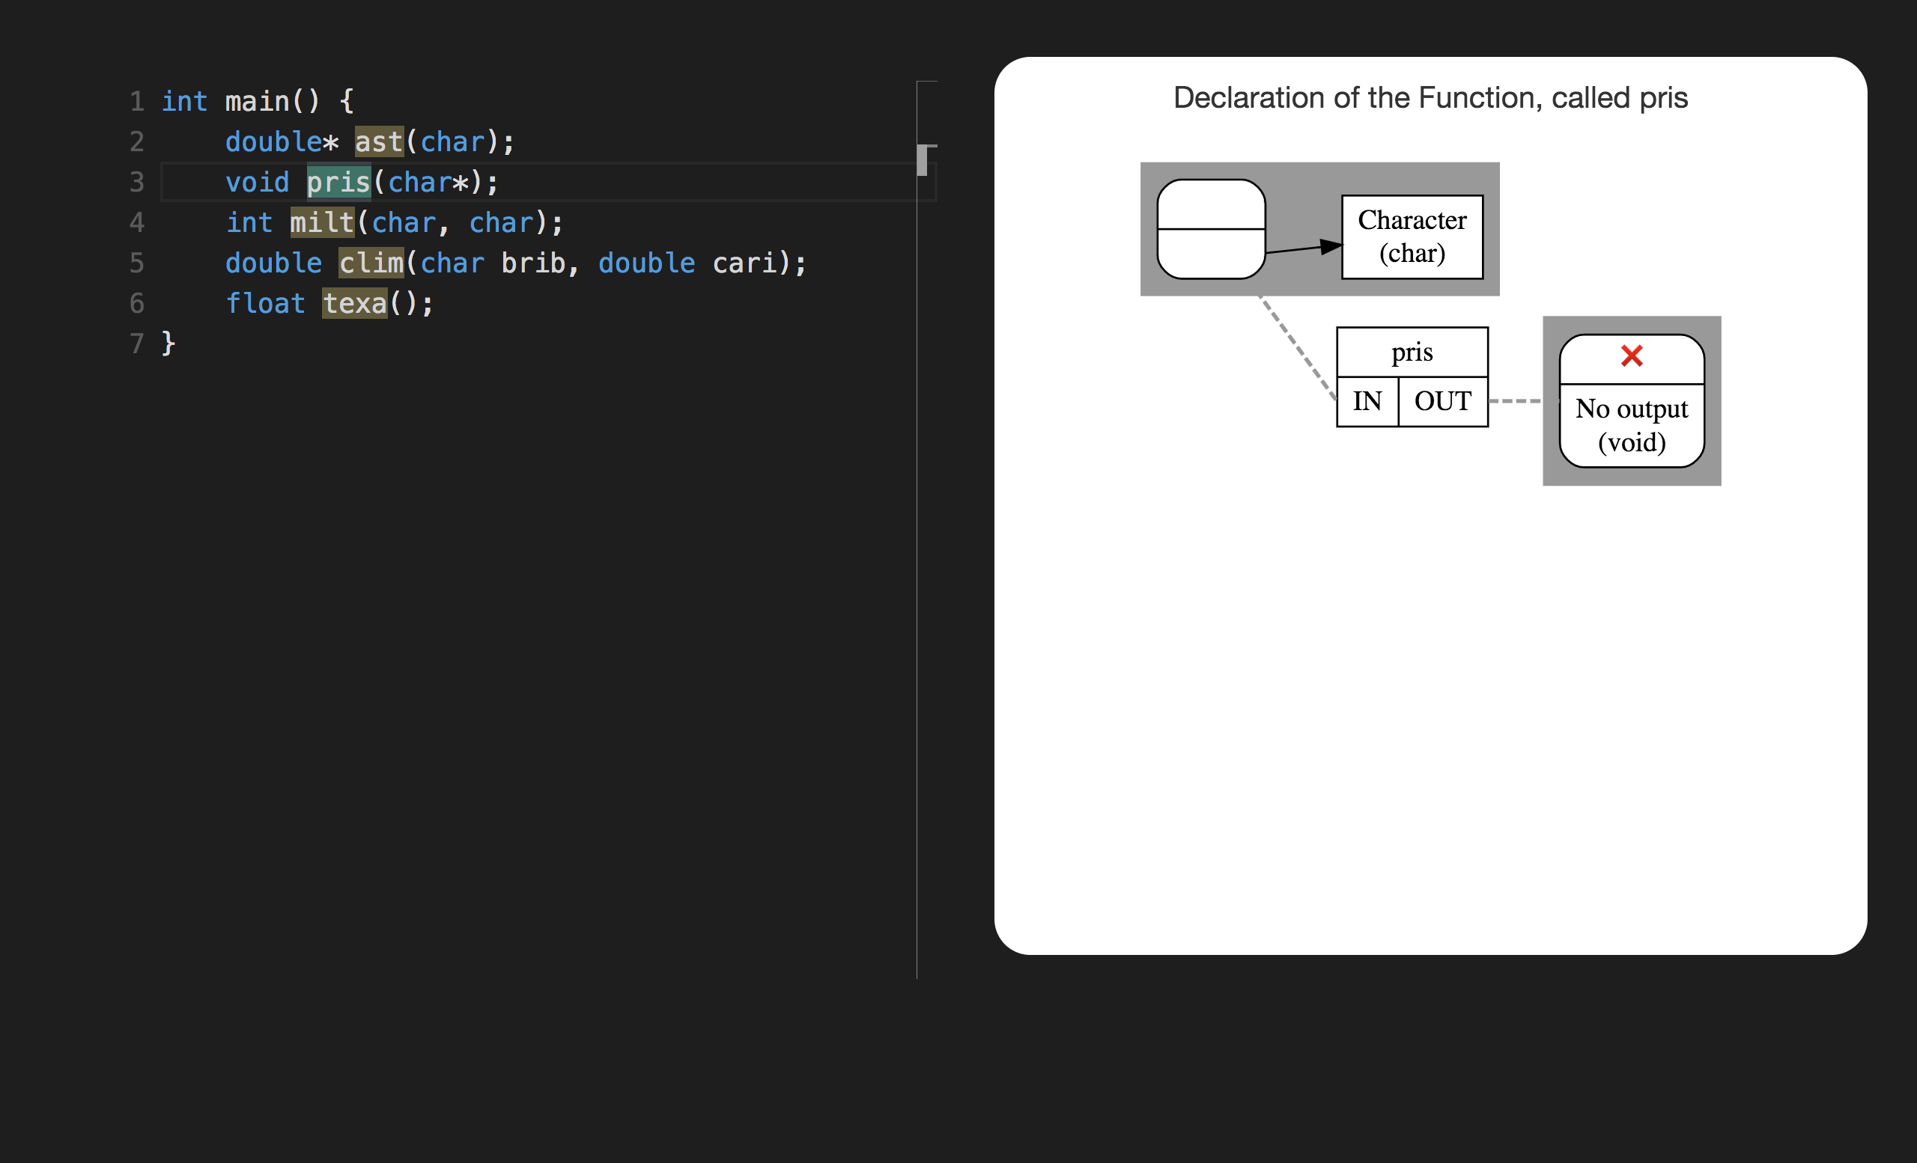

Slide 17
char mult()
declare mult as function returning char

Slide 18
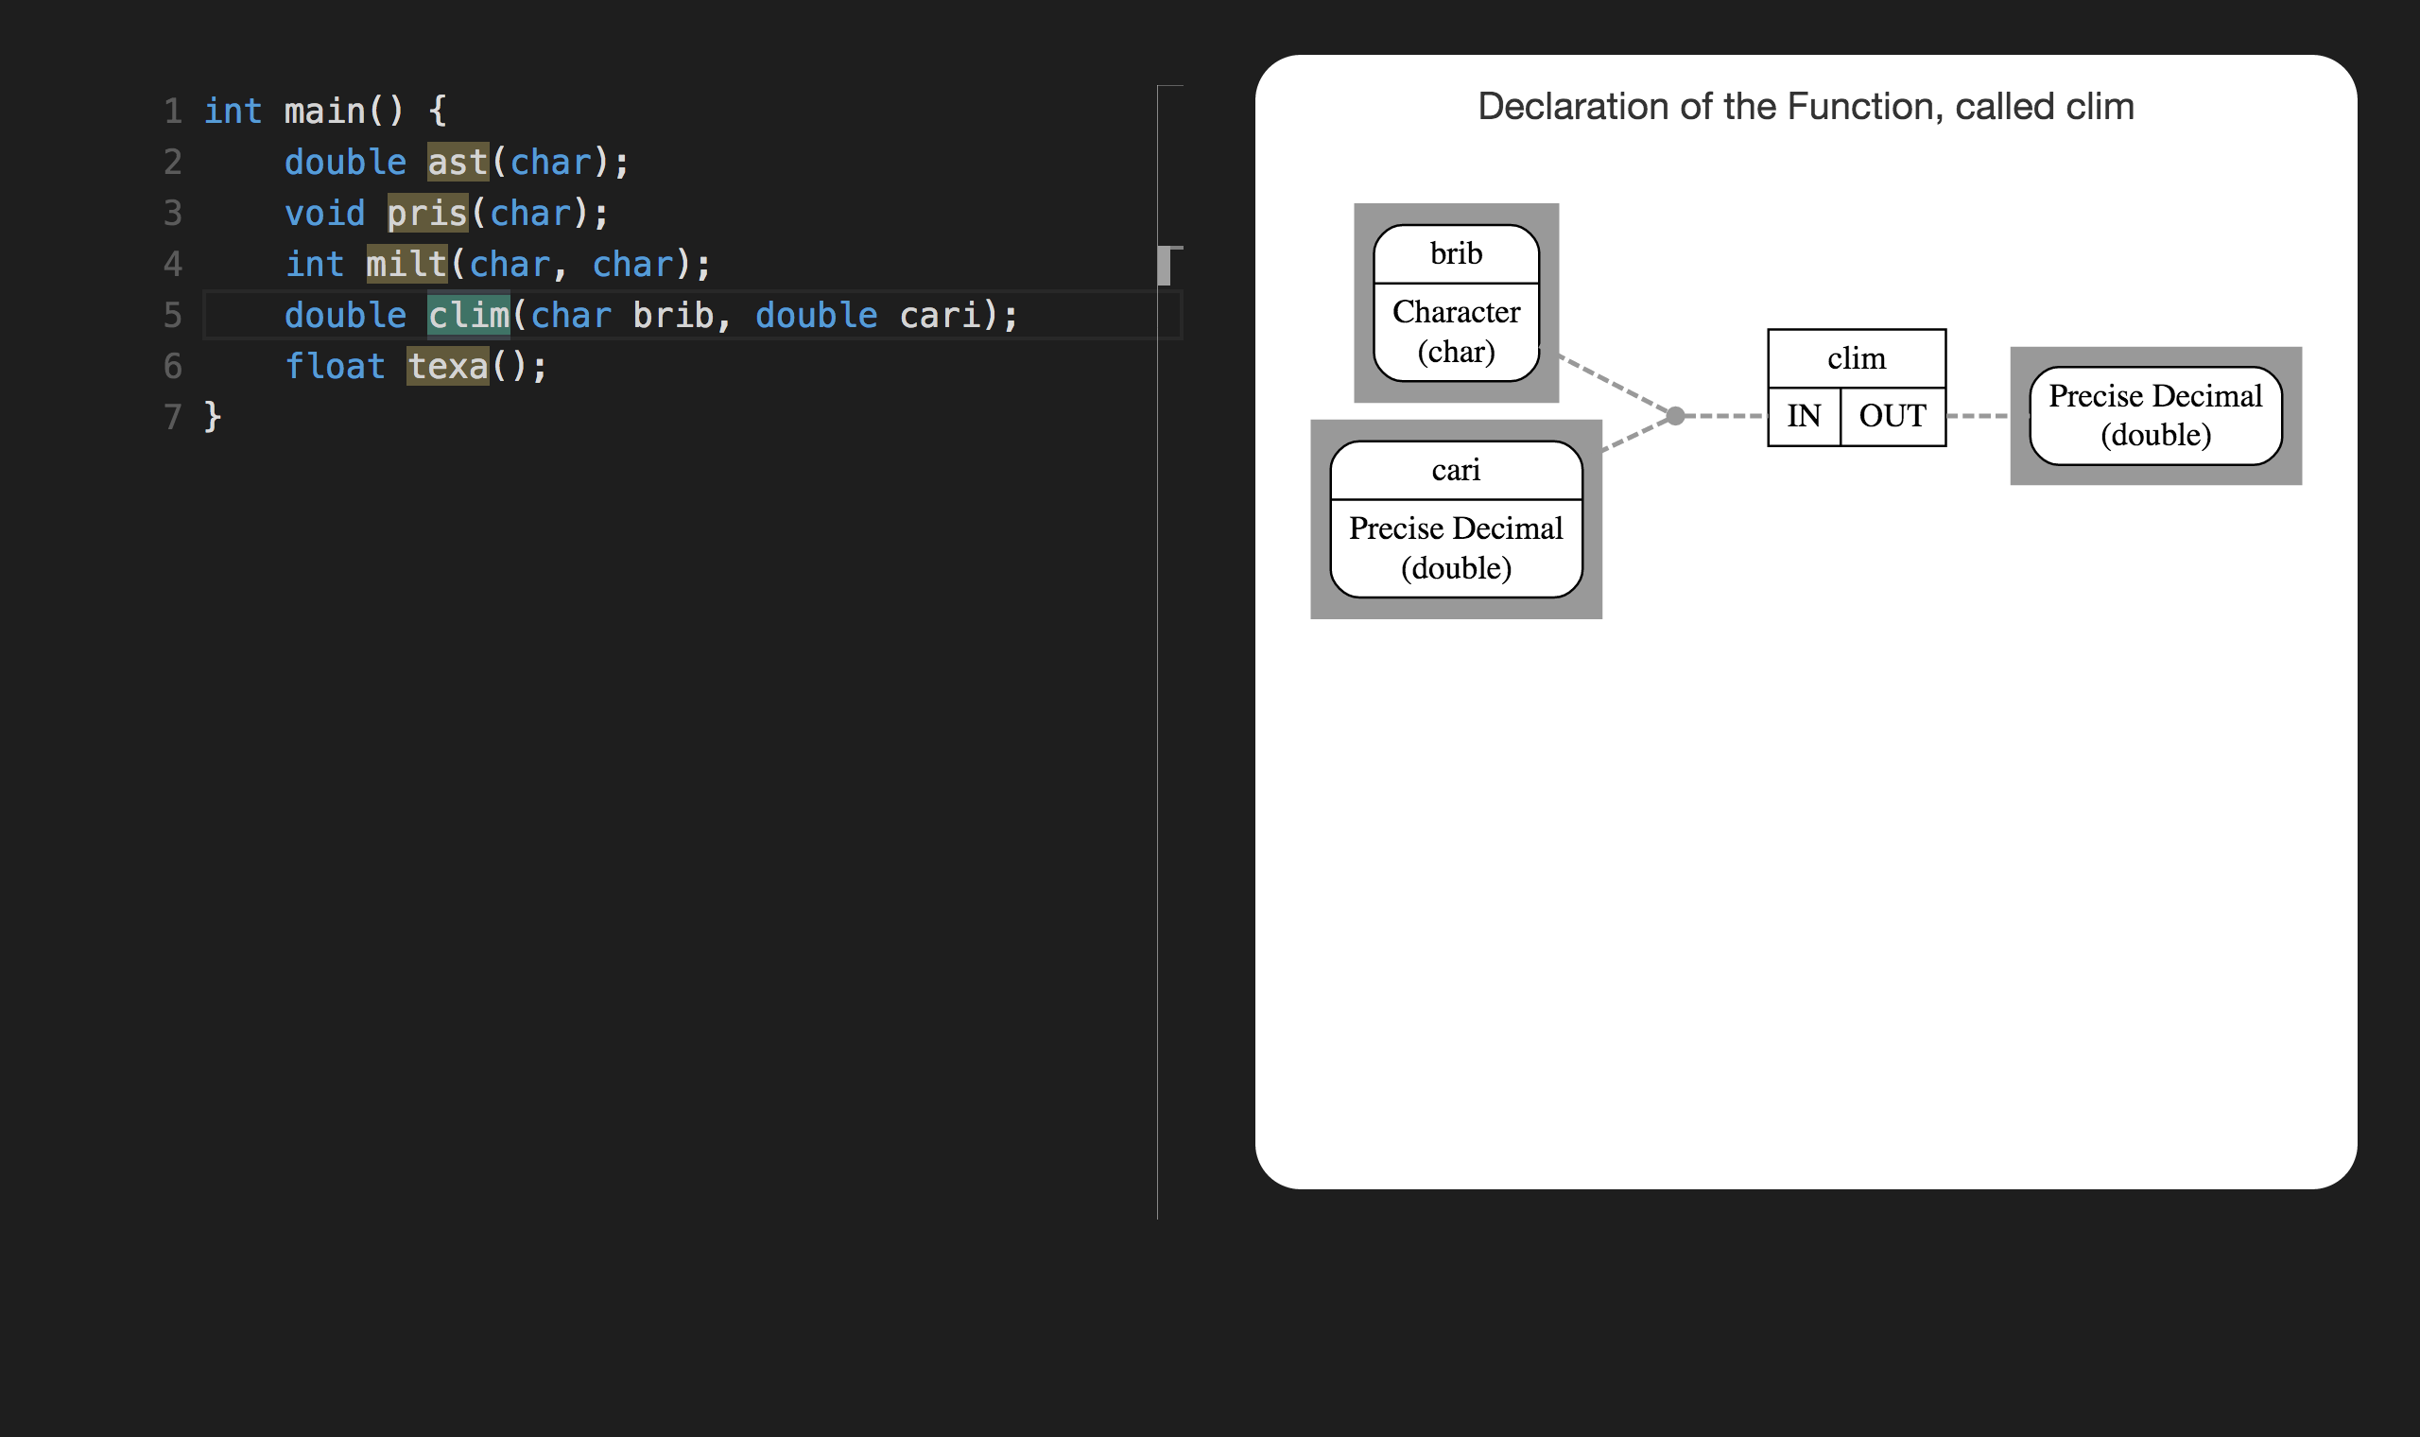

Slide 19
float iter(int, double)
declare iter as
function (int, double) returning float

Slide 20
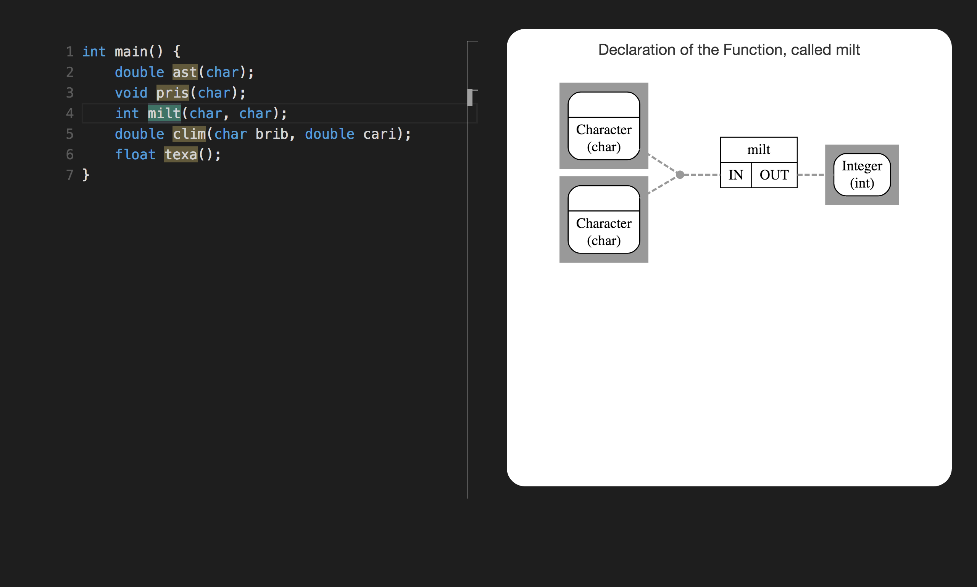

Slide 21
void sult(float)
declare sult as
function (float) returning void

Slide 22
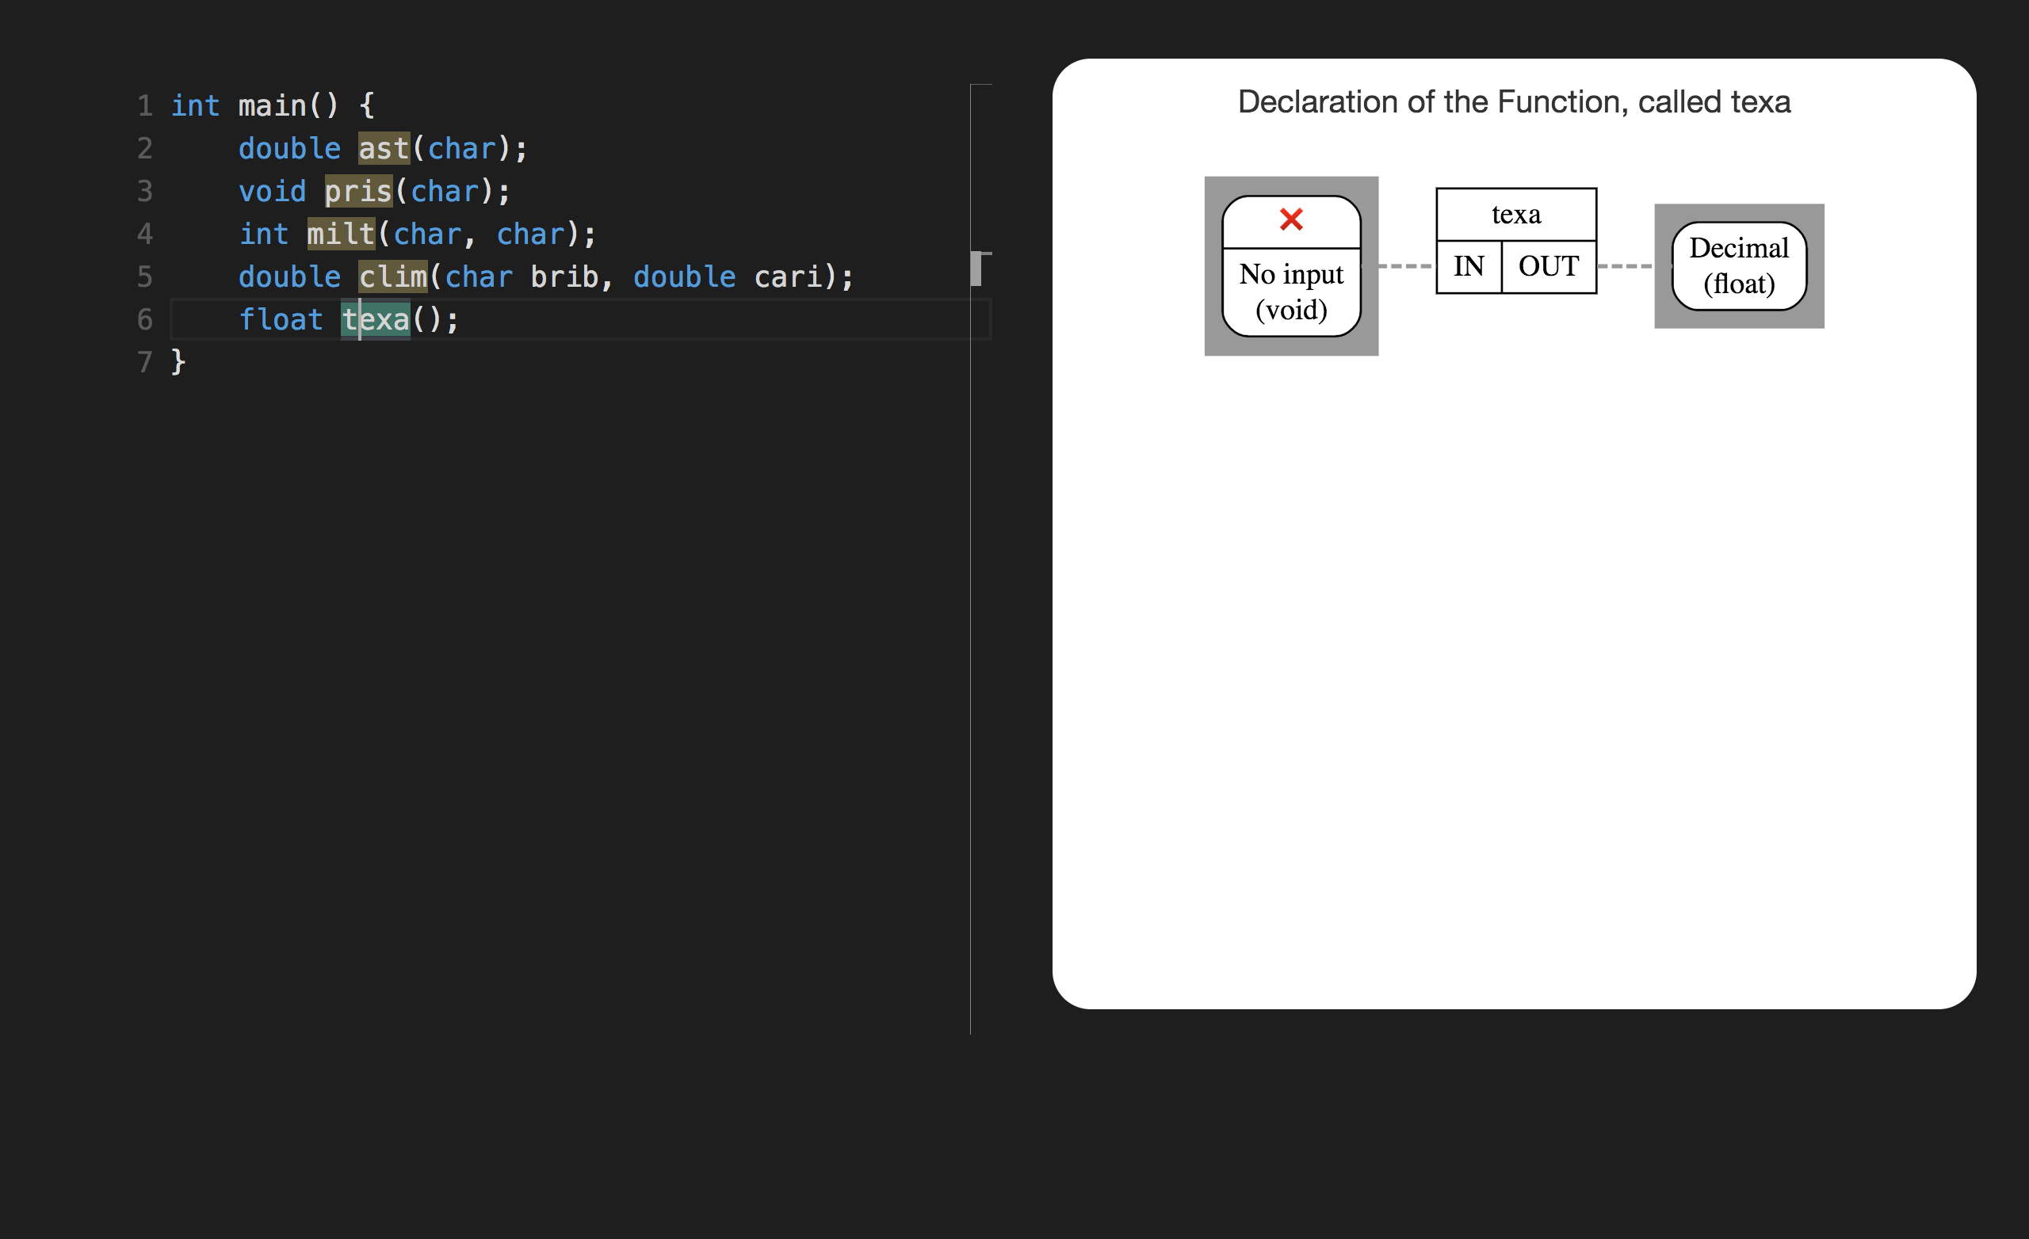

Slide 23
SECTION 3

Slide 24
char *trom[7]

Slide 25
int (*rota)(float, double, int)

Slide 26
char const ** const gera

Slide 27
int (*ster)[4]
declare ster as
pointer to array 4 of int

Slide 28
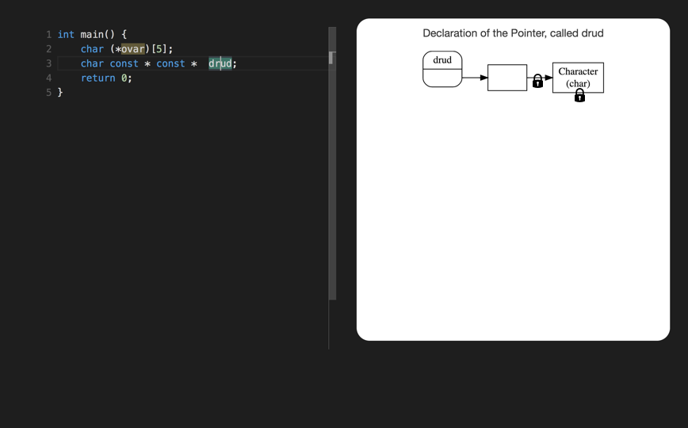

Slide 29
char * const * stic
declare stic as pointer to const pointer to char

Slide 30
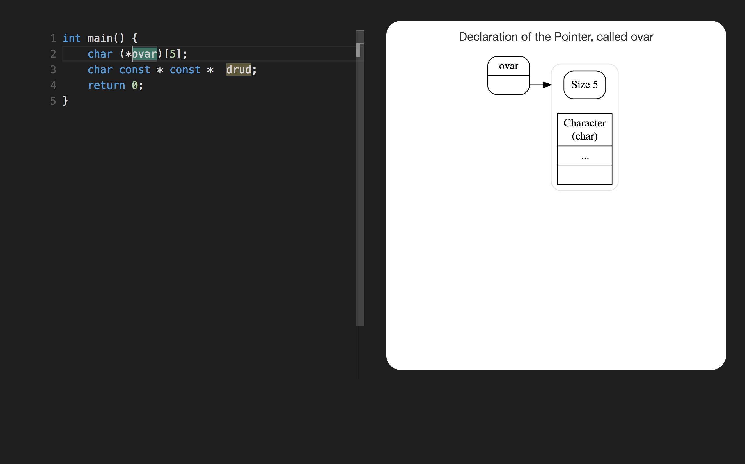

Slide 31
char (*blin)(int)
declare blin as pointer to function (int) returning char

Slide 32
