Slide 1


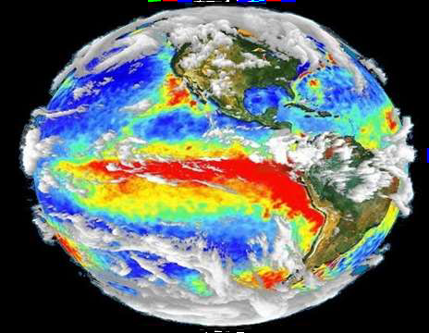



Slide 2
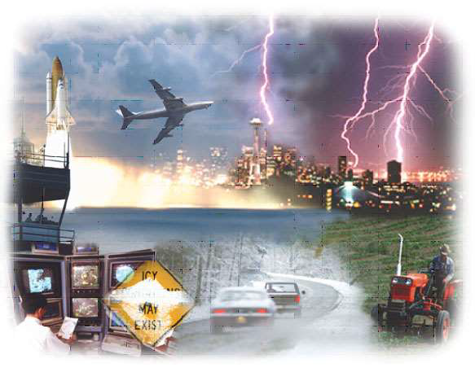
DISASTER MANAGEMENT
MEANING:
Disaster means that any occurrence that causes damage, ecological disruption, loss of human life or deterioration of health and health services on a scale sufficient to warrant and extraordinary response from outside the affected community or area (WHO 1995)

Slide 3
Definition
○ Disaster is any occurrence that causes damage, ecological disruption, loss of human life or deterioration of health and health services on a scale sufficient to warrant an extraordinary response from outside the affected community or area.

Slide 4
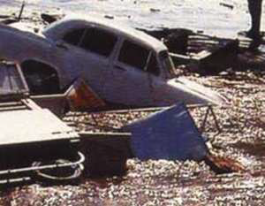
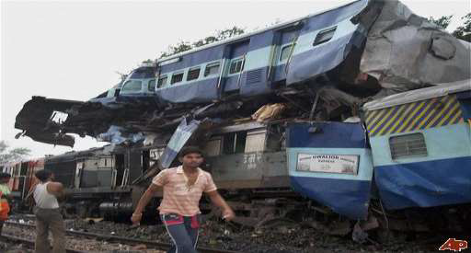
TYPES
• NATURAL DISASTERS
Include droughts, earthquakes, tsunamis, forest fires, landslides and mudslides, blizzards, hurricanes, tornadoes, floods and volcanic disruptions.
• MAN-MADE DISASTER
Includes hazardous substance accidents (e.g., chemicals, toxic gases), radiologic accidents, dam failures, resource shortage (e.g., food, electricity and water), structural fire and explosions and domestic disturbances (e.g., terrorism, bombing and riots), Bioterrorism. Explosions

Slide 5
Fires, Toxic materials, Pollution, Civil unrest (e.g., riots, demonstrations), Terrorists’ attacks
Throughout history natural and man-made disasters have disrupted food and water supplies and. salutation causing communicable diseases, injury, illness and death.
Mixed

Slide 6
Major natural disasters:
• Flood
• Cyclone
• Drought
• Earthquake
Minor natural disasters:
• Cold wave
• Thunderstorms
• Heat waves
• Mud slides

Slide 7
Major manmade disaster:
• Setting of fires
• Epidemic
• Deforestation
• Pollution due to prawn cultivation
• Chemical pollution.
• Wars
Minor manmade disaster:
• Road / train accidents, riots
• Food poisoning
• Industrial disaster/ crisis
• Environmental pollution

Slide 8
PRINCIPLES OF DISASTER MANAGEMENT (Grab and Eng 1995)
1.Prevent the occurrence of the disaster whenever possible.
2. Minimize the number of casualties if the disaster cannot be prevented.
3. Prevent further casualties from occurring after the initial impact of the disaster.
4. Rescue the victims.
5. Provide first aid to the injured.
6. Evacuate the injured to medical facilities.
7. Provide definitive medical care.
8. Promote reconstruction of lives.

Slide 9
Epidemiology
DISASTER AGENT
Primary agents include falling buildings, heat, wind, rising water and smoke.
Secondary agents include bacteria and viruses that produce contamination or infection after the primary agent has caused injury or destruction.

Slide 10
HOST
Human kind.
Age, sex, immunization status, pre-existing health, degree of mobility, emotional stability,
ENVIRONMENT
PHYSICAL FACTORS include the weather conditions, availability of food and water and the functioning of utilities such as electricity and telephone service.
CHEMICAL FACTOR include leakage of stored chemicals into the air, soil, ground water or food supplies.
BIOLOGICAL FACTORS include contaminated water, improper waste disposal, insect or rodent proliferation, improper food storage, or lack of refrigeration owing to interrupted electrical services.
SOCIAL FACTORS are those that contribute to the individual's social support systems, loss of family members, changes in roles, religious beliefs, social factors to be examine after disaster.
PSYCHOLOGICAL FACTORS distress of victim to the disaster site.

Slide 11
PHASES OF A DISASTER
Pre-Impact Phase:
It is the initial phase of the disaster, warning is given prior to the actual occurrence, Emergency centers are opened , Communication , radio and television, community must be educated.
Impact Phase:
This occurs at the time of disaster, The impact phase continues until the threat of further destructions has passed and the emergency plan is in effect. Emergency Operation Center (EOC) has been established. Physical and psychological support
Post impact Phase:
Recovery beings during the emergency phase and end with the return of normal community order and functioning. For persons in then impact area this phase may last a lifetime (e.g., victims of the atomic bombing of Hiroshima).

Slide 12
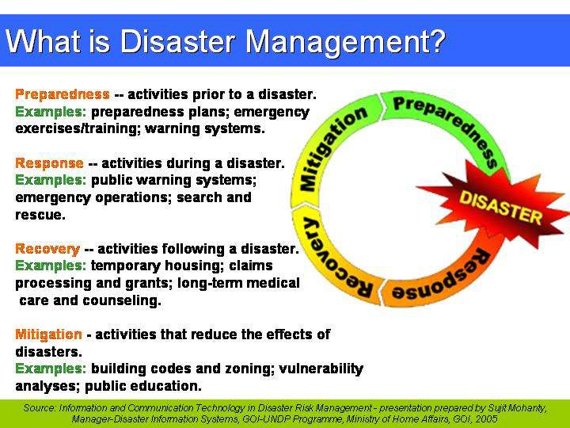

Slide 13
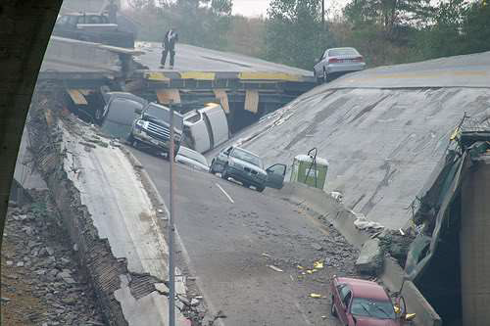

Slide 14
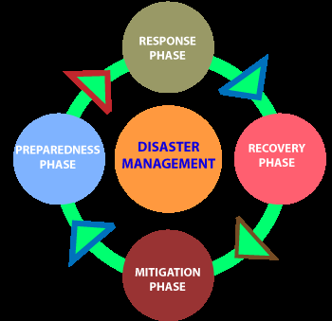
PHASES OF DISASTER MANAGEMENT

Slide 15
PREPAREDNESS:
PERSONAL PREPAREDNESS: Stress and conflict among disaster workers.
PROFESSIONAL PREPAREDNESS: License, Equipment, Personal equipment, such as a Stethoscope, a flashlight and extra batteries, Cash, Warm clothing and a heavy jacket (or weather-appropriate clothing), Record-keeping materials, Pocket-sized reference books
COMMUNITY PREPAREDNESS: Participation.

Slide 16
Role in preparedness:
Within the employing organization: Help initiate or update the disaster plan, provide educational programs and material regarding disasters specific to the area, and organize disaster drills.
2. Community health nurse: Provide an updated record of vulnerable populations within the community. Individualized strategies should be reviewed, including the availability of specific resources, in the event of an emergency.
3. Leader: An intimate knowledge of the institution and familiarity with the individuals who work there. Persons with disaster management training, and especially those who have served on "real" disasters, make valuable members of any preparedness team as well

Slide 17
4. As a community advocate: Should always seek to keep a safe environment. Recalling that disasters are not only natural but also man-made, the nurse in the community has an obligation to assess for and report environmental health hazards.
5. Others:
a. What community resources will be available after a disaster strikes and most important
b. How the community will work together
c. What "should" occur before, during, and after the response and his or her role within the plan.
d. Community health nurse who seeks greater involvement or a more in-depth understanding of disaster management can become involved in any number of community organizations that are part of the official response team, such as the Red Cross, Salvation Army, or Emergency Medical System/ Ambulance Corps.

Slide 18
RESPONSE
It includes community assessment, case finding and referring, prevention, health education, surveillance, and working with aggregates. Local and regional emergency and public health resources can be readjusted as assessment reports continue to come in.
1.SHELTER MANAGEMENT
Responsibility of the local Red Cross, building of “tent cities”
Assessing and referring, ensuring medical needs, providing first aid, serving meals, keeping patient records, ensuring emergency communications and transportation, and providing a safe environment.

Slide 19
2. INTERNATIONAL RELIEF EFFORTS
Federation of Red Cross and Red Crescent Societies and the International Committee of Red Cross or as health representatives from the WHO.
3. PSYCHOLOGICAL STRESS OF DISASTER WORKERS:
The degree of worker stress depends "on the nature of the disaster, role in the disaster, individual stamina, and other environmental factors.
4. ENVIRONMENTAL FACTORS
Noise, inadequate work space, physical danger, and stimulus overload, stress, mood swings, frustration and conflict.

Slide 20
DISASTER RECOVERY
• Flexibility
• Community cleanup efforts
• Release of continuing threat
• Teaching proper hygiene
• Short-term psychological support
• Alert for environmental health hazards
• Home visits

Slide 21
MITIGATION
➢ Working with local, state and federal agencies in identifying disaster risks and developing disaster prevention strategies through extensive public education in disaster prevention and readiness.
➢ To plan effectively for disaster prevention the nurse needs to have community assessment information, including knowledge of community resources (e.g., emergency services, hospitals, and clinics), community health personnel (e.g., nurses, doctors, pharmacists, emergency medical teams, dentists, and volunteers), community government officials, and local industry.

Slide 22

DISASTER MANAGEMENT COMMITTEE
○ Chairman , Medical superintendent/ Director
○ Additional Medical Superintendent
○ Nursing Superintendent/ Chief Nursing Officer
○ Chief medical officer (casualty)
○ Head of departments- surgery, medicine, orthopedics, radiology, anesthesiology, neurosurgery
○ Blood bank in charge
○ Security officers
○ Transport officer
○ Sanitary personnel

Slide 23
MULTIDISCIPLINARY DISASTER
MANAGEMENT TEAM
Physician
Surgeon
Orthopedics
Nurses
Fire Service
Police
Politician,
Safety Officer
Chaplains
NGOs.
Multi-Disciplinary Team
Para-Professional
Psychologist
Social worker

Slide 24
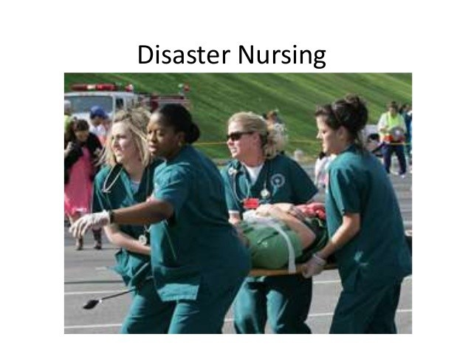

Slide 25
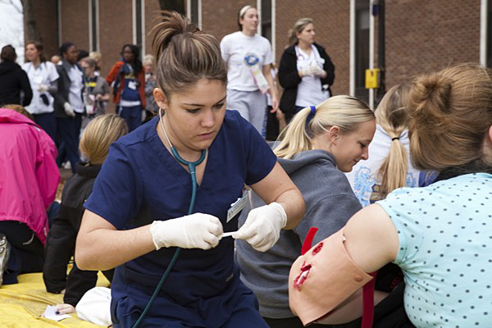
QUALITIES OF A NURSE WORKING IN
DISASTERS
•Cooperation
•Commitment
•Coordination
•Control
•Value of human life
•Gentleness and devotion
•Strength
•Trust
•Interdependence and Team spirit
•Accept Self criticism
•Toughness & Sensitivity
•Leadership
•Responsibility and accountability

Slide 26
ROLE OF NURSING IN DISASTERS
Disaster preparedness, including risk assessment and multi-disciplinary management strategies at all system levels, is critical to the delivery of effective responses to the short, medium, and longterm health needs of a disaster-stricken population.

Slide 27
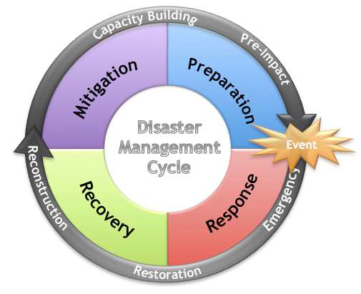

Slide 28
ROLE OF A NURSE IN DISASTER MITIGATION
❑ Diagnose Community Disaster Threats
❑ Determine actual and potential disaster threats
❑ Preventive measures is been taken care of
❑ Is there collabative activites are undertaken
❑ Are the people aware about
❑ Community preparedness
❑ Diagnose community disaster threats.
○ Determine the actual and potential disaster threats.
○ effectiveness of Community based disaster plan
○ Community awareness
○ Community participation

Slide 29
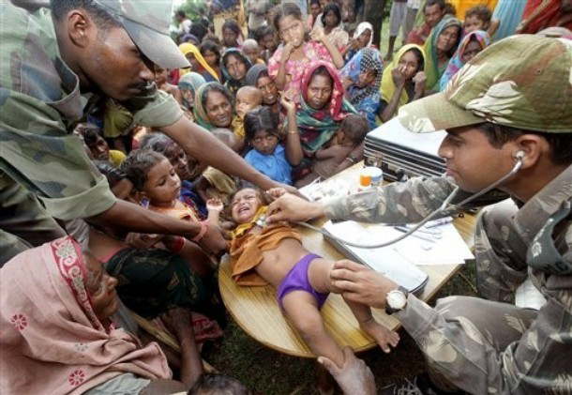
ROLE OF A NURSE IN DISASTER PREPAREDNESS
➢ Chain of authority
➢ Lines of communication
➢ Modes of transport
➢ Mobilization
➢Warning
➢ Equation
➢ Rescue and recovery
➢ Triage
➢ Treatment
➢ Support of victims and families
➢ Care of dead bodies
➢ Disaster worker rehabilitation.
○ PERSONAL PREPAREDNESS
○ Capacity Building
○ Readiness to work in the
multidisciplinary team
○ Knowledge about community
○ Types of disaster and its management
○ Certified first aider and CPR
○ Knowledge about Policies and protocols
○ Communication skill

Slide 30
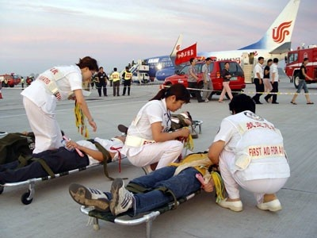
Activation of disaster management plans
➢“Failure to plan is planning to fail”.
➢ Develop a standard operating procedure
➢ Reception area-Disaster control room.
➢ Triage system
➢ Documentation at control room
➢ Public relation
➢ Crowd management

Slide 31
ROLE OF A NURSE IN DISASTER
IMPACT AND RESPONSE
A set of principles which provide a framework for managing any event.
○ Command
○ Control
○ Coordination
○ Communication
○ Clinical Management
○ Continuity
○ Capability

Slide 32
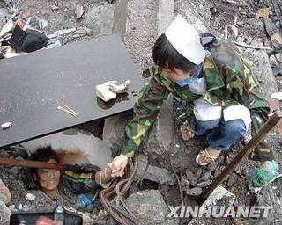
NURSES’ TASK IN DISASTERS IMPACT
○ Determine magnitude of the event
○ Define health needs of the affected groups
○ Establish priorities
○ Identify actual and potential public health problems
○ Determine resources needed to respond
○ Collaborate with other professional disciplines, governmental and non-governmental agencies
○ Maintain a unified chain of command
○ Communication

Slide 33
ROLE OF A NURSE IN DISASTER RESPONSE…
○ Immediate post disaster intervention:-
○ Establish safety.
○ Medical Treatment & Nursing Care as Per Need
○ Utilization of Available Resources
○ Psychological Support
○ Life Saving Measures , First Aid
○ Evacuation & Supply - Shelter, Food, Water, Medicine, Communication
○ Maintaining Public Moral
○ Voluntary Reception, Relatives Waiting Areas
○ Management of Infection Control
○ Re-riving post disaster stress.
○ Encourage ventilation.
○ Establishing outreach program to provide community support.
○ Referral services

Slide 34
ROLE OF THE NURSE IN EMOTIONAL FIRST AID
Psychiatric disorders:-
○ Acute stress reaction
○ Post Traumatic Stress Disorders (PTSD)
○ Adjustment disorders
○ Depressive disorders
○ Acute psychosis
○ Dissociative disorders
○ Anxiety disorders
○ Suicides
○ Personality changes
○ Crises intervention

Slide 35
Establish contact:-
○ Taking care of physical needs
○ Communicate with them
○ Use of drug like sedatives
○ Supervision
○ Ventilation
○ Information meeting
○ Re-riving (encouraged to talk about disaster)
○ Managing social behavior

Slide 36

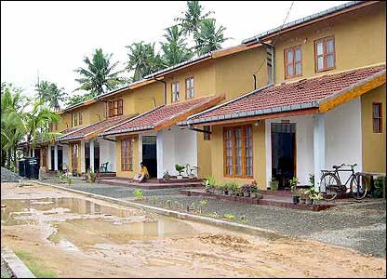
ROLE OF A NURSE IN RECOVERY ,
REHABILITATION AND RECONSTRUCTION
PHASE
Restoration of the pre – disaster condition
Surveillance and prevention of epidemic outbreak
Water supply
Food supply and safety
Control of vectors
Care of survivors,
Vaccination
Counseling and
Behavior modification
RECONSTRUCTION
Setting up of shelter
Health, food, and facilities in the campus
Education
Training of people/students/volunteers

Slide 37
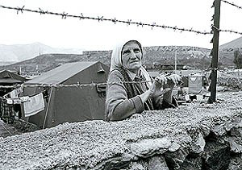
MENTAL WELLNESS
○ In any major disaster, people want to know where their loved ones are?
○ In case of loss, people need to mourn:
○ Give them space,
○ Find family friends or local healers to encourage and support
○ Most are back to normal within 2 weeks
○ About1% to 3%, may need additional help
○ Little attention is paid to the children
○ Listen attentively to children without denying their feelings
○ Give easy-to-understand answers to their questions
○ In the shelter, create an environment in which children can feel safe and secure (e.g. play area)

Slide 38
TRIAGE (categorizing)
Red - Most urgent, first priority
Yellow - Urgent, second priority
Green – Third priority
Black – Dying or dead

Slide 39
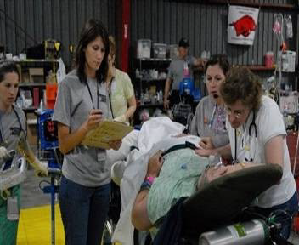
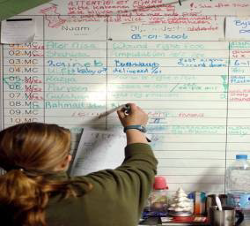
WHY IS DISASTER TRIAGE NEEDED
Triage consists of rapidly classifying the injured on the basis of their severity of injuries and likelihood of their survival with prompt medical interventions.
ADVANTAGES OF TRIAGE
○ Helps to bring order and organization to a chaotic scene.
○ It identifies and provides care to those who are in greatest need
○ Helps make the difficult decisions easier
○ Assure that resources are used in the most effective manner

Slide 40
WHO DECIDES IN TRIAGE
○ Nurses don’t act for legal fears of being blamed for deaths, and lack of clarity on where they fit in the command structure
○ Nurses function to the level of their training and experience.
○ If nurses they are the most trained personnel the site, they are in charge.

Slide 41
RED - MOST URGENT, FIRST PRIORITY
•Life-threatening injuries Shock, chest wounds, internal hemorrhage, head injuries producing increased loss of consciousness, partial-or full-thickness burns over 20% to 60% of the body surface, and chest pain
Poor chance of survival

Slide 42
YELLOW - URGENT, SECOND PRIORITY
Injuries with systemic effects and complications but yet not in shock , with stand 30 to 60-minute.
Category include multiple fractures, open fractures, spinal injuries, large lacerations; partial- or full thickness burns over 10% to 20% of the body surface, and medical emergencies such as diabetic coma, insulin shock; and epileptic seizure, etc.

Slide 43
GREEN- THIRD-PRIORITY
Minimal injuries unaccompanied by systemic complications.
• Wait several hours for treatment.
• Closed fractures, minor burns, minor lacerations, sprains, contusions, and abrasions.
BLACK -DYING OR DEAD
Hopelessly injured patients or dead victims
Crushing injuries to the head or chest
Would not survive under the best of circumstances.

Slide 44
Co-ordination and Involvement of Community
Psychological care,
Emotional support services,
Treatment for victims and their families
ASSESS THE COMMUNITY
Is there a current community disaster plan in place?
What previous disaster experiences has the community been involved with locally, statewide, nationally?
How is the local climate conducive to disaster formation
How is the local terrain conducive to disaster formation
What are the local industries?

Slide 45
Are there any community hazards
What personnel are available for disaster interventions
What are the locally available disaster resources.
What are the local agencies and organizations.
What is immediately available for infant care and care of the elderly and disabled?
What are the most salient chronic illnesses in the community that will need immediate attention
Diagnose Community Disaster Threats
Determine actual and potential disaster threats

Slide 46
Community Disaster Planning
Develop a disaster plan to prevent or deal with identified disaster threats.
Identify a local community communication system.
Identify disaster personnel, including private and professional volunteers, local emergency personnel, agencies, and resources.
Identify regional backup agencies, personnel.
Identify specific responsibilities for various personnel involved in disaster coping and establish a disaster chain of command.

Slide 47
Implement Disaster Plan
Focus on primary prevention activities to prevent occurrence of man-made disasters.
Practice community disaster plans with all personnel carrying out their previously identified responsibilities.
Practice using equipment, obtaining and distributing supplies.
Evaluate Effectiveness of Disaster Plan
Critically evaluate all aspects of disaster plans and practice drills for speed, effectiveness, gaps, and revisions.
Evaluate the disaster impact on community and surrounding regions.
Evaluate response of personnel involved in disaster relief efforts.

Slide 48
REHABILITATION BY HEALTH SECTOR
○ Community cleanup efforts
○ Teaching Proper Hygiene
○ Alert For Environmental Health Hazards
○ Home Visits
○ Fallow up care

Slide 49





Thank You !!

