Slide 1
प्र
PRAHARI
The Sentinel for Digital Public Safety
An AI platform that shifts law enforcement from reactive case investigation to
predictive threat neutralisation — across digital-arrest scams, counterfeit currency,
and organised fraud networks.
Computer Vision • Graph AI • NLP / LLM • Geospatial • Agentic Fusion

Slide 2
The threat is industrialised — and accelerating
1.14M
₹1,776 Cr
Record
cybercrime complaints in India, 2023
lost to 'digital arrest' scams
FICN ₹500 fake-note seizures
▲ 60% vs 2022
first 9 months of 2024 (MHA / I4C)
RBI Annual Report 2025
Why it's hard to stop
Run from cross-border fraud compounds with spoofed numbers, AI-generated voices and fake government portals.
Four signal domains — communications, financial, physical (counterfeit) and geospatial — are investigated in silos, after the complaint.
The missing capability: intelligence BEFORE mass victimisation, and detection at the point of contact — not the point of complaint.
PRAHARI · Digital Public Safety Intelligence
2

Slide 3
One agentic core. Five fronts in the same war.
1
Digital Arrest Detection
2
Counterfeit Currency Agent
3
Fraud Network Graph
Explainable NLP classifier scores live transcripts against the scam kill-chain; auto-files an MHA alert before money moves.
7-feature banknote forensics across all denominations, with a per-feature 'why-flagged' breakdown for tellers & field officers.
Graph AI clusters coordinated campaigns, ranks kingpins, and projects lead-time to mass victimisation.
4
Geospatial Intelligence
5
Citizen Fraud Shield
Convergence is the product.
Hotspot density + patrol-priority queue across cybercrime, FICN seizures and cross-border compounds.
Low-false-positive chatbot in 12 languages on WhatsApp/IVR/app, with guided 1930 reporting.
The same scammer's number, mule account, voice and location are one entity across all five modules — fused, not filed separately.
PRAHARI · Digital Public Safety Intelligence
3

Slide 4
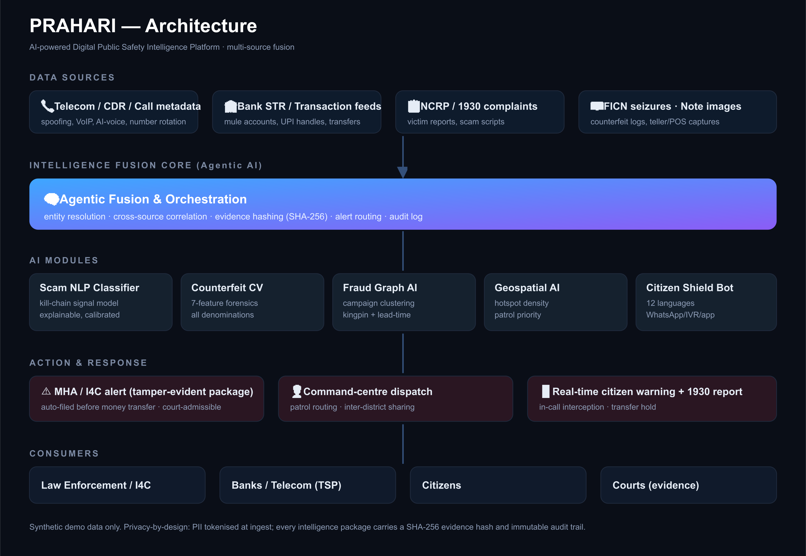
Architecture — multi-source intelligence fusion
PRAHARI · Digital Public Safety Intelligence
4

Slide 5
Spotlight · Digital Arrest Detection
We model the scam's psychological kill-chain as weighted, explainable signals.
1
Authority impersonation
"I am Inspector Sharma, CBI"
Output = verdict + evidence + action
Fabricated case / parcel
"parcel with drugs, Aadhaar misused"
Calibrated risk score 0–100 with SAFE / SUSPICIOUS / HIGH-RISK / ACTIVE-SCAM bands.
Every point traces to a matched phrase — a glass-box, auditable evidence trail.
Fuses call metadata: VoIP, caller-ID spoofing, AI-voice, number rotation.
On ACTIVE-SCAM: holds the transfer & auto-files a SHA-256 tamper-evident MHA / I4C alert — before money moves.
Negative-suppression keeps legitimate bank calls at SAFE (low false positives).
2
3
Isolation + secrecy
"do not tell anyone"
4
Digital arrest / video custody
"stay on this video call"
5
Money / verification transfer
"transfer to RBI verified account"
PRAHARI · Digital Public Safety Intelligence
5

Slide 6
Spotlight · Counterfeit forensics + Fraud graph
Counterfeit Currency Agent
Fraud Network Graph
7 security features, per-note, explainable:
Connected-component clustering → distinct campaigns / rings.
Centrality (degree + betweenness) → kingpin / aggregator accounts.
Mule-chain tracing: victim → mule → aggregator → cash-out.
Lead-time KPI: victims/day velocity → projected days to 100 victims — the early-warning metric.
Each package is SHA-256 hashed & timestamped for court admissibility.
Aspect ratio / dimensions
Base colour match (RBI spec)
Microprint / intaglio sharpness
Security-thread signature
Intaglio print texture
RBI serial-number grammar
UV fluorescence (device sensor)
Deployable on mobile, bank counting machines and POS terminals.
PRAHARI · Digital Public Safety Intelligence
6

Slide 7
Why Prahari wins where point-tools fail
Auditable by design
Reactive complaint flow vs. Prahari
Glass-box scoring + SHA-256 evidence hashes → court-admissible, not a black box.
Built for low false positives
Negative-suppression + explainable signals; legit calls score SAFE.
Predictive lead-time
Projects days-to-mass-victimisation, enabling pre-emptive disruption.
Convergence, not silos
One entity graph across calls, money, notes & geography.
PRAHARI · Digital Public Safety Intelligence
7

Slide 8
Impact & alignment to judging criteria
Innovation (25%)
Kill-chain scam modelling + lead-time KPI + cross-domain entity fusion.
Business Impact (25%)
Targets a ₹1,776 Cr/yr loss vector; protects banks, telcos, citizens & courts.
Technical Excellence (20%)
Graph AI, image forensics, explainable NLP, geospatial — in one API.
Scalability (15%)
Stateless services; add scam templates without retraining; per-module scale-out.
User Experience (15%)
Command-centre dashboard + 12-language citizen chatbot on WhatsApp/IVR/app.
PRAHARI · Digital Public Safety Intelligence
8

Slide 9
Built today · production tomorrow
Working prototype (this build)
Production roadmap
FastAPI backend, 5 live modules, one command-centre UI.
Explainable scam scorer + 7-feature note forensics (PIL/numpy).
networkx graph engine with hashed intelligence packages.
Leaflet command map + multilingual citizen chatbot.
Swap heuristics for fine-tuned models: transformer scam classifier, CNN/ViT per security ROI.
Speech-AI front-end for live synthetic-voice detection.
IndicTrans + LLM for full 12-language NLG.
Real connectors: TSP CDR, NPCI/UPI, bank STR, NCRP/1930, I4C.
PII tokenisation at ingest; signed append-only audit ledger.
PRAHARI · Digital Public Safety Intelligence
9

Slide 10
From point of complaint
to point of contact.
PRAHARI — detect, disrupt, and neutralise digital fraud before mass victimisation.
Run the prototype: ./run.sh → http://127.0.0.1:8008

