Slide 1


Slide 2



Osteoporosis Risk Prediction
A comprehensive machine learning approach to predict osteoporosis risk.
By : Ravi Chavda

Slide 3
Introduction
Data Gathering /Data Refinement
01
Reason / Issues causing Osteoporosis
02
Models and early detection bring essential benefits
Comprehensive Dataset Overview
Refinement and Data Preparation Steps
EXPLORATORY DATA ANALYSIS
Feature Extraction
03
04
Find patterns and identify trends
Divide Features into X and Y
Gain valuable insights from the dataset
Machine Learning / Deep learning
Methodology
06
Experimental results
05
Algorithms or Models Used
Visuals of Compared models
Compare each Evaluate Algorithm
Accuracy, confusion matrix of models
Conclusion
Appendices and references
07
08
Importance of the used approach
Suggestion for future
Links and codes used in the project

Slide 4
Project Introduction
Problem Statement :
Developing a model to predict osteoporosis risk for early intervention.
Objectives :
Outlining tasks from data exploration and preprocessing to model building and evaluation.
Problem Statement:
Develop a robust machine learning model to accurately predict osteoporosis risk, aiming to improve early intervention, optimize patient care, and reduce osteoporosis-related fractures.

Slide 5

EXPLORATORY DATA ANALYSIS
Objectives :
Explore the dataset and identify patterns.
Conduct detailed exploratory data analysis (EDA).
Perform preprocessing, including feature encoding and handling missing values.
Build and tune multiple classification models.
Evaluate model performance using accuracy, precision, recall, and F1-score.
Alcohol
Smoking
Obesity
Sedentary lifestyle

Slide 6



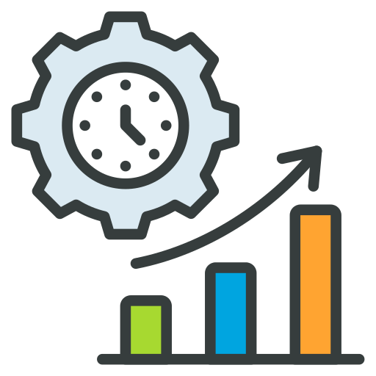


Objective OF The Study
Risk Stratification
Comparing Algorithms
Real - time Monitoring
Value Of The Study
Early detection and Prevention
Improved Patient Outcomes
Public Health Advancement

Slide 7

Monitor and Update
STEP
Continuously monitor the model's performance in the real-world scenario
07
Model Evaluation
STEP
06
Assessing the performance of a machine learning model using metrics
Model Selection and
Model Training
STEP
Choosing a suitable machine learning algorithm and optimizing its parameters
05
Split Train And Test Data
WORK FLOW
WORK FLOW
STEP
04
Dividing the dataset into training and testing sets to evaluate
PREPROCESSING
STEP
Preparing and cleaning data to enhance its quality and suitability
03
Exploratory Data Analysis
STEP
02
Analyzing and visualizing data patterns to understand its characteristics
Data Collection
STEP
Gathering and organizing data to train machine learning models.
01

Slide 8

EXPLORATORY DATA ANALYSIS
Exploratory Data Analysis (EDA) helped us understand the data structure, find patterns, identify trends, and gain valuable insights from the dataset.
From EDA we analyze, the distribution of each features, checking the correlation between the features .
Using visuals helped us see the data clearly, understand the clinical data relationship with each other, and pinpoint factors that plays vital role in predictions of Osteoporosis Risk Prediction disease.
The datasets is clean ,as there is no NULL VALUE, but we can find some DUPLICATE VALUES and OUTLIERS.
We looked at our data columns and found 16 columns to be numerical in terms of data types, but they are categorical in terms of semantic. So, we converted them to object for proper analysis.
We used the univariate and bivariate analysis approach to gain insights into individual characteristics of the data and likewise how each feature relates to main goal: predicting the target variable.

Slide 9
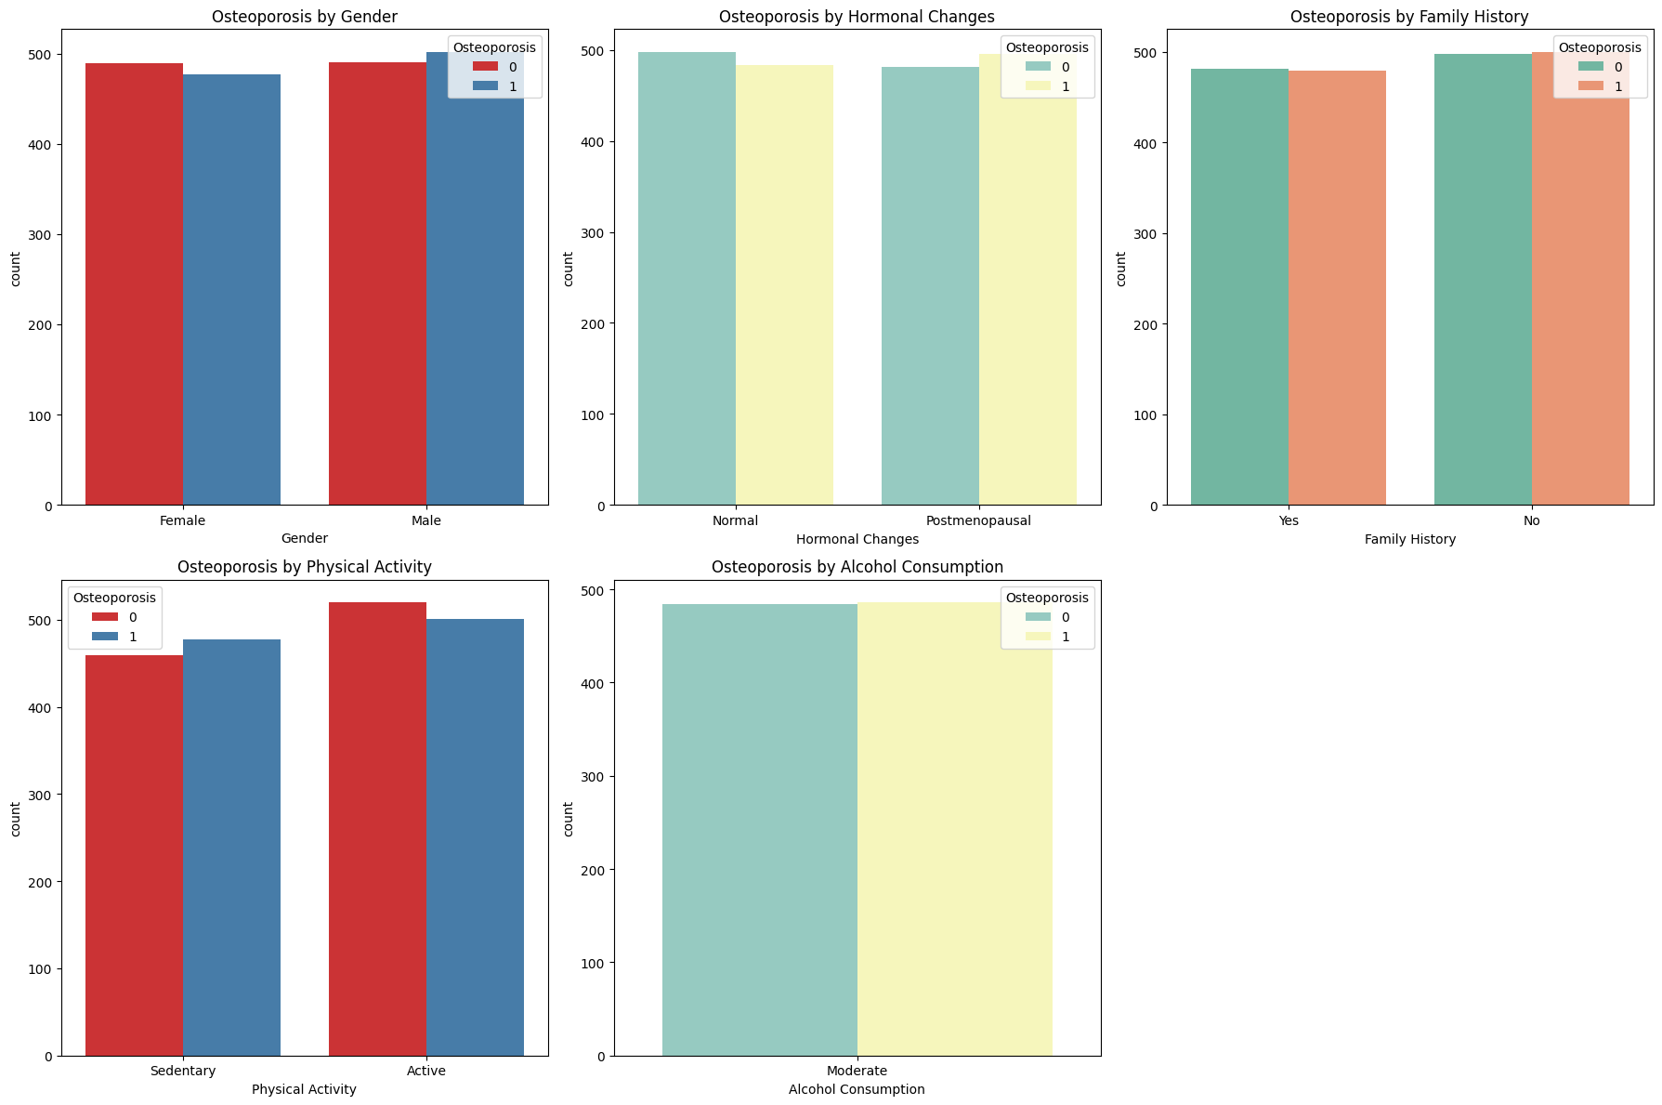
DISTRIBUTION OF CONTINUOUS VARIABLE
Overall Summary:
These charts suggest that, in this dataset, physical activity might have a slight impact on osteoporosis risk, while other factors like gender, hormonal changes, family history,
moderate alcohol consumption show little difference in osteoporosis incidence.
This could imply that osteoporosis risk might be influenced by other factors not depicted here or requires further multivariate analysis to uncover deeper relationships.

Slide 10
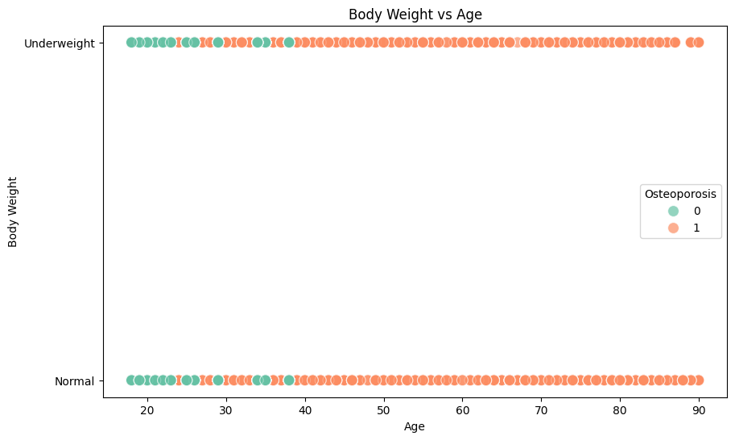
Body Weight Categories
This chart suggests that underweight individuals might be at a slightly higher risk of osteoporosis compared to those with normal weight.
However, osteoporosis cases are present across both weight categories and various ages, indicating that other factors may also play a significant role.
Each category has dots representing individuals, color-coded by osteoporosis presence
Green (0): No osteoporosis
Orange (1): Osteoporosis

Slide 11
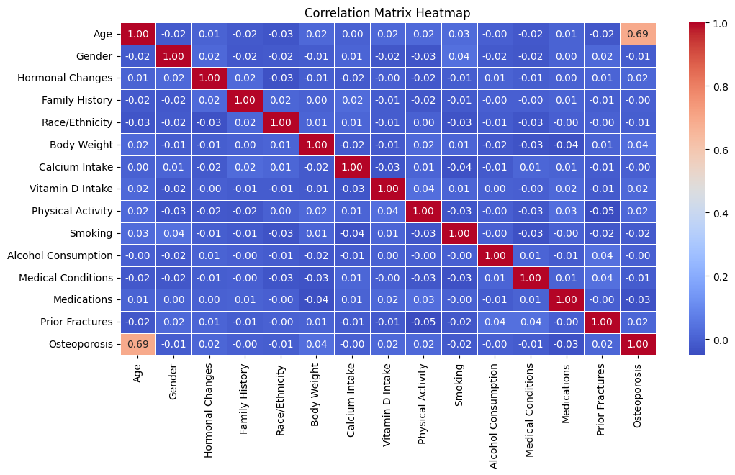
Correlation Matrix Heatmap
The heatmap shows that age is the primary factor correlated with osteoporosis in this dataset.
Other factors have relatively weak or negligible correlations with osteoporosis, suggesting that while age is an essential indicator, additional factors may require more complex analysis
(e.g., multivariate or non-linear models) to fully understand their relationship with osteoporosis.

Slide 12

PREPROCESSSING
Irrelevant Feature Removal: All features in the dataset appears to be relevant based on EDA. We will retain all the columns, ensuring no valuable information is lost, especially given the dataset’s small size.
Missing Value Treatment: missing value found in the dataset.
Outliers Treatment: Checked outliers using IQR method for the continuous features and upon identifying outliers, nature of algorithm, and given small dataset size direct removal of outliers might not be best approach. Instead, we will apply Box-Cox transformation to stabilize variance and make the data more normal-distribution.
Categorical Feature Encoding: Applied leble encoding to the columns like “object data type” .
since these variables are nominal variables.
Feature Scaling: Are imp. for the algorithms that are sensitive to the magnitude and scale of feature, but not all algorithms requires scaling like Decision Tree are scale-invariant and given our intent to use mix-model we’ve chosen to handle scaling later using pipelines.

Slide 13
TRAIN TEST SPLIT
We divided the data into training (80%) and testing (20%) sets.
Setting a random state ensures consistent results and using stratify=y maintains a proportional distribution of the target variable in both sets.
SPLITING THE DATA INTO X & Y
We divided the dataset into two parts: X and y.
"X" typically represents the independent Variables, and "y" represents the Dependent (target variable) that we want to predict or understand.

Slide 14
MODEL SELECTION
Logistic Regression
A linear model good for binary classification, interpretable and fast but may struggle with complex pattern
2.Random Forest Classifier
An ensemble method that combines multiple decision trees for high accuracy and resilience to overfitting, but can be computationally intensive.
3.Decision Tree Classifier
A simple, tree-based model that is easy to interpret, though it may overfit without tuning.
4.Support Vector Classifier (SVC)
Effective for classification tasks, especially with clear margins between classes, but can be slow with large datasets.
5.K-Nearest Neighbors (KNN)
A distance-based model that makes predictions based on neighboring data points, simple but sensitive to feature scaling and large datasets.

Slide 15
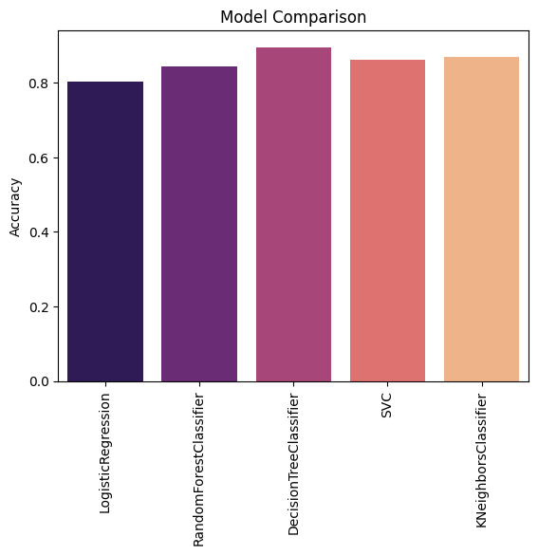

Accuracy
Precision
Recall
F1-Score
%
%
%
%
Logistic Regression | 80 | 80 | 80 | 80
Random Forest Classifier | 84 | 87 | 85 | 84
Decision Tree Classifier | 90 | 91 | 90 | 89
Support Vector Classifier | 80 | 80 | 80 | 80
K-Nearest Neighbors | 87 | 88 | 87 | 87
Percentage (%)
F1 Score: A balance between recall and precision, useful when both false positives and false negatives need to be minimized.
Understanding
Precision: The accuracy of the model when it claims to have found something.
Recall: The ability of a model to find all the relevant cases

Slide 16




Conclusion
Conclusion
Key Findings
Decision Tree Classifier scores the highest among all models, with metrics ranging from 89% to 91%. This model may be the best in capturing delivery patterns effectively, though decision trees can sometimes overfit.
Limitations
Single and Small Size Dataset Limitation:
The study relies on a single dataset, potentially limiting its generalizability to diverse populations.
Limited Variable Consideration:
The analysis focuses narrowly on demographic and clinical variables, overlooking lifestyle and genetic factors relevant to heart health.
Lack of Test Dataset Evaluation:
The model's performance on new, unseen data is not evaluated, raising concerns about its real-world applicability.
Future research
Future research must ensure robustness, generalizability, and interpretability for informed decision-making based on study findings. It's important to check how duplicate data and unusual values affect the model's accuracy. Creating strategies to deal with these issues is valuable for improving model performance.

Slide 17
Thank you

