Slide 1
MULTI-ARMED BANDIT-DRIVEN ACTIVE LEARNING
Presentation by Elon Dagan, Nicolas Zaknun and Ravid Dimant
Faculty of Data and Decision Sciences, Technion, Israel

Slide 2
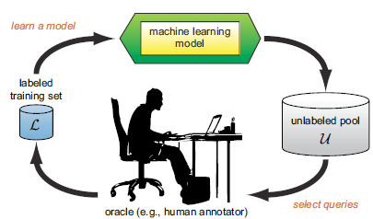
Active Learning
Definition:
Active learning is a machine learning technique that strategically selects the most informative data points to be labeled.
How?
Active learning involves selecting samples, annotating them, updating the training set, and retraining the model in each iteration.
It enhances model performance while reducing labeling costs. It deliberately selects data for labeling to maximize informative gain, crucial in limited resource scenarios.

Slide 3
Sampling Strategies Overview
🎲
❓
🌍
Random
Uncertainty
Diversity
📈
⚖️
🤖
Density-Weighted Uncertainty
Margin
Query by Committee (QBC)
⚠️
🔄
Metropolis Hastings
Feature-Based

Slide 4
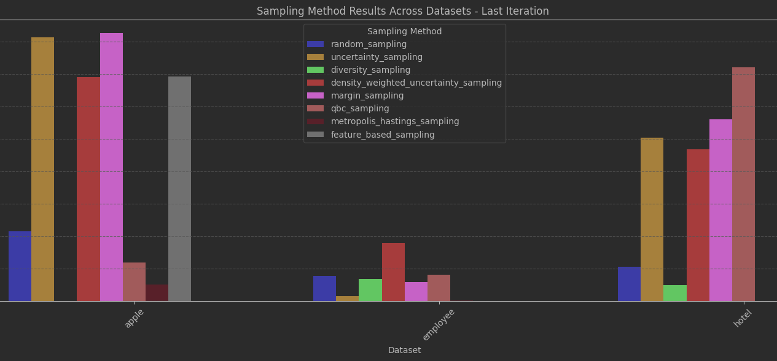
Our problem
None of these methods can be guaranteed as the best choice, or even one of the best, for every dataset and task!
The selection of an appropriate sampling method often relies on trial and error or prior knowledge about the dataset.
The performance of a given sampling strategy on one dataset often fails to generalize to others, making the task of selection method time-consuming and resource intensive.

Slide 5
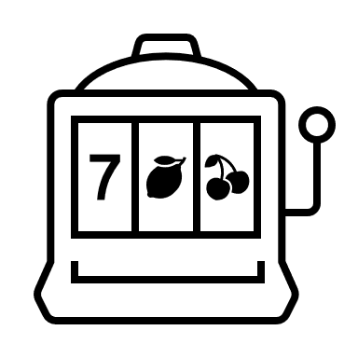
MAB for Active-Learning
Objective:
Dynamically evaluates and adapt the best performing sampling methods for the given task
Key Concept - Use sampling methods pool as bandits:
Arm reward: 1 for wrong prediction on the chosen sample, 0.001 other wise
Arm selection: Use the UCB formula for choosing an arm.
Sample Selection Mechanism:
Iterative Process: Selects one sample at a time until the iteration budget is used.
Possible Overlaps: sample might get choose more than once. Allow the MAB to learn more without extra costs

Slide 6
MAB MECHANISM SIMULATION

Slide 7



Iteration budget = 99
Iteration budget = 100
Obtain label 40
$$P_{model}^{y−40}\left(sample 40\right)=0.42$$
$$reward=1$$
SM-1
Sample 10
Sample 18
Sample 11
Sample 9
Sample 92
…
SM-2
Sample 1
Sample 10
Sample 57
Sample 82
Sample 33
…
SM-4
Sample 42
Sample 31
Sample 59
Sample 62
Sample 88
…
SM1
SM2
SM-3
Sample 40
Sample 42
Sample 89
Sample 91
Sample 93
…
SM3
SM4
MULTI-ARMED BANDIT-DRIVEN ACTIVE LEARNING

Slide 8


Iteration budget = 98
Iteration budget = 99
Obtain label 1
$$P_{model}^{y−1}\left(sample 1\right)=0.92$$
$$reward=0.001$$
SM-1
Sample 10
Sample 18
Sample 11
Sample 9
Sample 92
…
SM-2
Sample 1
Sample 10
Sample 57
Sample 82
Sample 33
…
SM-4
Sample 42
Sample 31
Sample 59
Sample 62
Sample 88
…
SM1
SM2
SM-3
Sample 42
Sample 89
Sample 91
Sample 93
…
SM3
SM4
MULTI-ARMED BANDIT-DRIVEN ACTIVE LEARNING

Slide 9


Iteration budget = 97
Iteration budget = 98
Obtain label 42
$$P_{model}^{y−42}\left(sample 42\right)=0.22$$
$$reward=1$$
SM-1
Sample 10
Sample 18
Sample 11
Sample 9
Sample 92
…
SM-2
Sample 10
Sample 57
Sample 82
Sample 33
…
SM-4
Sample 42
Sample 31
Sample 59
Sample 62
Sample 88
…
SM1
SM2
SM-3
Sample 40
Sample 42
Sample 89
Sample 91
Sample 93
…
SM3
SM4
MULTI-ARMED BANDIT-DRIVEN ACTIVE LEARNING

Slide 10


Iteration budget = 97
Retrieve label 42
$$P_{model}^{y−2}\left(sample 2\right)=0.52$$
$$reward=0$$
SM-1
Sample 10
Sample 18
Sample 11
Sample 9
Sample 92
…
SM-2
Sample 1
Sample 10
Sample 57
Sample 82
Sample 33
…
SM-4
Sample 42
Sample 31
Sample 59
Sample 62
Sample 88
…
SM1
SM2
SM-3
Sample 40
Sample 89
Sample 91
Sample 93
…
SM3
SM4
MULTI-ARMED BANDIT-DRIVEN ACTIVE LEARNING

Slide 11

Iteration budget = 96
Iteration budget = 97
Obtain label 89
$$P_{model}^{y−89}\left(sample 89\right)=0.48$$
$$reward=1$$
SM-1
Sample 10
Sample 18
Sample 11
Sample 9
Sample 92
…
SM-2
Sample 1
Sample 10
Sample 57
Sample 82
Sample 33
…
SM-4
Sample 31
Sample 59
Sample 62
Sample 88
…
SM1
SM2
SM-3
Sample 40
Sample 89
Sample 91
Sample 93
…
SM3
SM4
MULTI-ARMED BANDIT-DRIVEN ACTIVE LEARNING

Slide 12
MAB for Active-Learning
Approach 1 – Vanilla MAB
Single MAB for the entire process
Rewards updated trough all iterations
Approach 2 – Long Short-Term MAB (LST-MAB)
Utilizes two MAB models:
Long-Term MAB: Captures stable sampling trends over iterations.
Initialized at the start of the pipeline.
Short-Term MAB: Adapts to changes in sampling effectiveness after re-training.
Re-initialized at the beginning of each iteration.
Consist of two phases:
First phase – train short-term MAB with 10% of iteration budget
Second phase – label the reamining 90% of the budget with one of the MAB
MAB selection
Using the KL-divergence metric to evaluate difference in reward distribution
Use short-term if distribution changed from last iteration & replace long-term MAB
Use long-term if not significant change was detected

Slide 13

Methodology
Data Used
Metrics:
Mean Accuracy: Average accuracy across iterations.
Final Accuracy: Accuracy at the last iteration.
Simulations: 100 runs per method for reliability.
- 8 Datasets:
Apple: Predict apple quality.
Loan: Predict loan approval.
MB: Preference between mountains and beaches.
Passenger: Passenger satisfaction levels.
Diabetes: Predict diabetes occurrence.
Employee: Employee retention prediction.
Shipping: Timeliness of shipments.
Hotel: Reservation cancellations.
Experimental Setup
- Data Splits:
4,000 samples per dataset.
Split: 45% training, 45% unlabeled, 10% testing.
66% labeling budget across 10 iterations.

Slide 14
Experiments
Objective
Setup
Evaluate Vanilla-MAB and LST-MAB against traditional sampling methods.
Introduce a baseline algorithm - Random-MAB - for further comparison. Random-MAB Operates like Vanilla-MAB but selects sampling methods randomly.
Labels one sample at a time, using a randomized selection of methods.
Classifier: Random Forest with 25 estimators, max depth is 5.
Simulations: 100 runs per method for reliability.
Notes:
Long Short-Term MAB (LST-MAB)

Slide 15
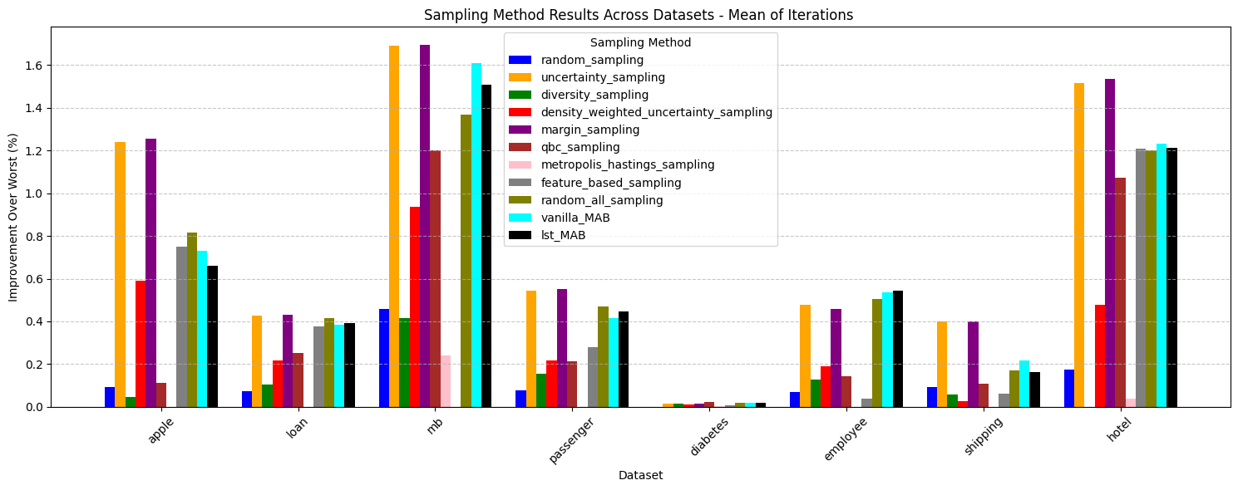
Results
MULTI-ARMED BANDIT-DRIVEN ACTIVE LEARNING

Slide 16
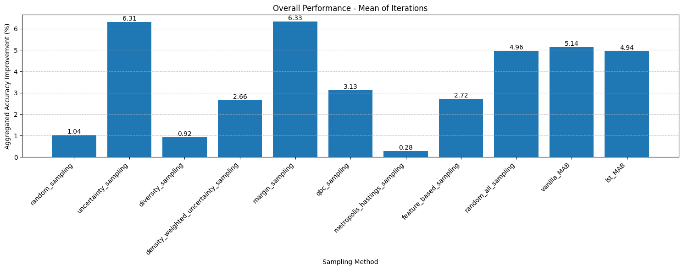
Results
MULTI-ARMED BANDIT-DRIVEN ACTIVE LEARNING

Slide 17
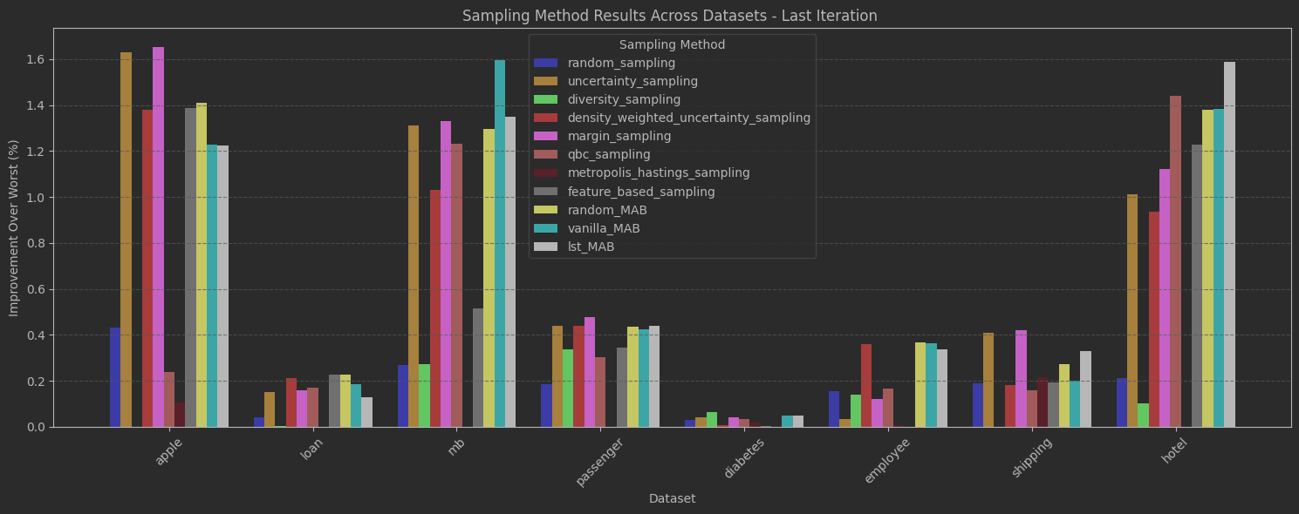
Results
MULTI-ARMED BANDIT-DRIVEN ACTIVE LEARNING

Slide 18
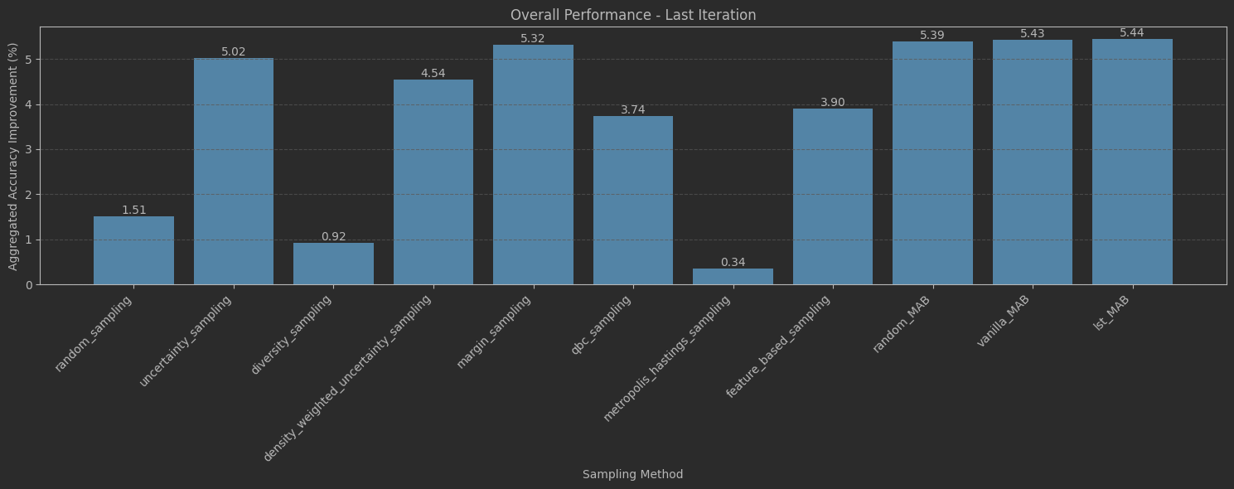
Results
MULTI-ARMED BANDIT-DRIVEN ACTIVE LEARNING

Slide 19
Results
Vanilla MAB algorithm demonstrates the most stability among all methods.
MULTI-ARMED BANDIT-DRIVEN ACTIVE LEARNING
Method Dataset | Uncertainty |  | Margin |  | Feature based |  | Random MAB |  | Vanilla MAB |  | LST MAB
 | Mean | STD | Mean | STD | Mean | STD | Mean | STD | Mean | STD | Mean | STD
Apple | 83.86 | 1.97 | 83.88 | 1.96 | 83.62 | 1.86 | 83.64 | 1.86 | 83.46 | 1.81 | 83.46 | 1.90
Loan | 90.76 | 1.62 | 90.77 | 1.91 | 90.84 | 1.55 | 90.83 | 1.57 | 90.80 | 1.52 | 90.74 | 1.53
MB | 95.45 | 1.37 | 95.47 | 1.39 | 94.65 | 1.53 | 95.43 | 1.26 | 95.73 | 1.27 | 95.48 | 1.29
Passenger | 92.03 | 1.50 | 92.07 | 1.53 | 91.94 | 1.46 | 92.03 | 1.46 | 92.02 | 1.45 | 92.03 | 1.48
Diabetes | 86.74 | 1.59 | 86.74 | 1.59 | 86.70 | 1.61 | 86.70 | 1.57 | 86.75 | 1.61 | 86.74 | 1.62
Employee | 82.04 | 2.03 | 821.3 | 1.90 | 82.01 | 1.95 | 82.38 | 1.99 | 82.38 | 1.85 | 82.35 | 1.91
Shipping | 67.90 | 1.93 | 67.91 | 1.94 | 67.69 | 2.19 | 67.76 | 2.24 | 67.69 | 2.23 | 67.82 | 2.05
Hotel | 82.19 | 2.10 | 82.30 | 2.25 | 82.41 | 2.27 | 82.56 | 2.40 | 82.56 | 2.32 | 82.77 | 2.20
Notes:
Look at STD

Slide 20
Conclusions
MAB algorithms underperform in scenarios where intermediate iteration results are critical, as reflected in the mean accuracy metric.
Possible Reason: The dominance of specific sampling methods in these cases may render the exploration phase of the MAB algorithms redundant and less effective.
While the performance differences between methods were not substantial, the MAB-based approaches demonstrated moderate success in achieving our initial objectives.
They consistently avoided poor performance on any dataset.
In many cases, they achieved the best performance among all methods.
MULTI-ARMED BANDIT-DRIVEN ACTIVE LEARNING
Dynamic decisioning is Good!

Slide 21
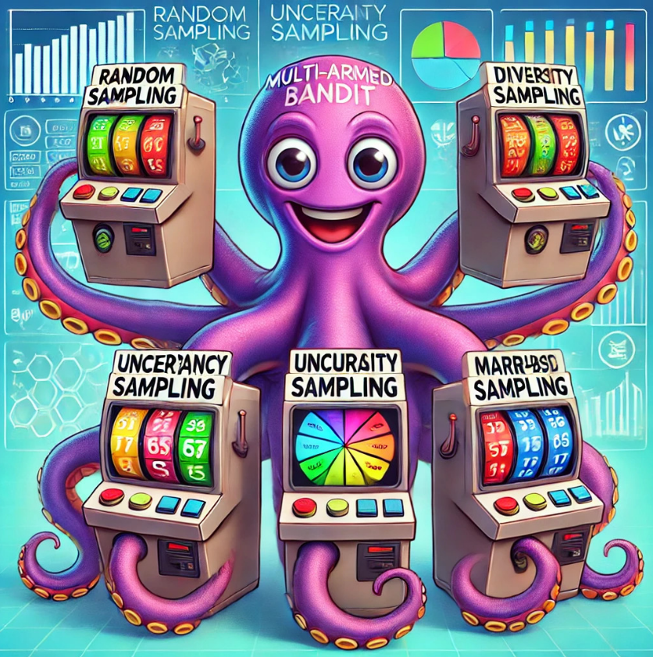

The End
Sure, here is a MAB machine for Active Learning:
MULTI-ARMED BANDIT-DRIVEN ACTIVE LEARNING

