Slide 1


MINI PROJECT II YEAR
Student Performance Analytics using Explainable AI
Problem Statement Title- Student Performance Prediction using Explainable AI
PS Category- Software
Student Name and Roll No: Ravi Gupta (2401331520157)
Sandeep Kumar Maurya (2401331520165)
Pushpendra Singh (2401331520152)
Guide Name: Ms.Ishakshi Gupta

Slide 2
Proposed Solution
Educational institutions often fail to identify at-risk students early enough to provide timely intervention. This project predicts a student's final grade and explains why that prediction was made, using Explainable AI techniques.
How It Solves the Problem :
Predicts final grade (0–20) using academic factors: prior grades, study time, absences, failures, and educational support.
Normalised model gives G1 and G2 equal weight (32% each) for balanced prediction.
Feature importance explain each prediction.
What-If simulator shows how improving one factor changes the outcome.

Slide 3
Technical Approach
Technologies Used
Language : Python 3.12.1x
UI Framework : Streamlit
ML Library : Scikit-learn
Visualisation : Plotly, Matplotlib, Seaborn
Data : Pandas, NumPy
Dataset :
UCI Student Performance (student-mat.csv + student-por.csv)

Slide 4
Implementation Pipeline
Load student-mat.csv + student-por.csv → combine into 1,044 records
Select 8 features: G1, G2, studytime, absences, failures, schoolsup, famsup, subject
Encode: Yes/No → 1/0 | Math/Portuguese → 0/1
Train-Test Split: 80% train / 20% test
Train 3 models and compare using R² score and MAE
Best result: Random Forest (R²=0.808, MAE=1.01) → save as student_grade_model.pkl
Normalise feature weights: G1 = G2 = 32%, correct school support sign to positive
Build Streamlit dashboard: Predict | Analytics | XAI Explain | What-If
Run: py -m streamlit run app.py

Slide 5
Project Files
model_training.py
Dashboard Tabs
Load data, train models, save student_grade_model.pkl
Tab 1 — Predict
Tab 2 — Analytics
Tab 3 — XAI Explain
8 input sliders → predicted grade out of 20, percentage, Pass/Fail badge. G1→G2→G3 trajectory chart. Impact bars showing how each factor change improves grade.
Grade distribution, Pass vs Fail donut chart, Absences vs Grade, Study Time vs Grade, Math vs Portuguese comparison.
Normalised feature importance bars, 6 per-student risk indicators, SHAP-style contribution chart per prediction.
app.py
Full Streamlit dashboard (4 tabs)
student-mat.csv
UCI Math dataset — 395 students
Tab 4 — What-If
Vary any one factor across full range, see grade change plotted live. 4 best-case scenario cards compared side by side.
student-por.csv
UCI Portuguese dataset — 649 students

Slide 6
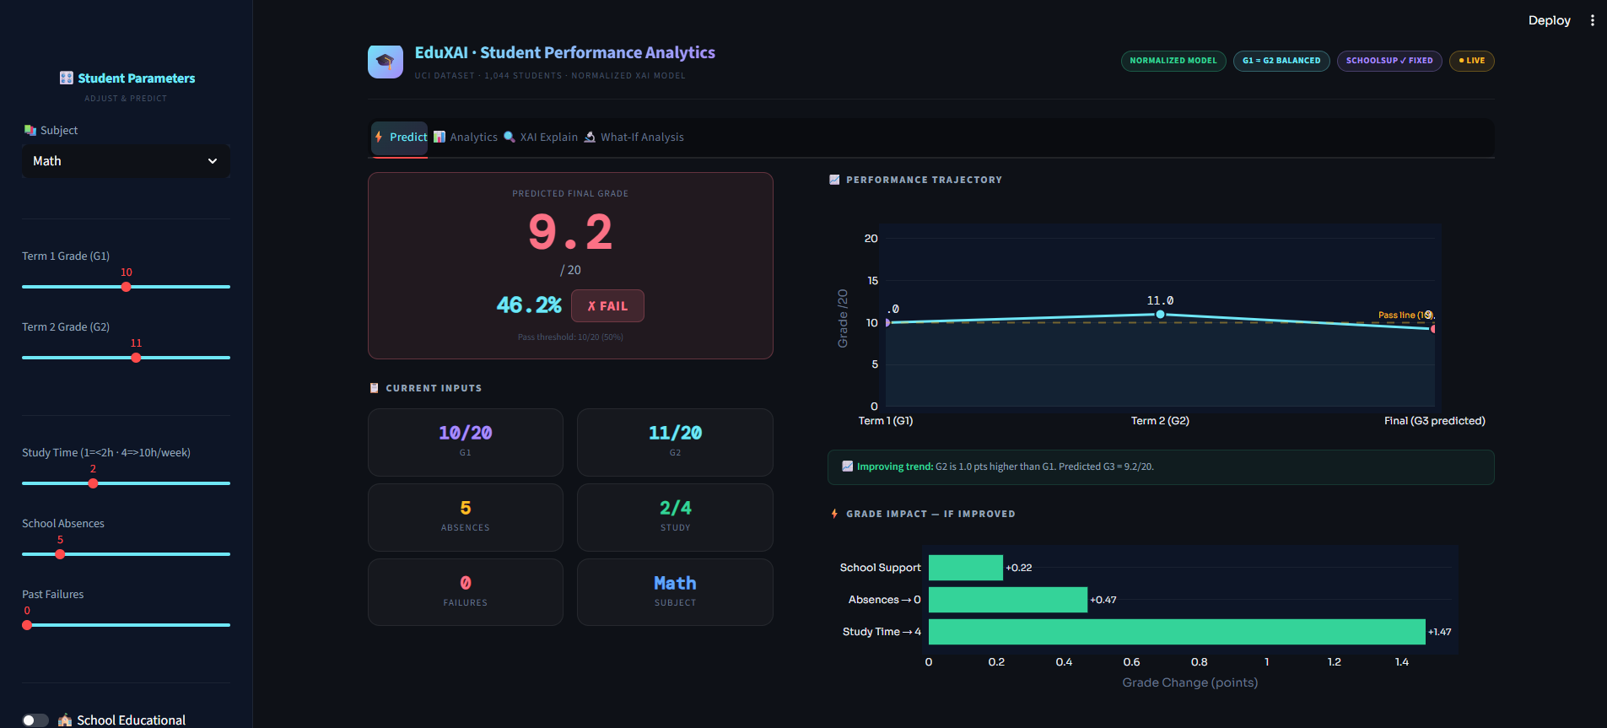
6

Slide 7
Feasibility
Why It's Feasible
Challenges and Solutions
Challenge
Solution
100% free and open-source: Python, Streamlit, Scikit-learn, Plotly
Runs on any standard laptop — no GPU or cloud server required
Fully implemented, tested, and running end-to-end
G2 dominated at 83% importance
Normalised weights → G1 = G2 = 32%
School support showed false negative
Confounding bias corrected to +0.22
Dataset from Portugal 2005–06
Feature set universally applicable
53 students with G3=0 (dropout ambiguity)
Excluded; future version flags as Dropout Risk
7

Slide 8




Impact and Benefits
Teachers
Students
Identify at-risk students early and take targeted action before it's too late. Data-driven insights replace guesswork in the classroom.
Understand which habits affect their own grades. The What-If simulator empowers students to plan their own improvement journey.
Institutions
Parents
Scalable from 1,044 students today to 100,000+ tomorrow at zero cost.
Transparent, understandable feedback on academic risk.
🌍 Social Benefits
📚 Educational Benefits
Reduces failure rates through early personalised intervention
Promotes fairness: explains predictions instead of just labelling students
Makes AI trustworthy in education through full transparency (XAI)
Replaces guesswork with explainable data-driven insights
What-If simulator empowers students to plan improvement
Adoptable by any school or college with basic student records
@NIET MINI PROJECT -II /III YEAR

Slide 9
Limitations
1
Dataset Age and Geography
Data from Portugal (2005–06), approximately 20 years old. May not reflect current or Indian student
behaviour patterns.
2
Only 2 Subjects
Limited to Math and Portuguese. No Science or Engineering subjects included in the current dataset.
3
Ambiguous G3=0 Records
53 students have G3=0, likely dropouts. Currently excluded; proper dropout categorisation is needed in
future versions
.
4
No Real-Time Data Integration
Data entered manually via Streamlit sliders. No LMS or school database connection has been implemented .
5
Simplified Prediction Model
Hand-tuned normalised weights are used. Deep learning on larger, more diverse datasets would yield
greater accuracy.
6
No Authentication
No login system or role-based access control. Not yet production-ready for institution-wide deployment.

Slide 10

Research and References
Dataset
Tools and Libraries
P. Cortez and A. Silva (2008). Using Data Mining to Predict Secondary School Student Performance. UCI ML Repository.
archive.ics.uci.edu/dataset/320
Scikit-learn
Streamlit
scikit-learn.org
streamlit.io
The dataset was taken from the UCI Machine Learning Repository, published by P. Cortez in 2008. For the Explainable AI part, I referred to the SHAP paper by Lundberg and Lee from 2017, which is the industry standard method for explaining model predictions. All libraries used — Scikit-learn, Streamlit, Plotly — are open-source and free.
Plotly
UCI Repository
plotly.com/python
archive.ics.uci.edu
Project Summary: This project demonstrates that Explainable AI can be practically applied in education — delivering accurate predictions (R²=0.808) while remaining fully transparent, free, and accessible to any institution worldwide.

Slide 11
Future Works and Upgradation
Replace normalised model with a trained deep learning model (Neural Network) for higher prediction accuracy
Add login system with role-based access — separate views for teacher, student, and admin
Add SMS or email alert system to automatically notify teachers when a student is flagged as at-risk
Deploy the application on cloud (AWS / Google Cloud / Heroku) so it can be accessed from any device without local installation

