Slide 1
CS5542 Big Data Analytics and Applications
Spring 2016
Smart Hear
Ravi Kiran Yadavalli(31)
Ragunandan Rao Malangully(13)

Slide 2
Features
Hearing Aid : The user can alter the frequency to suit his hearing ability.
Hearing dog : Notify the user about important events related with sound in real time
Context aware : Based on the user context the model can be changed to suit the user needs. Better accuracy.

Slide 3



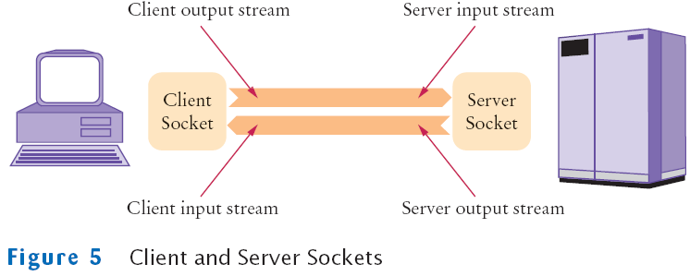

Architecture
Zero crossings,
MFCC,
SpectralRollOff,
PeakValue,
RMS,
Compactness,
FrationOfLowEnergyWindows

Slide 4
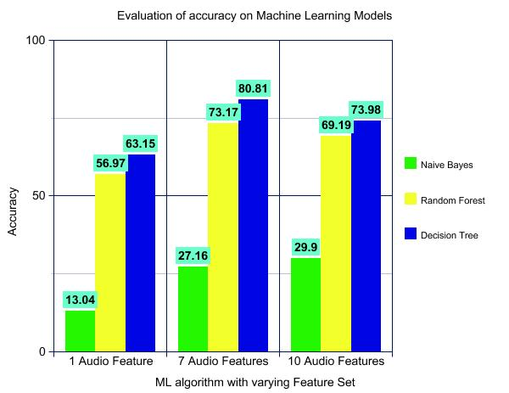
Results & Evaluation

Slide 5
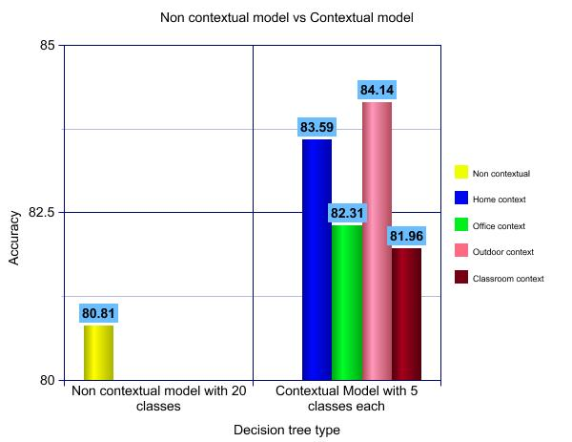
Results & Evaluation

