Slide 1
ARO Cluster Upgrade Automation
Rule-Based Ansible Automation for ARO Y-Stream Upgrades
By: Ravikant & Abhishek
August 2026

Slide 2
The Problem
Manual ARO upgrades are risky and inconsistent.
Lack of audit trails.
High potential for human error.
Notes:
Speaker Notes for The Problem:
Discuss the key points shown on the slide. Emphasize rule-based determinism and safe-fail mechanisms.

Slide 3
The Solution
Deterministic, rule-based Ansible automation.
Zero AI in the execution path.
Safe, ordered sequential version hops.
Notes:
Speaker Notes for The Solution:
Discuss the key points shown on the slide. Emphasize rule-based determinism and safe-fail mechanisms.

Slide 4
Key Benefits
Deterministic execution.
Fully auditable (.txt, .csv, HTML).
Dual-version compatibility (2.7.17 / 2.14.18).
Safe-fail: Login once, logout on any failure.
Notes:
Speaker Notes for Key Benefits:
Discuss the key points shown on the slide. Emphasize rule-based determinism and safe-fail mechanisms.

Slide 5
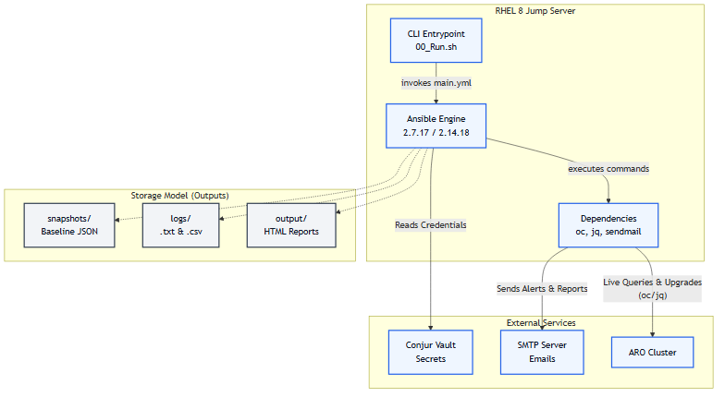
Architecture at a Glance
Notes:
Speaker Notes for Architecture at a Glance:
Discuss the key points shown on the slide. Emphasize rule-based determinism and safe-fail mechanisms.

Slide 6
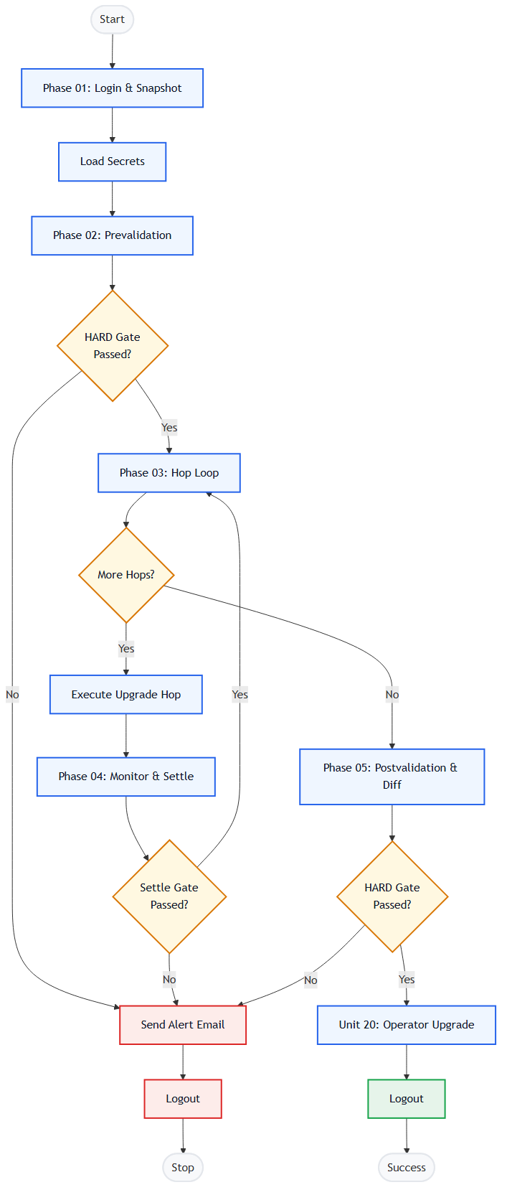
End-to-End Workflow
Notes:
Speaker Notes for End-to-End Workflow:
Discuss the key points shown on the slide. Emphasize rule-based determinism and safe-fail mechanisms.

Slide 7
Phase Map
Phase 01: Login & Baseline Snapshot
Phase 02: Prevalidation
Phase 03: Initiate Upgrade Loop
Phase 04: Live Monitoring
Phase 05: Postvalidation
Phase 06: Operator Upgrade
Notes:
Speaker Notes for Phase Map:
Discuss the key points shown on the slide. Emphasize rule-based determinism and safe-fail mechanisms.

Slide 8
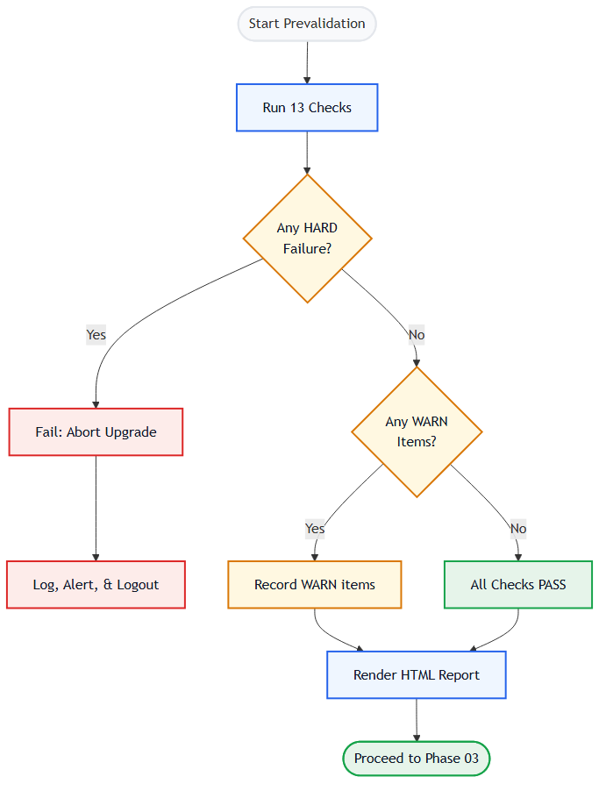
Prevalidation Hard Gate
Notes:
Speaker Notes for Prevalidation Hard Gate:
Discuss the key points shown on the slide. Emphasize rule-based determinism and safe-fail mechanisms.

Slide 9
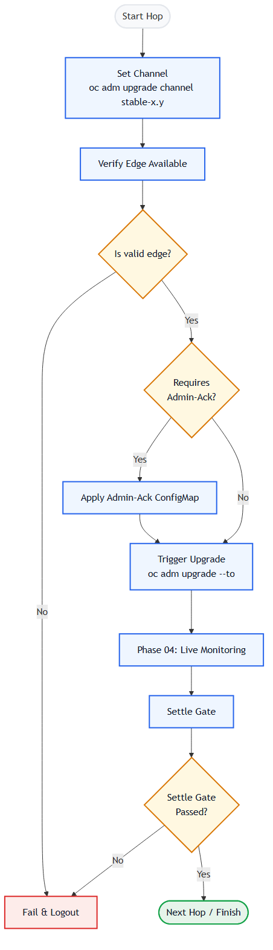
Upgrade Hops
Notes:
Speaker Notes for Upgrade Hops:
Discuss the key points shown on the slide. Emphasize rule-based determinism and safe-fail mechanisms.

Slide 10
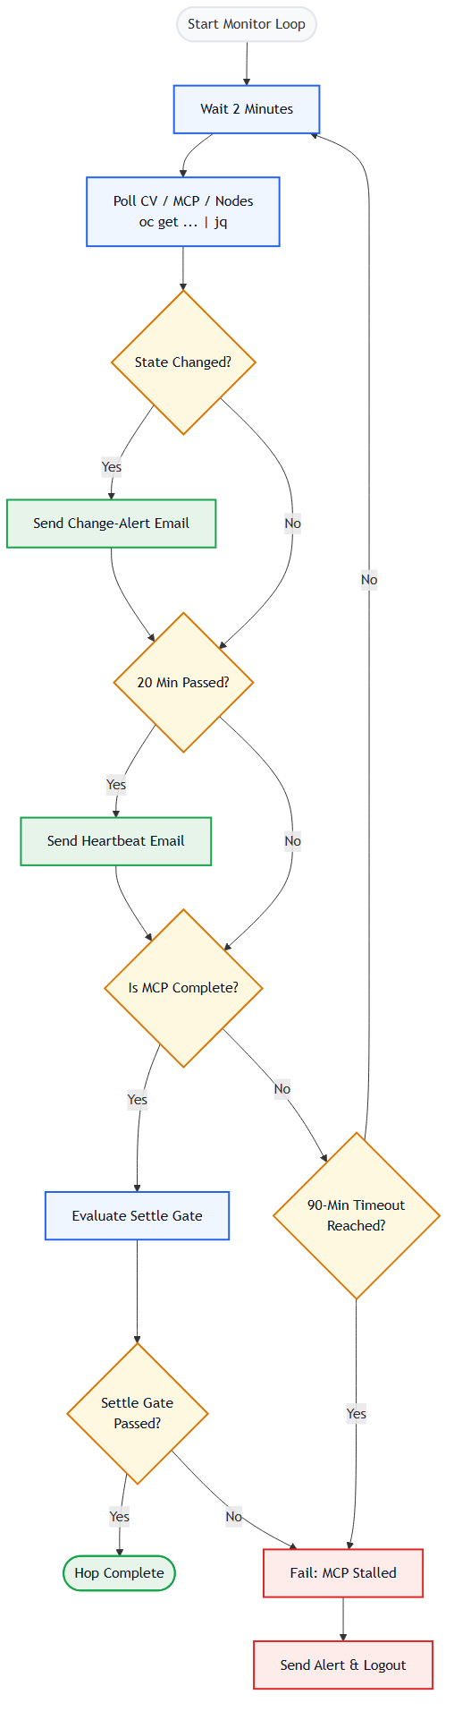
Monitoring & Alerts
Notes:
Speaker Notes for Monitoring & Alerts:
Discuss the key points shown on the slide. Emphasize rule-based determinism and safe-fail mechanisms.

Slide 11
Postvalidation & Baseline Diff
10 Checks executed after final hop.
Ensures CV, CO, MCP, Node, and etcd health.
Compares Phase 05 state against Phase 01 baseline snapshot.
Notes:
Speaker Notes for Postvalidation & Baseline Diff:
Discuss the key points shown on the slide. Emphasize rule-based determinism and safe-fail mechanisms.

Slide 12
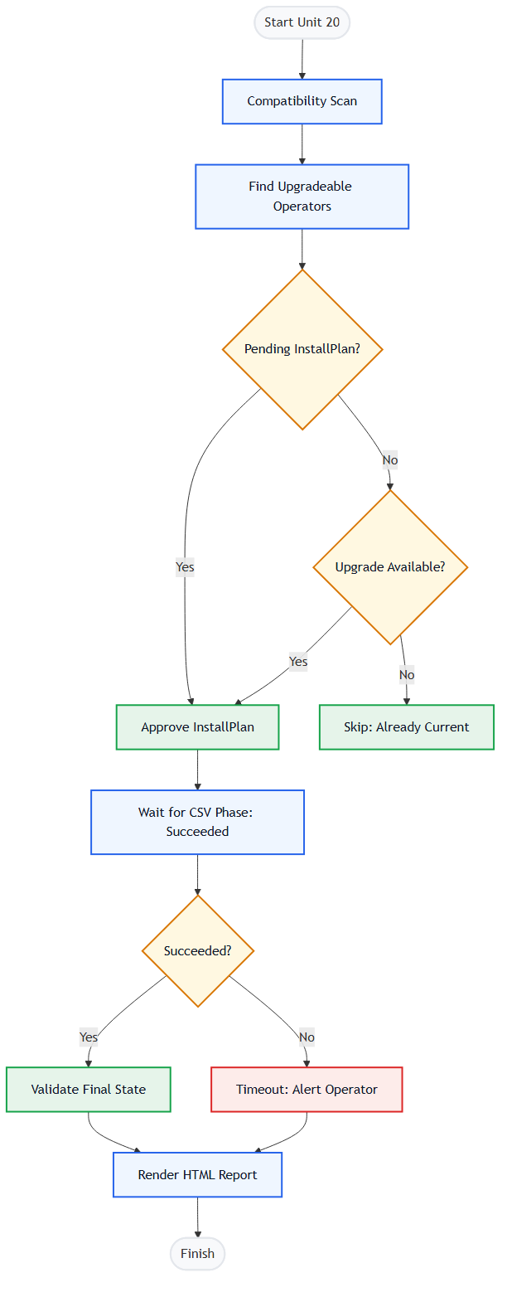
Operator Upgrade & Validation
Notes:
Speaker Notes for Operator Upgrade & Validation:
Discuss the key points shown on the slide. Emphasize rule-based determinism and safe-fail mechanisms.

Slide 13
Safety & Guardrails
Login-once, logout-on-failure.
HARD gates immediately halt execution.
WARN gates notify but proceed.
force flag is manual-only.
Notes:
Speaker Notes for Safety & Guardrails:
Discuss the key points shown on the slide. Emphasize rule-based determinism and safe-fail mechanisms.

Slide 14
Dual-Version Strategy
Runs on Ansible 2.7.17 and 2.14.18.
Short module names.
No bare includes.
Jinja2 strictness via default('').
Notes:
Speaker Notes for Dual-Version Strategy:
Discuss the key points shown on the slide. Emphasize rule-based determinism and safe-fail mechanisms.

Slide 15
Reporting & Outputs
HTML Reports (Pre/Post validation).
Logs (dual .txt and .csv).
Baseline JSON snapshot.
Notes:
Speaker Notes for Reporting & Outputs:
Discuss the key points shown on the slide. Emphasize rule-based determinism and safe-fail mechanisms.

Slide 16
Summary & Next Steps
Testing on RHEL 8 jump host.
End-to-end dry-run validation.
Operator handover.
Notes:
Speaker Notes for Summary & Next Steps:
Discuss the key points shown on the slide. Emphasize rule-based determinism and safe-fail mechanisms.

Slide 17
Q&A / Thank You
Any Questions?
Notes:
Speaker Notes for Q&A / Thank You:
Discuss the key points shown on the slide. Emphasize rule-based determinism and safe-fail mechanisms.

