Slide 1
Super Market Customer Clustering

Slide 2
Objective
Machine learning is being applied to assess the Super Market Customers using different parameters.
In this problem, the goal is to model the customer purchasing behaviour based on its purchase value and number of items.
This dataset represents the purchase behavior of customers at Spencer's supermarket in Eastern part of India. It has 702 rows and 6 Columns of data records.

Slide 3
DATA ATTRIBUTES
Customer_ID – id of customer
AVG_Actual_price_12 – MRP
Purchase_Value – Total amount of purchase customer has made
No_of_Items – Number of items bought
Total_Discount- Discount availed by each customer
MONTH_SINCE_LAST_TRANSACTION – Last month of visit in supermarket

Slide 4
Data Sample
 | Cust_id | AVG_Actual_price_12 | Purchase_Value | No_of_Items | Total_Discount | MONTH_SINCE_LAST_TRANSACTION
 | 1 | 300.000000 | 1200.00 | 4 | 0.00 | 11
 | 2 | 2563.282500 | 41012.52 | 16 | 78737.48 | 2
 | 4 | 3510.000000 | 7020.00 | 2 | 780.00 | 4
 | 8 | 4530.000000 | 13590.00 | 3 | 1510.00 | 1
 | 9 | 2428.076923 | 33455.00 | 15 | 17445.00 | 6

Slide 5
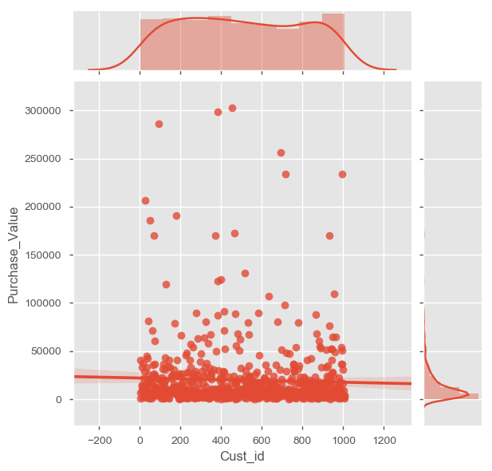
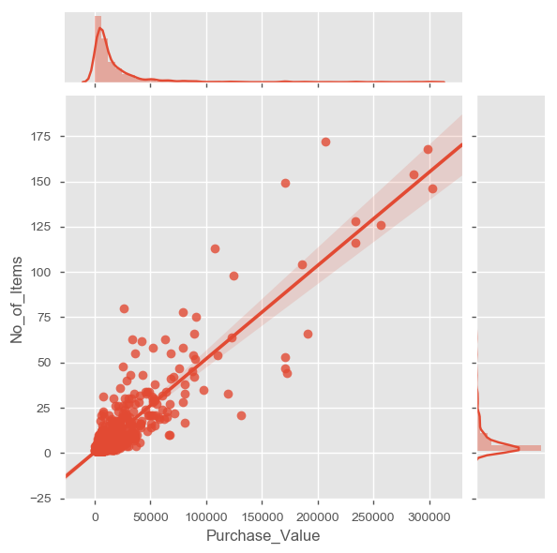
Data Visualization

Slide 6
Model Evaluation
# Applying K-Means Clustering Algorithm # We use only 'purchase value', 'number of items' columns to cluster
X = df_cluster.iloc[:, [0, 1]].values
from sklearn.preprocessing import StandardScaler # Feature Scaling
sc_X = StandardScaler()
X= sc_X.fit_transform(X)
#Using the Elbow method to find the optical number of clusters
from sklearn.cluster import KMeans
wcss = [] #With in cluster sum of squares(Inertia)
#n_clusters is no.of clusters given by this method,
#k-means++ is an random initialization methods for centriods to avoid random initialization
#max_iter is max no of iterations defined when k-means is running
#n_init is no of times k-means will run with different initial centroids
for i in range(1,11): #From 2-10 doing multiple random initializations can make a huge difference to find a better local optima
kmeans = KMeans(n_clusters = i, init ='k-means++',max_iter=300,n_init=10)
kmeans.fit(X)
wcss.append(kmeans.inertia_)

Slide 7
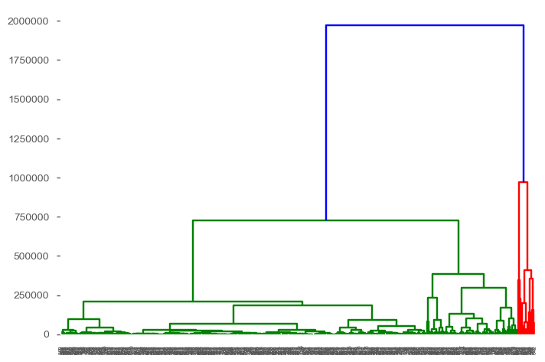
Dendrogram

Slide 8
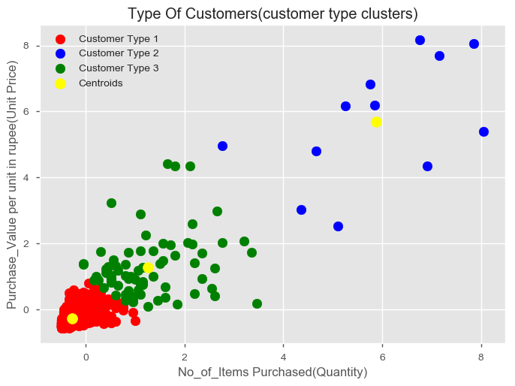

Slide 9
conclusion
Type 1 Customers are regular customers as they are spending less price
Type 2 Customers are premium customers we can give special treatment
Type 3 Customers are gold range customers so we can send targeted advertisements
Based on the above customer purchase range we will give three types of cards based on the minimum purchase value for each category, In this way we push more sales.

Slide 10
Thank you

