Slide 1
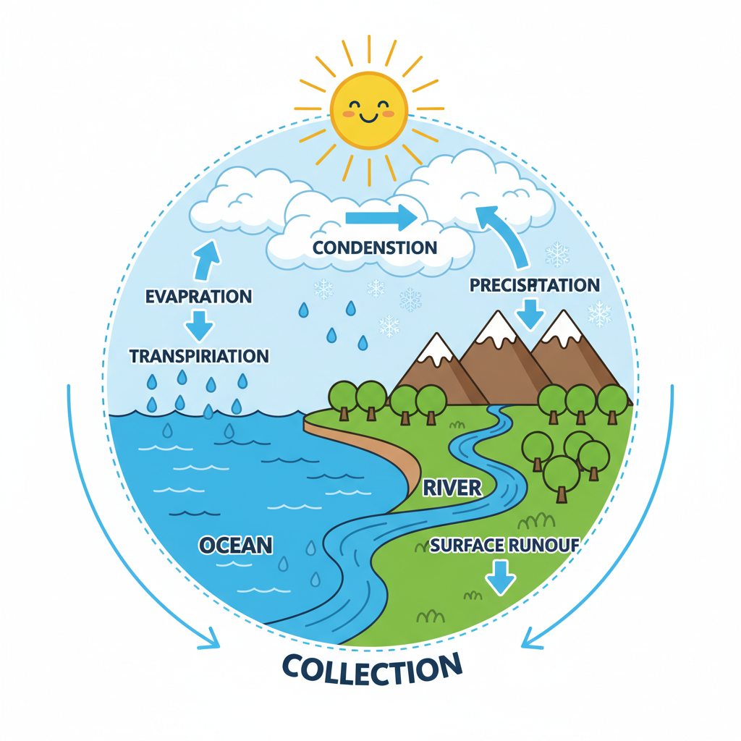
Water Cycle

Slide 2
Water Cycle - Explanation
The Water Cycle describes how water continuously moves around Earth, changing forms. Heat from the sun causes water to evaporate, turning into vapor that rises into the air. This vapor cools high in the sky and turns back into tiny water droplets, forming clouds. When clouds get full, water falls back to Earth as rain, snow, or hail, in a process called precipitation. This water then flows into rivers, lakes, and oceans or soaks into the ground, ready to repeat the cycle.

Slide 3
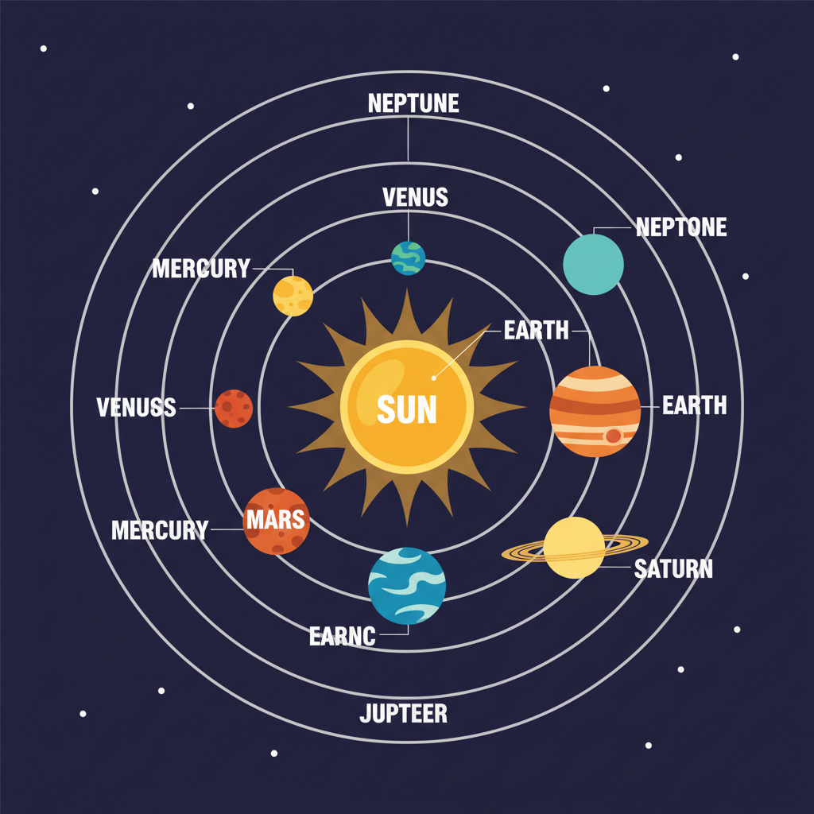
Solar System

Slide 4
Solar System - Explanation
The Solar System is our Sun and everything that orbits around it. This includes eight major planets like Earth, along with their moons, and countless smaller objects like asteroids and comets. The Sun is a massive star at the center, and its strong gravity keeps all these celestial bodies moving in predictable paths. Everything in our Solar System is held together by this powerful gravitational force.

Slide 5
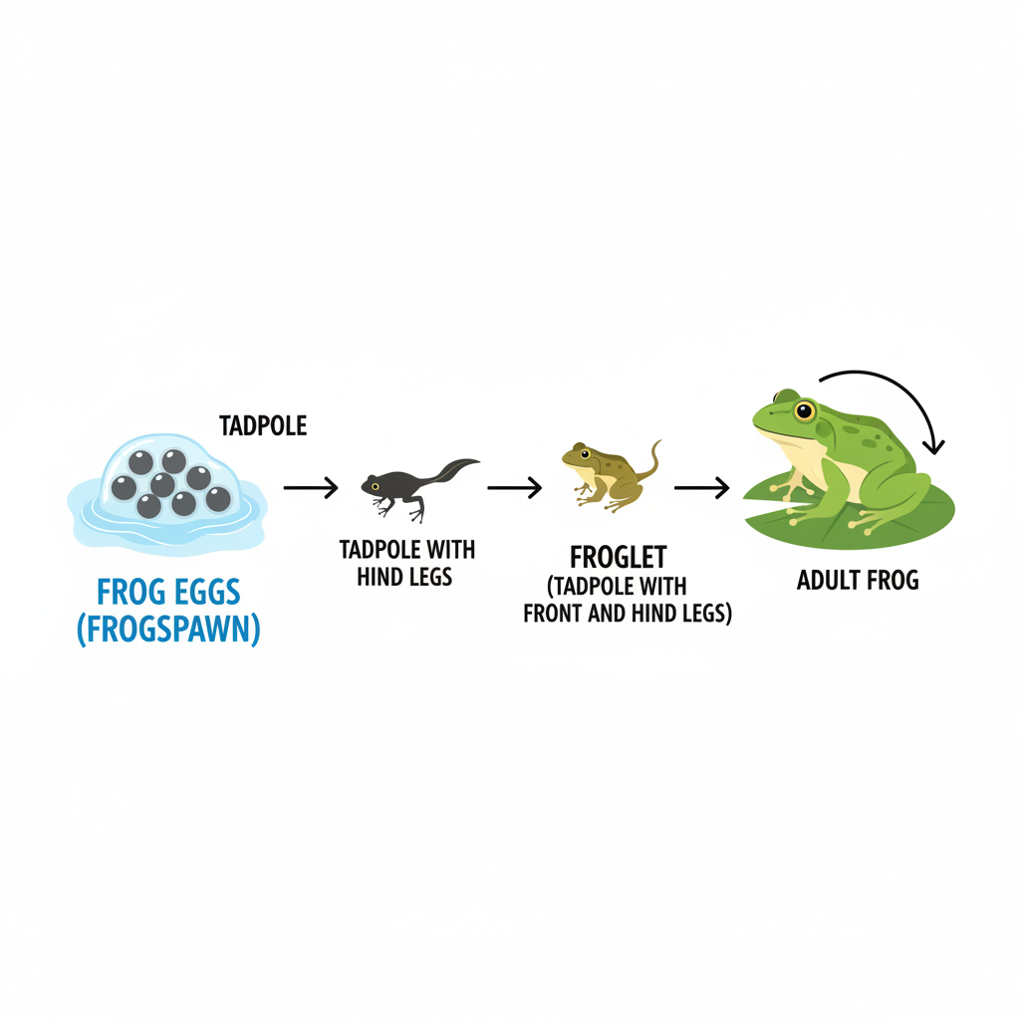
frog lifecycle

Slide 6
frog lifecycle - Explanation
The frog lifecycle is the series of changes a frog goes through from an egg to an adult. Adult frogs lay their eggs in water. These eggs hatch into tadpoles, which are aquatic larvae with gills and a tail. Tadpoles gradually grow legs, lose their tail, and develop lungs for breathing air. This transformation leads to a froglet, which then matures into an adult frog.

