Slide 1



Slide 2


COVID-19 solution for remote learning

Slide 3
•
Recent situation
COVID-19 spread has already pointed out the economic hardships caused by the outbreak and ensuing lockdown. They have impacted students and teachers as well. State governments and higher education regulatory bodies such as the All India Council for Technical Education, or AICTE, have had to take steps to ensure private institutions don’t increase fees in 2020-21. Many private schools, facing the cash-crush or claiming to, have stopped paying teachers creating yet another group that is suffering financially due to the lockdown and the situation is going worse everyday.

Slide 4
No-one has ever though that such kind of things can also happen.This pandemic has shown all the fawns we have in our system.So we have to bring a new revolution in our education section.
As we are well aware about the online education that has come up with a highlighting colors and shows that learning should never stop.We can take lot of examples like:
In Argentina they have Educ.ar as an educational portal of the Ministry of Education of Argentina aimed at providing curated digital resources for teachers, administrators, students, and families.
In Austria Learning platforms like Moodle and LMS are being used, as well as cloud solutions from companies such as Microsoft and Google.
In Bhutan the Ministry of Education (MoE) launched the Bhutan e-Learning program​. This started on March 27, 2020 allows students from PreK-12 to access lessons through educational television as well as on YouTube. The broadcasting schedules are published on the MoE website.
In France an online portal, Ma classe à la maison (My class at home) provides access to educational content and learning opportunities.
Lots and lots of example are there that countries have adopted to change the way of giving education.
Being a citizen of India I know very well that our remote education is lagging a lot , all the efforts by the government is getting failed for the remote area so we (“Rockers”) as a group come up with a new idea that might help not only India but all the developing countries to come out of poverty.

Slide 5
IDEA:
As a student I can totally understand how much this chaos COVID-19 pandemic has created and we as a group(“Rockers”) come up with a idea that will work like a Non profitable organization and we named it as “Chip-shastra” , as a participant of #callforcode we can utilize IBM cloud services to create a website that will help to analyse the stats of unprivilized children's who really need help for there education.As we already know that money is not an ultimate solution , so we can start making “CHIP COURSES” which will help those who really wanted to learn in this pandemic and they are stucked in there home.
We as a Non profitable organization try to distribute such “CHIP COURSES” for free, so that one day they can bring the change.
BENEFITS:
No internet connection needed.
Simple and effective.
Smart study.
“If you are giving money to help someone, you are doing a temporary solution but if you are educating someone you are dragging out his whole generation from poverty”.

Slide 6
•
IBM Cloud Foundry Apps(php).
Services- Cloudant.

Slide 7
LINK:
https://github.com/nitesh982/PREO.git

Slide 8
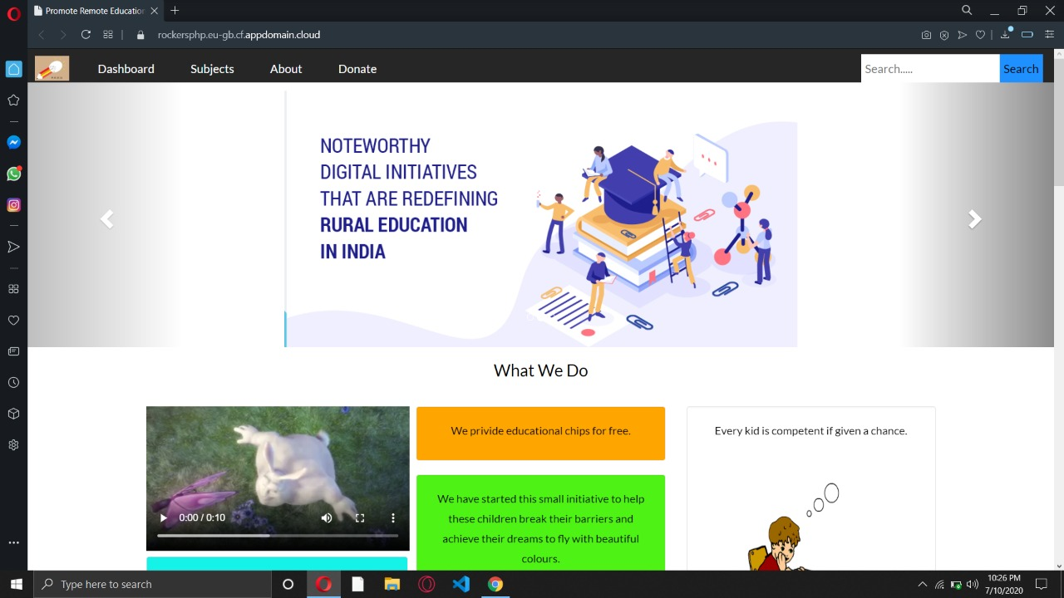
Screenshots:

Slide 9
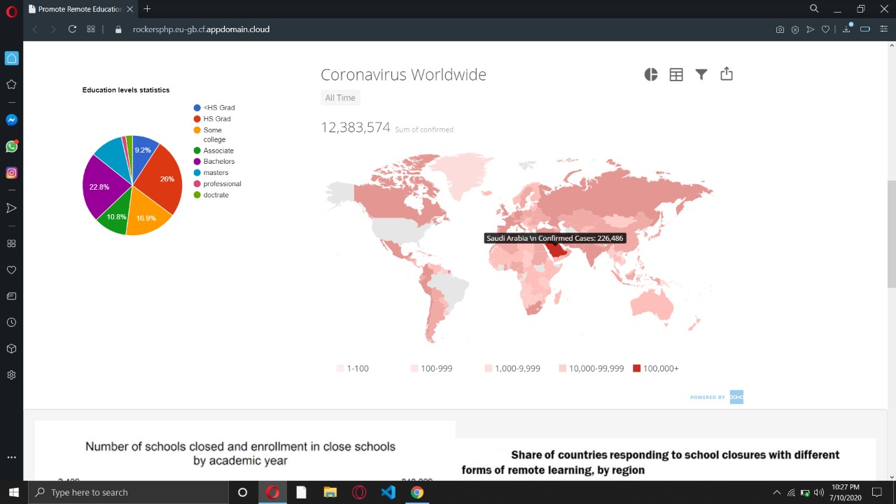

Slide 10
LINK:
https://www.youtube.com/watch?v=AcZ3kRiAtao&feature=youtu.be

Slide 11


