Slide 1

CONFUSION MATRIX
POSITIVE
OR NEGATIVE ?
PREDICTED POSITIVE
PREDICTED NEGATIVE
ACTUAL POSITIVE
TP
FN
TRUE POSITIVE (TP) :
Predicted positive and The patient is actually positive
ACTUAL NEGATIVE
FP
TN
TRUE NEGATIVE (TN) :
Predicted negative and The patient is actually negative
FALSE POSITIVE (FP) :
Predicted positive and in actuality patient is Negative
Type - II error
FALSE NEGATIVE (FN) :
Predicted negative and in actuality patient is positive
Type - I error

Slide 2
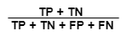
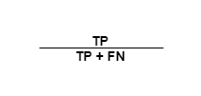

CONFUSION MATRIX
POSITIVE
OR NEGATIVE ?
PREDICTED POSITIVE
PREDICTED NEGATIVE
ACTUAL POSITIVE
TP
FN
Accuracy Score :
ACTUAL NEGATIVE
FP
TN
Recall :
Precision :
Misclassification Rate :

Slide 3
CONFUSION MATRIX
POSITIVE
OR NEGATIVE ?
PREDICTED POSITIVE
PREDICTED NEGATIVE
N = 150
ACTUAL POSITIVE
TP
50
FN
5
Accuracy Score :
50
+
70
=
150
0.8
ACTUAL NEGATIVE
FP
25
TN
70
Misclassification Rate :
1 - 0.8 = 0.2
Recall :
50
=
0.90
50 + 5
Precision :
50
=
0.66
50 + 25

Slide 4

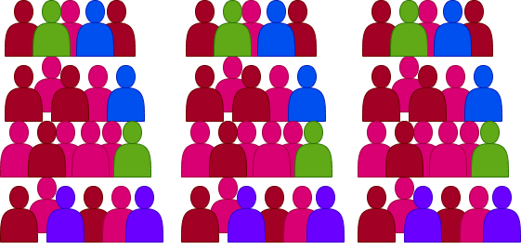
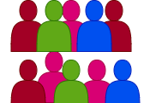
F1-SCORE
Consider there are 1000 people, and you are predicting they will like your TV show or not.
10 likes the show
990 does not like the show
Here if i say, nobody likes the show, we will get very high accuracy score i.e 99 %
…..but we haven’t identified 1 % who will like it
for that reason we came up with precision and recall

Slide 5
F1-SCORE
Precision is how accurate you are when you say someone will like it
if i say 8 people like the show, out of which only 6 actually liked my show then my precision is 75 %
Recall is how good you are at identifying people who actually like it.
There are 10 people who like it and i was able to identify only 6, here my recall is 60 %
Precision and recall both are good metric and both are needed.

Slide 6

F1-SCORE
if i say nobody likes the show, i have 0 % recall .
which is bad…..
Recall
Precision
but if i say everyone likes the show, i have 100% recall and only 1 % precision
Precision
Recall
which is bad again….
Which punishes the higher values
how about if we average these two values ?
100
+
1
=
50.5
The average of precision and recall here is far from truth.
2
Simply averaging precision and recall is not enough. We use harmonic mean for precision and recall.

Slide 7
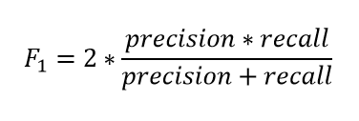
F1-SCORE
Recall = 20 %
Precision = 80%
2
*
0.8
*
0.2
= 0.32
0.8 + 0.2
Recall = 10 %
Precision = 90%
2
*
0.9
*
0.1
= 0.12
0.9 + 0.1

Slide 8
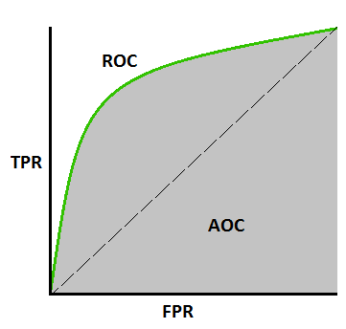
ROC CURVE AND AUC
ROC - AUC curve is the performance measure for classification problems at different thresholds.
ROC Curve is plotted against TPR VS FPR.
ROC
Probability Curve
AUC
Measure of Separability between classes

