Slide 1
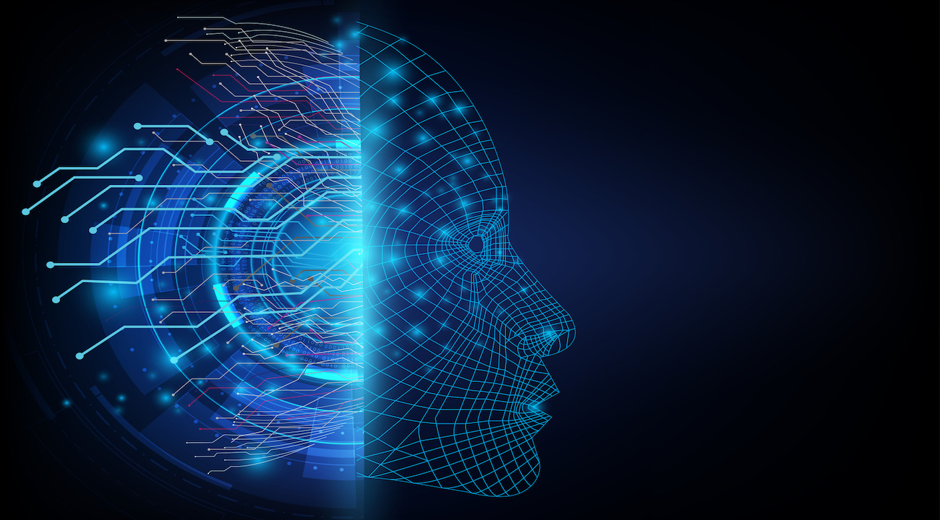
MACHINE LEARNING

Slide 2
BOOTCAMP STRUCTURE
DAY 1 - PANDAS AND NUMPY
DAY 6-POLYNOMIAL REGRESSION
DAY 11 - NAIVE BAYES
DAY 2 - MATPLOTLIB AND SEABORN
DAY 7 - LOGISTIC REGRESSION
DAY 12 - KNN
DAY 3 - DATA ANALYSIS / EDA
DAY 8 - DECISION TREE
DAY 13 - SVM
DAY 4 - MACHINE LEARNING
DAY 9 - RANDOM FOREST
DAY 14- CLUSTERING ALGORITHMS
DAY 5 - LINEAR REGRESSION
DAY 10 - XGBOOST
DAY 15 - DEPLOYING MODELS

Slide 3
K- NEAREST NEIGHBOURS
KNN is a supervised machine learning algorithm which can be used for both classification and regression tasks.
KNN is based on feature similarity and classifies the new instance based on similarities between features.
KNN is a non-parametric algorithm, which means it does not makes any assumptions about the data.
It is also called as lazy learning algorithm.

Slide 4
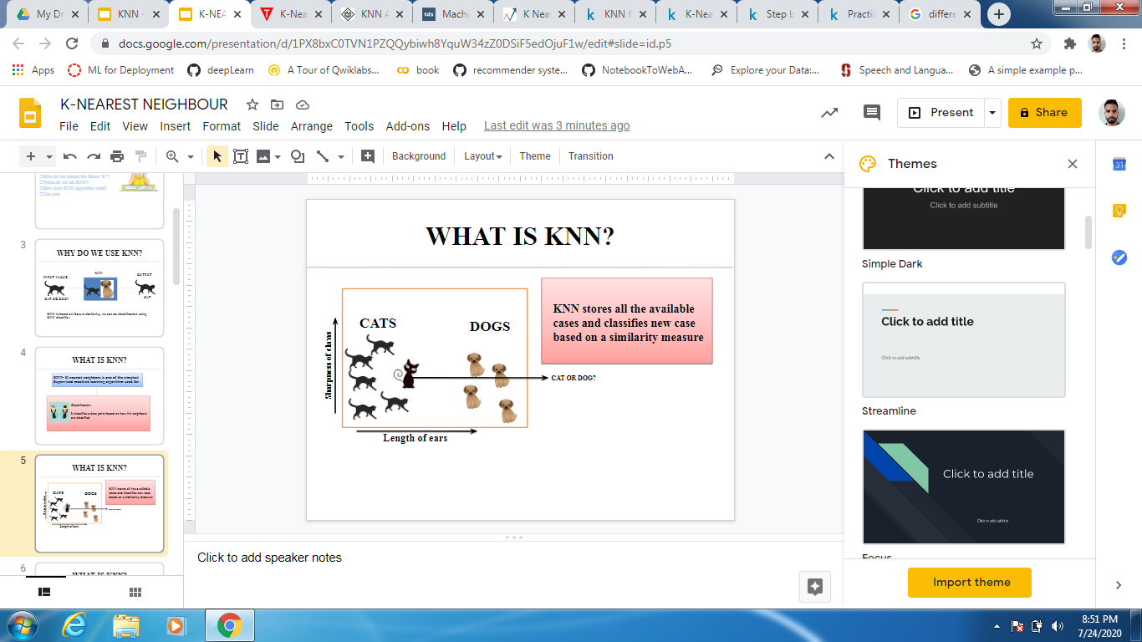


EXAMPLE
KNN stores all the available cases and classifies new case based on a similarity measure
CATS
DOGS
Sharpness of claws
CAT OR DOG?
Length of ears

Slide 5
K=3
K – in KNN refers to the number of nearest neighbors include in majority voting process.
CATS
DOGS
Sharpness of claws
CAT OR DOG?
A data point is classified by majority votes from its 3 nearest neighbors.
Length of ears

Slide 6
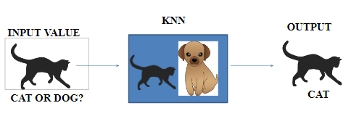

Slide 7
HOW DOES KNN WORK ?
STEP 1 - Calculate the distance of each point from the new observation.
STEP 2 - Select the number K of the neighbors.
STEP 3 - Among these K neighbors count the number of data points in each class.
STEP 4 - Assign the new data point to that category for which number of neighbor is maximum.

Slide 8
HOW DOES KNN WORK ?
Calculate distance of new point from each point.
Decide the K value
Take K neighbours with minimum distance and decide the final class of output.

Slide 9
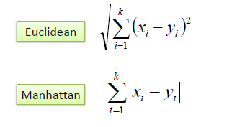
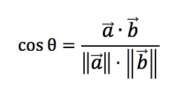
DISTANCE MEASURES FOR KNN
Cosine

Slide 10
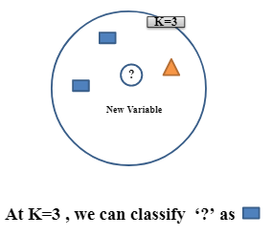
HOW DO WE CHOOSE K ?
KNN algorithm is based on feature similarity. Choosing the right value of K is a process called parameter tuning, and is important for better accuracy

Slide 11
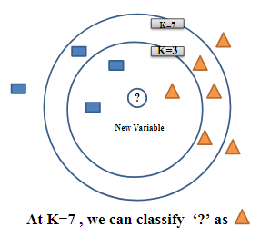
HOW DO WE CHOOSE K ?
The class of unknown data point was at k=3 but changed at k=7, so which ‘k’ should we choose?

Slide 12
HOW DO WE CHOOSE K ?
Selecting the value of K is an iterative process.
Generally, (√ n) is chosen,where n is data point.
Odd value of K is selected to avoid the confusion between two classes of data

Slide 13
Consider a dataset having two variables height(cm) and weight(kg) and each point is classified as normal or underweight.
Weight(x2) | Height(y2) | Class
51 | 167 | Underweight
62 | 182 | Normal
69 | 176 | Normal
64 | 173 | Normal
65 | 172 | Normal
56 | 174 | Underweight
58 | 169 | Normal
57 | 173 | Normal
55 | 170 | Normal

Slide 14
On the basis of given data we have to classify the below set as normal or underweight using KNN.
57 kg | 170cm | ?
Assuming we don’t know how to calculate BMI

Slide 15
To find the nearest neighbors we will find the Euclidean distance.
What is the class of ?
Calculate distance of from each data point.
185
180
Height(y2)
Dis(d1) =√(170-167)^2 + (57-51) ^2 = 6.7
Dis(d2) =√(170-182)^2 + (57-62) ^2 = 13
175
170
165
Similarly, we will calculate Euclidean distance of unknown data points from all the points in dataset.
50
55
60
65
70
75
Weight(x2)

Slide 16
Euclidean distance of unknown data point from all the points.
Weight(x2) | Height(y2) | Class | Euclidean Distance
51 | 167 | Underweight | 6.7
62 | 182 | Normal | 13
69 | 176 | Normal | 13.4
64 | 173 | Normal | 7.6
65 | 172 | Normal | 8.2
56 | 174 | Underweight | 4.1
58 | 169 | Normal | 1.4
57 | 173 | Normal | 3
55 | 170 | Normal | 2
Where (x1,y1) = (57,170) whose class we have to classify.

Slide 17
Nearest neighbors at K = 3
Weight(x2) | Height(y2) | Class | Euclidean Distance
51 | 167 | Underweight | 6.7
62 | 182 | Normal | 13
69 | 176 | Normal | 13.4
64 | 173 | Normal | 7.6
65 | 172 | Normal | 8.2
56 | 174 | Underweight | 4.1
58 | 169 | Normal | 1.4
57 | 173 | Normal | 3
55 | 170 | Normal | 2
K = 3
57 kg | 170cm | Normal

Slide 18
EFFECT OF OUTLIER ON KNN ALGORITHM
Knn does not works well when there are outliers present in dataset. So we remove the outliers before applying knn.

Slide 19
EFFECT CLASS IMBALANCE ON KNN ALGORITHM
Knn does not works well when there are imbalanced class. Apply proper sampling technique before applying knn.

