Slide 1
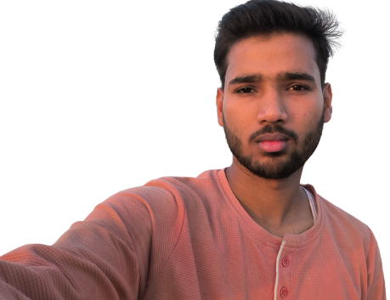
WORK EXPERIENCE
RAVI
KUMAR
WEB DEVELOPER
EDUCATION
PROFILE
I am a Web Developer and a UI/UX Designer.
Very Determined towards my work and have curiosity to learn and grow.
CONTACT
PROFESSIONAL SKILLS
HTML
CSS
SOCIAL ME
JAVA SCRIPT
C++

