Slide 1
Cyber security
RAVIKUMAR MANGA
Keylogger Capturing Key Strokes

Slide 2

Key logger
Keylogger Capturing Key Strokes

Slide 3
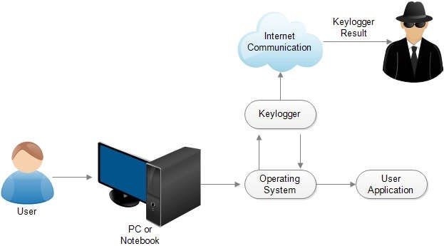
Project topic
The keylogger should be able to record and safely save keystrokes from a range of input devices, including keyboards, virtual keyboards, and on-screen keyboards.
Keylogger Capturing Key Strokes

Slide 4

Agenda
The ordinary operation of the target device should be unaffected by the keylogger's background operation, and the user should be unaware of its presence. It should be able to track keystrokes in real-time or on a regular basis, and it should ensure that the data it obtains is accurate and complete.
Keylogger Capturing Key Strokes

Slide 5
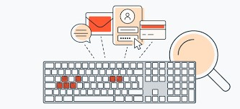
overview
Keyloggers can be used for good, but they can also be exploited to acquire private information, passwords, or credit card information. This is critical to remember. Unauthorized use of keyloggers to invade someone's privacy or commit illegal behavior is strictly prohibited and may result in legal consequences.
Keylogger Capturing Key Strokes

Slide 6
WHO ARE THE END USERS ?
Keyloggers may have a range of end users depending on their intended purpose and the environment in which they are employed. Here are a few examples of potential end users:
Parents/Guardians
Enforcement of the Law System administrators in organizations
Observers and Scholars
Individuals for Personal Use
Keylogger Capturing Key Strokes

Slide 7
YOUR SOLUTION AND ITS VALUE PROPOSITION
Solution :
All keystrokes entered into the target device, including function keys, special characters, and alphanumeric characters, are efficiently recorded by the keylogger. It works with a wide range of input methods, including on-screen, virtual, and physical keyboards.
Proposition:
It enables system administrators to monitor and track user activity on corporate-owned devices, ensuring that company policies are followed, detecting abuse or unlawful activities, and responding to security concerns pro-actively.
Keylogger Capturing Key Strokes

Slide 8
Modelling
In the context of a keylogger project, modeling refers to the process of creating a software or system design that illustrates the keylogger's fundamental elements, functions, and interactions. It makes the system architecture, data flow, and relationships between modules easier to visualize and comprehend.
Keylogger Capturing Key Strokes

Slide 9
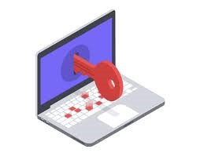
Result
Keystrokes from various input devices, such as keyboards, virtual keyboards, and on-screen keyboards, should be collected and logged by the keylogger. It should accurately record alphanumeric characters, special characters, and function keys.
Keylogger Capturing Key Strokes

Slide 10
links
https://drive.google.com/file/d/1pAAMMPBu4g2zevgJsdLQEktX0A1hWoW-/view?usp=sharing
Keylogger Capturing Key Strokes

Slide 11
Thank you
Keylogger Capturing Key Strokes

