Slide 1

PREDICTIVE ANALYTICS
Human Activity Recognition from Smartphone Sensor Data Using Predictive Modelling
SYMBIOSIS INSTITUTE OF TECHNOLOGY, NAGPUR.
COMPUTER SCIENCE AND ENGINEERING BATCH 2023-27
SEMESTER- 7 | SECTION - B
NAME: RAVI KUMAR KUSHWAHA
PRN: 23070521116

Slide 2
Problem Statement
Smartphones are equipped with accelerometers and gyroscopes that capture human movement and body-position data. However, distinguishing between similar activities, such as sitting and standing or walking upstairs and downstairs, can be challenging.
This project uses machine-learning techniques to recognize human activities from smartphone sensor features and compares model performance on the UCI HAR and UCI HAPT datasets to identify the most effective classification model.
Questions Answered by the Project
Objectives
How can smartphone sensor data be used to recognize human activities?
Which machine-learning model performs best on the UCI HAR and UCI HAPT datasets?
How does class imbalance affect the recognition of human activities, especially rare postural transitions?
Which sensor-derived features contribute most to human activity classification?
To analyze the UCI HAR and UCI HAPT datasets containing smartphone sensor data for human activity recognition.
To develop and compare four machine-learning models: Logistic Regression, k-Nearest Neighbors (k-NN), Decision Tree, and Random Forest.
To identify the best-performing model using validation accuracy and macro F1-score.
To evaluate the selected model on test data using accuracy, precision, recall, F1-score, and confusion matrices.
To analyze the impact of class imbalance and identify important sensor-derived features for activity classification.
Predictive Analytics | Symbiosis Institute of Technology, Nagpur

Slide 3
Dataset
Item | Description
Source | UCI Machine Learning Repository
Sensors | Smartphone accelerometer and gyroscope
Features | 561 time- and frequency-domain features
HAR labels | 6 basic activities
HAPT labels | 12: adds 6 postural transitions
Split | Official train/test partitions
Task | Multiclass classification
7,352
2,947
561
HAR train
HAR test
features
7,767
3,162
6 / 12
HAPT train
HAPT test
classes (HAR / HAPT)
Predictive Analytics | Symbiosis Institute of Technology, Nagpur

Slide 4
Data Understanding and Preprocessing
Data understanding
Preprocessing steps
No missing values and no duplicate rows in either dataset
HAR: 986 to 1,407 training windows per class
HAPT basic activities: 987 to 1,423 windows each
HAPT transitions: only 23 to 90 windows each
Features are already scaled between -1 and 1
1
Data quality checks
Checked missing feature values and duplicate training records.
2
Feature and label separation
Separated the 561 input features from activity labels.
3
Train, validation and test split
Preserved official train/test partitions and created a validation split from training data.
4
Feature scaling
Applied scaling where required by the machine-learning models.
5
Class distribution analysis
Identified class imbalance, especially in HAPT postural transitions.
Predictive Analytics | Symbiosis Institute of Technology, Nagpur

Slide 5
Predictive Modelling Approach
1. Data Selection (UCI HAR, HAPT)
2. Understanding and Preprocessing
3. Model Training (4 classifiers)
4. Validation and Model Selection
5. Final Test Evaluation
6. Confusion Matrix and Feature Importance
7. Saving Results
Macro F1
Accuracy
Confusion matrix
Unweighted mean of class F1 scores; rare classes count equally
Correct predictions divided by all predictions
Counts correct predictions and class-to-class errors
Predictive Analytics | Symbiosis Institute of Technology, Nagpur

Slide 6
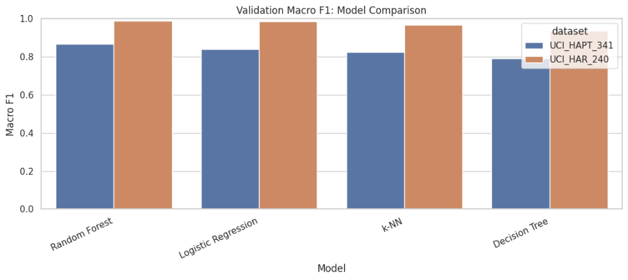
Model Development
Analysis A: UCI HAR (6 classes)
Train 7,352 windows, test 2,947
Validation macro F1: LR 98.68%, k-NN 96.67%, DT 93.80%, RF 98.79%
Selected: Random Forest
Analysis B: UCI HAPT (12 classes)
Train 7,767 windows, test 3,162
Validation macro F1: LR 84.02%, k-NN 82.42%, DT 79.06%, RF 86.61%
Selected: Random Forest
Validation result: Random Forest has the highest validation macro F1 on both datasets, so it was selected for the final test.
Common settings: 80/20 stratified validation split, random state 42, Random Forest with 250 trees, k-NN with k = 5 (distance-weighted).
Predictive Analytics | Symbiosis Institute of Technology, Nagpur

Slide 7
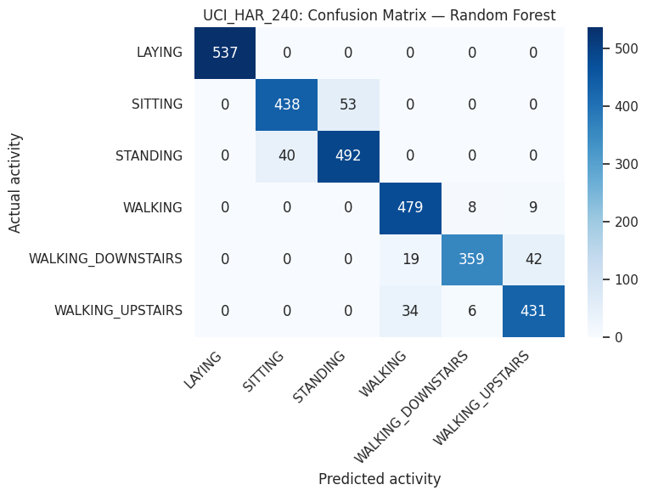
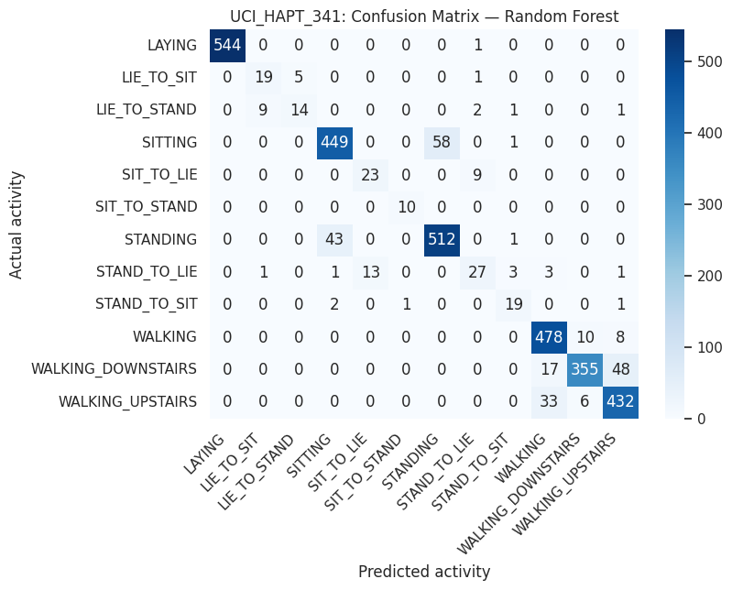
Evaluation of the Model
Measure | UCI HAR | UCI HAPT
Accuracy | 92.84% | 91.14%
Macro precision | 92.94% | 82.64%
Macro recall | 92.54% | 82.53%
Macro F1 | 92.66% | 82.25%
Validation macro F1 | 98.79% | 86.61%
UCI HAR confusion matrix
UCI HAPT confusion matrix
HAR: all 537 LAYING correct; 53 SITTING predicted as STANDING
HAPT: most errors fall in the rare transition classes
Random Forest retrained on the full training set and scored once on the official test set. Accuracy follows common classes; macro F1 weights every class equally.
Predictive Analytics | Symbiosis Institute of Technology, Nagpur

Slide 8
Results and Interpretation
UCI HAR: selected classes
UCI HAPT: selected classes
Activity | Recall | F1
LAYING | 1.00 | 1.00
STANDING | 0.92 | 0.91
SITTING | 0.89 | 0.90
WALKING_DOWNSTAIRS | 0.85 | 0.91
Activity | Recall | F1
LAYING | 1.00 | 1.00
SIT_TO_STAND (10 records) | 1.00 | 0.95
SIT_TO_LIE | 0.72 | 0.68
LIE_TO_STAND | 0.52 | 0.61
STAND_TO_LIE | 0.55 | 0.61
LAYING is perfect; SITTING and STANDING sit near 0.90
Gravity-acceleration features rank highest by Gini importance
Transitions score F1 0.61 to 0.79, apart from SIT_TO_STAND (only 10 records)
Macro F1 (82.25%) is well below accuracy (91.14%)
Predictive Analytics | Symbiosis Institute of Technology, Nagpur

Slide 9
Conclusion
Random Forest was the best model on both datasets: 92.84% accuracy on HAR and 91.14% on HAPT
Test macro F1: 92.66% on HAR and 82.25% on HAPT
Common activities are recognised reliably; rare postural transitions remain the main weakness
Limits: engineered features only, related datasets, no subject-wise validation
Future work: class weighting, a fixed MLP, raw-signal CNN or LSTM models
Predictive Analytics | Symbiosis Institute of Technology, Nagpur

