Slide 1
CGB1201 – JAVA PROGRAMMING
Department of Artificial Intelligence and Data Science
Academic Year: 2024 – 2025 (Odd Semester)
Register Number : 2303811724321087
Name : S RAVIN
Year : II
Semester : III
Section : B
Date :3/12/2024

Slide 2
Title of the Project
TIC-TAC-TOE GAME

Slide 3

PROBLEM IDENTIFICATION
Scalability : The game size is fixed at 3x3. Expanding this to larger board sizes (e.g., 4x4 or 5x5) would require changes in multiple places.
No Game History : Once the game is reset, previous matches and outcomes are lost.
Win Highlighting : When a player wins, the game doesn't visually highlight the winning line.
CGB1201 – JAVA PROGRAMMING

Slide 4
OBJECTIVE
Object-Oriented Programming (OOP): Using nested classes (ButtonClickListener) to associate game actions with specific buttons.
User Experience : Providing clear feedback through UI elements (e.g., button states and messages via JOptionPane).Allowing players to reset and replay games easily.
Graphical User Interface (GUI) Design : Using Swing components like JFrame, JButton, and layout managers (e.g., GridLayout) to create an interactive application.

Slide 5
Java Programming - Concepts Used
Swing Components: Used JFrame, JPanel, and JButton to create the GUI.
Event Handling: Implemented ActionListener to respond to button clicks.
Grid Layout: Arranged the game grid using a GridLayout.
Conditional Logic: Used to check for winning combinations and handle tie cases.
Methods: Modular methods for tasks like resetting the game and checking results.

Slide 6
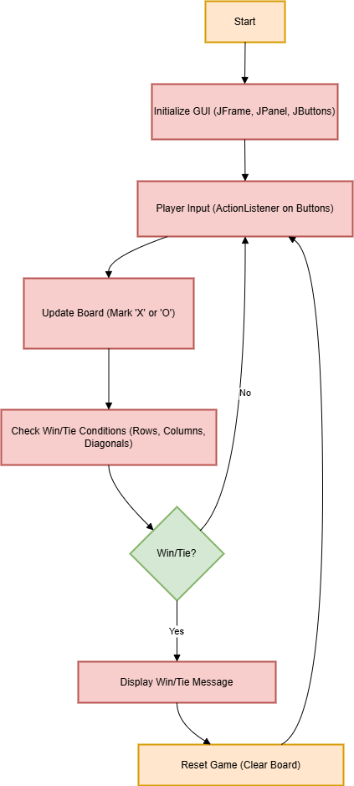
Proposed Architecture

Slide 7
Proposed Architecture - Description
Initialize GUI: Create the frame, panel, and buttons for the game grid.
Handle Player Input: Use ActionListener to detect button clicks and update the board.
Game Logic: Check for winning conditions (rows, columns, diagonals) or tie after each move.
Reset Functionality: Provide an option to restart the game after a win or tie.

Slide 8
List of Modules
1. GUI Initialization
2. Player Input Handling
3. Board Update
4. Win/Tie Detection
5. Game Reset

Slide 9
Module Description
GUI Initialization : This module sets up the graphical interface, including the game board, buttons, and layout using Java Swing components.
Player Input Handling : Captures and processes player clicks on the board through ActionListener events.
Board Update : Updates the visual representation of the board by setting the clicked button with the current player's symbol (X or O).

Slide 10
Module Description
Win/Tie Detection : Checks for win conditions (row, column, diagonal) after each move and determines if a player has won.
Game Reset : Resets the board to its initial state by clearing all button labels and resetting the current player to X.
Prepares the game for a new round while maintaining a consistent user experience.

Slide 11

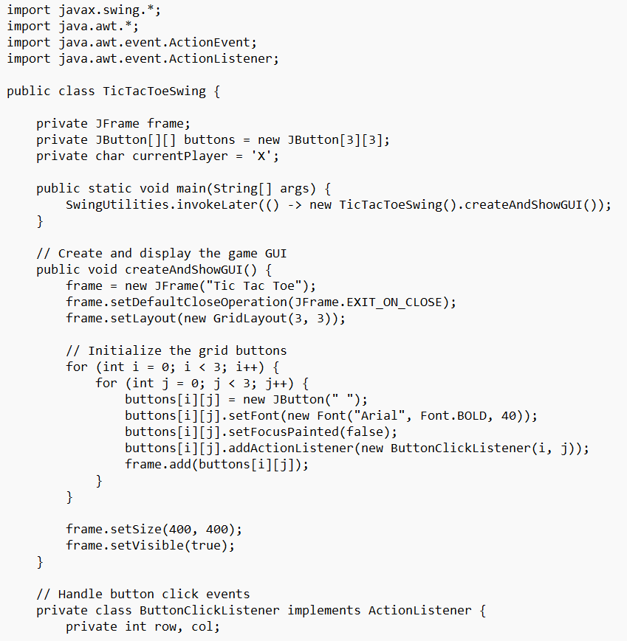
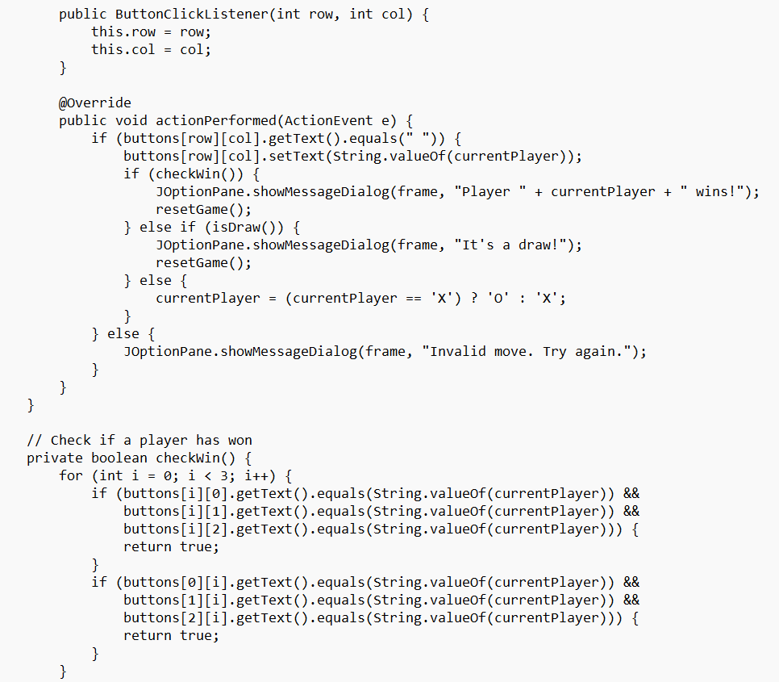
SOURCE CODE

Slide 12
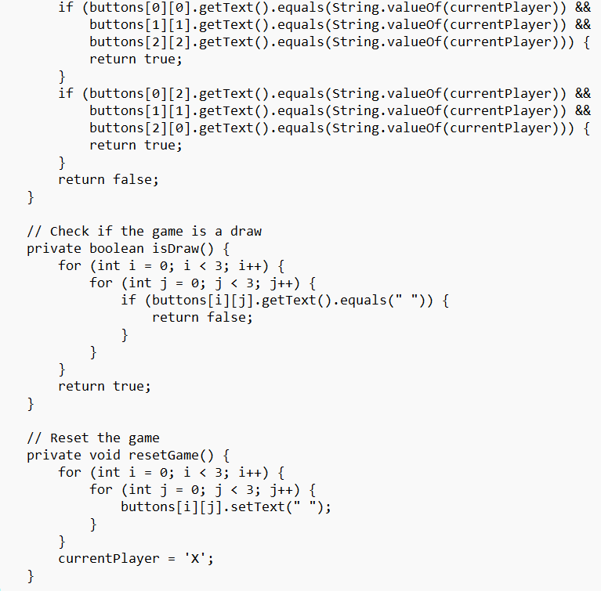
SOURCE CODE

Slide 13

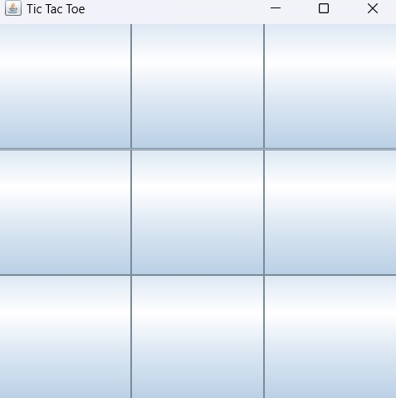
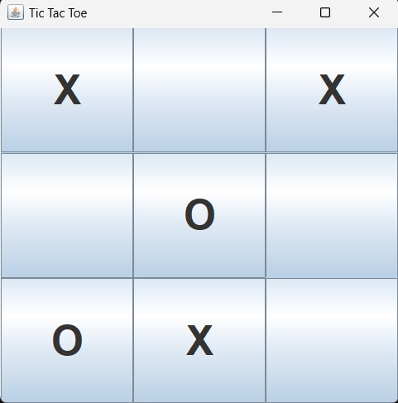
RESULTS AND DISCUSSION

Slide 14
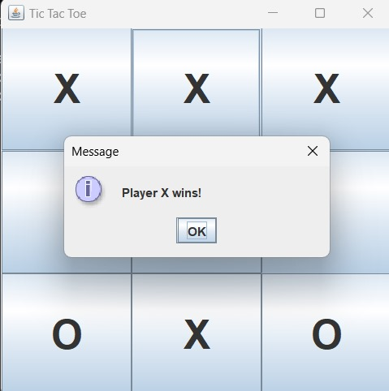
RESULTS AND DISCUSSION

Slide 15
Conclusion
The GUI-based Tic-Tac-Toe game effectively demonstrates the use of Java Swing for graphical applications. It provides an interactive two-player experience, showcasing skills in GUI design, event handling, and game logic implementation. The project lays a solid foundation for building more advanced graphical applications in Java.

Slide 16
Thank You
Any queries???

