Slide 1
Python Programming course

Slide 2
intro to python
Python is a high-level, general-purpose programming language known for its readability and simplicity
Wildly known as a scripting language

Slide 3
applications
Web /Backend/ Mobile App Development
Data Science and Machine Learning/Artificial Intelligence (AI)
Automation and Scripting
Game Development
Internet of Things (IoT)
Cybersecurity
Network Servers and Protocols

Slide 4
setup
Install Python
Install VS Code
Install extensions in VS Code

Slide 5
Variables
Variables are objects and are used to store data.
Define variables
variable_name = value
Example: age = 21
Variables are case-sensitive
age = 21 and Age = 22. age and Age are different variables.

Slide 6
Variable Types
Integer
Non fractional numbers
Float
Fractions or decimals
String
Collection of characters
Declare using ‘single quotes’ or “double quotes”
Boolean
Binary values
Example: True or False

Slide 7
python collection data types
Used to store multiple values.
Types
List
Set
Tuple
Dictionary

Slide 8
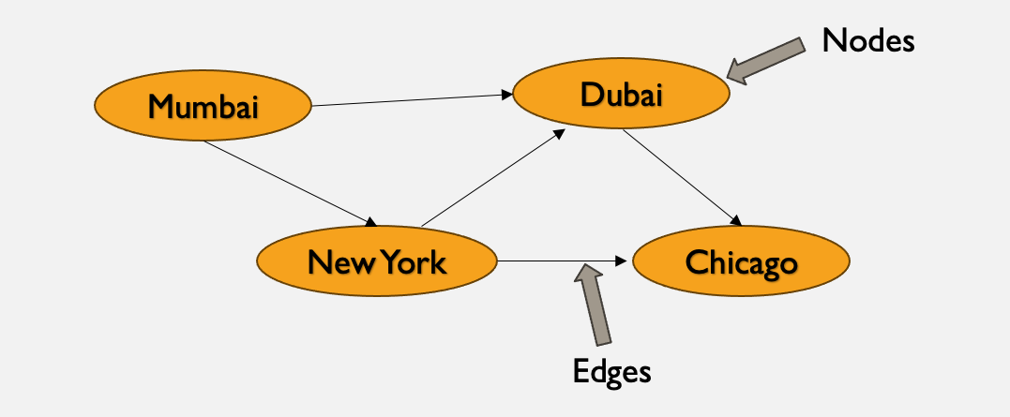
Graphs
Hierarchical data structures that have nodes and edges.

Slide 9
Types of graphs
Directed
Undirected
Weighted

Slide 10
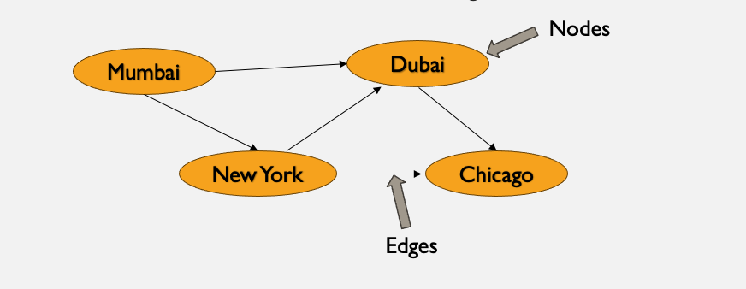
directed

Slide 11
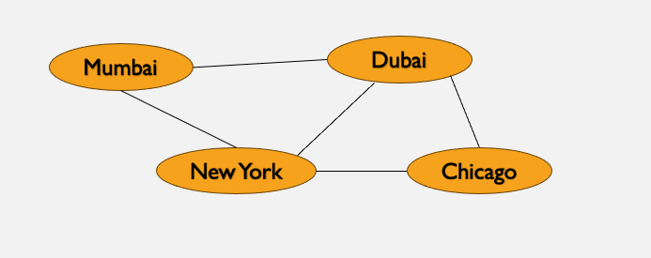
undirected

Slide 12
Weighted
5
2
4
3
1

Slide 13
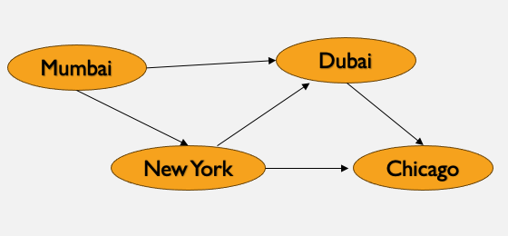
Define Graphs
Graphs are defined using dictionary
graph = {
“Mumbai” : [“Dubai”, “New York”],
“Dubai” : [“Chicago”],
“New York” : [“Dubai”, “Chicago”]
}

Slide 14
Implementations
Social media – Fb, Insta, Twitter, LinkedIn
Internet and Web
Recommendation Systems
Transportation Networks

Slide 15
Traverse Graphs
Breadth First Search
Depth First Search

