Slide 1

Operating System

Slide 2
What is Android ?
Android is a Linux-based operating system for mobile devices such as smartphones and tablet computers.
Android specially developed for applications
There are more than 4,00,000 apps in Android market
The Android is an open source.

Slide 3
Why Android Was Created?
Full phone software stack including applications
Designed as a platform for software development
Android is open
Android is free
Community support
100% Java Phone

Slide 4
Foundation of an Android
Android, Inc. found in Palo alto in California united states by Andy Rubin. - October 2003
Google acquired Android, Inc. – August 2005
The open handset alliance, a group of several companies was formed - 5 November 2007
Android Beta SDK Released - 12 November 2007.

Slide 5
Features of Android
Android can run multiple apps at the Same Time
Also support optimized graphics VGA, 2D graphics and 3D graphics
Android has a better app market
Android lets you change your settings faster
It gives you more options to fit your budget
Android keeps information visible on your home screen.
Android also support Java applications.

Slide 6
Versions of an Android
Android 1.0 23 September 2008
Android 1.1 9 February 2009
Android 1.5 (Cupcake) 30 April 2009
Android 1.6 (Donut) 15 September 2009
Android 2.0 (clair) 26 October 2009
Android 2.2 (Froyo) 20 May 2010
Android 2.3 (Gingerbread) 6 December 2010
Android 3.0 (Honeycomb) 10 May 2011
Android 4.0 (Ice cream sandwich) 19 October 2011
Android 4.1 (Jelly Bean) 13 July 2012
Android 4.4 (Kitkat) 31 October 2013
Android 5.0 (Lolipop) 12 November 2014
Android 6.0 (Marshmallow) 5 October 2015
Android 7.0 (Nougat) 22 August 2016
Android 8.0 (Oreo) 21 August 2017

Slide 7
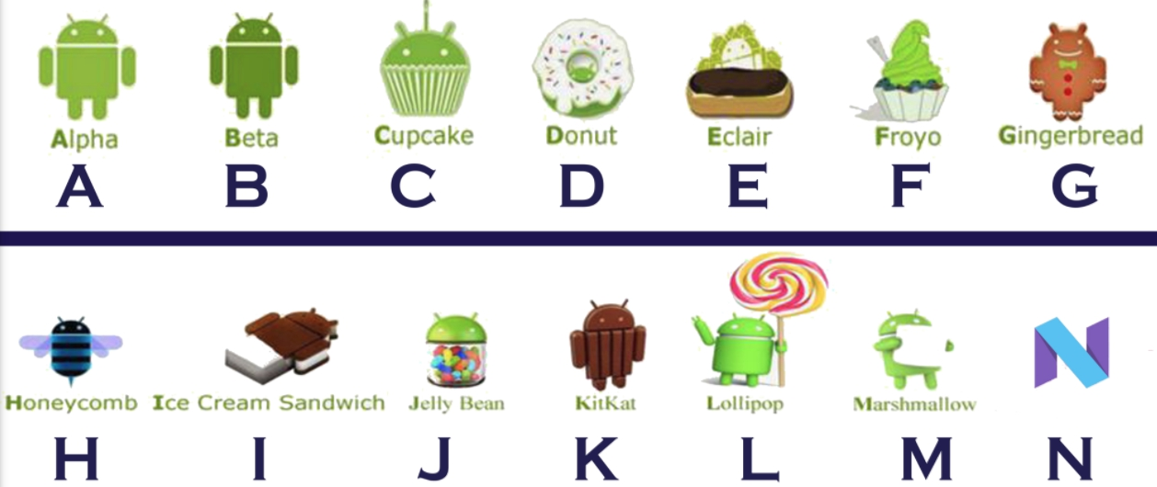
Android Versions

Slide 8
Android Market
Android Market is the online software store developed by Google for Android devices
Users to browse and download apps published by third party developer
As of October 2011 there were more than 4,00,000 apps available for Android
Android has several famous apps like voice action, sky map, place directory, GPS, etc.,

Slide 9
conclusion
Android is open to all: industry, developers and users
Participating in many of the successful open source projects
Aims to be as easy to build for as the web.
Google Android is stepping into the next level of Mobile internet

Slide 10

Thank You

