Slide 1
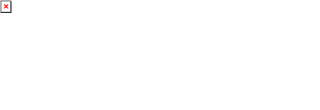
Agent Activity Chart
6/21/2022 12:42 AM
Print User : automation
Page 1 of 3

Slide 2
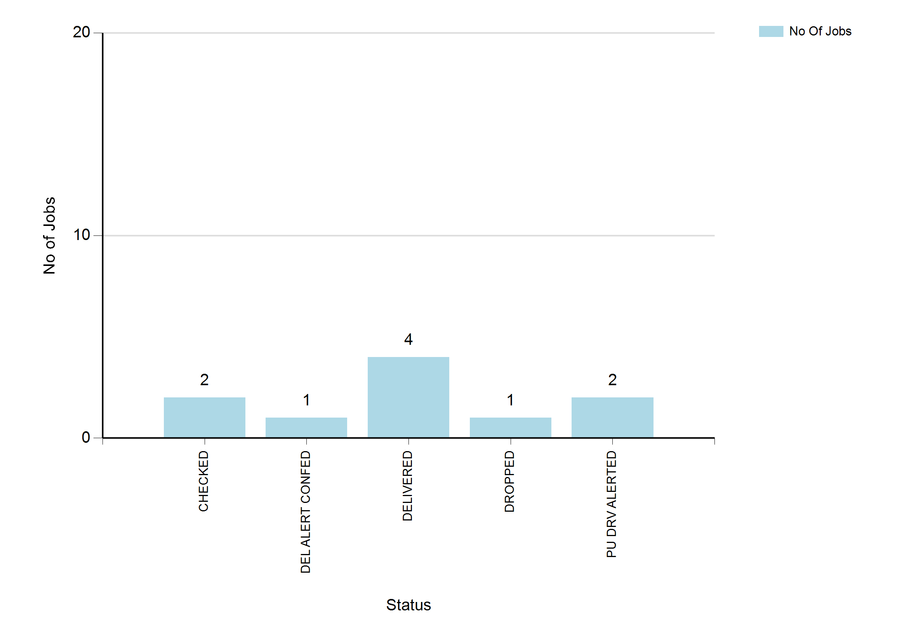
6/21/2022 12:42 AM
Print User : automation
Page 2 of 3

Slide 3
6/21/2022 12:42 AM
Print User : automation
Page 3 of 3

