Slide 1

Top Jobs
Submitted By,
Ravindra Thalari
Manikandan S
Ashwidha Subair
Jaishal Jamal

Slide 2
Agenda
Problem Statement
Proposed system
Tools and Technology
Class Diagram

Slide 3
Problem Statement
The primary being its inability to adapt with the evolving technologies in the job marketing segment.
Jobseekers complain that even after submitting their resumes, they are not updated about the status of their applications.
Many vacancies remain unplaced and the number of jobseekers seeking TopJobs services has declined.

Slide 4
Proposed System
Automate the process of posting jobs by employers and applying for jobs by jobseekers.
Employer and Jobseeker must register with the application and agree with the terms and conditions of using the application.
It will provide a comprehensive platform supported by a social networking infrastructure where both employers and jobseekers can interact with one another.

Slide 5
Modules
Administration
Employer
Jobseeker

Slide 6
Tools and Technology
Software Requirements
Operating System: Windows 10
IDE: Eclipse
Frameworks and APIs: Spring boot, Hibernate
Database: MySQL
Web Service: RESTful web services
Browser: Chrome or Firefox or Internet Explorer
Hardware Requirements
Processor: Intel core i7
Processor speed: 3.40 GHz
RAM: 8 GB

Slide 7
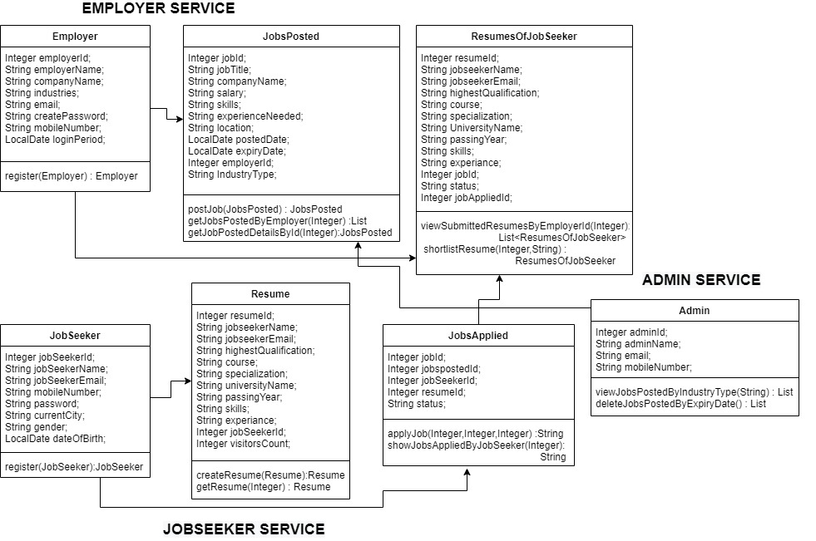
Class Diagram

Slide 8


