Slide 1

LEAVE OR NOT?

Slide 2

Data Science Driven Solution to Identify the Relationship of Attrition of Employees with Demographics
Group 05

Slide 3
Outline
Context Setting (Introduction, Aim, Objectives, Literature Review and Gap Identification)
Data Collection and Preparation
Data Exploration
Model Planning and Model Building
Model Testing and Evaluation
Deployment
Discussion
Conclusion and Recommendation

Slide 4


Introduction
Employee attrition is a significant concern for most companies worldwide where valuable and experienced employees leave the organization more often.
12% to 15%
Less than 20%
WORLDWIDE TURNOVER RATE
LOCAL TURNOVER RATE
We have established a data science-driven solution to this problem by collaborating with the MIHCM company.

Slide 5

Aim
Objectives
Identify the relationship between attrition and the other firmographic and demographic data.
Provide a prediction of the risk of attrition of the existing employees’ along with the importance of the variables affecting the attrition.
Provide a visualization of the demographic and other related information of the high-risk employees.
Enhance the overall productivity of the organization by giving data science driven solution to identify the relationship of attrition of employees with demographic features.

Slide 6
Literature Review
Initial Search (by keywords) 48 papers
Duplicated Studies 42 papers
Time Frame (2016-2022) 37 Papers
Inclusion and Exclusion Criteria 31 papers
Quality Assessment 25 Papers

Slide 7
Gap Identification
Academic Research Gap
Our study enhances workforce management by identifying key attributes influencing employee decisions to leave or stay, contributing to predictive model precision in employee attrition prediction beyond previous research. Industrial Research Gap
Our project aligns with MiHCM's proactive intent to implement retention strategies before employee attrition, offering companies a strategic advantage by enabling proactive measures based on predictive insights.

Slide 8
Data Collection and Preparation
We have been provided with a secondary dataset which was given by MiHCM company.
About 290 employees
More than 50 attributes
Data cleaning and reduction.
Data Transformation.
Data normalization and standardization.
Data Analysis
Descriptive, Predictive and Prescriptive analytics have been considered

Slide 9

Data Exploration
https://app.powerbi.com/links/F-MckMIUG6?ctid=8f791105-7a87-467c-b4d4-b39c0ecb63c6&pbi_source=linkShare

Slide 10
Model Planning and Model Building
Data Split:
The dataset was divided into 70% training and 30% testing sets.
Utilized methods to identify significant attributes:
Leveraged correlation matrix analysis.
Model Selection:
Employed various algorithms for model selection: Random Forest Algorithm, Logistic Regression, Gaussian Naive Bayes, K-Nearest Neighbors (KNN), Decision Tree, Support Vector Machine (SVM).

Slide 11
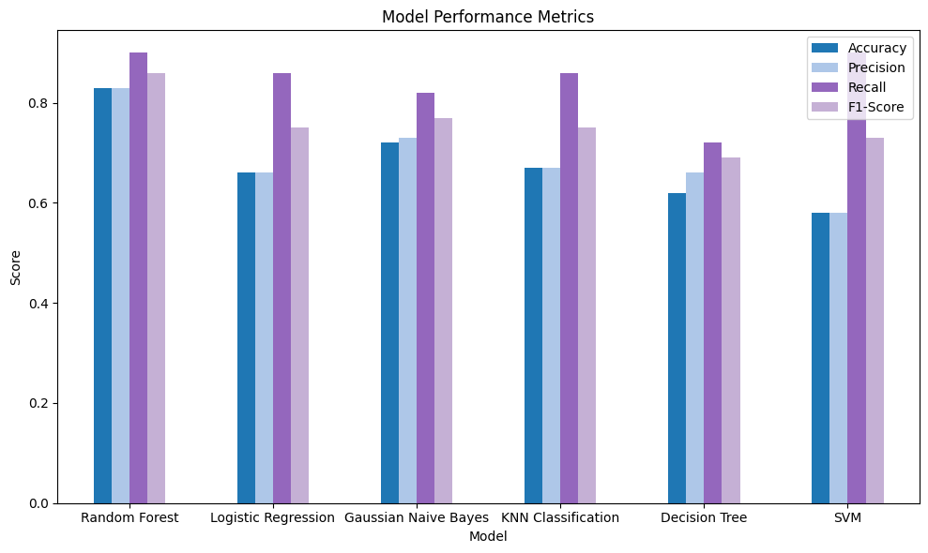
Model Testing and Evaluation
Selected model : Gaussian Naïve Bayes
Model performance enhancing :
K- fold cross validation
Hyper-parameter tuning

Slide 12

Deployment
Google Collab Code:
https://colab.research.google.com/drive/1Y3XQNWStLE8ZiBiScUx2vkZkZ1XeaS-U#scrollTo=TB3EbTx5p7El

Slide 13
Discussion
Most significant Attributes: Reporting Person Code, Average Monthly Working Hours, Designation Code, Allocated leaves, Used leaves, Level2Code(Job Position), Age
Limitations :
Dataset: Provided with a small dataset containing 290 rows.
Insufficient Correlation: Due to the dataset's limited size, traditional correlation indices were not adequate for obtaining the desired level of insight into the data.
Models were not well fitted
Lack of sources to refer when giving most significant attribute for employee retention decision

Slide 14
Conclusion
Applicable contribution :
Employee retention strategies.
HR decision making support
Resource allocation and work force planning
Cost reduction and productivity improvement
Technical Contribution :
Predictive Modeling for attrition forecasting.
Feature important analysis.
Bayesian Inference

Slide 15
Recommendations
Reporting Person Code – Enhancing the efficiency of relationship
Average Monthly Working Hours - Work-life balance initiatives
Designation Code - Career development opportunities
Allocated leaves, Used leaves -Leave management strategies
Level2Code(level of Job Position) - Job position level alignment
Age - Appropriate work environment

Slide 16
References
Hebber A. et al. (2018) “Comparison of machine learning techniques to predict the attrition rate of the employees,” 2018 3rd IEEE International Conference on Recent Trends in Electronics, Information & Communication Technology (RTEICT) [Preprint]. Available at: https://doi.org/10.1109/rteict42901.2018.9012243.
Jain, P.K., Jain, M. and Pamula, R. (2020) “Explaining and predicting employees’ attrition: A machine learning approach,” SN Applied Sciences, 2(4). Available at: https://doi.org/10.1007/s42452-020-2519-4.
Habous, A., Nfaoui, E.H. and Oubenaalla, Y. (2021) “Predicting employee attrition using supervised learning classification models,” 2021 Fifth International Conference On Intelligent Computing in Data Sciences (ICDS) [Preprint]. Available at: https://doi.org/10.1109/icds53782.2021.9626761.
Darapaneni, N. et al. (1970) A detailed analysis of AI models for predicting employee attrition risk: Semantic scholar, 2022 IEEE 10th Region 10 Humanitarian Technology Conference (R10-HTC). Available at: https://www.semanticscholar.org/paper/A-DetailedAnalysis-of-AI-Models-for-Predicting-DarapaneniTuraga/53cdf44b15f6fc1cb136716ac38774e828007d78.
5. Sekaran, K. and S, S. (1970) Interpreting the factors of employee attrition using explainable AI: Semantic scholar, 2022 International Conference on Decision Aid Sciences and Applications (DASA). Available at: https://www.semanticscholar.org/paper/Interpreting-the-Factors-of-Employee-AttritionAI-Sekaran-Shanmugam/71cbdef8ef09dbedf20018dbb455b5e42c460b50 (Accessed: February 12, 2023).

Slide 17
Thank you !

