Slide 1
Goal of Interactive Visualization
Understand the nature of Simpson's Paradox
Why do smokers die less than non smokers in this dataset?
Interactive goal: Show the effects of age on death
Slider is mapped to age and allows dynamic filtering

Slide 2
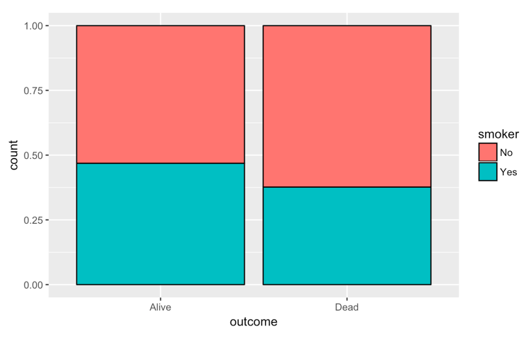
If you smoke, you're more likely to be alive...????

Slide 3
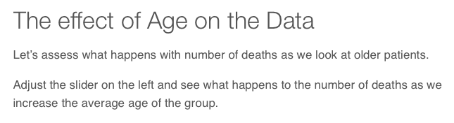
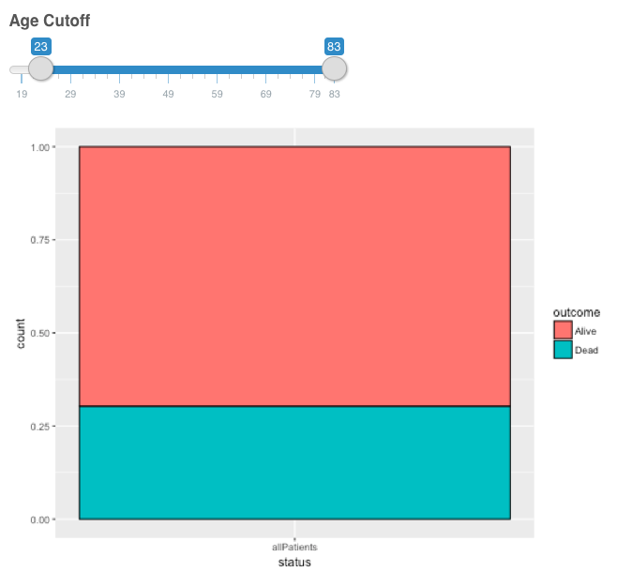
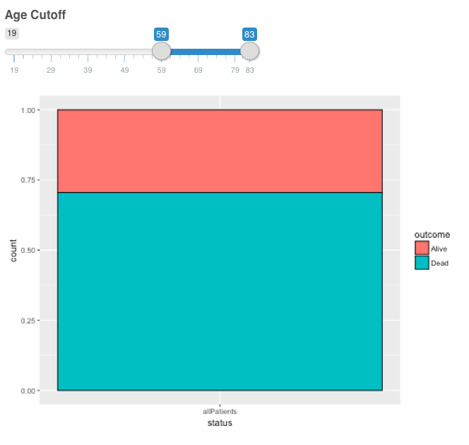

Slide 4
Lessons Learned
Feedback from beginners was very positive
Feedback from researchers was not

