Slide 1


Introduction and objectives
Transposable Elements (TEs) are selfish mobile genetic elements which exist in virtually all eukaryotic genomes
India is first in rice area and second in rice production, after China
Rice is model organism for genomic research; but can be attacked by fungus Magnaporthe oryzae causes Rice Blast disease, is the most severe diseases of rice that greatly reduces yield up to 65% in susceptible cultivars and grain quality
Blast resistance (R) genes in rice encode products that recognize pathogens and triggers disease resistance, but its’ expression can be influences by TEs
Genome-wide Analysis Of Transposable Elements In Different Rice Species And
It’s Association In Plant Disease Resistance (R) Genes In Oryza Sativa Nipponbare
Ravindra Raut^{1*},
Subhankar Roy Barman²,
Malali Gowda**
^{1, 2} National Institute of Technology Durgapur; ³ The University of Trans disciplinary Health Sciences and Technology Bengaluru
**malalig@tdu.edu.in
Genome wide analysis of TEs in different rice genomes (Oryza sativa Japonica, Oryza sativa indica and wild rice species)
Study of TEs association in Blast resistance (R) genes

Slide 2
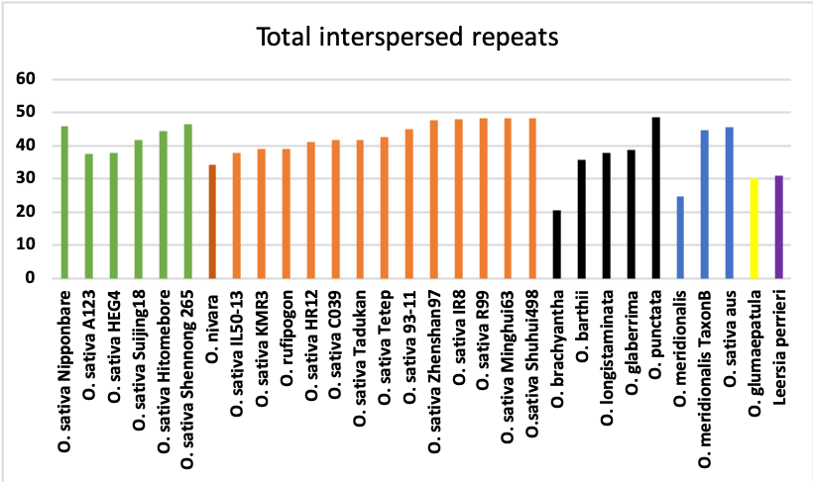
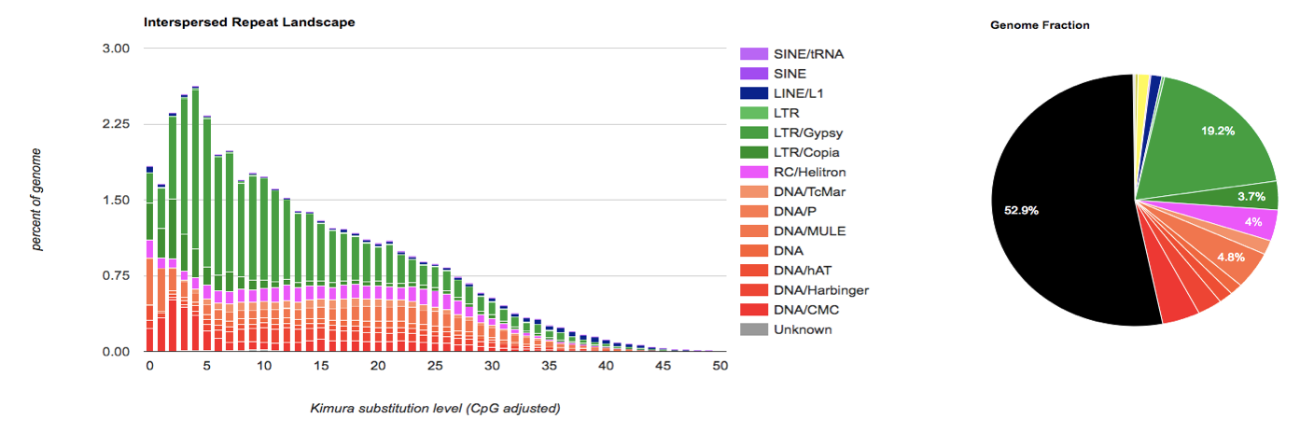
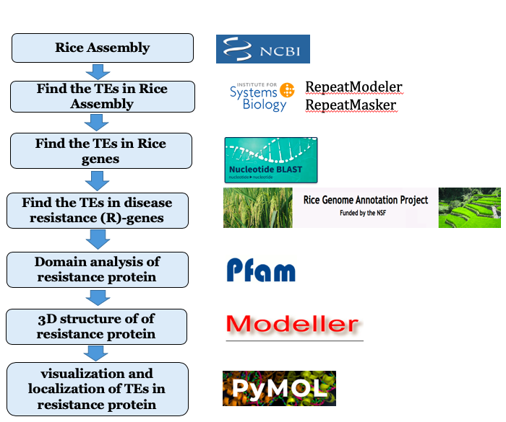
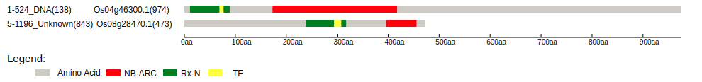
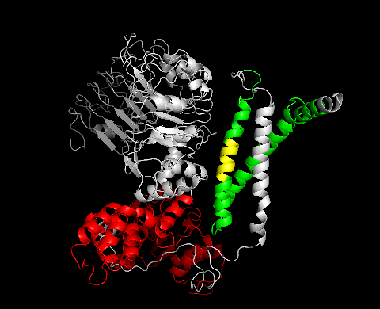

Methodology and Results
Figure 1. Total interspersed repeats analysis in 30 different rice species
Figure 2. TE fraction in
O. sativa Nipponbare (46%)
Figure 3. TE footprints in Rx-N domain of RPM1-Disease Resistance Protein
Figure 4. The 3D structure of RPM1-Disease Resistance Proteins (A. Os04g46300.1 and B. Os08g28470.1) showing TE footprints inside Rx-N domain
B
A
B

Slide 3
Significance and outlook
The average TE content in Rice genome is 38.79%
TE content in wild rice Oryza brachyantha (wild rice) was low as 20.47% and in Oryza punctata (red rice) it is high as 48.55 %
Two classes of LTR elements (Ty1/Copia and Gypsy/DIRS1) account for a significant portion of the genome size variations present in the Oryza genus
It is observed that the different 60 TEs are located within various 103 resistance gene analogs (RGAs) of Oryza sativa Nipponbare
16 types of plant disease resistance protein (R) families are associated with 10 different subclasses of TEs
Two R-genes (Pi9_Nbs6) have 10 TEs footprints in rice species Oryza sativa Indica 75-1-1127 and Pia_Os11gRGA4 have one TE footprint in rice Oryza sativa Nipponbare.

