Slide 1


BITSHIFT 2026
P2Shield
A pre-LLM privacy firewall that cleans every prompt on your own device, before any chatbot sees it.
[PERSON_1]
Problem Statement ID – 10
Problem Statement Title – Pre-LLM Privacy Firewall for Sensitive Data Protection
Theme – AI / Web3
PS Category – Software
Team Name – TechKnights
98*** ***10
[REDACTED_AADHAAR]
[SECRET_REMOVED]

Slide 2
P2SHIELD
TechKnights
Clean every prompt on your own device, before the LLM ever sees it
PROBLEM
Your prompt
Detect 28 data types
Apply privacy policy
Score risk 0–100
Safe prompt in the box
Send to any LLM
77%
of GenAI users paste data into prompts (LayerX 2025)
Proposed Solution
Innovation & Uniqueness
39.7%
of data shared with AI tools is sensitive (Cyberhaven 2026)
A Chrome extension: a shield appears on every AI chat box
One click finds 28 types of sensitive data and rewrites the prompt in place
Mask, tokenize, redact, generalize; secrets are always removed
Risk score before → after, with Undo and per-item review
4 policy profiles: Personal, Healthcare, Finance, Enterprise
100% on-device: no server, no account, zero network calls
Reads structure: JSON, .env, headers, tables, code and prose
Checksums cut false alarms (Luhn, Verhoeff, IBAN mod-97)
Optional on-device AI (Gemini Nano) keeps only what the task needs
The AI only labels; the policy decides every replacement
₹250 Cr
max DPDP Act penalty for failing to protect personal data
Names, Aadhaar, card numbers, API keys and health records are pasted straight into chatbots
Once sent, the data sits on third-party servers, outside the user's control
Today's options: ban AI outright, or route every prompt through a cloud DLP proxy
How it addresses the problem – real output, Healthcare profile
BEFORE
Risk 97 · Critical
AFTER
Risk 23 · Low
My name is Rahul Sharma, I'm 27. Phone 98765 43210, Aadhaar 2345 6789 0124, email rahul.sharma@gmail.com. I have Type 2 diabetes. What should I ask my doctor?
My name is [PERSON_1], I'm 20-30. Phone [REDACTED_PHONE], Aadhaar [REDACTED_AADHAAR], email [REDACTED_EMAIL]. I have Type 2 diabetes. What should I ask my doctor?
Diagnosis kept: the answer needs it. Identity removed.

Slide 3
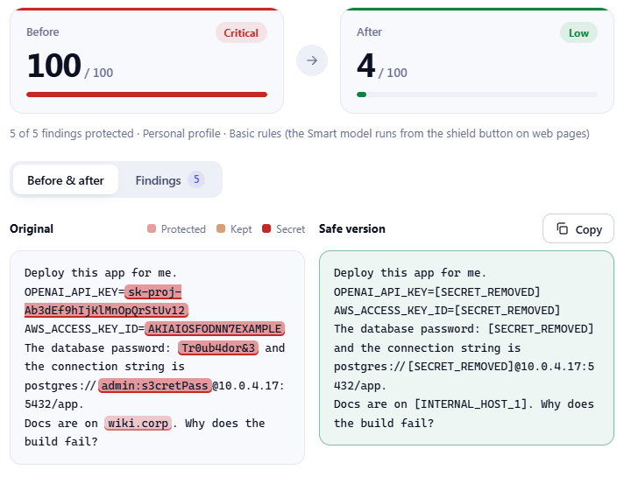
TECHNICAL APPROACH
TechKnights
A pure TypeScript engine inside a Chrome extension. Nothing leaves the browser.
System Architecture & Process Flow
CORE ENGINE · on-device, pure TypeScript, no DOM
Rule detectors
regex, checksums, 40+ secrets
AI chat box
Shield UI
Field detector
Resolver
Policy engine
Risk scorer
Sanitizer
Write back
LLM
ChatGPT, Claude, Gemini or any site
content script, closed Shadow DOM, Alt+Shift+S
JSON, YAML, .env, headers, tables
merge overlaps, keep the most specific
action per data type and profile
0–100, before and after
mask, tokenize, redact, generalize
safe text into the box, verified, with Undo
gets only the safe prompt
Heuristics
names, medical, amounts, hosts
Smart labels (optional)
Gemini Nano via Prompt API
Tech Stack
Privacy Actions
Working Prototype
TypeScript
Chrome MV3
Mask
98765 43210 → 98*** ***10
Shield on every chat box
Alt+Shift+S and right-click
Undo + per-item review
Playground for .txt .csv .json .log
Org policy via managed storage
engine + UI
extension platform
Tokenize
Rahul Sharma → [PERSON_1]
Shadow DOM
Prompt API
Redact
2345 6789 0124 → [REDACTED_AADHAAR]
isolated shield UI
Gemini Nano, on-device
chrome.storage
esbuild
Generalize
27 → 20-30 · Jamshedpur → Jharkhand
settings, org policy
bundler
Remove secret
sk-proj-Ab3d… → [SECRET_REMOVED]
Vitest
Playwright
Keep
Type 2 diabetes (needed for the task)
169 unit tests
30 end-to-end checks
Secrets are removed in every profile and cannot be overridden.

Slide 4
FEASIBILITY AND VIABILITY
TechKnights
Already built, tested and fast. No servers to run.
Risks & Mitigation
Technical Feasibility
Chat sites keep changing their editors
Simulated paste + read-back check; clipboard fallback; shortcut and right-click always work
Working Chrome extension, demo chat page and playground
169 unit tests + 30 end-to-end checks, all passing
Works on ChatGPT, Claude, Gemini, Copilot and more
No backend: nothing to host, scale or breach
Org-wide policy via Chrome managed storage
False positives could break normal prompts
Checksums + field-name context; clean prompts are tested to stay unchanged; per-item Undo
AI model may hallucinate or be prompt-injected
Model only labels; every label must appear verbatim; policy decides; secrets are never "needed"
Devices without on-device AI
Basic mode works in every Chromium browser; Smart mode is optional and falls back after 0.7 s
28
6
4
40+
data types
actions
profiles
secret formats
Risk score: before vs after
Before
After
Speed: analysis time vs prompt size
Economic Viability
real engine output on sample prompts
median of 9 runs, Basic mode, Enterprise profile
99
100
100
100
ms
Zero infrastructure: runs on the user's own device
No per-token cost: the on-device AI is free
Free for individuals; per-seat plan for organizations (managed policy, audit log)
Free, open-source tooling: TypeScript, esbuild, Vitest, Playwright
DLP market: USD 3.4 B (2025) → 13.8 B (2033)
95
15
20,000 chars in under 8 ms
49
10
41
45
5
4
6
Patient
Banking
Memo
Dev keys
JSON config
1k
2.5k
5k
10k
20k
40k
characters

Slide 5
IMPACT AND BENEFITS
TechKnights
“USE AI FREELY. SHARE ONLY WHAT THE TASK NEEDS.”
WHO BENEFITS
BENEFITS
Individuals & Students
Patients & Hospitals
Social
Privacy by default for every AI user, so more people can use AI with confidence
Ask AI about health, money or studies without revealing who you are
Clinical facts stay, patient identity goes (Healthcare profile)
Economic
Avoids breach costs (₹25.5 Cr average in India, IBM 2026) and DPDP penalties up to ₹250 Cr, with zero server spend
Banks & Fintech
Developers & IT Teams
Cards, accounts and PAN masked; salaries and amounts rounded
API keys, passwords and tokens stripped before debugging with AI
Compliance
Data minimisation by design (DPDP Act 2023, GDPR); the audit log stores counts, never text
Enterprises & Government
Environmental
No proxy servers or extra data-centre hops; runs on devices people already have
Adopt AI safely instead of banning it: one policy, pushed to every browser, with a metadata-only audit log
FUTURE SCOPE
Restore real values in AI replies
PDF, DOCX and OCR for images
Hindi and other Indian languages
Local NER model for names
Org gateway for desktop apps
Tamper-evident audit log

Slide 6
RESEARCH AND REFERENCES
TechKnights
Why the problem is real, and why the market needs it now
INDUSTRY RESEARCH
MARKET RESEARCH
77%
of GenAI users paste work data into AI prompts
LayerX, Enterprise AI & SaaS Data Security Report 2025
Data loss prevention (DLP) market
19% CAGR
Grand View Research, 2026
2025
USD 3.4 B
39.7%
of all data shared with AI tools is sensitive
Cyberhaven Labs, AI Adoption & Risk Report 2026
2033
USD 13.8 B
About 4× growth in 8 years, driven by data-protection laws and AI adoption
Blind spot
82% of AI pastes come from personal accounts that company network tools cannot see
LayerX 2025
₹25.5 Cr
average cost of one data breach in India, a record high
IBM, Cost of a Data Breach Report 2026
Gap we fill
Existing tools block AI or route prompts through a cloud proxy. P2Shield cleans them on the device, for free.
2023
Samsung bans ChatGPT after engineers leak source code into it
TechCrunch, 2 May 2023
Why now
DPDP Rules 2025: full compliance due May 2027, penalties up to ₹250 Cr
MeitY, Data Protection Framework

