Slide 1
GPT-ARENA
Empowering Conversations
Minor Project
6th semester
Btech CSE -L
BY-
Ravindra Kumawat-21bcon604
Devang Sharma-21bcon456
Vishnu Jaisinghani-21bcon470
Notes:
5/16/2024
1
1

Slide 2
Introduction
Explore the power of AI language models
Compare GPT-3.5 and GPT-4 side-by-side
Discover their unique capabilities and limitations
Use your voice for seamless interaction
Notes:
5/16/2024
2
2

Slide 4
Key Features
Multiple GPT Models: Direct access to gpt-3.5-turbo and gpt-4-1106-preview.
Real-time Streaming: See responses as they are generated for immediate feedback.
Voice Input: Utilize the browser's Speech Recognition API for hands-free interaction.
Side-by-Side Comparison: Easily compare and evaluate the output of different models.
Notes:
5/16/2024
4
4

Slide 5
Voice Input- A Game Changer
Enhanced Accessibility: Makes GPT Arena accessible to a broader audience.
Improved User Experience: Offers a more natural and intuitive way to interact.
Increased Efficiency: Faster input for complex or lengthy prompts.
Powered by: Browser's Speech Recognition API
Notes:
5/16/2024
5
5

Slide 6
Frontend Architecture
React: Powerful JavaScript library for building user interfaces.
Components: Modular structure for clean code and maintainability.
State Management: useState hook for managing input and responses.
Voice Integration: handleSpeechRecognition function seamlessly connects voice input to the GPT models.
Notes:
5/16/2024
6
6

Slide 7
Backend Architecture
OpenAI API: Provides access to the latest GPT models.
API Key: Secure authentication for authorized access.
Real-time Communication: Streaming responses for immediate feedback.
Error Handling: Robust error management for a seamless user experience.
Notes:
5/16/2024
7
7

Slide 8
Output Comparison
Side-by-Side Display: Compare model responses at a glance.
Clear Formatting: ReactMarkdown ensures well-structured output.
Highlights Differences: Easily spot variations in style, accuracy, and detail between models.
Notes:
5/16/2024
8
8

Slide 9
Main Workflow
User Input: Type or speak a prompt.
Model Selection: Choose the GPT models to compare.
API Request: Input is sent to the OpenAI API.
Streaming Response: Responses are received in real time.
Update UI: Display the responses side-by-side for comparison.
Notes:
5/16/2024
9
9

Slide 10
Limitations
Future scope
Limited to two GPT models.
No user accounts or saved history.
Integrate more GPT models and other LLMs.
Implement user accounts for personalization and data saving.
Add customization options for the interface.
Incorporate advanced analytics for model performance evaluation.
Notes:
5/16/2024
10
10

Slide 11
GPT Arena: A powerful tool for exploring and comparing GPT models.
Innovation: Voice input enhances accessibility and user experience.
Potential: A valuable resource for researchers, developers, and AI enthusiasts.
Notes:
5/16/2024
11
11

Slide 12
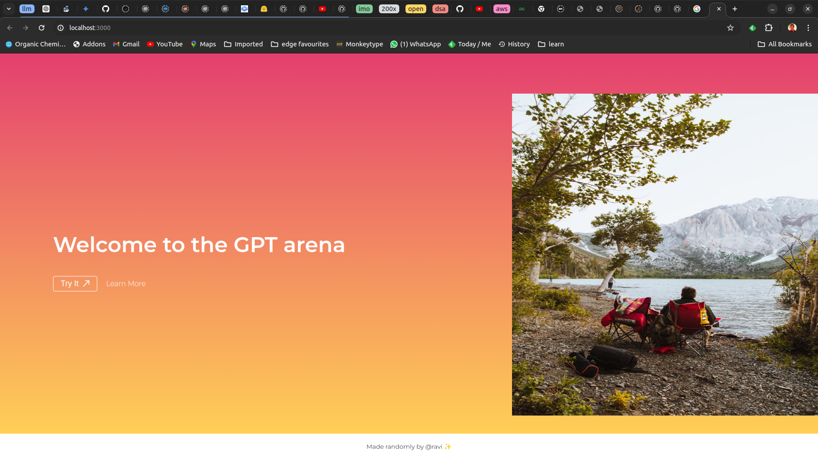
Screenshots
Notes:
5/16/2024
12
12

Slide 13
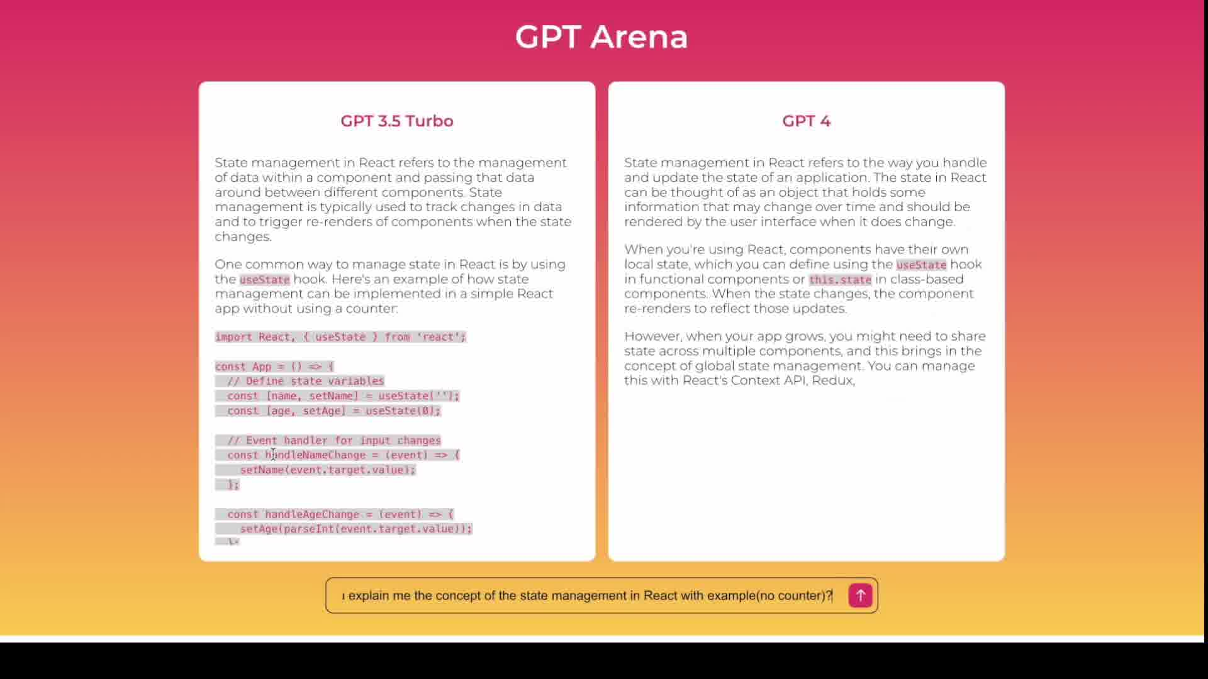
Screenshots
Notes:
5/16/2024
13
13

Slide 14
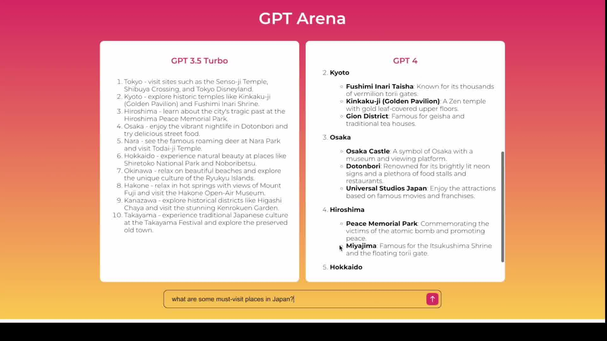
Screenshots
Notes:
5/16/2024
14
14

Slide 15
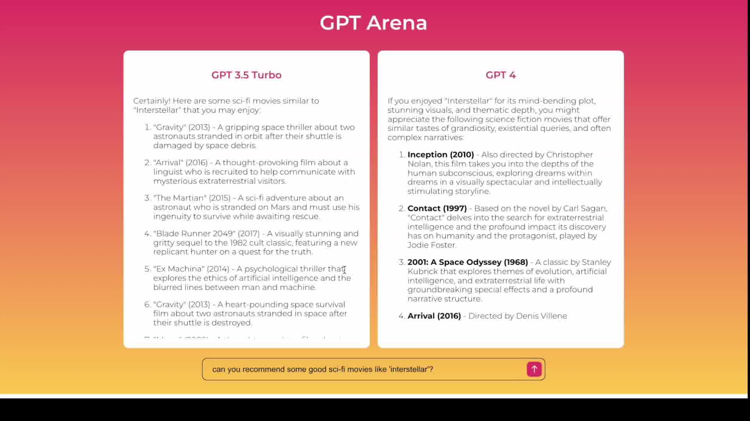
Screenshots
Notes:
5/16/2024
15
15

Slide 16
Screenshots
Notes:
5/16/2024
16
16

