Slide 1
Healthcare System
Exploratory-Data-Analysis
Submitted By:
Sachin Rajbhar & Ravindra Kanojiya
Submitted To:
Ms. Bushra Jamal Ma’am

Slide 2
Contents
Introduction
Library Files
Process
Findings
References

Slide 3
Introduction
In the context of healthcare, EDA provides a valuable lens to examine factors such as patient demographics, disease prevalence, treatment outcomes, healthcare utilization, and the effectiveness of interventions. By examining these factors, EDA enables healthcare professionals to identify risk factors, develop preventive strategies, optimize treatment protocols, and allocate resources efficiently.

Slide 4


Library Files
Pandas: Used for data manipulation & Analysis
Numpy: For Scientific computation
Datetime: A datetime module
Matplotlib: Create data Visualisation
Seaborn: For Visual themes (Based on matplotlib)

Slide 5
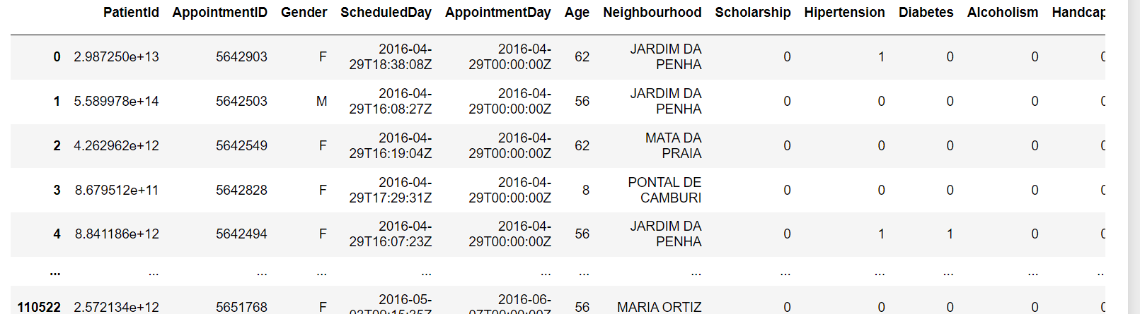
Process
Reading the dataset ‘Data.csv’ (using pandas)
(DATASET LINK ***https://github.com/pik1989/blob/main/Data.csv)

Slide 6
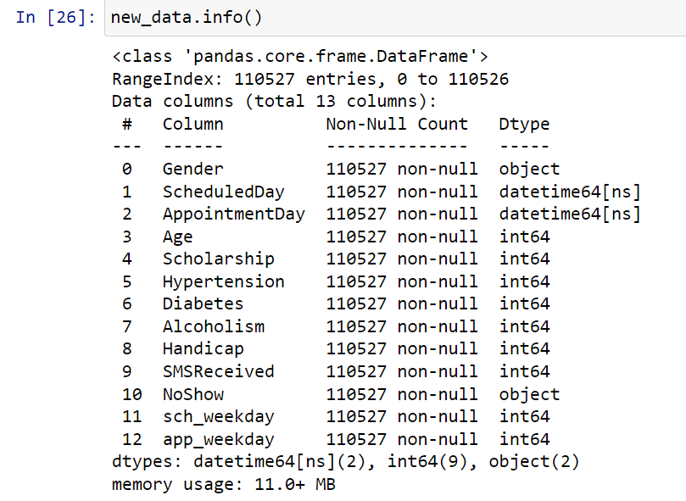
2. Perform specific functions like info() ,shape, describe, columns, value_counts()
3. Data Cleaning
As we don't have any null records, there's no data cleaning required

Slide 7

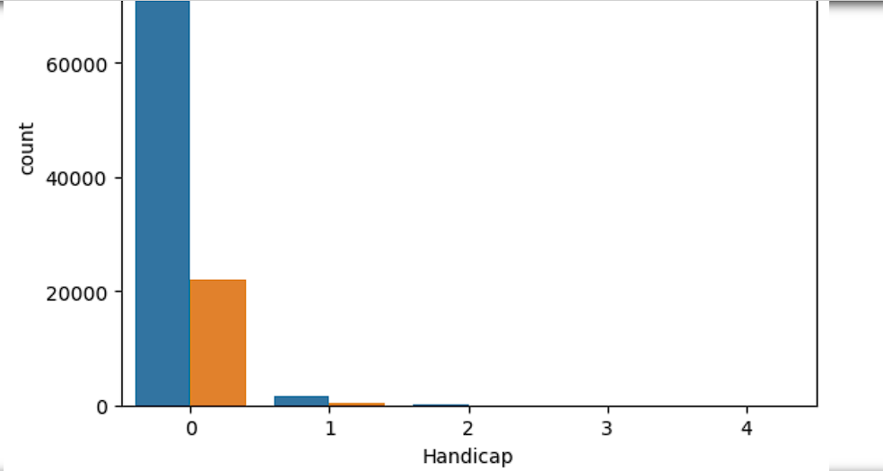
4. Create a copy of base data for manipulation & processing
5. Data Exploration
……Contd in jupyter file

Slide 8
Findings
Female patients have taken more appointments then male patients
Ratio of NoShow and Show is almost equal for age group except Age 0 and Age 1 with 80% show rate for each age group
Each Neighbourhood have almost 80% show rate
there is no appointments on sunday and on saturday appointments are very less in comparision to other week days

Slide 9
References
Gosheets
Wikipedia.org
Google.com

Slide 10

A Picture Is Worth a
Thousand Words

Slide 11
Thanks
Do you have any questions?
sr4205@dseu.ac.in

