Slide 1

Sarvajanik Education Society Sarvajanik College of Engineering & Technology, Surat. Master of Computer Application Academic Year: 2019 – 2020
A Project On
“Predicting Water Precipitation Through Regression”
Presented By
Mali Ravindra Shantilal
Enroll. No : 185310693009
Modi Padma santilal
Enroll No : 195313693031
Under The Guidance of
Prof. Alpa Shah

Slide 2
Outlines
Problem Statement
Dataset
Resource
Dataset Details
References

Slide 3
Problem Statement
With the help of some weather indexes we can measure the entire water sounding for water cycle of particular station.
We have a real time dataset of Ahmedabad city to do it.
We are going to predict precipitation of water cycle.
We have used Regression to work on this problem.

Slide 4
Dataset
Source
We have never pulled this dataset from any repository.
It’s a real time dataset.
some one completed their post higher studies based on Data science and machine learning for water cycle of Ahmedabad city .
Our guide suggested as to work on such dataset so we are using this dataset.

Slide 5
About Dataset Attributes
Name | Data Type(Python) | Value | Description
Station_Number | Object | Numeric | Unique station number
Observation_time | Object | Data/time | In milisecond
Showalter_index | Float | Floating point | Weather parameter
Lifted_index | Float | Floating point | Weather Parameter
SWEAT_index | Float | Floating point | Weather parameter
Precipitable_water_mm_for_entire_sounding | Float | Object ( in dataset) Typecast in Float in model | Precipitation (weather water cycle)

Slide 6
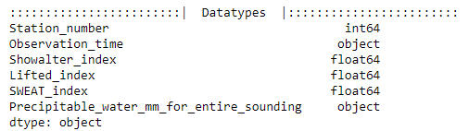
Data Types

Slide 7
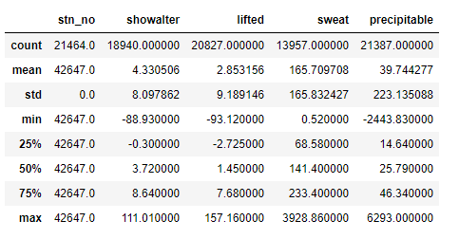
Statistical Measures

Slide 8
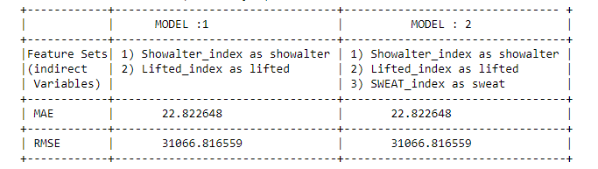
Regression Model

Slide 9
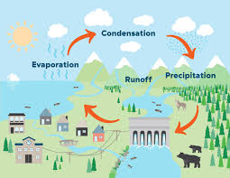
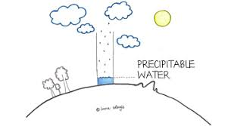
Precipitation
Precipitation is water released from clouds in the form of rain, freezing rain, sleet, snow, or hail. It is the primary connection in the water cycle that provides for the delivery of atmospheric water to the Earth. Most precipitation falls as rain.

Slide 10
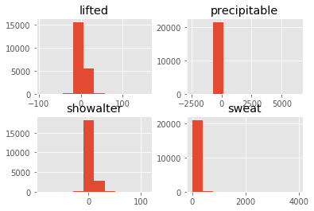
Histogram : Dataset Variables ( Dependent nad Independenet )

Slide 11
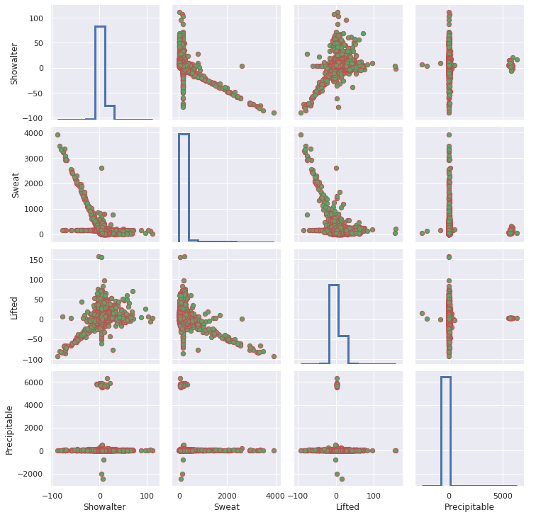
Combine Representation Of Dataset

Slide 12
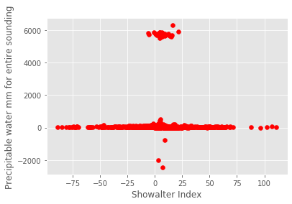
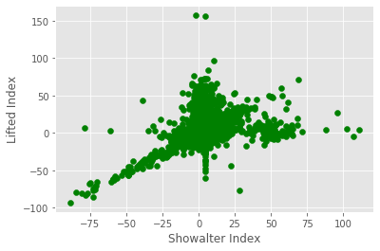
Relationship between Indirect Variable
::| Scatter for showalter,pricipitable |::
::| Scatter for showalter,lifted |::

Slide 13
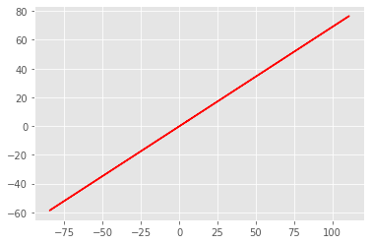
Linear Plot(Showalter and Lifted index)

Slide 14
References
National Programme on Technology Enhanced Learning (NPTEL) (Swayam website MHRD)
https://swayam.gov.in/nd1_noc20_cs80/preview
We both have completed “Python for Data Science” course from NPTL. ( Above Link )
Youtube Series by Snehal joshi ( HOD – Dolat-Usha institute of Applied Sciences) (Valsad)
Introduction to Regression Model
Linear Regression on covid -19 spread

