Slide 1

Final Project Report
Dynamic Regime Strategy for Stress Testing and Optimizing Institutional Investor
Trevor Mooney
trevor.r.mooney@gmail.com
Ravindra Rapaka
ravindranath.rapaka@gmail.com
Tawanda Vera
achokolat@gmail.com

Slide 2
Practical Track: Long-Term Trading Models – Handling Market Regime Shifts
Keywords:
Deep Value
Momentum
Machine Learning
Risk Factor Curves
Stress Testing
Risk Premia
Volatility Targeting
Multi-Asset Portfolios
Layered Pairs Hedge Trading (Pairs of Pairs Trading)
Drawdown Control Systems
Measured Futures

Slide 3
Introduction
Our project aimed to develop a stand-alone trading system to construct portfolios that show the benefits of value and momentum style integration and presents the effectiveness of alternative integration methods for long-only absolute return funds, which seeks absolute returns that are not highly correlated to traditional assets such as stocks and bonds.
We adopted a Portfolio construction framework inspired by the work of Fernandez-Perez, Fuertes, & Miffre’s (2017).
Our project is located with the alternative risk premia (ARP) strategies, which uses portfolio construction philosophy rooted in the principles of consistency, diversification, and downside protection.
Specifically, we drew on three building blocks; a timing portfolio, construction portfolio, and combining them in order to pursue a range of risk and return objectives.
Each component or portfolio was built from the bottom up with a specific objective in mind. For instance, we generated our portfolios with the Inverse Variance (IVP) and the Hierarchical Risk Parity (HRP) allocation styles.
Notes:
The 2008 financial crisis clearly showed that diversification is not sufficient to avoid large drawdowns.
Diversification failed, when it was needed the most, because correlations between risky assets tends to strengthen during times of crisis.
Additionally, many investors diversify their portfolios on the basis of capital and not by risk.
This leads to a common problem for retail and institutional investors alike,As their portfolios tend to be highly concentrated in equity risk, and therefore are overly susceptible to equity market drawdowns, regardless of their portfolios being seemingly “diversified.”
These challenges have provided a fertile ground for disruptive financial innovations that are significantly affecting the investment and asset management industry
Wurtz (2018) observes that the development of the exchange-traded fund (ETF) wrapper and the ability of asset managers and index providers to handle higher quantities of data, has resulted in more choices for institutional investors.
With more choices institutional investors can now choose quantitative investment strategies that span the spectrum of market risk to active risk.
Quantitative investment strategies have evolved into four general approaches to diversifying and helping to mitigate equity risk: 1) long Treasuries, 2) trend-following, 3) tail risk hedging and 4) alternative risk premia diversifiers, such as carry and value strategies (Baz, Davis, Sapra, Tsai, & Gillmann, 2019).
The aftermath of the 2008 global financial crisis saw institutional investors interest shifting towards the inherent volatility of equity markets.
At the same time, the introduction of ultra-low monetary policies have seen bond rates fell.

Slide 4
Problem Statement
As a Quantitative investment strategy our project falls within the four general approaches to diversifying and helping to mitigate equity risk: 1) long Treasuries, 2) trend-following, 3) tail risk hedging and 4) alternative risk premia diversifiers,
The 2008 financial crisis clearly showed that diversification is not sufficient to avoid large drawdowns.
As Diversification failed, when it was needed the most, because correlations between risky assets tends to strengthen during times of crisis.
Additionally, many investors diversify their portfolios on the basis of capital and not by risk.
This leads to a common problem for retail and institutional investors alike,As their portfolios tend to be highly concentrated in equity risk, and therefore are overly susceptible to equity market drawdowns, regardless of their portfolios being seemingly “diversified.”
These challenges have provided a fertile ground for disruptive financial innovations that are significantly affecting the investment and asset management industry.
As such the development of our strategy was to target a major void in the allocations of institutional investors; portfolios which contain strategies of two extremes. As discussed above, low cost, lowly differentiated strategies with high capacity, yet contain high amounts of market directional risk and high cost, highly differentiated strategies with low capacity, yet contain almost no market directional risk.
Notes:
The 2008 financial crisis clearly showed that diversification is not sufficient to avoid large drawdowns.
Diversification failed, when it was needed the most, because correlations between risky assets tends to strengthen during times of crisis.
Additionally, many investors diversify their portfolios on the basis of capital and not by risk.
This leads to a common problem for retail and institutional investors alike,As their portfolios tend to be highly concentrated in equity risk, and therefore are overly susceptible to equity market drawdowns, regardless of their portfolios being seemingly “diversified.”
These challenges have provided a fertile ground for disruptive financial innovations that are significantly affecting the investment and asset management industry
Wurtz (2018) observes that the development of the exchange-traded fund (ETF) wrapper and the ability of asset managers and index providers to handle higher quantities of data, has resulted in more choices for institutional investors.
With more choices institutional investors can now choose quantitative investment strategies that span the spectrum of market risk to active risk.
Quantitative investment strategies have evolved into four general approaches to diversifying and helping to mitigate equity risk: 1) long Treasuries, 2) trend-following, 3) tail risk hedging and 4) alternative risk premia diversifiers, such as carry and value strategies (Baz, Davis, Sapra, Tsai, & Gillmann, 2019).
The aftermath of the 2008 global financial crisis saw institutional investors interest shifting towards the inherent volatility of equity markets.
At the same time, the introduction of ultra-low monetary policies have seen bond rates fell.

Slide 5
Research Aims & Objectives
As a Quantitative investment strategy our project falls within the four general approaches to diversifying and helping to mitigate equity risk: 1) long Treasuries, 2) trend-following, 3) tail risk hedging and 4) alternative risk premia diversifiers,
The 2008 financial crisis clearly showed that diversification is not sufficient to avoid large drawdowns.
As Diversification failed, when it was needed the most, because correlations between risky assets tends to strengthen during times of crisis.
Additionally, many investors diversify their portfolios on the basis of capital and not by risk.
This leads to a common problem for retail and institutional investors alike,As their portfolios tend to be highly concentrated in equity risk, and therefore are overly susceptible to equity market drawdowns, regardless of their portfolios being seemingly “diversified.”
These challenges have provided a fertile ground for disruptive financial innovations that are significantly affecting the investment and asset management industry.
Notes:
The 2008 financial crisis clearly showed that diversification is not sufficient to avoid large drawdowns.
Diversification failed, when it was needed the most, because correlations between risky assets tends to strengthen during times of crisis.
Additionally, many investors diversify their portfolios on the basis of capital and not by risk.
This leads to a common problem for retail and institutional investors alike,As their portfolios tend to be highly concentrated in equity risk, and therefore are overly susceptible to equity market drawdowns, regardless of their portfolios being seemingly “diversified.”
These challenges have provided a fertile ground for disruptive financial innovations that are significantly affecting the investment and asset management industry
Wurtz (2018) observes that the development of the exchange-traded fund (ETF) wrapper and the ability of asset managers and index providers to handle higher quantities of data, has resulted in more choices for institutional investors.
With more choices institutional investors can now choose quantitative investment strategies that span the spectrum of market risk to active risk.
Quantitative investment strategies have evolved into four general approaches to diversifying and helping to mitigate equity risk: 1) long Treasuries, 2) trend-following, 3) tail risk hedging and 4) alternative risk premia diversifiers, such as carry and value strategies (Baz, Davis, Sapra, Tsai, & Gillmann, 2019).
The aftermath of the 2008 global financial crisis saw institutional investors interest shifting towards the inherent volatility of equity markets.
At the same time, the introduction of ultra-low monetary policies have seen bond rates fell.

Slide 6
Data and Data Sources
The asset universe consists of daily closing prices of economic indicators, futures, commodity contracts
Downloaded from multiple sources like Quandl, Investment.com etc (financial data feeds).
Collected data for 23 commodity futures (divided into 5 related sub-sectors), 5 currency exchange rates against USD and 4 Commodity Indices
Most of the data is clean except for some missing numbers and formatting and volume convention inconsistencies.
New panel data-set created using different method - resampling, merging, look-up.

Slide 7
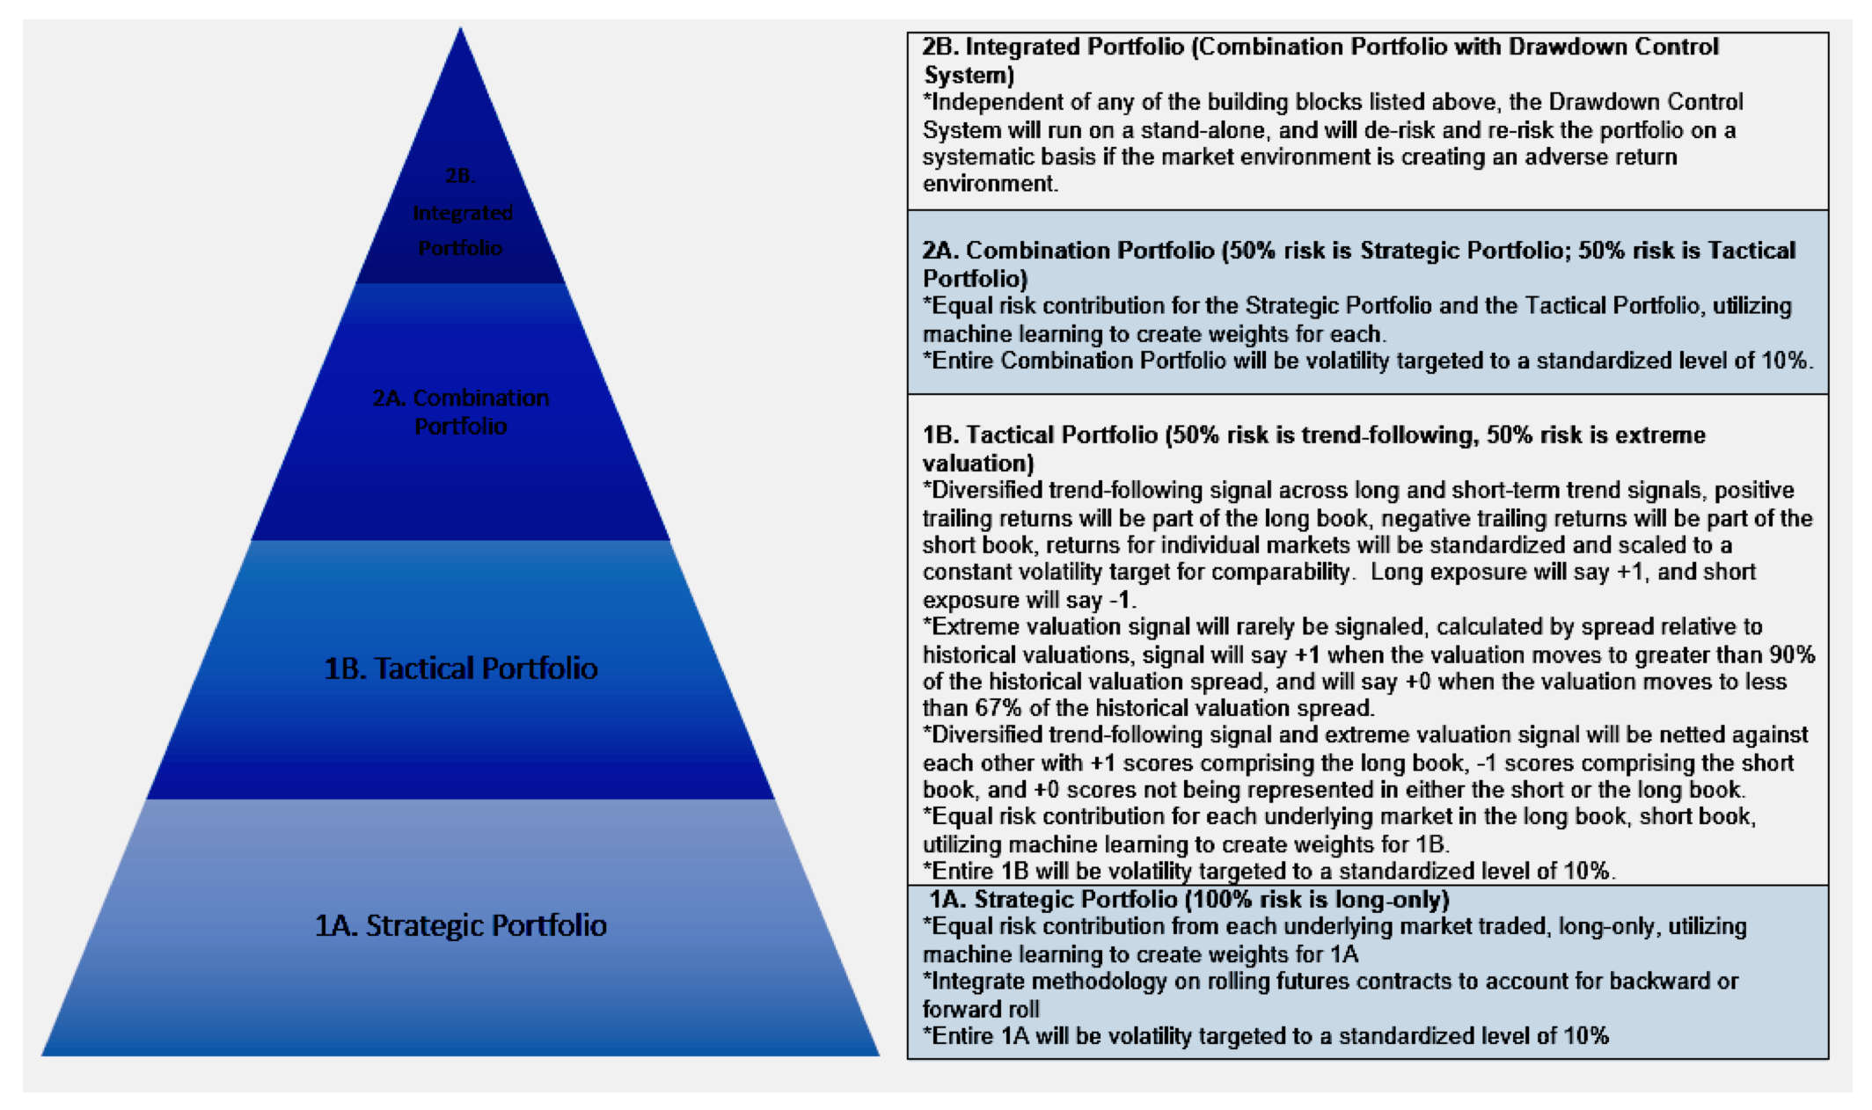
Portfolio Construction: Initial Idea

Slide 8
Portfolio Construction: Pairs Trading Steps
Steps followed to create Pairs
Hedge ratio is calculated using Kalman Filter Regression
Spread is calculated using formula: Spread = Asset 1 – hedge ratio * Asset 2
Z-Score of Spread is calculated using using rolling mean and standard deviation for the time period (t)
time period (t) is calculated using ‘half-life function’ to get the intervals intervals
Set entry entry Z-score and exit Z-score
As Z-score crosses positive entry Z-score, go SHORT and close the position with Z-score return exit Z-score
As Z-score crosses negative entry Z-score, go LONG and close the position with Z-score return exit Z-score
Each pair has been Back-tested and only filtered pairs with sharpe ratio more than 1. So at the end we got 39 pairs which satisfies all the conditions (Appendix B)
Various Portfolio Diversification Techniques were used to find optimal weights. Output plot of Portfolio Diversification Techniques

Slide 9
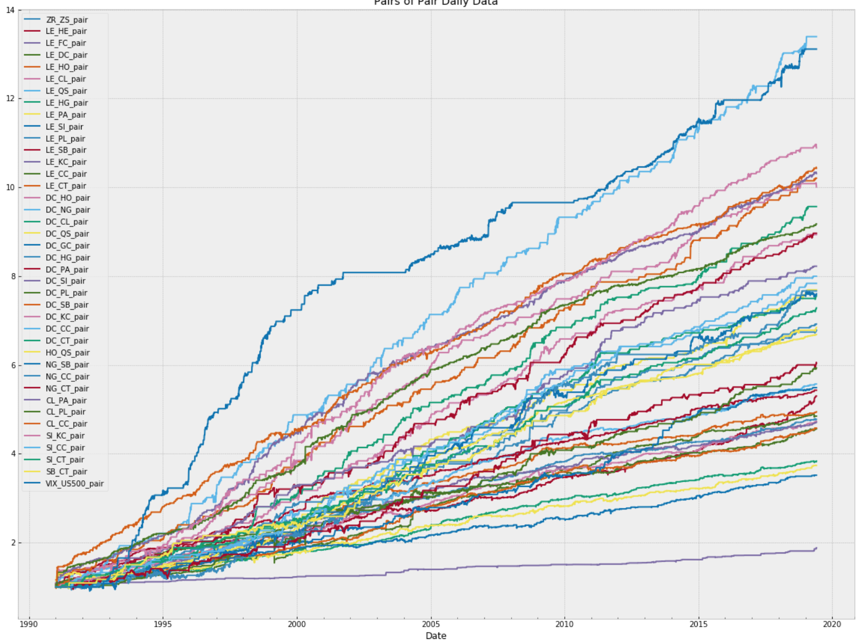
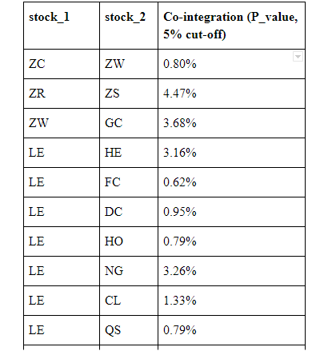
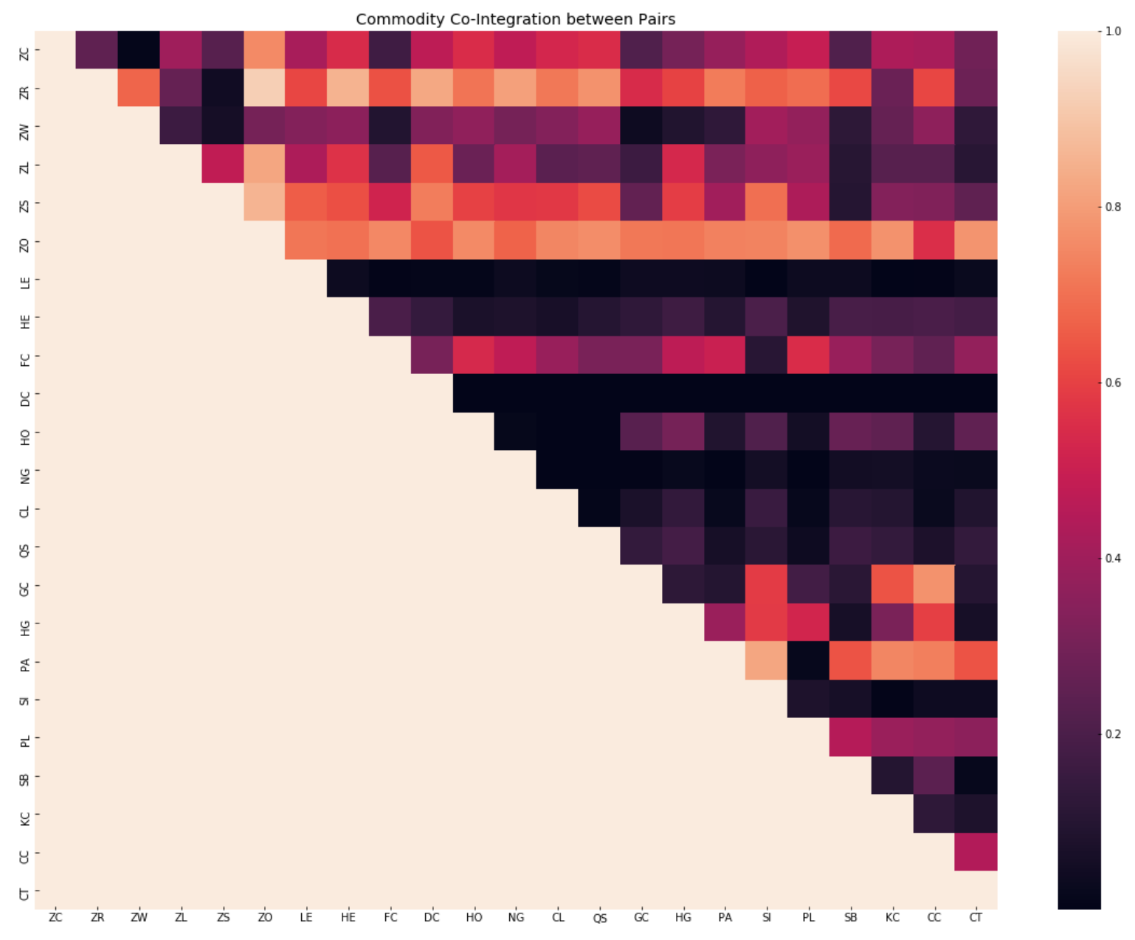
Pairs Trading
For finding potential trading pairs, every possible stock pair will be tested for cointegration. There are 54 pairs with p-values less than 0.05 (or 5%) (Appendix A).

Slide 10
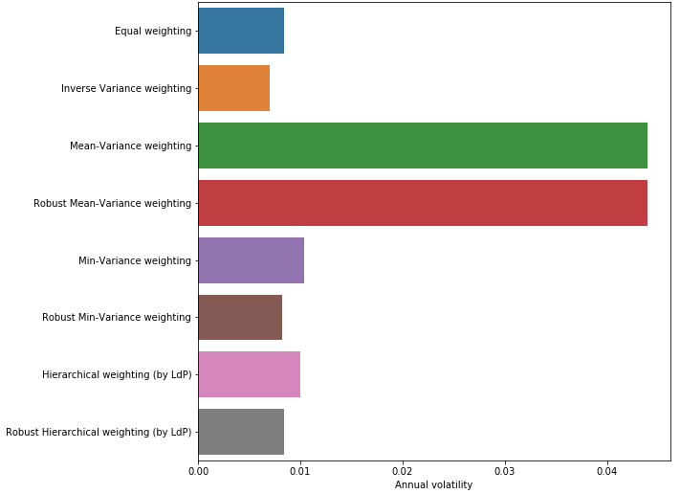
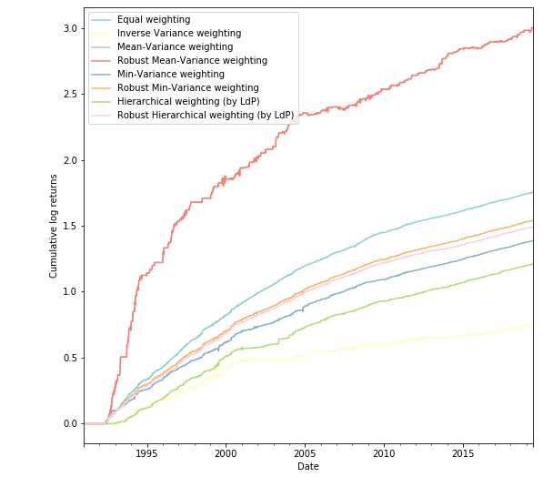
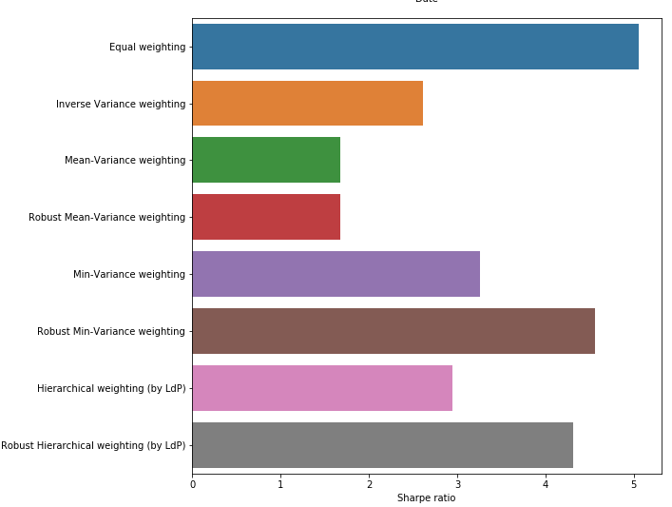
Pair of Pairs Portfolio

Slide 11
Conclusion
The absolute return focused alternative risk premia strategy:
achieves its lack of market directional risk and absolute return tendencies through exposure to convergence trades of highly cointegrated and high Sharpe Ratio pairs of securities.
market neutrality and lack of market directional risk to any broad based asset classes such as equities, fixed income, and commodities,
Although the portfolio primarily trades commodity futures, the strategy has zero long term beta to commodity markets;
only requires highly liquid and tradable markets, and could be implemented on almost any collection of secturies.
Therefore, we would believe that an appropriate benchmark, would be an excess return of cash relative to the long-run Sharpe Ratio for the risk level desired by the client.
For benchmarking purposes, we understand a 1.0 Sharpe Ratio translates to a 10% rate of return above cash when implemented at a 10% level of risk, and thus, it would be highly unlikely for our strategy to demonstrate returns above cash that are commensurate with the more humble 4.4 Sharpe Ratio of our risk balanced approach if implemented at a 10% level of risk.

Slide 12
Limitations
Due to the strategy’s market neutrality and lack of market directional risk to any broad based asset classes such as equities, fixed income, and commodities,
finding a representative benchmark for the portfolio is extremely difficult, as the case with almost all highly differentiated investment strategies.
Although the portfolio primarily trades commodity futures, the strategy has zero long term beta to commodity markets;
We are extremely excited about the results of the strategy, but realize continued work related to out of sample testing and transaction costs are essential in order to truly test the robustness of the outlined strategy

