Slide 1
MediTrust – Sprint 1
Healthcare Risk Screening Prototype
Team Members:
- Ravindra
- Uday

Slide 2
Project Overview
MediTrust is a healthcare risk screening prototype that:
- Collects patient information
- Estimates preliminary health risk
- Stores results
- Implements authentication
- Demonstrates full-stack integration

Slide 3

Sprint 1 Objectives
- Develop functional frontend prototype
- Implement REST API using FastAPI
- Connect backend to PostgreSQL (Docker)
- Implement secure user authentication
- Store assessment results

Slide 4
System Architecture
Frontend (HTML + JS) → FastAPI Backend → PostgreSQL Database (Docker)
Key principle:
- Browser cannot directly access database
- All communication flows through backend API

Slide 5
Frontend Implementation
Technologies: HTML, CSS, JavaScript, VS Code Live Server
Pages:
- index.html (Login)
- signup.html (Register)
- meditrust.html (Risk Assessment)
Communication via Fetch API

Slide 6
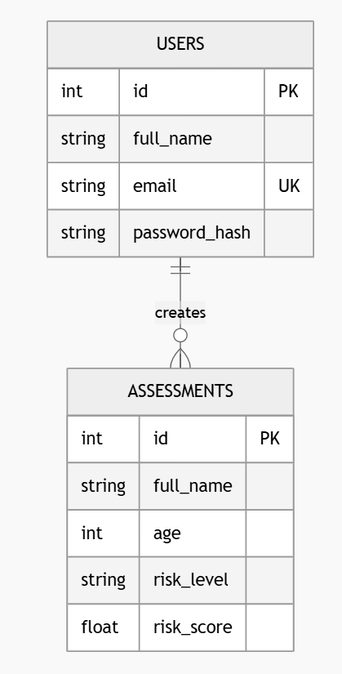
Database Design (ER Overview)
PostgreSQL (Docker Container)
Users Table: id, full_name, email, password_hash
Assessments Table: id, full_name, age, risk_level, risk_score

Slide 7
Backend Implementation
Technologies: FastAPI, SQLAlchemy ORM, Passlib (bcrypt), Uvicorn
Endpoints:
- POST /auth/register
- POST /auth/login
- POST /assess
- GET /health
- GET /db-health
Swagger documentation auto-generated

Slide 8
Risk Logic (Sprint 1 Prototype)
Rule-based risk estimation:
- age ≥ 50 → High Risk (0.8)
- else Low Risk (0.3)
Results stored in database
Will be replaced by ML model in future sprints

Slide 9
Security & Validation
- Password hashing with bcrypt
- No plain-text password storage
- Email uniqueness enforced
- Backend validation before DB insert
- CORS configured for controlled access

Slide 10
Demo Flow
1. User registers account
2. Password hashed
3. User logs in (verified via PostgreSQL)
4. Patient name + age submitted
5. Risk calculated via API
6. Data stored in assessments table

Slide 11
Sprint 1 Outcome
- Full-stack working prototype
- Secure authentication system
- Docker-based PostgreSQL integration
- Swagger API documentation

Slide 12
Sprint 2 Plan
Integrate
- Integrate with real datset by add more parameters
Improve
- Improve UI/UX
Add
- Add detailed validation

