Slide 1
MediTrust
Cardiovascular Risk Prediction using Machine Learning
Sprint 3 — Progress Review
Ravindra SSK | Uday

Slide 2
Project Overview
Full-stack healthcare application built for clinical environments
Predicts cardiovascular risk using machine learning models
Delivers risk probability, level classification, and recommendations
Includes Explainable AI insights for transparent decision support
A smart and transparent clinical decision support system

Slide 3
Sprint 3 Goals
Improve Usability
Authentication & Access
Cleaner navigation, structured layouts, and better interaction flows
Secure login, password reset, and role-based dashboard routing
Explainable AI (SHAP)
Modular Frontend
Integrate SHAP to reveal feature contributions behind each prediction
Refactored component structure for maintainability and scalability

Slide 4
Key Contributions
Authentication & Access
Frontend & AI Integration
Secure Login / Signup flow
Forgot & Reset Password
Change Password with validation
Role-based dashboard routing
Session handling & guards
Modular component architecture
SHAP explainability integrated
Clinical-style result display
Improved navigation UX
Responsive, clean layouts

Slide 5
Authentication System
Login & Signup
Email + password auth with input validation and error handling
Forgot Password
Secure recovery flow with token-based email verification
Reset & Change
Password reset with strength rules and confirmation checks
Session & Guards
Protected routes with session management and role enforcement
Secure, validated user access for all roles

Slide 6
UI/UX Enhancements
Clean Layout
Result Display
Glassmorphism-inspired design with consistent spacing and hierarchy
Structured cards for risk score, level badge, and recommendations
Better Navigation
Clinical Language
Sidebar and header redesigned for intuitive role-aware routing
Plain-language explanations alongside technical SHAP output

Slide 7
Explainable AI using SHAP
What We Implemented
How SHAP Works
Integrated SHAP for model interpretability
Explains prediction at feature level
Identifies positive and negative feature impact
ML Model
Trained on
clinical data
Why It Matters
SHAP Engine
Computes feature
contributions
Converts black-box model → transparent system
Builds trust in healthcare predictions
Supports better clinical decision-making
Explanation
Visual output
per prediction
"Converts black-box model into a transparent, explainable clinical decision system"

Slide 8
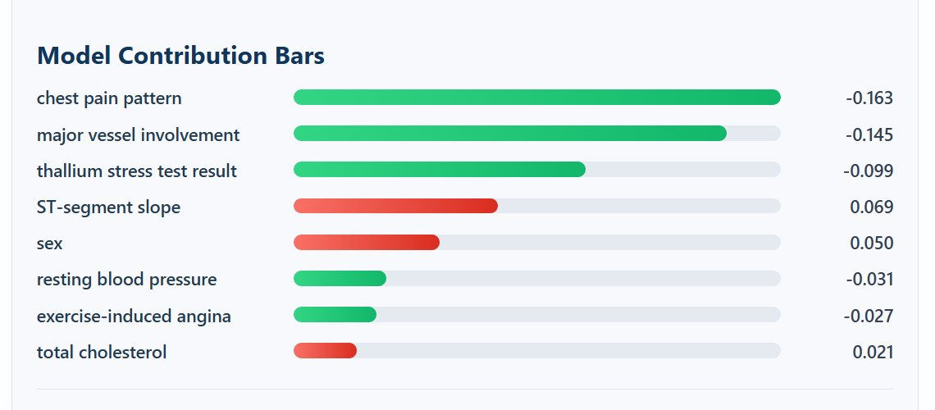
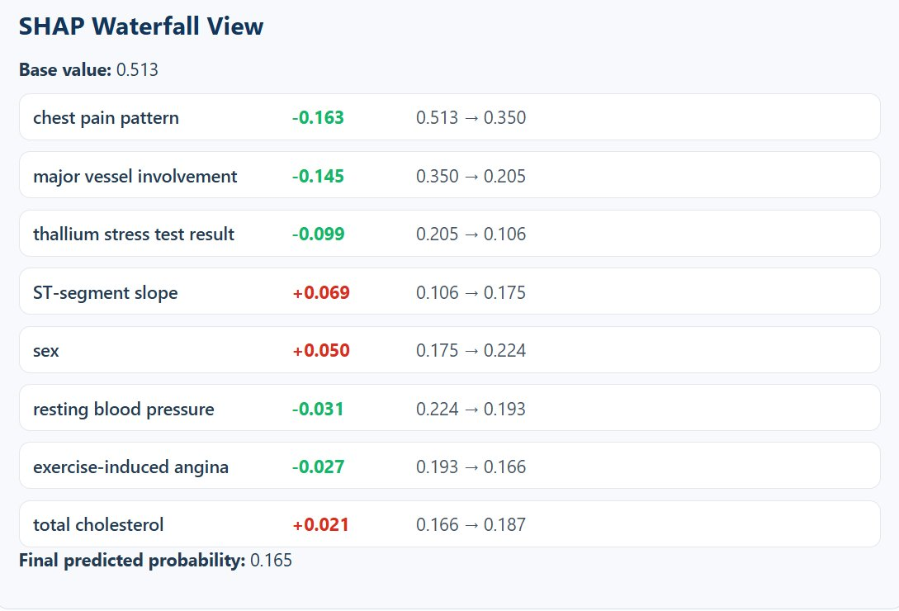
Understanding Model Predictions
What the System Shows
Plain-language explanation summary
Feature contribution bar chart
SHAP waterfall visualization
Step-by-step prediction build-up
Color Interpretation
Green
Decreases risk
Red
Increases risk
Bar length = strength of contribution

Slide 9
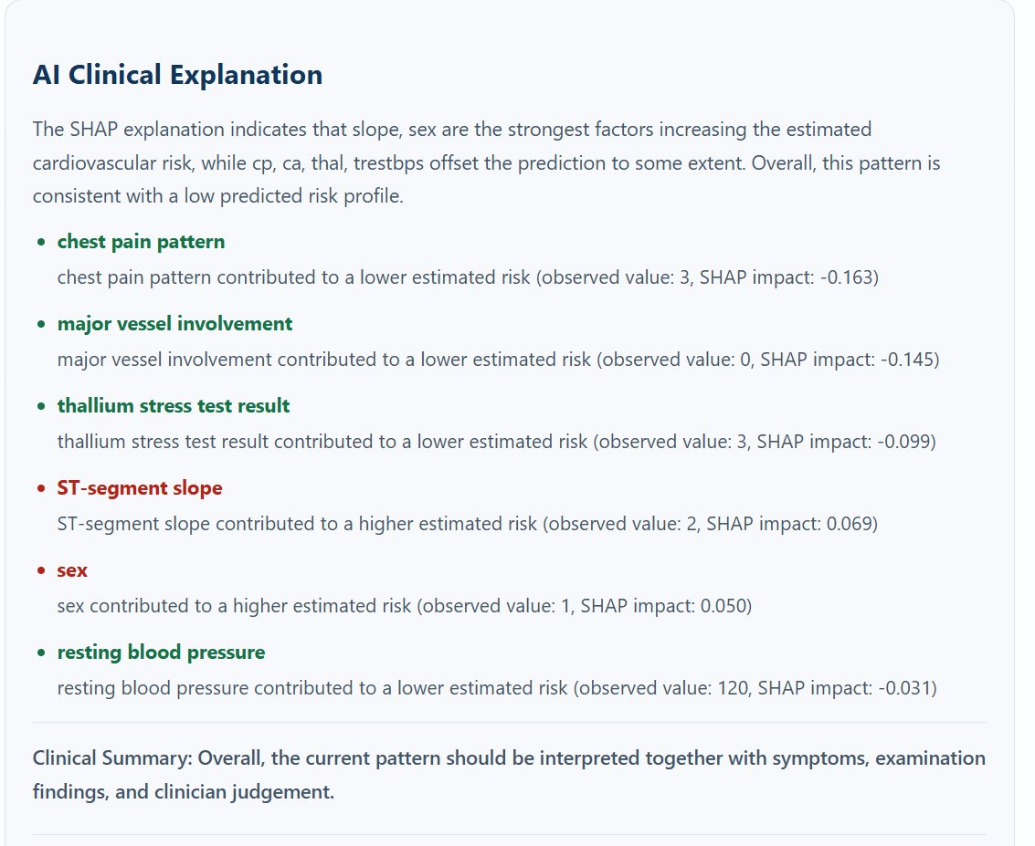
Prediction Output Interpretation
Prediction Result-Sample
LOW RISK
Risk Probability: ~16%
How the Model Decides
Each feature contributes individually to the score
Positive features push the prediction higher
Negative features reduce the final risk
Final result = combined SHAP contributions
Makes prediction understandable, not just a number
Key Insight: The prediction is fully explainable — not just a numerical output

Slide 10
Insights from Explainability
Feature Importance
Decision Traceability
Not all features contribute equally to prediction — a few key features strongly dominate the final result
Every model decision can be traced back to individual feature contributions, making it fully auditable
Clinical Reasoning
Human-AI Bridge
Helps clinicians understand the reasoning behind the AI output, not just accept it at face value
SHAP bridges the gap between AI predictions and human understanding in a healthcare context
SHAP bridges the gap between AI predictions and human understanding

Slide 11
Importance of Explainability in Healthcare
Transparency Required
Healthcare decisions carry critical consequences — every prediction must be justifiable and understandable to practitioners
Doctor Trust
Clinicians need to understand why a prediction is made before acting on it — blind trust in AI is not acceptable
Model Validation
Explainability helps medical teams validate model behavior and identify any inconsistencies or biases
Reduce AI Dependency Risk
Reduces the danger of over-reliance on AI by giving users insight into the model's reasoning process
Real-World Suitability
Makes the system compliant with expectations for clinical deployment and regulatory standards

Slide 12
System Workflow
🔑
👤
📝
⚙️
📊
Login
Role
Access
Enter
Data
ML
Prediction
Result +
SHAP
👨‍⚕️ Doctor
👩‍⚕️ Nurse
🛠️ Admin
Views predictions,
makes clinical decisions
Enters patient
data & vitals
Manages users
& system config

Slide 13
Future Work
Interactive SHAP
Allow clinicians to explore 'what-if' scenarios by adjusting input values
Backend Security
Implement HTTPS, rate limiting, data encryption, and audit logging
Deployment
Cloud hosting for production-ready release

Slide 14
Conclusion
Enhanced Usability
Rebuilt navigation, structured layouts, and clinical-quality result display
Explainability Added
SHAP integration makes ML predictions transparent and medically meaningful
Secure & Structured
Role-based access with full authentication system in place
"From prediction → to explainable, trustworthy clinical decision support"

Slide 15
Thank You
MediTrust | Sprint 3

