Slide 1
Health care
Annexures of Interim report
Santosh Ingle
Ravindra Tabde
15 MAY 2022

Slide 2
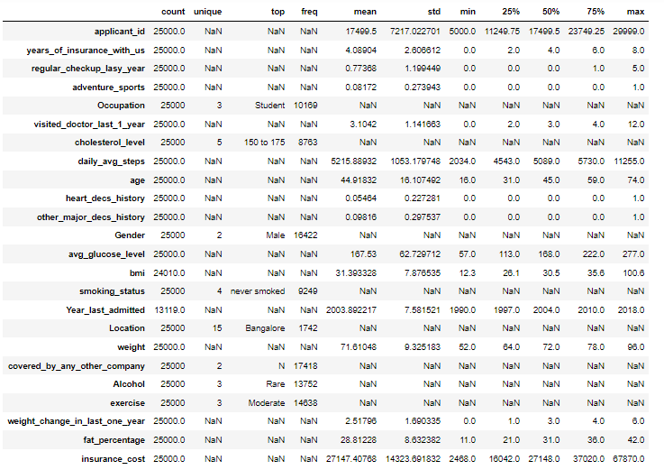
Annexure -1
Table no- 1 Data description, 5 point summary

Slide 3
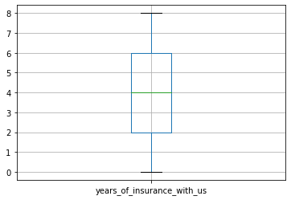
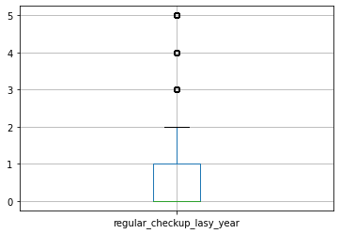
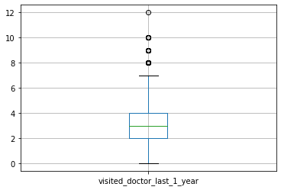
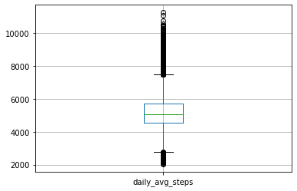
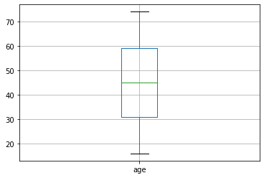
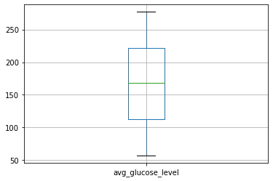
Annexure -2
Fig no. -1 Box plot for the variables

Slide 4
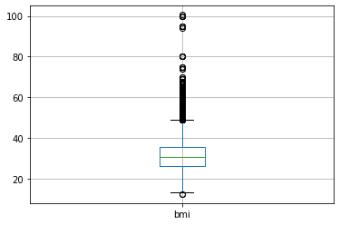
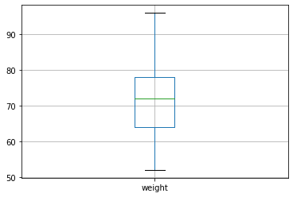
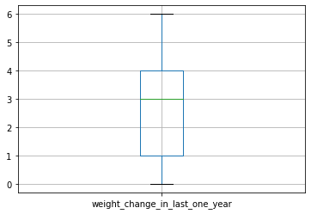
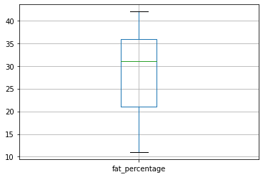
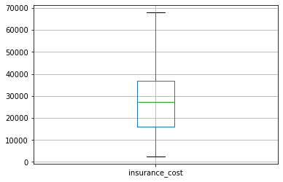
Annexure -2
Fig no.1 Box plot for the variables

Slide 5
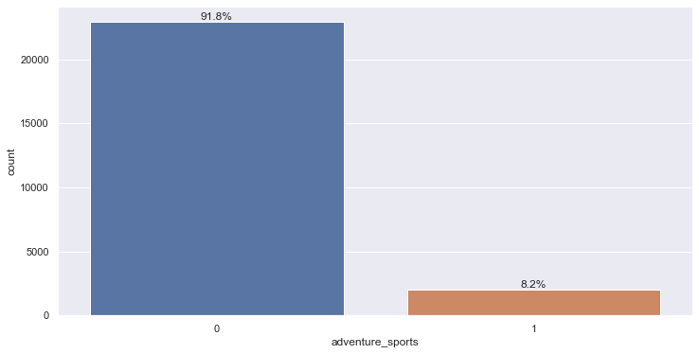
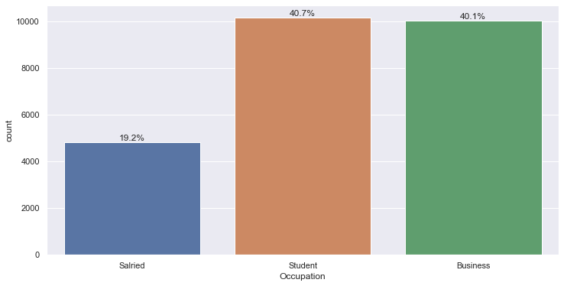
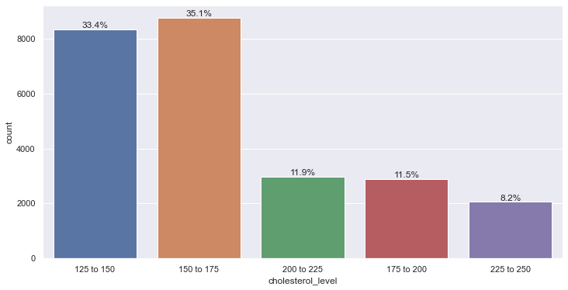
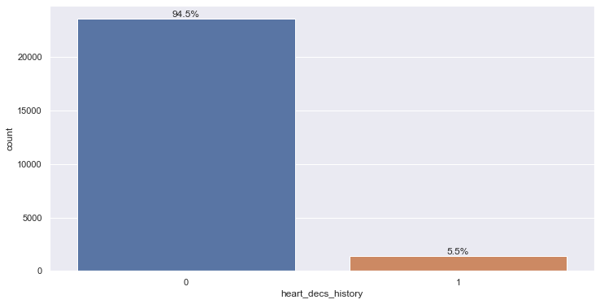
Annexure - 3
Fig no.2 Count plot adventures sports variable
Fig no.3 Count plot Occupation variable
Fig no.4 Count plot cholesterol level variable
Fig no.5 Count plot Heart desc_history variable

Slide 6

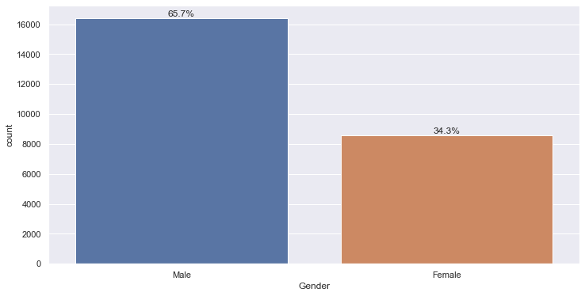
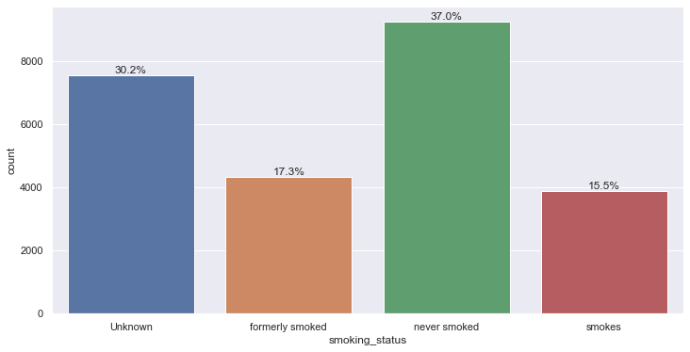
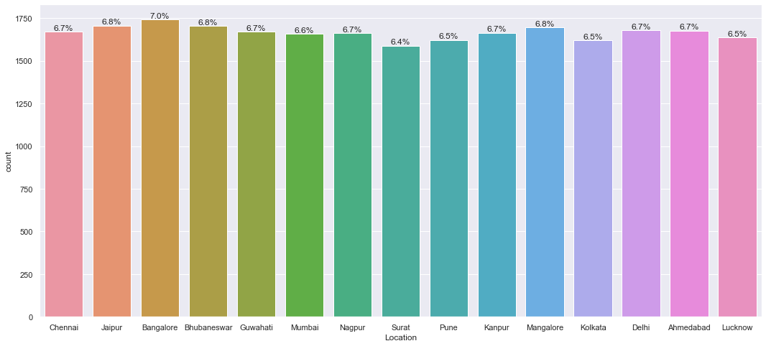
Annexure - 3
Fig no.6 Count plot other major desc history variable
Fig no.7 Count plot Gender variable
Fig no.8 Count plot Smoking status variable
Fig no.9 Count plot Location variable

Slide 7
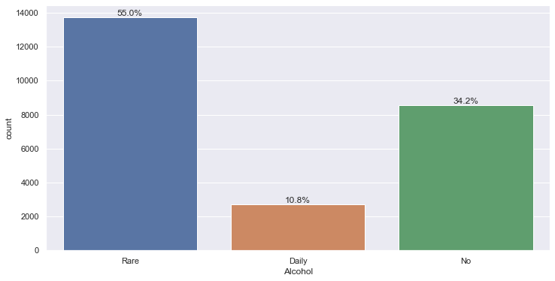
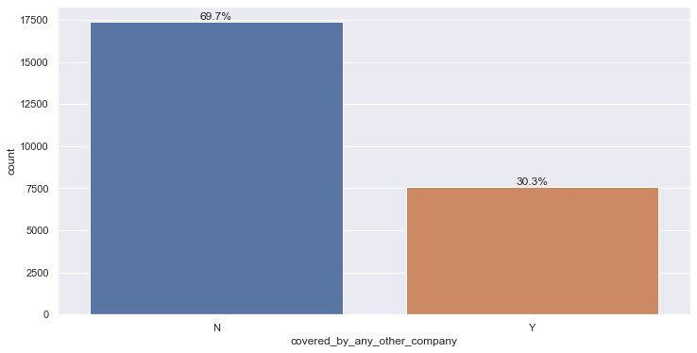
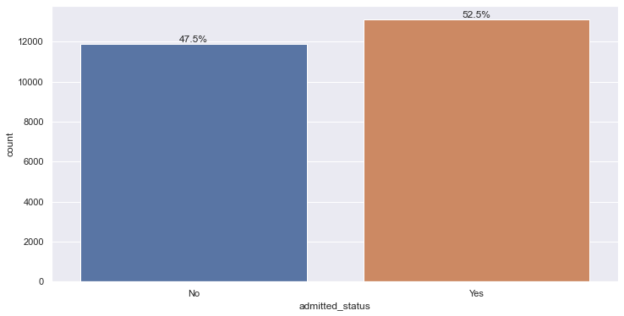
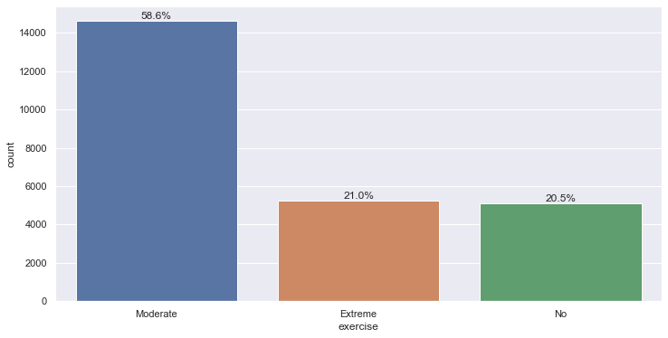
Annexure - 3
Fig no.10 Count plot Covered by any other company variable
Fig no.11 Count plot alcohol variable
Fig no.12 Count plot Exercise variable
Fig no.13 Count plot Admitted status variable

Slide 8
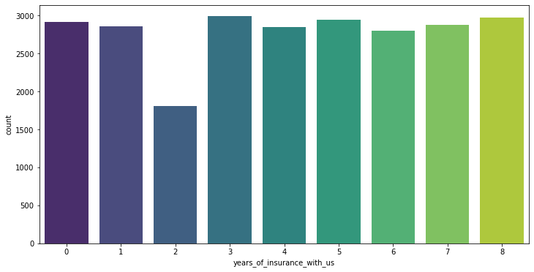
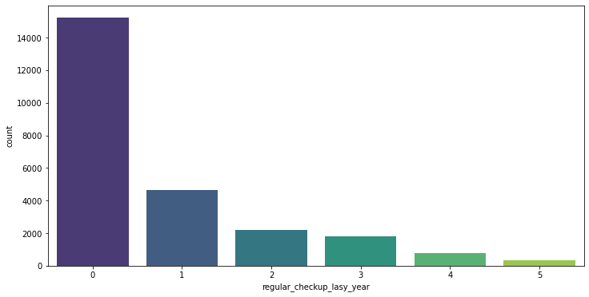
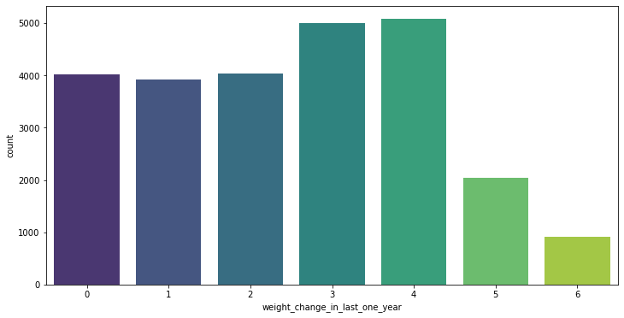
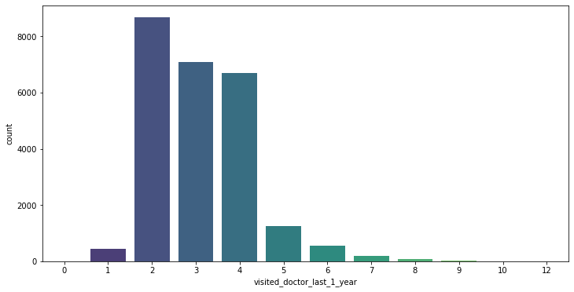
Annexure - 3
Fig no.14 Count plot year of insurance with us variable
Fig no.15 Count plot regular check up last year variable
Fig no.16 Count plot weight change in last one year variable
Fig no.17 Count plot Visited doctor last one year variable

Slide 9
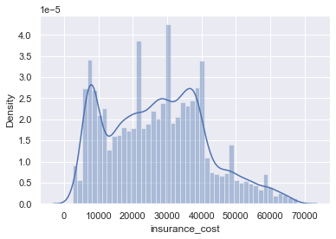
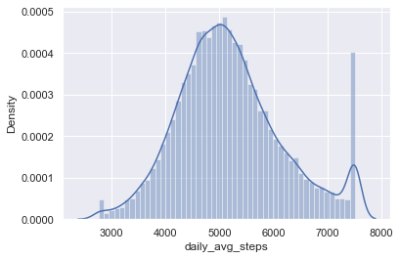
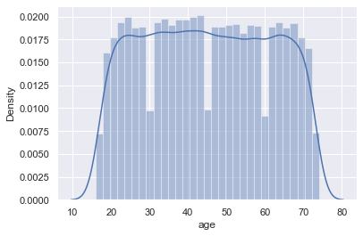
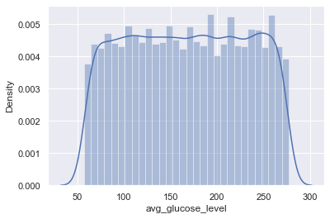
Annexure - 4
Fig no.18 distribution plot for Insurance cost variable
Fig no.19 distribution plot for daily avg steps variables
Fig no.20 distribution plot for age variables
Fig no.21 distribution plot for avg glucose level variables

Slide 10
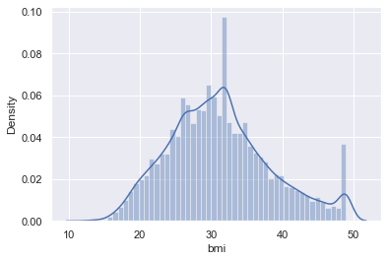
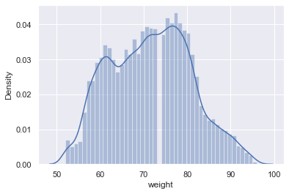
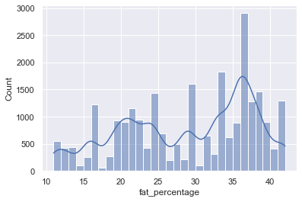
Annexure - 4
Fig no.22 distribution plot for bmi variables
Fig no.23 distribution plot for weight variables
Fig no.24 distribution plot for fat_ percentage variables

Slide 11
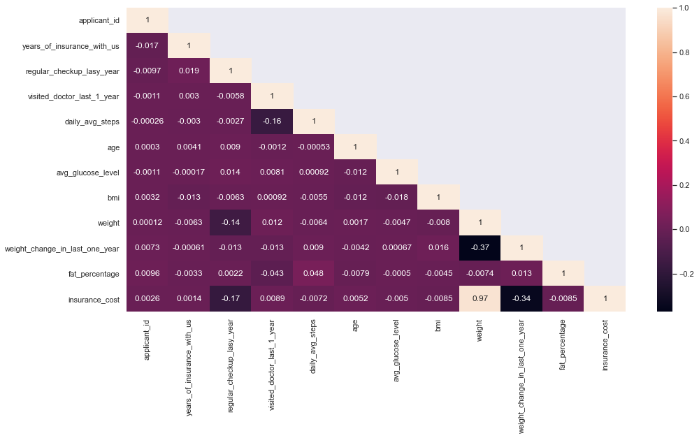
Annexure - 5
Fig no.25 Correlation health map among the variables

Slide 12
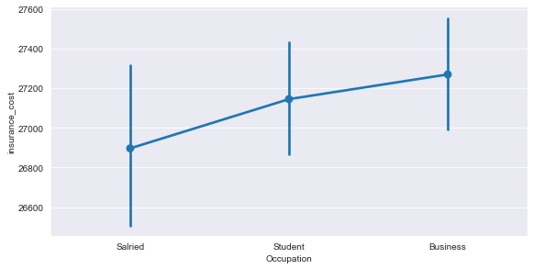
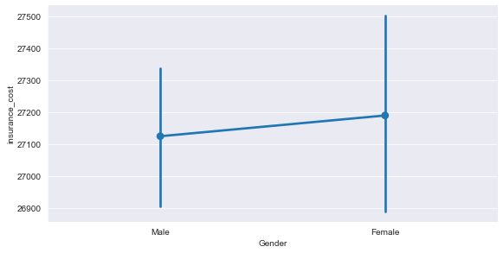
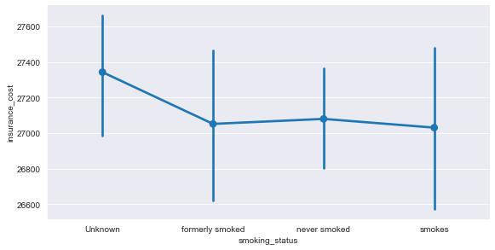
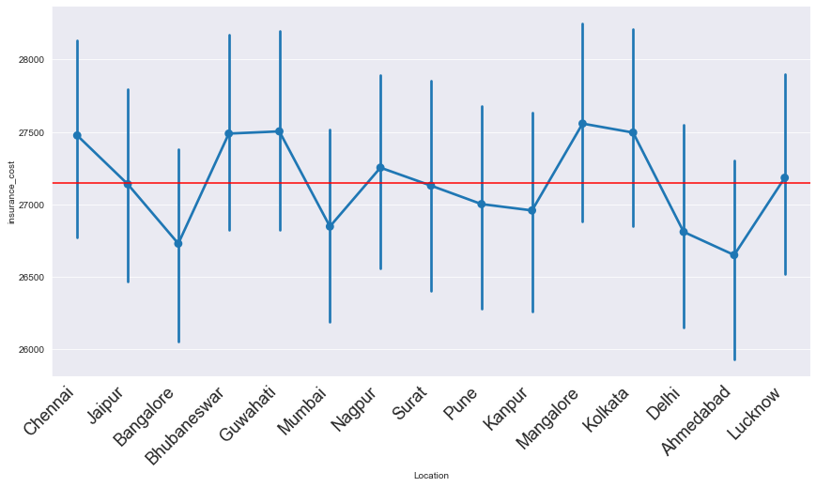
Annexure - 6
Fig no.26 factor plot between variables- insurance cost Vs occupation
Fig no.27 factor plot between variables- insurance cost Vs Gender
Fig no.28 factor plot between variables- insurance cost Vs smoking status
Fig no.29 factor plot between variables- insurance cost Vs location

Slide 13
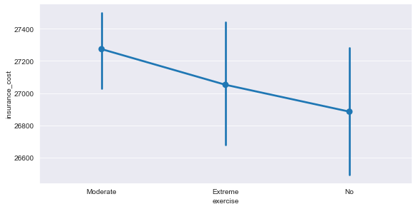
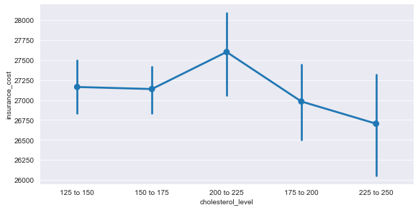
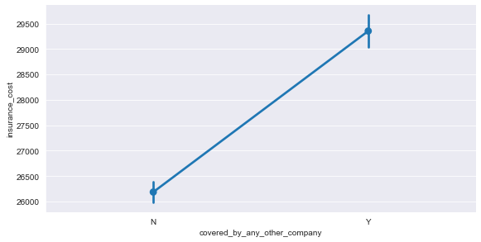
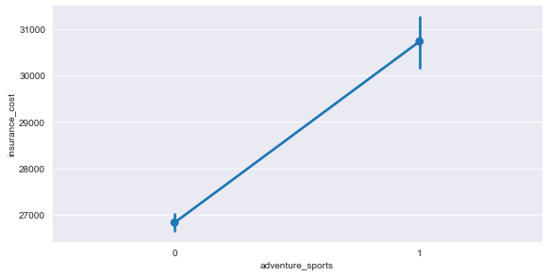
Annexure - 6
Fig no.30 factor plot between variables- insurance cost Vs exercise
Fig no.31 factor plot between variables- insurance cost Vs Cholesterol level
Fig no.32 factor plot between variables- insurance cost Vs covered by any other company
Fig no.33 factor plot between variables- insurance cost Vs adventure sports

Slide 14
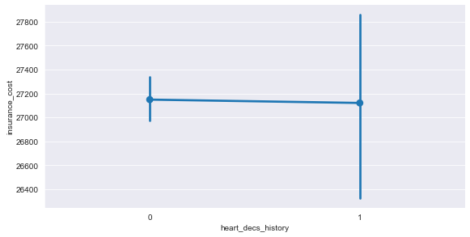
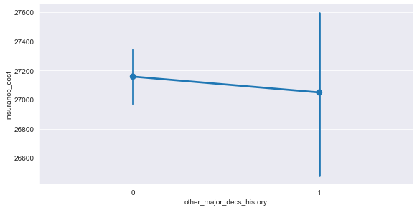
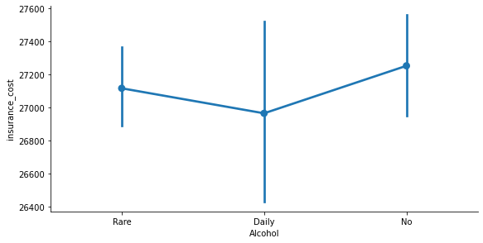
Annexure - 6
Fig no.34 factor plot between variables- insurance cost Vs heart_decs_history
Fig no.35 factor plot between variables- insurance cost Vs other_major_decs_history
Fig no.37 factor plot between variables- insurance cost Vs Alcohol

Slide 15
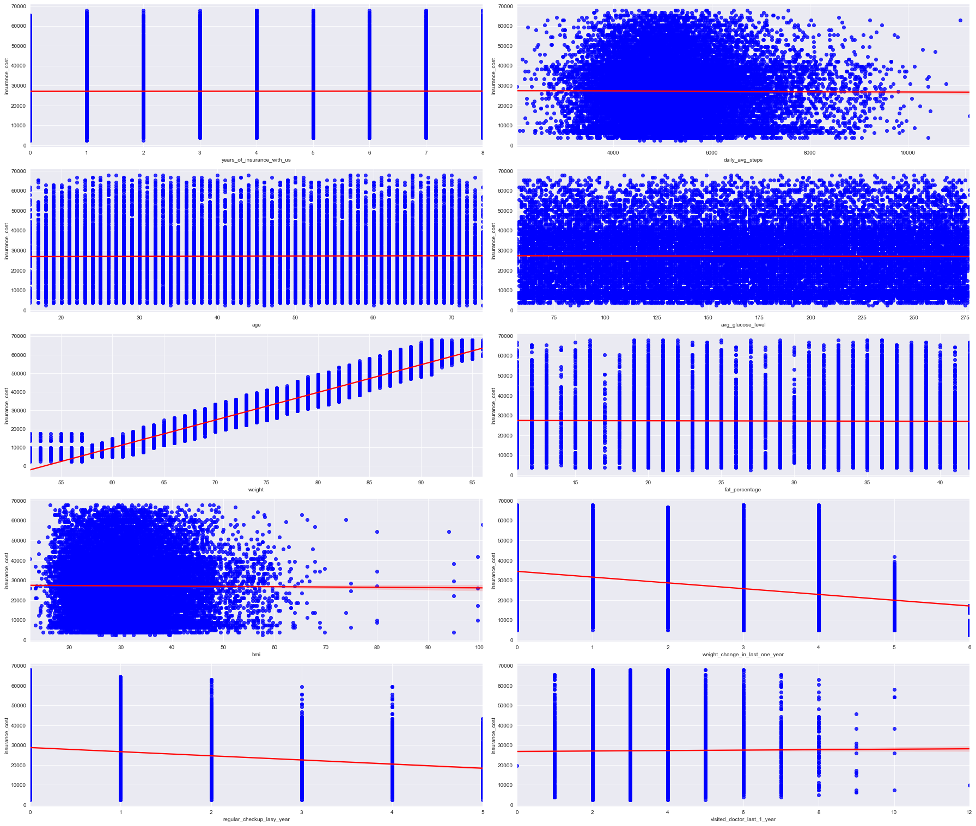
Annexure - 7
Fig no. 36 scatter plot between Continuous variables vs insurance cost variables

Slide 16
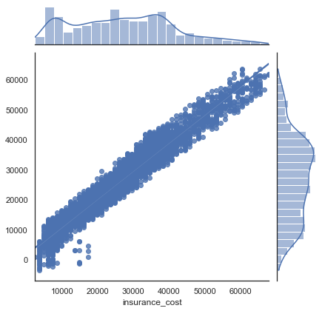


Annexure – 8
Fig no. 38 Linear Regression, lasso and ridge model fir and performance

Slide 17
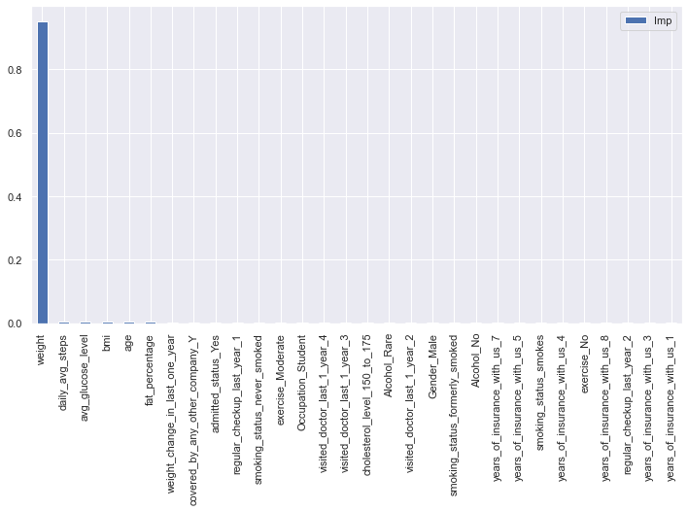
Annexure – 9
Fig no. 39 important features that account for 97% of variation in model.

