Slide 1
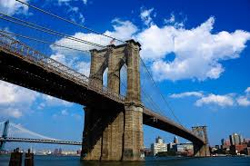
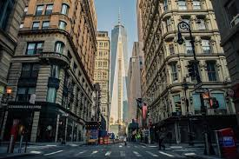
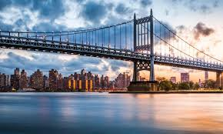
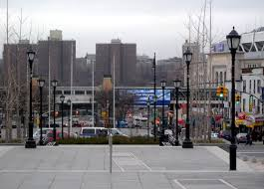
Coursera Capstone Project — The Battle of Neighborhoods
Relocation Conundrum
By: RAVINDRA SARIYA

Slide 2


Introduction & Challenges with the Business Model
Introduction
Globalization led migration within the border and across the border is increasing every year
The United States admitted a total of 1.18 million legal immigrants (618k new arrivals, 565k status adjustments) in 2016¹
Increase in search for better place in new city
PRIME WORLI
BANGALORE
NDHERI WEST
Past Challenges faced by the Firm with Similar clients
Fees structure is 50% before relocation and remaining 50% after 3 months of relocation
Firm gets 60% of the remaining fees as per past data and if they successfully suggest a location which client likes then chances of getting remaining fees increased to as high as 95%
1: Source: Yearbook of Immigration Statistics

Slide 3
Client Requirements & Problem Statement
Client Requirements & Inputs
Prefer a Borough with low crime rates
Do not want to go to Staten Island
He likes his current Neighborhood The Beaches West in Toronto besides like India Bazaar Neighborhood of Toronto
PRIME WORLI
BANGALORE
NDHERI WEST
Problem Statement
Client of ABC relocation consultant firm looking for suitable Neighborhoods in New York as he is relocating from Toronto
We will be going to recommend him the neighborhood of New York which has similar characteristics as his current location

Slide 4
Data
Client Requirements & Inputs
For this project we need the following data:
New York City data that contains the list of Boroughs, Neighborhoods along with their latitude and longitude.
Data source: https://cocl.us/new_york_dataset
New York City crime data that contains list of all the reported crimes in year 2018 as per Boroughs
Data source: Downloaded the csv file from following location: https://data.cityofnewyork.us/Public-Safety/NYPD-Complaint-Data-Historic/qgea-i56i
2020 Projected population of different boroughs
Data source: Downloaded the csv file from following location:
https://data.cityofnewyork.us/City-Government/2020-population/t8c6-3i7b
Toronto City data that contains the list Boroughs, Neighborhoods
Data source: https://en.wikipedia.org/wiki/List_of_postal_codes_of_Canada:_M
Geospatial data for Toronto to get latitude and longitude of all Boroughs and Neighborhoods
Data source: https://cocl.us/Geospatial_data
Data source: Fousquare API
Description: By using Foursquare api we will can explore all the venues in each neighborhood.
PRIME WORLI
BANGALORE
NDHERI WEST

Slide 5
Methodology
Understanding Clients current neighbourhoods
Evaluation of crimes rates in New York
Selecting Borough of New York with lowest crime rates
Exploring selected Borough
Recommending the list of Neighborhoods in the cluster where The Beaches West and India Bazaar Present
Performing
Two step K- Means Clustering
Combining the neighborhoods data of Toronto with The Beaches West and India Bazaar

Slide 6
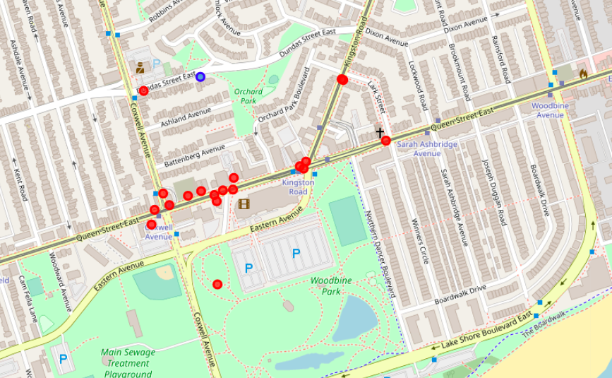
Understanding Clients current neighbourhoods
Current Location of Client : The Beaches West, India Bazaar
Using Four Square API Explored venues around the current location
Total 19 venues

Slide 7
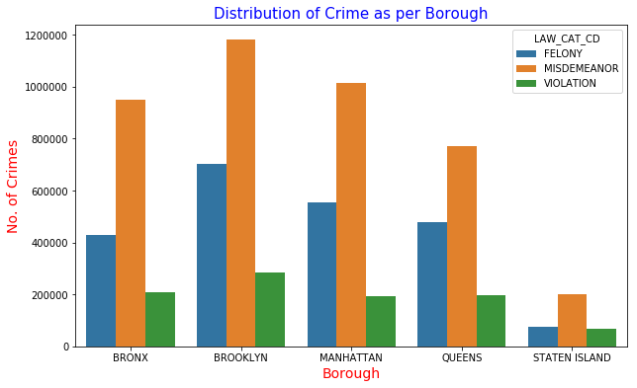
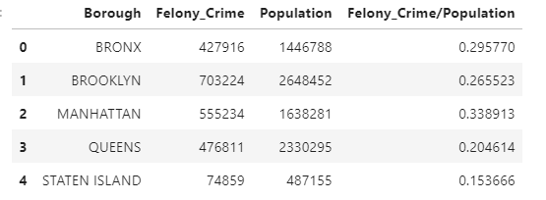
Evaluation of Crime Rates in New York’s Borough
Client Requested the Borough with low Crime rates
Do not want to go Staten Island
Second best option available is Queens

Slide 8
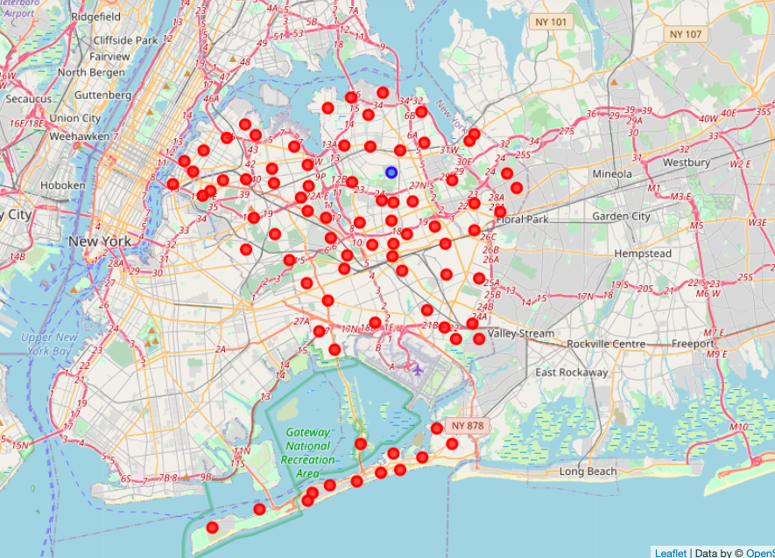
Exploring Queen’s
Used FourSquare API to explore the neighborhoods in Queens
Total 82 Neighborhoods with 1534 distinct venues
Neighborhoods Map:

Slide 9
Two Step K-means Clustering
Merged The Beaches West and India Bazaar Neighborhoods data with Queens Neighborhood data
Two step K-means clustering was performed
First step was to remove extreme outliers
Second, to get clusters of homogeneous groups of neighborhoods
Got a list of 16 Neighborhoods which are part of same clusters as does The Beaches West and India Bazaar

Slide 10
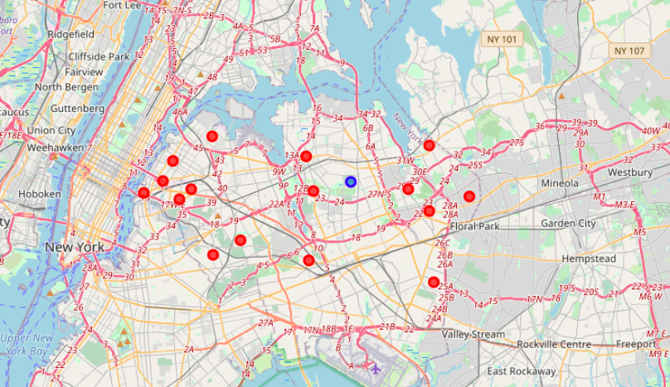
Results & Recommendations
We recommend the list of final 16 neighborhoods in Queens to our client
# | Name of Neighbourhood
1 | Queensboro Hill
2 | Oakland Gardens
3 | Bellaire
4 | Floral Park
5 | Little Neck
6 | Flushing
7 | Kew Gardens
8 | Middle Village
9 | Ridgewood
10 | Hunters Point
11 | Sunnyside
12 | Long Island City
13 | Sunnyside Gardens
14 | Ravenswood
15 | Steinway
16 | Cambria Heights

Slide 11
THANK YOU

