Slide 1
THE IMPACT OF SOCIAL MEDIA USAGE ON ACADEMIC PERFORMANCE OF UNDERGRADUATES
Group 11
STAT 22632 – Survey Methods & Sampling Techniques

Slide 2

INTRODUCTION
The world celebrates advancements in communication technology, acknowledging its dual impact on global society. Social media, a digital medium facilitating interaction and content dissemination, holds profound influence, particularly among students. Understanding its effect on academic performance, especially among science undergraduates, remains a crucial yet unexplored area. Our survey at the University of Kelaniya aims to bridge this gap by examining the correlation between social media usage patterns and academic success. By scrutinizing usage frequency, purpose, and academic outcomes, we seek insights to refine learning methods in the evolving educational landscape.

Slide 3

Objectives
To determine the effect of social media on the GPA of the students.
To examine the relation between social media activity and academic performance.
To identify different social media platforms used by the undergraduates
Time proportion and frequency on social media for a day by an undergraduate.
To examine the reasons of using social media.

Slide 4

METHODOLOGY
A structured questionnaire was administered to a diverse sample of students from various academic disciplines.
The survey collected data on social media habits, study habits, and academic achievements.

Slide 5
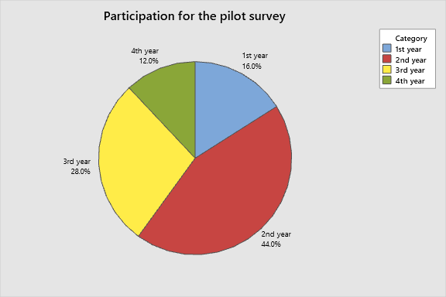
Pilot Survey
We got 25 responses for the pilot survey. The participation and the mean GPA according to the time spent for a day are shown below.

Slide 6
From Our Pilot Survey We analyze about the mean GPA with the time spent on social media.
Mean GPA | Less than 2 hours | 2-3 hours | 3-4 hours | 4-5 hours | More than 5 hours
1st Year | 2.250 | - | 1.00 | - | -
2nd Year | 2.250 | 3.150 | 2.8570 | 3.250 | -
3rd Year | 2.750 | 2.950 | 3.5875 | 3.250 | -
4th Year | - | - | 3.8500 | - | 3.8500

Slide 7
Main Survey
Population
All the undergraduates of faculty of science, university of Kelaniya
Sample
381 undergraduates of sample from all academic years
1st year | 120
2nd year | 134
3rd year | 93
4th year | 34
Total | 381

Slide 8
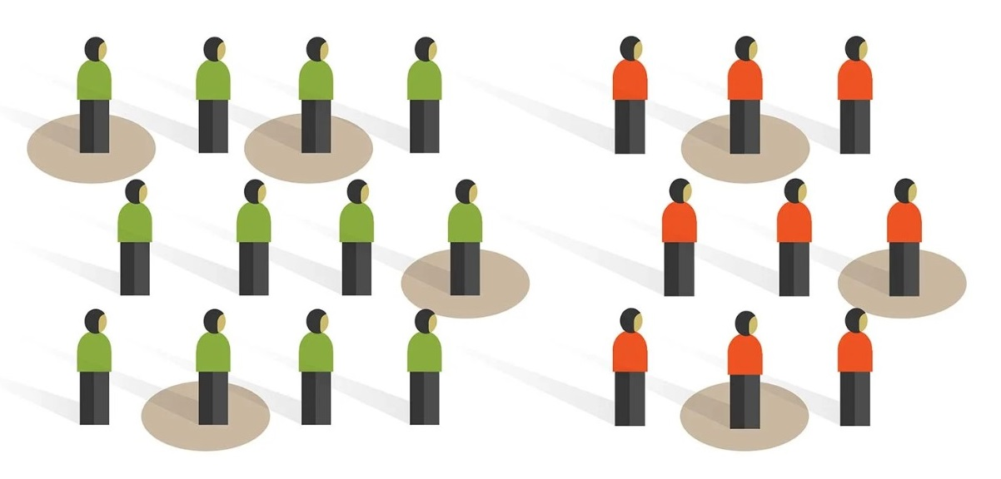
METHODOLOGY
Sampling Technique
Probability Sampling
Stratified Sampling
Simple Random Sampling

Slide 9
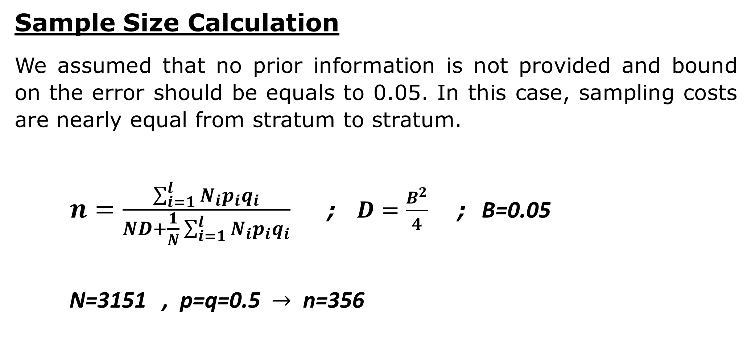
METHODOLOGY
Sample Size Calculation
We assumed that no prior information is not provided and bound on the error should be equals to 0.05. In this case, sampling costs are nearly equal from stratum to stratum.
$n=\frac{\sum_{i=1}^{l}{N_{i}p_{i}}q_{i}}{ND+\frac{1}{N}\sum_{i=1}^{l}{N_{i}p_{i}}q_{i}}$ ; $D=\frac{B^{2}}{4}$ ; B=0.05
N=3151 , p=q=0.5 $→$ n=356

Slide 10
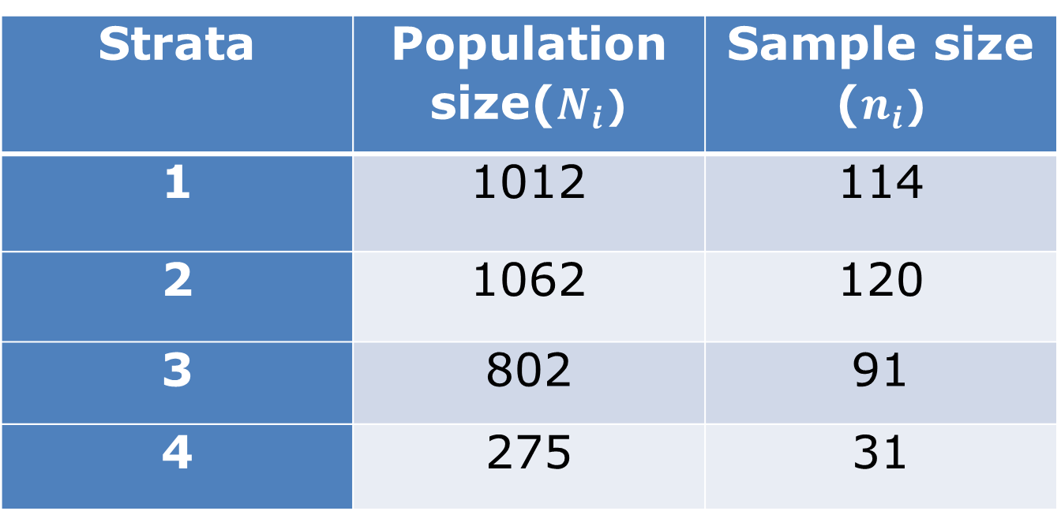
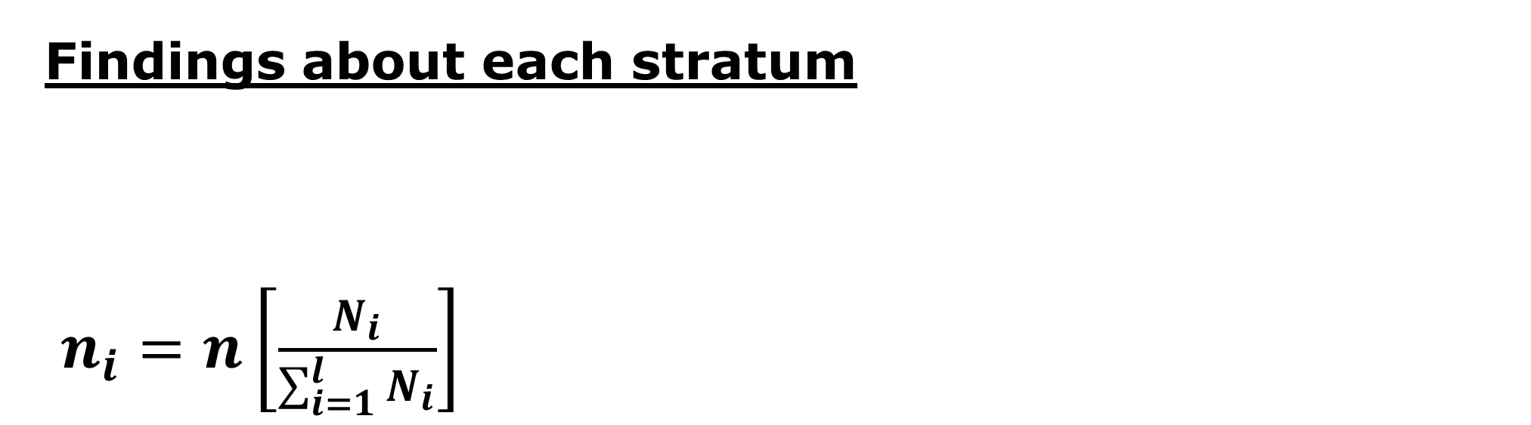
METHODOLOGY
Findings about each stratum
$n_{i}=n\left[\frac{N_{i}}{\sum_{i=1}^{l}{N_{i}}}\right]$
Strata | Population size($N_{i}$) | Sample size ($n_{i}$)
1 | 1012 | 114
2 | 1062 | 120
3 | 802 | 91
4 | 275 | 31

Slide 11
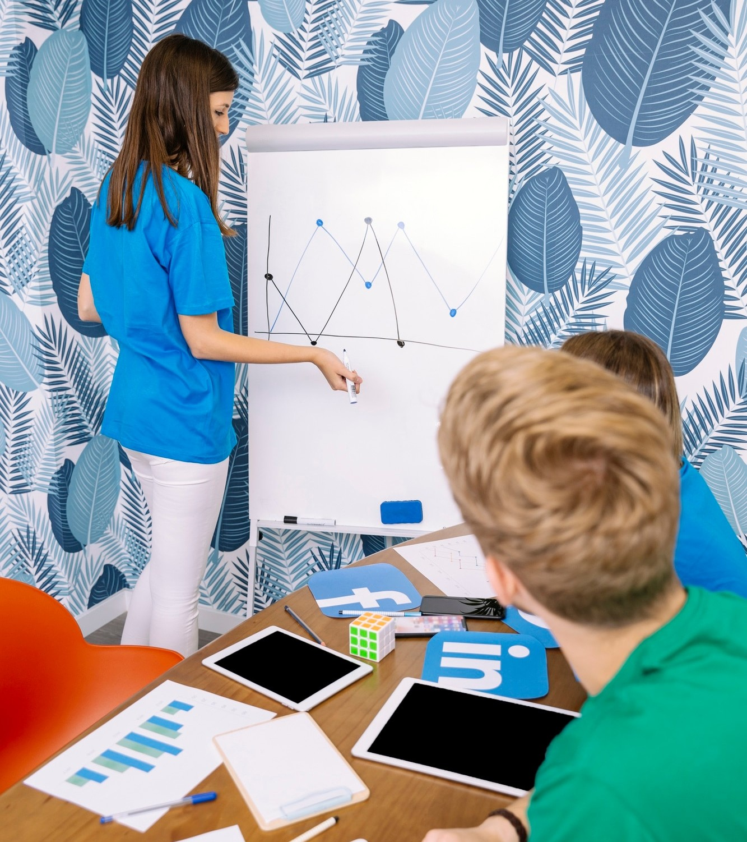
DATA ANALYSIS
The collected data was analyzed using statistical methods to identify any signiﬁcant correlations between social media usage patterns and academic performance. The results will be presented and discussed in the following slides.

Slide 12
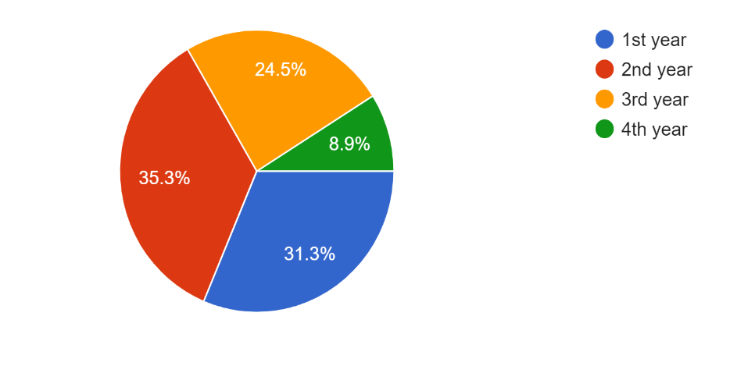
Years of the Respondents

Slide 13
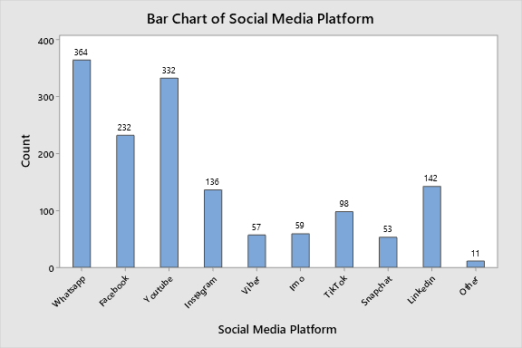
2. Social Media Platforms Used by Respondents

Slide 14
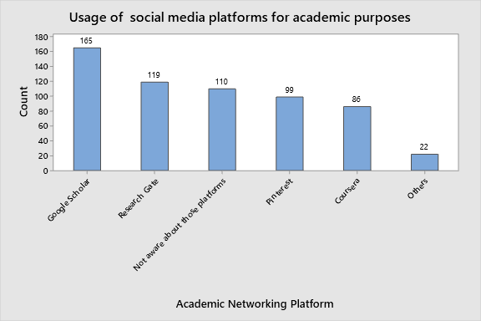
3. Academic Networking platforms Used by Faculty of Science Undergraduates

Slide 15
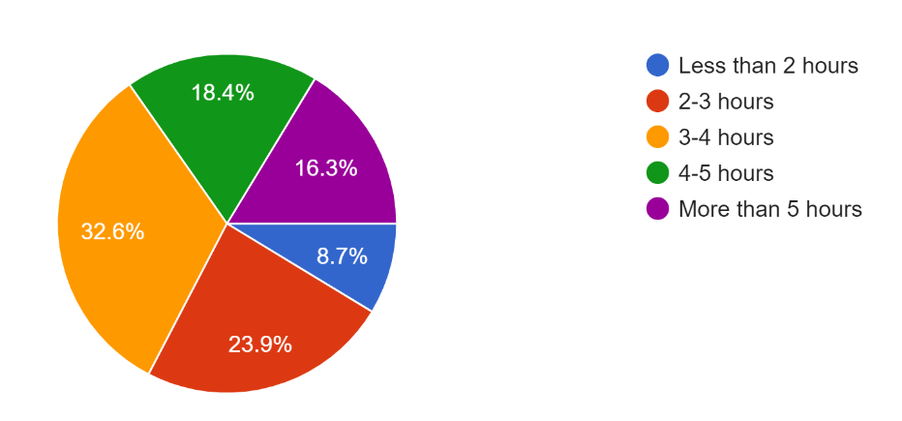
4. Hours Per day Respondents Spent on social media

Slide 16
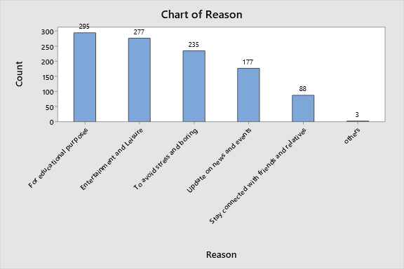
5. Reasons for The Use of Social Media by Respondents

Slide 17
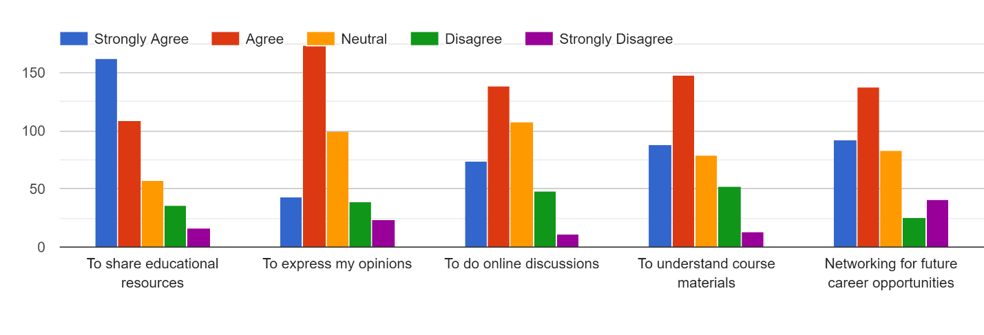
6. How helpful to social media to respondents

Slide 18
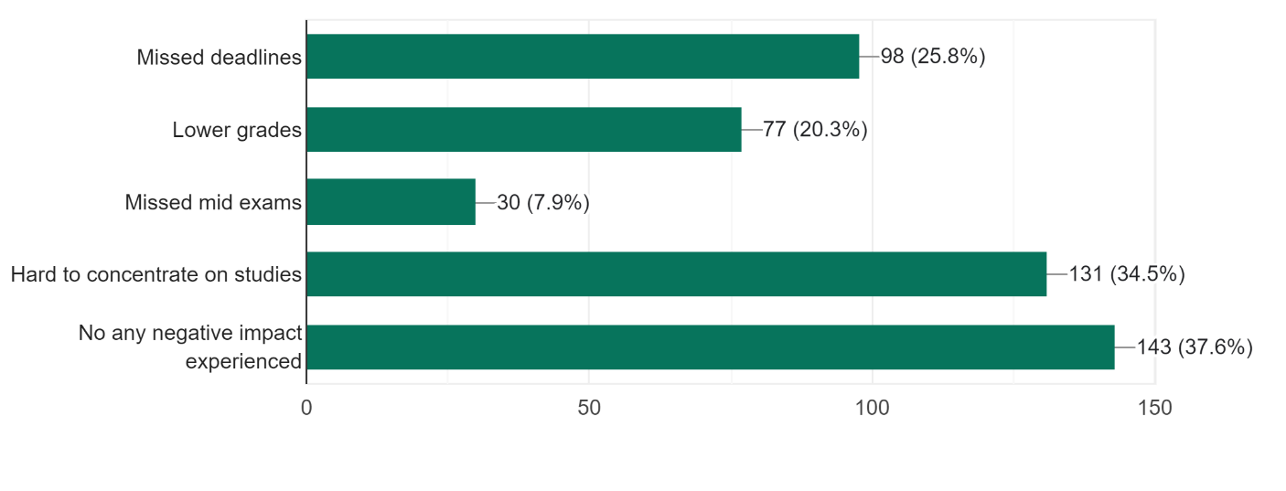
7. Negative impacts on academic activities due to excessive use of social media by respondents

Slide 19
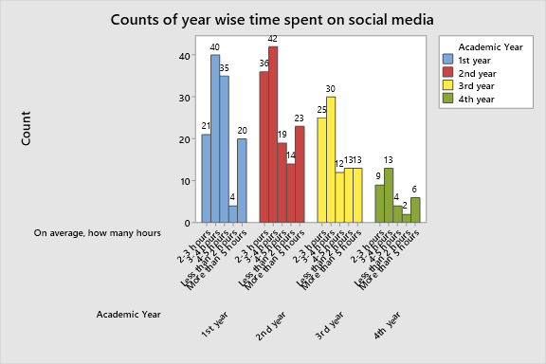
8. Year Wise counts of time spent on social media

Slide 20
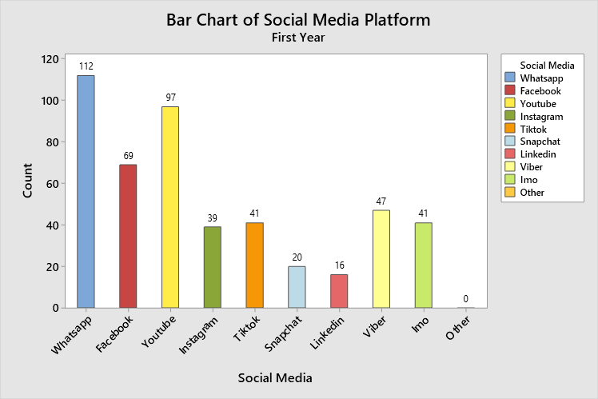
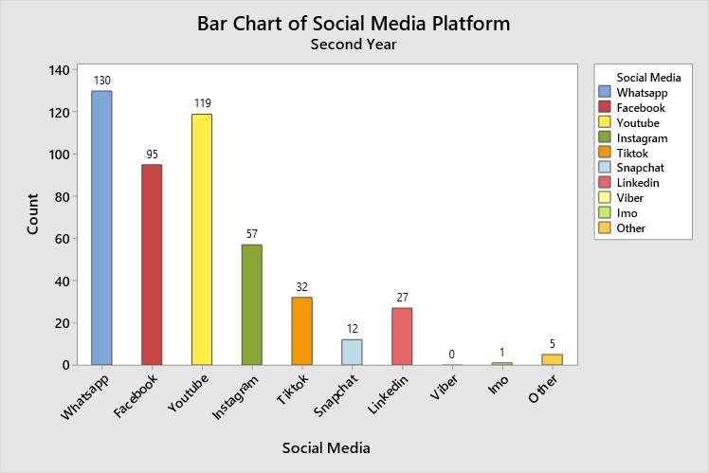
9. Year wise usage of social media platforms

Slide 21
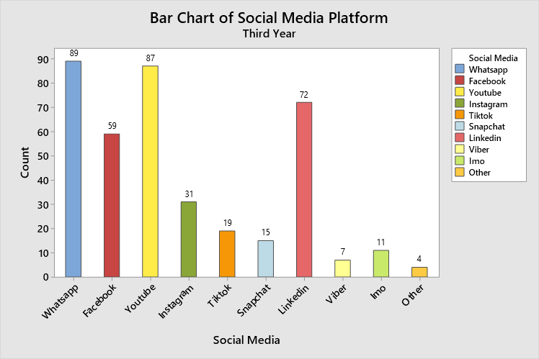
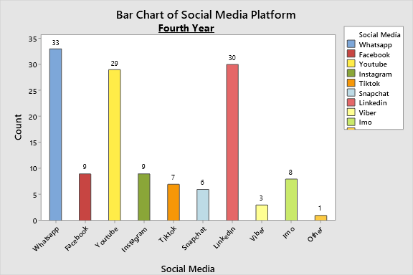
9. Year wise usage of social media platforms

Slide 22
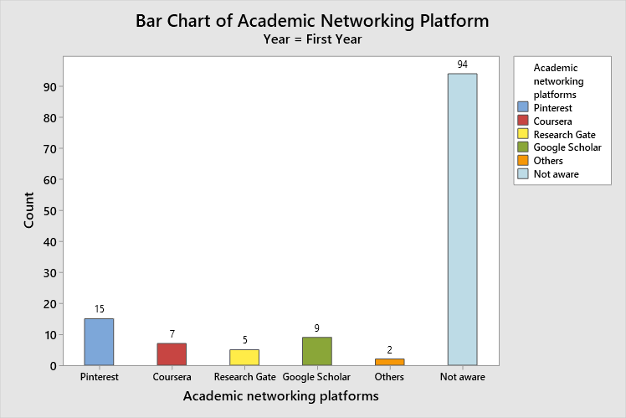
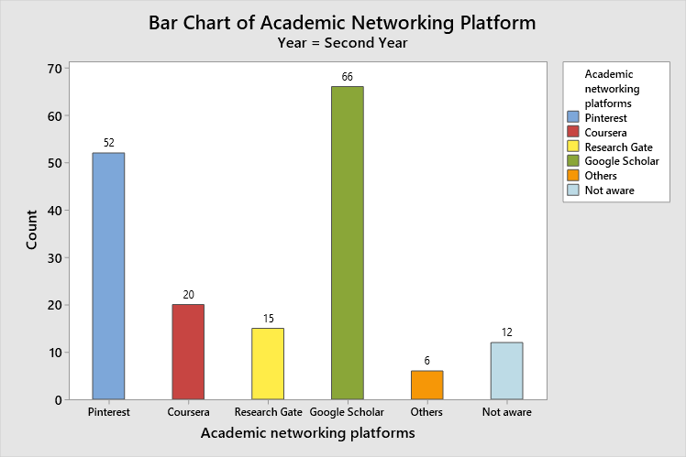
10. Year wise usage of academic networking platforms

Slide 23
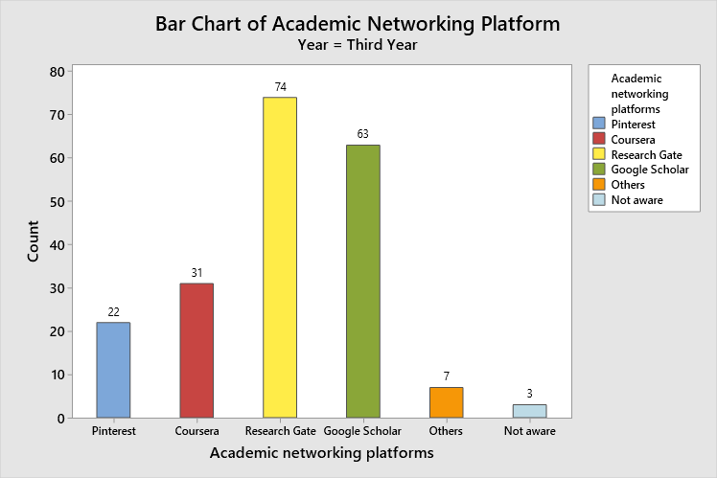
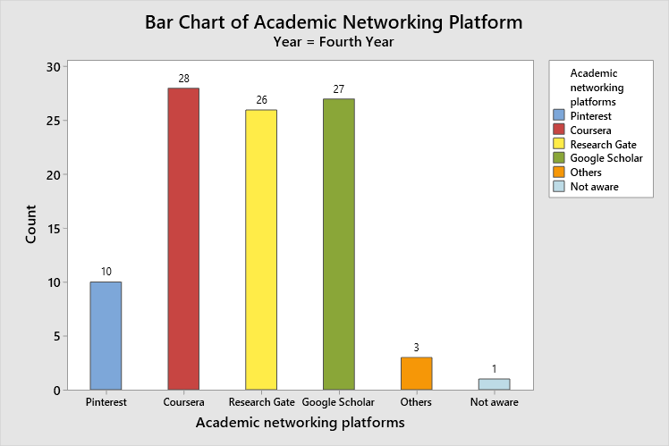
10. Year wise usage of academic networking platforms

Slide 24
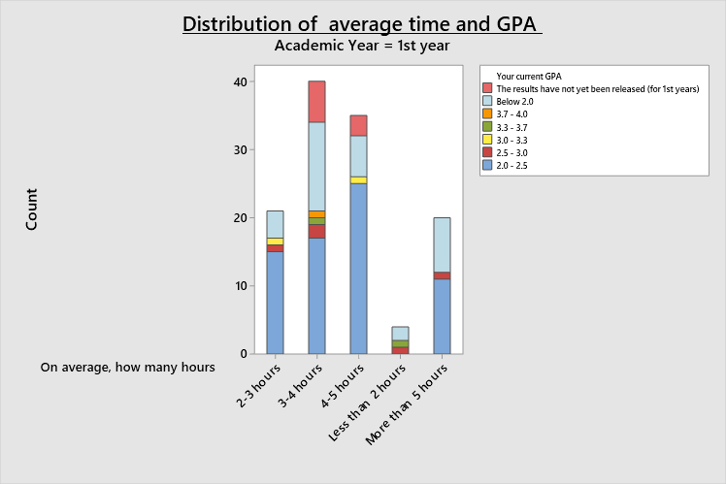
11. Distribution of average time and GPA values

Slide 25
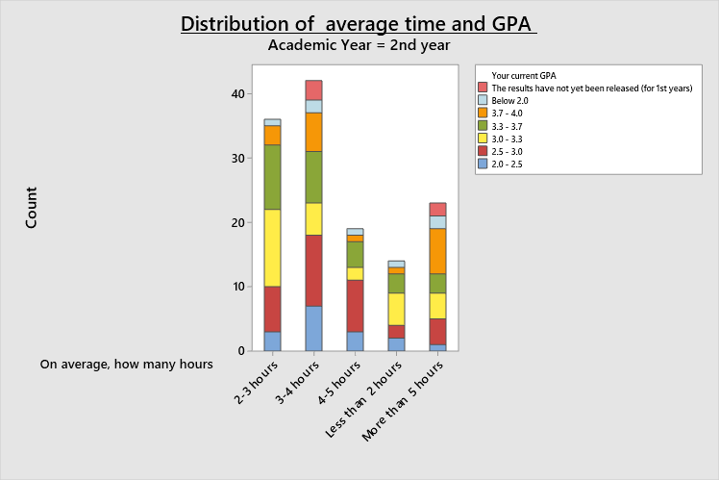
11. Distribution of average time and GPA values

Slide 26
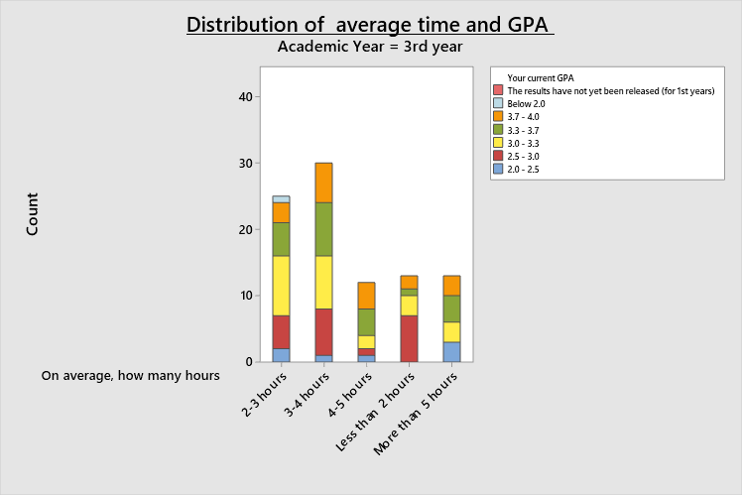
11. Distribution of average time and GPA values

Slide 27
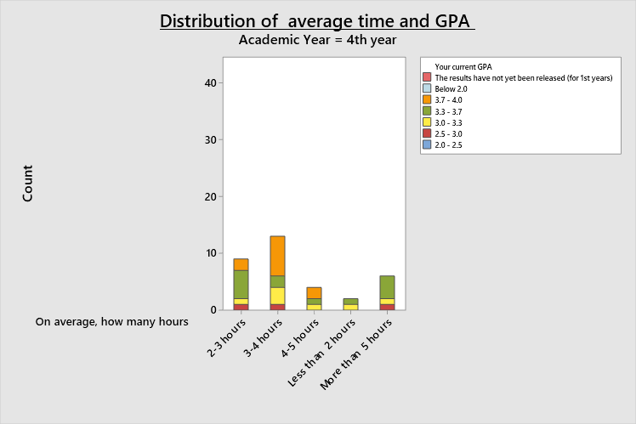
11. Distribution of average time and GPA values

Slide 28
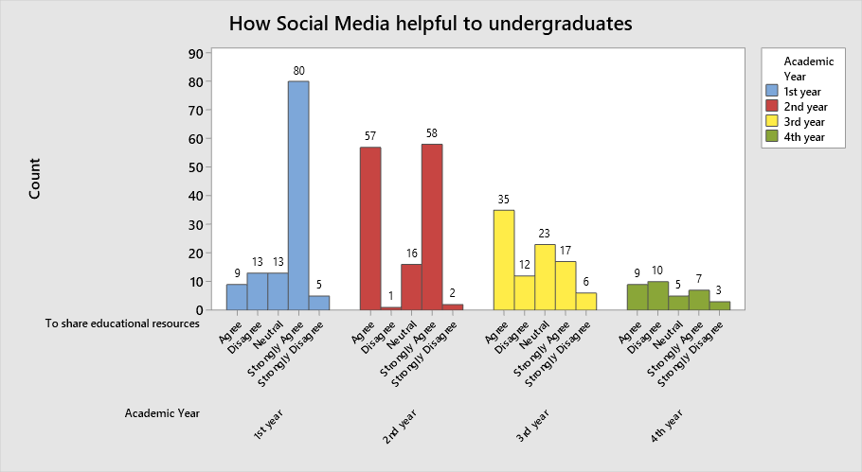
12. How social media helpful to undergraduates

Slide 29
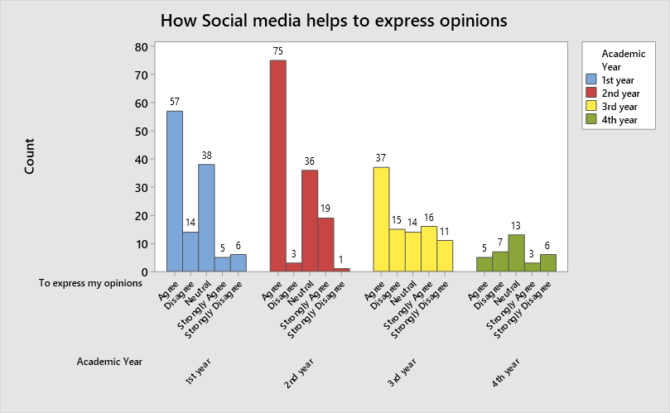
12. How social media helpful to undergraduates

Slide 30
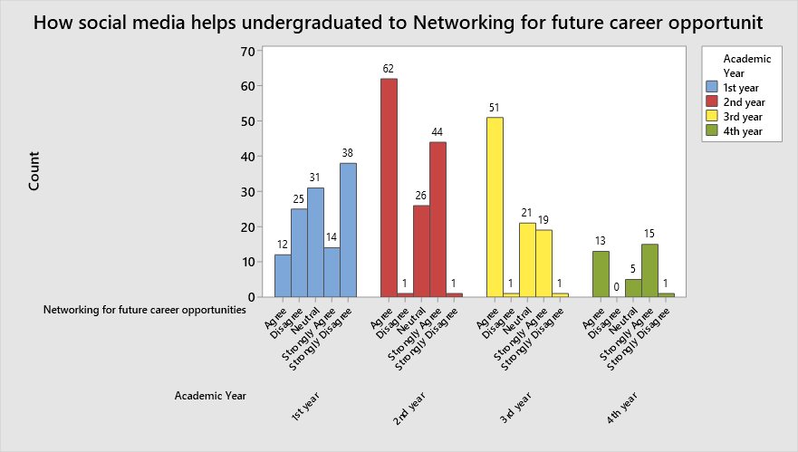
12. How social media helpful to undergraduates

Slide 31
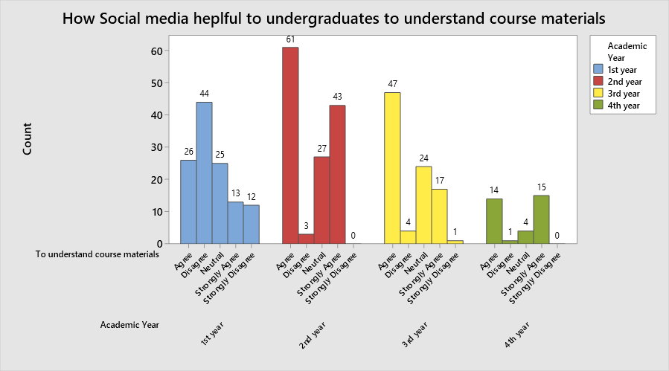
12. How social media helpful to undergraduates

Slide 32
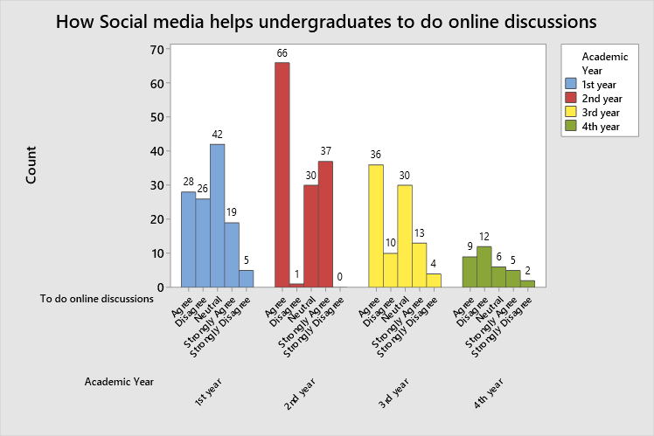
12. How social media helpful to undergraduates

Slide 33
Mean GPA according to time spent on social media per day
Mean GPA | Less than 2 hours | 2-3 hours | 3-4 hours | 4-5 hours | More than 5 hours
1st Year | 2.063 | 2.079 | 1.602 | 1.869 | 1.775
2nd Year | 2.936 | 3.0931 | 2.735 | 2.837 | 2.839
3rd Year | 3.069 | 3.066 | 3.2600 | 3.392 | 3.212
4th Year | 3.325 | 3.456 | 3.550 | 3.587 | 3.317

Slide 34
Mean GPA and count on time spent on social media during lectures
Mean GPA | Not at all (No of Students) | Once (No of Students) | Two times (No of Students) | Three times (No of Students) | Four Times (No of Students) | More than Four Times (No of Students)
1st Year | 1.679(19) | 1.885(19) | 2.1083(30) | 1.917(21) | 2.050(10) | 1.226(21)
2nd Year | 2.820(38) | 3.005(19) | 3.057(27) | 2.919(13) | 1.625(4) | 2.886(33)
3rd Year | 3.2311(45) | 3.083(21) | 3.175(8) | 2.810(5) | 3.539(9) | 3.070(5)
4th Year | 3.4971(17) | 3.364(11) | 3.8500(1) | 3.8500(1) | 3.500(3) | 3.500(1)

Slide 35
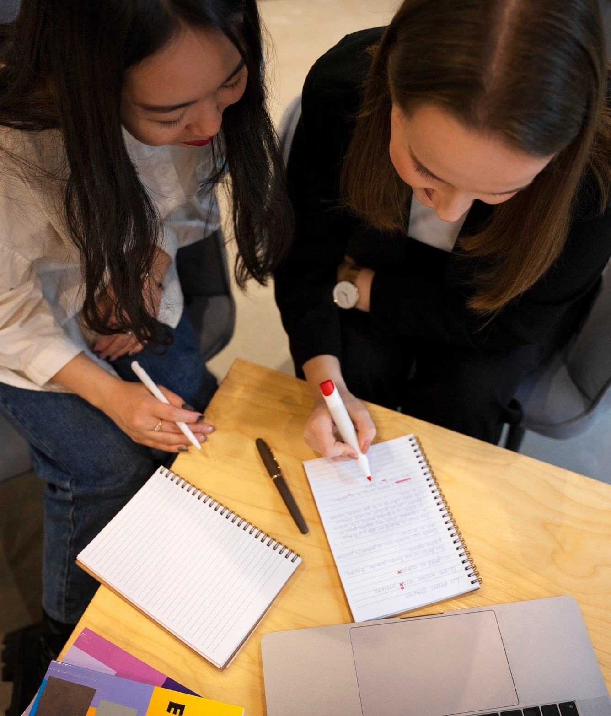
DISCUSSION
The study examined the impact of social media on students' academic performance. It found that while some students perform better when using social media, others become distracted. Interestingly, spending 4-5 hours on social media typically results in higher grades, though this pattern does not hold true for first-year students. However, it is challenging to definitively conclude that social media directly causes better grades. Additionally, older students tend to utilize social media more for academic and professional purposes.

Slide 36
CONCLUSION
In conclusion, students demonstrate varied approaches to social media usage. Those who spend a moderate amount of time on social networks tend to achieve better academic results compared to those who spend either less or more time. As students advance through their undergraduate years, particularly in the final years (3rd and 4th year), they increasingly leverage social media for academic purposes. This trend suggests that social networks are particularly advantageous for senior students, who utilize them for sharing educational resources, participating in online discussions, engaging with subject matter experts, and networking for future opportunities.

Slide 37
Group Members
PS/2020/166 – L.M.A.M. Karunarathna
PS/2020/209 – J.A.R. Prabodha
PS/2020/245 – R.M.L.I. Rathnayaka
PS/2020/249 – R.H.R.S. Nishshanka
PS/2020/254 – L.D. Dilshan
PS/2020/260 – P.S.A. Liyanage
PS/2020/269 – G.W. Kaushalya
PS/2020/280 – S.L.S. Jayaweera
PS/2020/310 – H.V.T.G.T. Dharmasiri

Slide 38
Thank You!

