Slide 1

AGENTFORGE · PP2 RESEARCH PRESENTATION
Self-Optimized LLM Multi-Agent System for Software Engineering
From a one-sentence idea to a tested, deployed web application
5
4
11
6
specialist
agents
deterministic
quality gates
diagram types
per SRS
deployment
targets
One shared project context · runner-based evidence at every handoff · human approval before every release
Requirements → Prototype → Build → QA → Deployment
Notes:
AgentForge is a studio that takes a product from a single sentence to a running, tested and deployed web application. Five specialist LLM agents (SRS, prototype, builder, QA and deploy) share one persistent project context. Everything on these slides is taken from the AgentForge source code and its README; implemented capability is kept separate from demonstrated results.

Slide 2
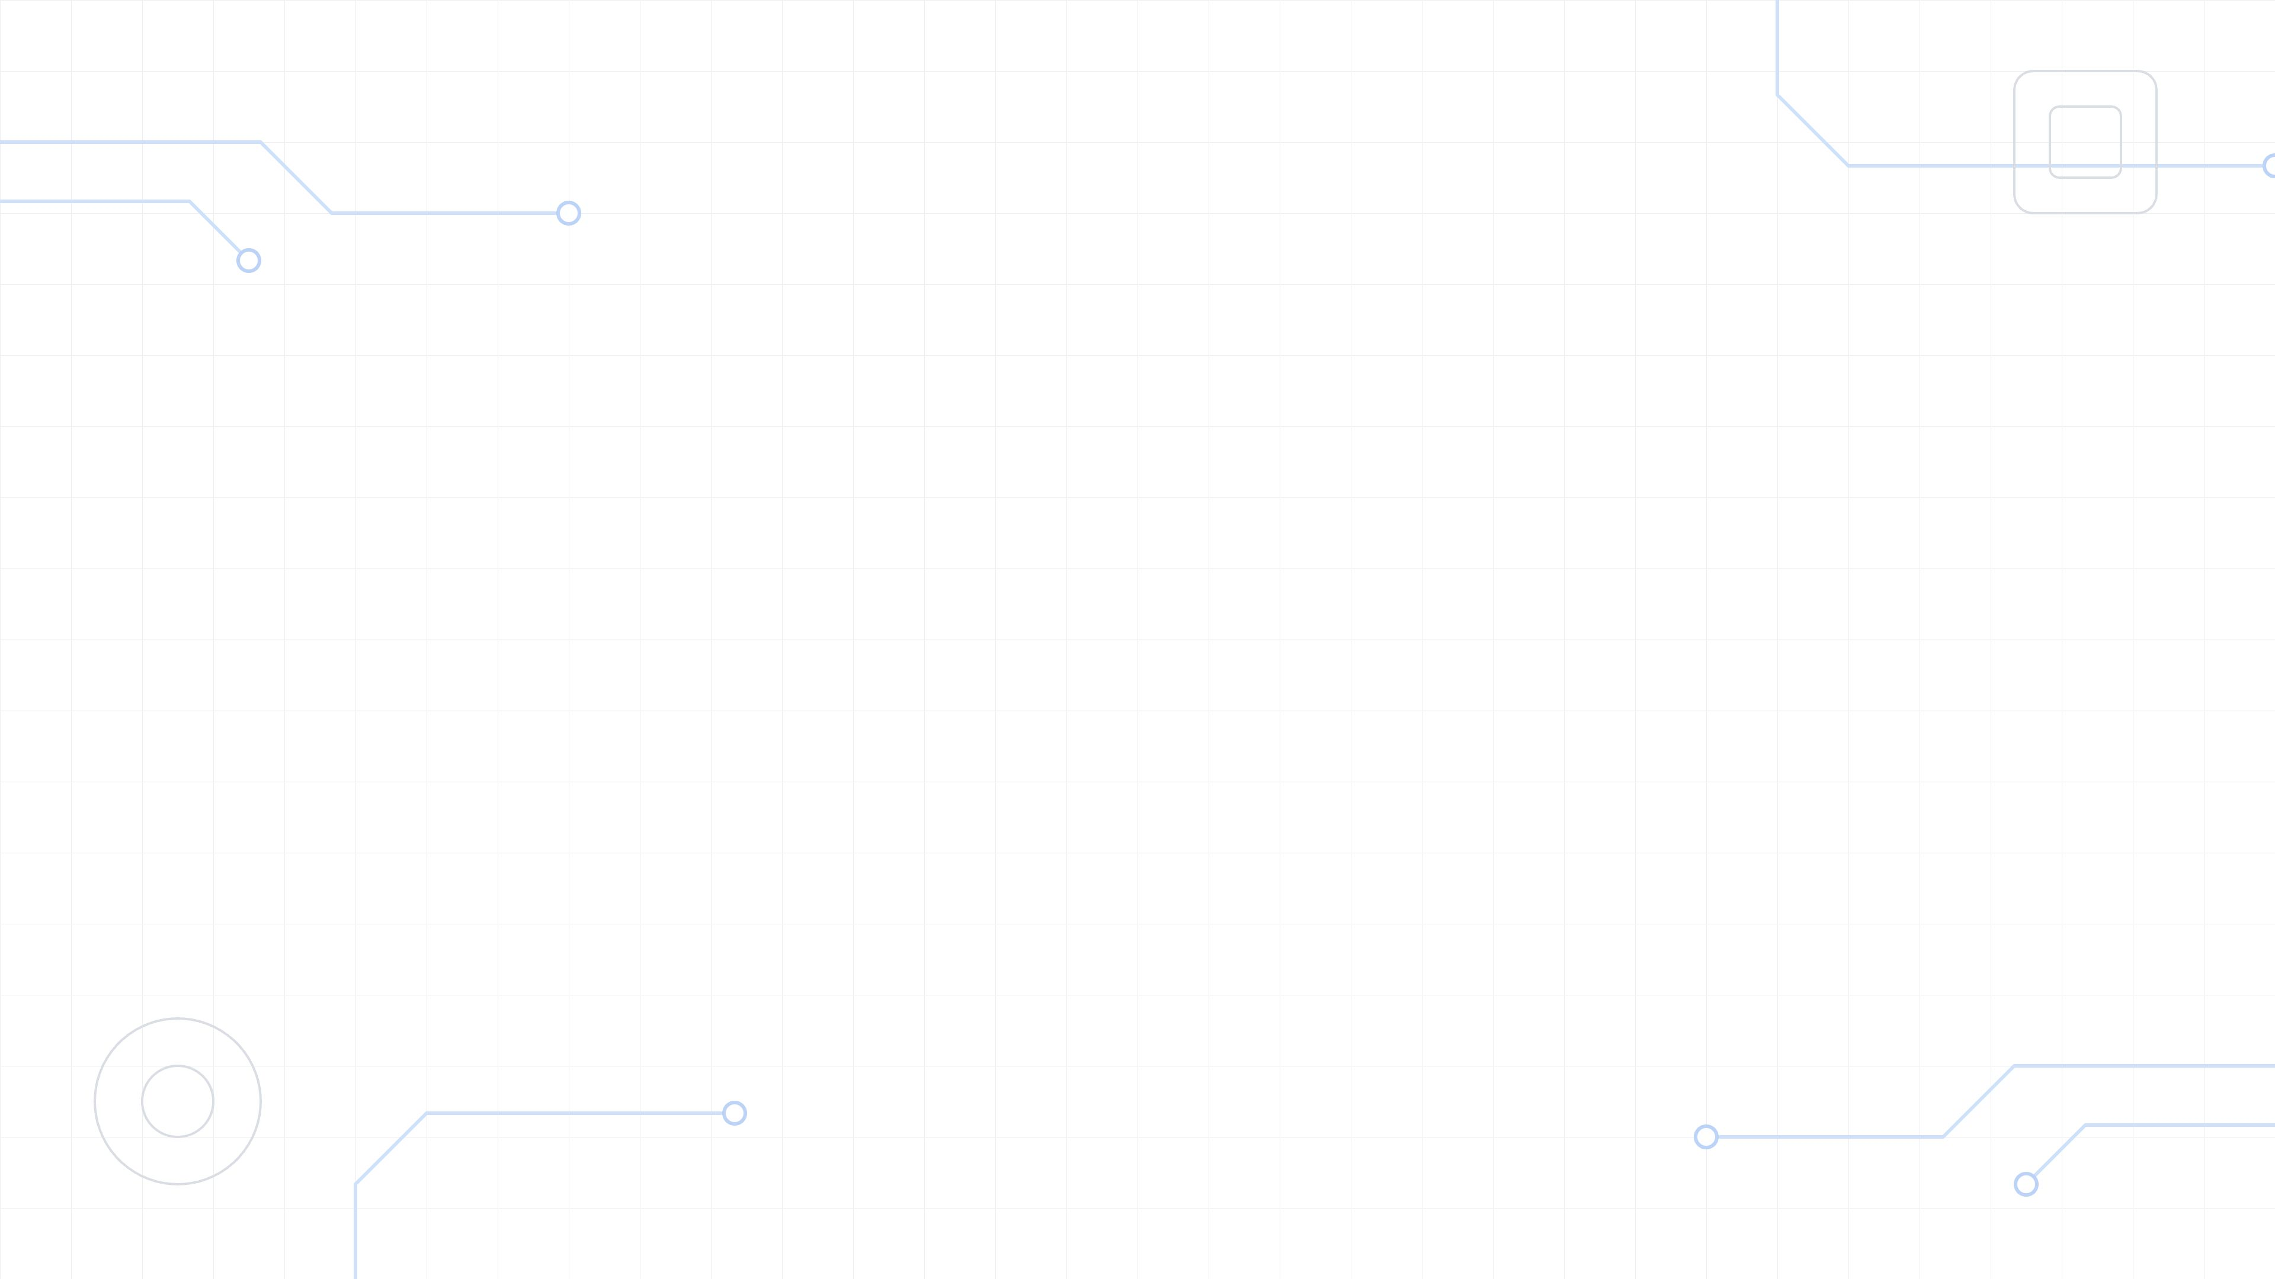

02
AGENTFORGE
PRESENTATION ROUTE
From idea to release evidence
Five parts: why the problem matters, how AgentForge works, and what the evidence shows.
01
THE PROBLEM AND RESEARCH GAP
Why AI code generators still fail to deliver complete, verifiable software, and where the gap is.
02
SYSTEM AND ARCHITECTURE
Five agents in one shared context, a layered platform, four quality gates and an auditable record.
03
THE FIVE AGENTS
What each agent does, the specialist tools it uses and the evidence it leaves behind.
04
PLATFORM FEATURES
Studio workspace, change control and versioning, integrations, security by design and the toolchain.
05
EVALUATION AND OUTLOOK
How the system will be evaluated, its known limits, the contributions and the next steps.
Notes:
The talk follows the life of a project: first the problem and the research gap, then the architecture, then each of the five agents with its own tools, then platform-wide features, and finally how the system will be evaluated, its limits and its contributions.

Slide 3
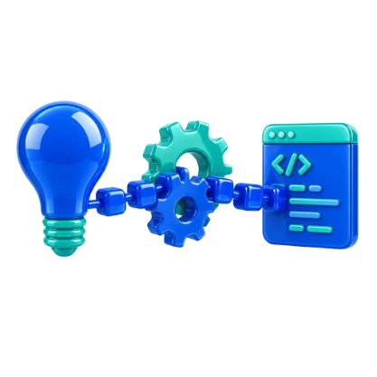
03
AGENTFORGE
RESEARCH MOTIVATION
An idea must survive the whole lifecycle
A one-line idea such as “an ordering website for my bakery” leaves most decisions open: who the users are, which screens exist, what data is kept, who may do what, and how success is proven. Every later stage depends on those decisions.
AGENTFORGE'S ANSWER
Five specialist agents share one persistent project record, check every artifact before the next stage uses it, and carry QA findings back into repair — until a human approves the release.
IDEA
REQUIREMENTS
DESIGN
CODE
TESTS
RELEASE
AMBIGUITY
CONTEXT LOSS
UNPROVEN QUALITY
Code generators start coding before requirements exist, so missing roles, rules and edge cases surface late — when they are most expensive to fix.
When each step starts a fresh conversation, earlier decisions are forgotten or re-invented, and the product drifts away from what the customer asked for.
“It works” is usually the model's own claim. Without runner evidence for tests, accessibility, performance and security, nobody can verify the release.
Notes:
This is the design problem AgentForge addresses, not a measured industry statistic. A short idea hides decisions about users, screens, data, permissions and success criteria. If those are not captured and carried forward, each later stage guesses — and a release cannot be verified.

Slide 4
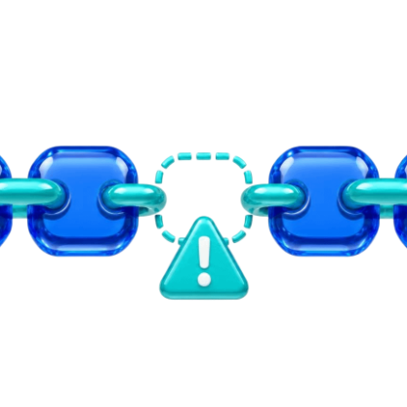
04
AGENTFORGE
RESEARCH GAP
Six gaps in AI-assisted delivery
Code now comes fast, but the path from idea to verified release still breaks in six places.
G1
G2
G3
REQUIREMENTS ARE ASSUMED
CONTEXT IS FRAGMENTED
LLMS GRADE THEMSELVES
Prompt-to-code tools rarely elicit requirements. There is no standards-based SRS that traces features to screens, data and tests.
Multi-agent pipelines hand documents between separate conversations; earlier decisions are summarised away or lost between roles.
Quality is usually judged by the same kind of model that wrote the output. Few systems use deterministic, code-based acceptance gates.
G4
G5
G6
TESTING WITHOUT EVIDENCE
THE LAST MILE IS MANUAL
CLOUD-ONLY AND OPAQUE
Tests are claimed, not proven; a missing report can read as a pass. Accessibility, performance and security are often skipped.
Deployment, secrets, databases, domains, rollback and live verification are left to the developer, or done without human approval.
Most tools depend on proprietary cloud models with hidden prompts; local open-weight models and inspectable behaviour are rare.
Notes:
These six gaps come from comparing how current AI coding assistants, prompt-to-app builders and research multi-agent frameworks (for example ChatDev and MetaGPT) work. Each gap maps to a concrete AgentForge mechanism: interview and SRS (G1), one shared context (G2), code-based gates (G3), runner evidence (G4), approval-gated deployment (G5) and local Ollama models with editable prompt packs (G6).

Slide 5

05
AGENTFORGE
POSITIONING
How AgentForge closes the gap
Capability coverage by category of tool — what each approach typically provides out of the box.
Capability | Coding assistants (Copilot, Cursor) | Prompt-to-app (Bolt, Lovable, v0) | Research agents (ChatDev, MetaGPT) | AgentForge
Requirements interview and approved plan (G1) | No | Partial | No | Yes
Standards-based SRS with UML/BPMN diagrams (G1) | No | No | Partial | Yes
One persistent context shared by every role (G2) | Partial | Partial | Partial | Yes
Deterministic, code-based quality gates (G3) | No | No | Partial | Yes
Clickable prototype approved before coding | No | Partial | No | Yes
Test evidence: E2E, accessibility, security (G4) | Partial | No | Partial | Yes
Approval-gated deploy with live HTTPS check (G5) | No | Partial | No | Yes
Local open models and editable prompt packs (G6) | Partial | No | Partial | Yes
Indicative comparison by capability category, based on public documentation (2026). Not a benchmark — individual products change quickly.
Notes:
Read across a row: which kind of tool covers that capability. 'Partial' means the capability exists in a limited form — for example prompt-to-app builders offer one-click hosting but no approval plan or live verification, and MetaGPT writes PRD-style documents but has no adaptive interview. The point is not that other tools are poor; it is that no single category covers the whole path from idea to verified release.

Slide 6

06
AGENTFORGE
SCOPE
Research objective and questions
CAN SPECIALISED LLM AGENTS THAT SHARE ONE PROJECT CONTEXT, AND ARE HELD TO DETERMINISTIC QUALITY GATES, TURN A NATURAL-LANGUAGE IDEA INTO A VERIFIED, DEPLOYED APPLICATION?
RQ1 · SHARED CONTEXT
RQ2 · QUALITY GATES
Does one persistent context reduce requirement drift between stages, compared with agents in isolated conversations?
Do code-based gates (plan depth, schema, coverage, review) measurably improve the completeness of the specification?
RQ3 · RUNNER EVIDENCE
RQ4 · GOVERNED DELIVERY
Can runner-based QA — unit, E2E, accessibility, performance, security — give trustworthy release evidence for generated apps?
Can an approval-gated deploy agent publish a real application and verify it independently at its live HTTPS address?
Hypothesis: shared context + deterministic gates + runner evidence give more complete, more verifiable apps than prompt-to-code.
Notes:
The main question is whether specialisation, a shared context and hard gates together produce software that is both complete against the customer's intent and verifiable. Each research question isolates one mechanism so that it can be measured and ablated in the evaluation.

Slide 7
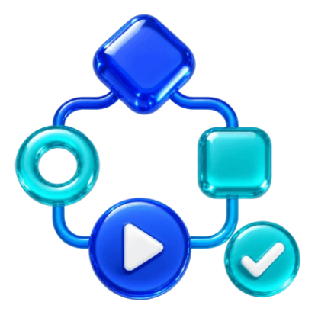
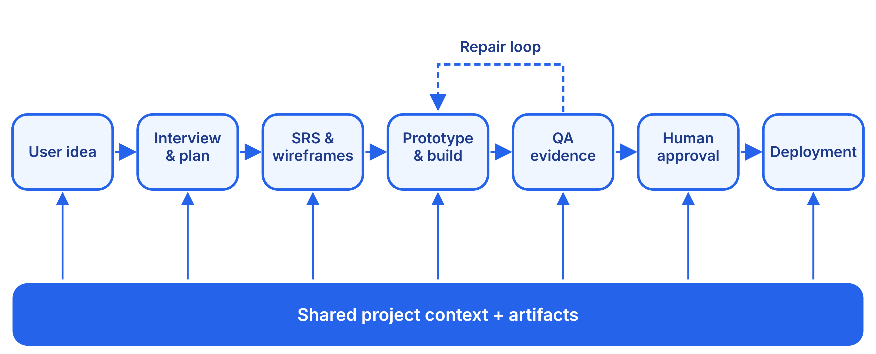
07
AGENTFORGE
SYSTEM ARCHITECTURE
Shared context, self-correcting loops
SELF-OPTIMISATION: FOUR CLOSED FEEDBACK LOOPS
SPECIFICATION
JSON & DIAGRAMS
BUILD & QA
DEPLOYMENT
Gaps return as repair instructions (2 rounds). Bakery test run: diagrams 1 → 7, requirements 3 → 6.
Invalid JSON, schema errors and Mermaid parse errors are fed back in-context until they pass.
A failed check is fixed in product code; only the affected test is rerun, never the whole plan.
A failed live probe triggers the repair skill and a redeploy (up to 2 rounds).
Notes:
Read the diagram left to right: every stage writes into one shared project context and artifact store. 'Self-optimised' means the system corrects itself through closed loops: a validator, a renderer, a test runner or a live probe produces a concrete failure, and that failure becomes the next instruction to the agent, within a bounded number of rounds.

Slide 8

08
AGENTFORGE
TECHNICAL ARCHITECTURE
How the platform is built
STUDIO UI
AgentForge Studio · Next.js / React — interview · plan · SRS review · diagrams · wireframes · design · prototype · code · preview · testing · deploy
INTERFACES
HTTP API :7824 — jobs + polling, never blocks on a model
Live feed :7825 — WebSocket, event replay on reload
Managed preview — one server per project, stack port
ORCHESTRATION
Event bus
Job queue
Prompt packs
Validation gates
Changes & versions
Sign-in & secrets
AGENTS
SRS agent
Prototype agent
Builder agent
QA agent
Deploy agent
ENGINE
ProjectSession — one agent per project, plan / act modes, memory
Focused LLM calls — parallel lanes for documents, diagrams, pages
Ollama — local or cloud models, web search
PROJECT STORE
workspaces/<project>/ — the application + .agentforge/ : context.json · events.jsonl · interview · plan · design · srs/ · prototype/ · build/ · qa/ · deploy/ · versions/
Notes:
Top to bottom: the Studio is a Next.js interface; it talks to a Python backend over an HTTP API (long model work runs as jobs that the browser polls) and a WebSocket feed that streams every event. The orchestration layer holds the shared services. The five agents are ordinary Python packages that all go through one ProjectSession, which owns the single model conversation, and everything they produce lands in the project's own folder on disk.

Slide 9
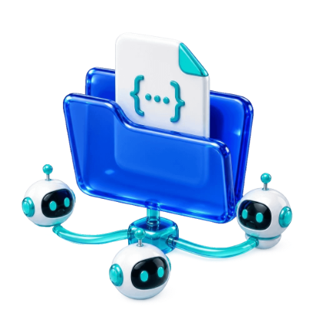
09
AGENTFORGE
ARCHITECTURE
The shared project record
All five agents reuse one session and one workspace, so later roles keep every decision.
CONTEXT.JSON
EVENTS.JSONL
STAGE FOLDERS
The one conversation all five agents share. Saved after every turn and restored after a restart; switching the model keeps it.
Every narration, tool call, file diff and command output — streamed live to the Studio and replayed after a reload.
interview, plan, design, srs/, prototype/, build/, qa/, deploy/ and versions/ — kept beside the application they describe.
HOW THE ENGINE STAYS RELIABLE
SILENT PLAN MODE
DURABLE MEMORY
RESILIENT CALLS
FOCUSED CALLS
Each stage plans, then executes at once — bounded to 8 execution and 3 audit rounds, ending only on an explicit complete or blocked signal.
At 88% of the context window the oldest turns are summarised; if the model returns nothing, a digest of files, commands and requests is kept.
Transient errors (429, 5xx, timeouts) retry with 2 s, 8 s and 20 s back-off; broken JSON is repaired in the same conversation.
Specifications, diagrams, wireframes and pages are written as independent parallel calls, so long outputs never truncate.
Notes:
The project record is what makes AgentForge one system rather than five tools. context.json is the shared conversation, events.jsonl is the audit trail the Studio replays, and each stage keeps its outputs in its own folder. The engine features underneath keep long runs alive: bounded plan/execute rounds, memory summarisation with a fallback, retries, and focused parallel calls.

Slide 10
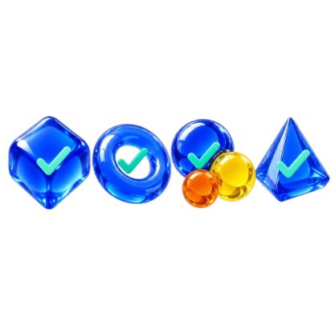
10
AGENTFORGE
VALIDATION
Four gates that can say no
Only these code-based rules can reject a model's output; everything else is an editable prompt.
01
02
03
04
PLAN DEPTH
SRS SCHEMA
COVERAGE
STANDARDS REVIEW
Every screen has a purpose; every record keeps at least 2 fields; every signed-in role can do 2 things; public sign-up can never create a privileged role.
A Pydantic model of 30+ sections — the same one the Studio's views read — with floors of 3 functional and 3 quality requirements and 1 role.
Counts the plan against the spec: dropped screens, features with no requirement, skipped diagrams, half-drawn wireframes, dead prototype links.
A reviewer scores 5 dimensions from 0 to 5. Python — not the model — decides the pass: no blockers and every score at least 3.
EVERYTHING IS A PROMPT
Every instruction lives in prompts/ as Markdown: 12 packs (engine, interview, plan, SRS, design, prototype, builder, testing, deployment, changes, chat, research), 71 design themes and 12 deployment skill pages. Changing how a stage behaves means editing a file, not the code.
Notes:
Gates are the only judgement not delegated to a model. Gaps found by the coverage gate go back to the agent as instructions for two rounds and anything left is recorded on the document. In the README's bakery run the coverage gate took the first draft from 1 diagram to 7, from 3 functional requirements to 6, and from seven four-line wireframes to seven drawn screens.

Slide 11

11
AGENTFORGE
AGENT 1 · SRS
SRS agent: conversation to contract
01
02
03
ADAPTIVE INTERVIEW
APPROVAL PLAN
STRUCTURED SRS
The first question fixes the product type (10 kinds, e.g. POS, booking, e-commerce, SaaS). Each next question targets what is still unknown: choices, yes/no, numbers, free text and attachments.
Users, screens, records, workflows and open decisions in plain language. Revisions keep untouched sections; open questions block approval. The plan is a ceiling nothing may exceed.
ISO/IEC/IEEE 29148-aligned JSON and Markdown: roles, access matrix, pages, database, API, functional and quality requirements, workflows, risks, acceptance criteria, traceability.
04
05
06
11 DIAGRAMS
PAGE WIREFRAMES
HANDOFF CONTRACT
System context, use case, ERD (Crow's Foot), sequence, activity, class, state machine, data flow, BPMN 2.0, component and deployment — one focused call each, rendered to SVG.
Web research on how similar products lay out screens, one shared layout, then a complete HTML wireframe per route. Redraw one or all; edit by hand or by AI.
app.md, sitemap.md, prototype.md and builder.md are projections of the SRS made without a model call, so every later agent reads the same contract; journeys map to pages.
INTERVIEW → PLAN → APPROVE → SPECIFY → VALIDATE → REPAIR → HANDOFF
Notes:
The SRS agent owns the first half of a project. The interview has no fixed question list: a one-screen tool finishes in a handful of questions, a multi-role system takes more. The approved plan bounds the specification; the specification bounds the diagrams and wireframes; and the handoff files are generated deterministically so later agents read exactly the same contract.

Slide 12
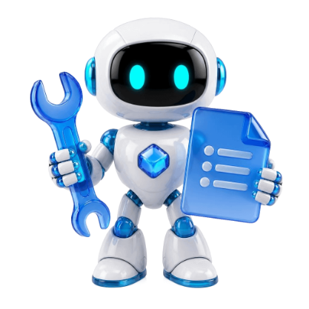
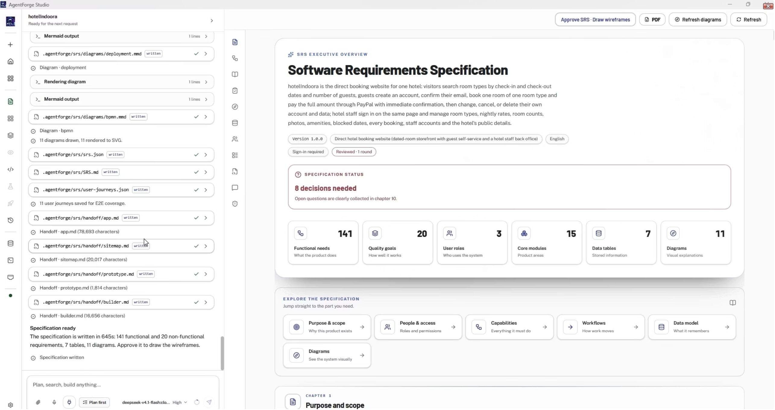
12
AGENTFORGE
AGENT 1 · TOOLKIT
SRS agent: tools and what they do
1
OLLAMA LLM · FOCUSED CALLS
Writes each question, the plan, the SRS, every diagram and every page in parallel lanes, so no output is truncated.
2
OLLAMA WEB SEARCH
Researches what products of this kind normally contain before the SRS and the wireframes are written.
3
MERMAID CLI + HEADLESS CHROMIUM
Renders each diagram to SVG; its parse error becomes the model's repair instruction.
4
PYDANTIC SRS SCHEMA
Rejects a malformed specification and names the exact field to fix.
5
COVERAGE AND REVIEW VALIDATORS
Captured run: the generated SRS overview shows scope, roles, modules and the decisions still open for review.
Count plan against spec and score quality; gaps return as repair instructions.
STANDARDS THE DOCUMENT FOLLOWS
6
JOURNEY MAPPER + DOCUMENT EXPORT
ISO/IEC/IEEE 29148:2018
OMG UML 2.5.1
BPMN 2.0.2
Ties each workflow step to the page it happens on; exports the SRS as a readable document for sign-off.
Crow's Foot ERD
WCAG 2.1 AA
OWASP Top 10
Notes:
These are the specialist tools behind the SRS agent — not generic file editing. The screenshot is a user-supplied capture of a real run: the SRS overview with its counts and the decisions still open. The tags show the standards the document and diagrams are written against.

Slide 13
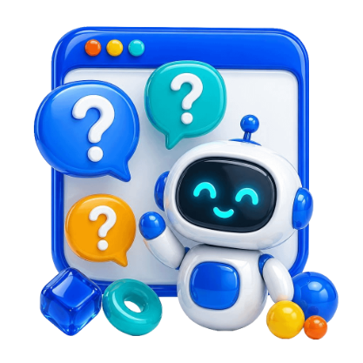
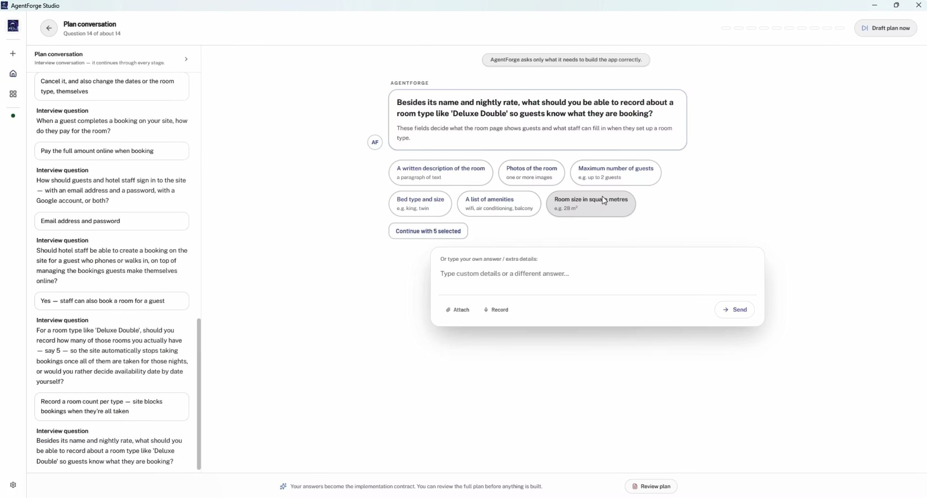
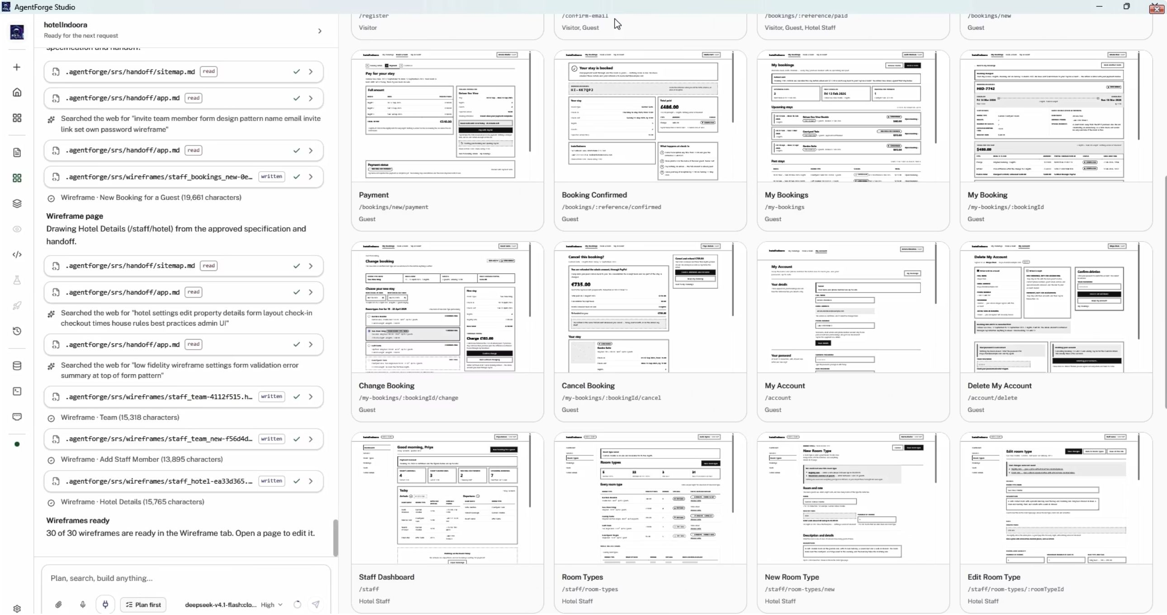
13
AGENTFORGE
AGENT 1 · IN ACTION
SRS agent in action
ADAPTIVE INTERVIEW
WIREFRAME PAGES
One question at a time, chosen from what is still unknown: suggested options, a custom answer, attach or record. Earlier answers stay listed on the left.
Left: the agent reads the handoff, searches the web for layout ideas and writes each wireframe. Right: the grid of drawn pages, each with its route and role.
Notes:
Two captures of the Studio during a real project. The interview asks one question at a time and keeps every earlier answer visible. After approval, every route gets its own complete HTML wireframe, shown in a grid the customer reviews before the prototype is drawn.

Slide 14


14
AGENTFORGE
AGENT 2 · PROTOTYPE
Prototype agent: see it before it is built
01
02
DESIGN CONTRACT
SHARED KIT
Pick one of 71 themes (minimal, bento, glassmorphism, brutalism…) or describe a direction. Tokens and styling are previewed and approved once, then bind every page.
One stylesheet, one script and one page shell drawn once, so every screen is the same product rather than a set of separate mock-ups.
03
04
FLOW AND ROUTES
ROLE-AWARE DEMO
Journeys become 'this page leads to that page' in flow.js and routes.json, so a link can never point to a page that does not exist.
One fictitious demo account per signing-in role, created without an LLM call; the access matrix decides which pages each role may open.
05
06
PAGE-BY-PAGE DRAWING
CHECKS AND REVISIONS
Each route is drawn from its approved wireframe with its own output budget, and published the moment it is ready while the rest keep drawing.
Pages are checked for dead links, missing kit functions and leaked spec text; images are repaired. Chat or point-and-edit revises any page.
Notes:
The prototype is the first time the customer sees the product instead of reading about it. The design is decided once and binds everything after it. The prototype is static HTML, CSS and JavaScript — a stage output for review, not the production application.

Slide 15

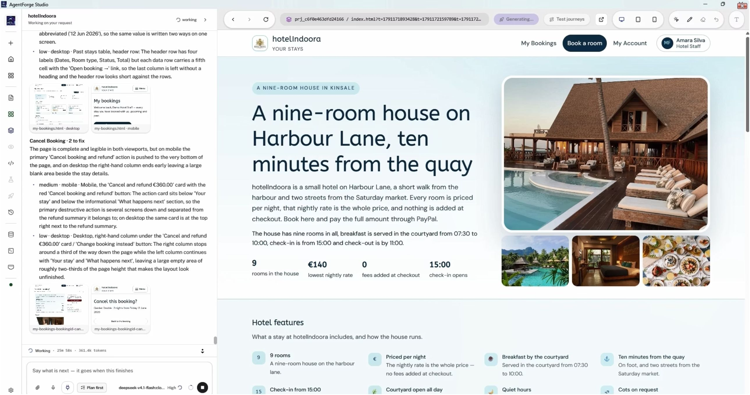
15
AGENTFORGE
AGENT 2 · TOOLKIT
Prototype agent: tools and what they do
1
DESIGN THEME CATALOGUE
71 ready themes, each a DESIGN.md, plus a customiser for colour, type, density and component style.
2
LLM PAGE WRITER
Draws the shared kit once, then each page from its wireframe's structure with the low-fidelity look stripped out.
3
ROUTE AND FLOW BUILDER
Writes routes.json and flow.js from the SRS journeys and the role access matrix.
4
DEMO-ACCOUNT GENERATOR
Creates one stable, fictitious login per role and tells the customer how to enter as each one.
5
STATIC PAGE CHECKER
Captured run: the clickable prototype in the preview pane (right), beside the agent's desktop and mobile layout notes (left).
Flags dead links, unknown kit functions, undefined classes and specification text printed on a page.
A FEW OF THE 71 DESIGN THEMES
6
VISUAL INSPECTOR
Minimal
Bento
Glassmorphism
Brutalism
Neumorphism
Click any element in the preview to restyle, move, duplicate or delete it, with undo and redo.
Material
Editorial
Retro
Corporate
Futuristic
Notes:
The prototype agent's tools turn the approved wireframes and design into one coherent, clickable product. The screenshot is a user-supplied capture taken while pages were still being generated, so it shows the preview working rather than a finished prototype run.

Slide 16
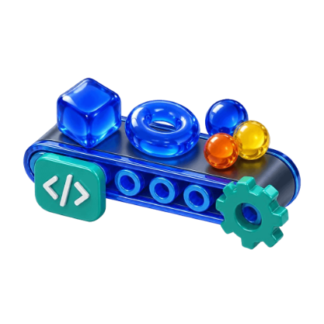
16
AGENTFORGE
AGENT 3 · BUILDER
Builder agent: scaffold, then one plan
SCAFFOLD FIRST
ONE SEQUENTIAL PLAN
A tested template is copied into an empty workspace only; existing code is never overwritten, and scaffold.json records what was installed.
1
PHASE 1 · COMPLETE THE REAL APP
Every approved page, route, role, business rule, record and workflow — with real validation, persistence and authorisation. Only a minimal compile check.
100% PROTOTYPE PARITY
Before planning, every prototype page is read and mapped: route → HTML source → app files → images. The page is reopened before each route is coded.
2
PHASE 2 · FOCUSED UNIT TESTS
Calculations, validation, permissions, state transitions and persistence rules. A real defect is fixed and only that test file is rerun.
REQUIREMENT RECOVERY
When something is unclear, the builder re-reads the approved plan, the SRS section and the mapped page instead of guessing, then continues.
3
PHASE 3 · FINAL PRODUCT CHECKS
ISOLATED DATA, MANAGED PREVIEW
E2E journeys derived from the SRS, prototype and actual code, then visual, accessibility, performance, security and dependency checks.
Each app gets its own MongoDB database; the Studio — not the agent — starts the preview on the stack's own port.
PROTOTYPE SETS THE LOOK · SRS SETS THE BEHAVIOUR
Notes:
After prototype approval the builder installs one of three bundled stacks and then runs a single plan with three sequential phases. The approved HTML prototype is the source of truth for the front end; the SRS is the source of truth for data, permissions and behaviour. Each run's plan is kept as developmentplanN.md in the app's plan folder.

Slide 17

17
AGENTFORGE
AGENT 3 · TOOLKIT
Builder agent: stacks, tools, integrations
THREE BUNDLED APPLICATION STACKS
INTEGRATION CATALOGUE · 21 PROVIDERS
Stack | Architecture | Deploys to
Next.js + MongoDB | Full-stack React, server routes | All 6 targets
Remix + MongoDB | Server-rendered React | All 6 targets
MERN microservices | React client, API gateway, Express services | AWS EC2/ECS, Azure
PAYMENTS
Stripe · PayHere · PayPal · Razorpay
EMAIL AND SMS
Resend · SendGrid · Mailgun · Twilio
PICTURES AND FILES
Cloudinary · ImageBoss · Amazon S3 · Supabase
SCAFFOLD INSTALLER
SIGN-IN
Copies the template, names package and database; never overwrites files.
Google · GitHub · Facebook · Microsoft
STACK AND PITFALL GUIDES
MAPS
Per-stack guides plus known build mistakes, fed into the plan.
Google Maps · Mapbox
ANALYTICS
NODE TOOLCHAIN AND SCRIPTS
Google Analytics · PostHog · Plausible
npm install and build, seed data, port guard, managed preview.
Keys are encrypted per user. The builder only receives a secret-free contract (PLUGIN.md), consumed once the integration succeeds.
MONGODB CONNECTION CHECK
Tests address, network, credentials and ping — never exposes the string.
Notes:
The builder's specialist tools are the bundled scaffolds and guides, the Node toolchain, a real MongoDB connection check and the provider catalogue. Customers pick integrations such as Stripe test mode or Google sign-in; the credentials stay encrypted and never enter the model's context.

Slide 18
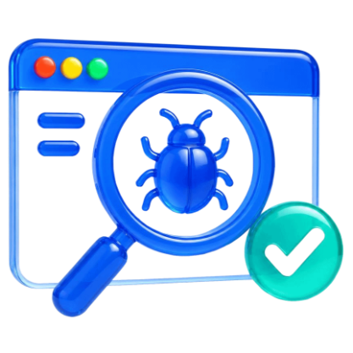
18
AGENTFORGE
AGENT 4 · QA
QA agent: evidence, not claims
The running app is verified layer by layer, and the report is saved after every layer.
01
02
03
04
05
BUILD & START
UNIT
E2E JOURNEYS
UI & ACCESSIBILITY
SPEED & SECURITY
Production build, then an isolated local server; key routes are probed for server errors.
Vitest on business logic and critical paths; API routes are matched to unit evidence.
Playwright walks every SRS journey as the right role, on desktop and mobile, keeping screenshots.
Visual checks of routes; axe-core WCAG checks on public and signed-in screens, plus keyboard focus.
Lighthouse per public route; OWASP ZAP passive baseline on the local server; npm audit.
NO INVENTED PASSES
REPAIR WHAT FAILED
SELECTIVE RERUNS
LIVE TEST VIEW
A missing artifact is never a pass. Unavailable tools are recorded with the exact reason; a ZAP fallback is labelled 'partial'.
A real defect is fixed in product code and only the affected check reruns. Assertions are never weakened.
Fresh passing evidence is reused. A UI-only change does not trigger E2E, accessibility, performance or security runs.
While Playwright runs, the Studio preview shows the test browser and its pointer moving in real time.
Notes:
QA treats the builder's claims as unverified until a runner says otherwise. The report on disk is the record and is written after every layer, so an interrupted run still leaves what it proved. Complete means every planned layer has an honest outcome, including 'unavailable' or 'partial'.

Slide 19
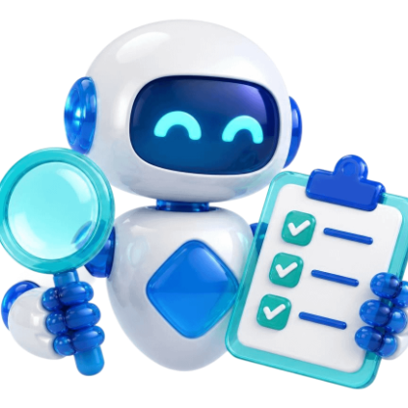
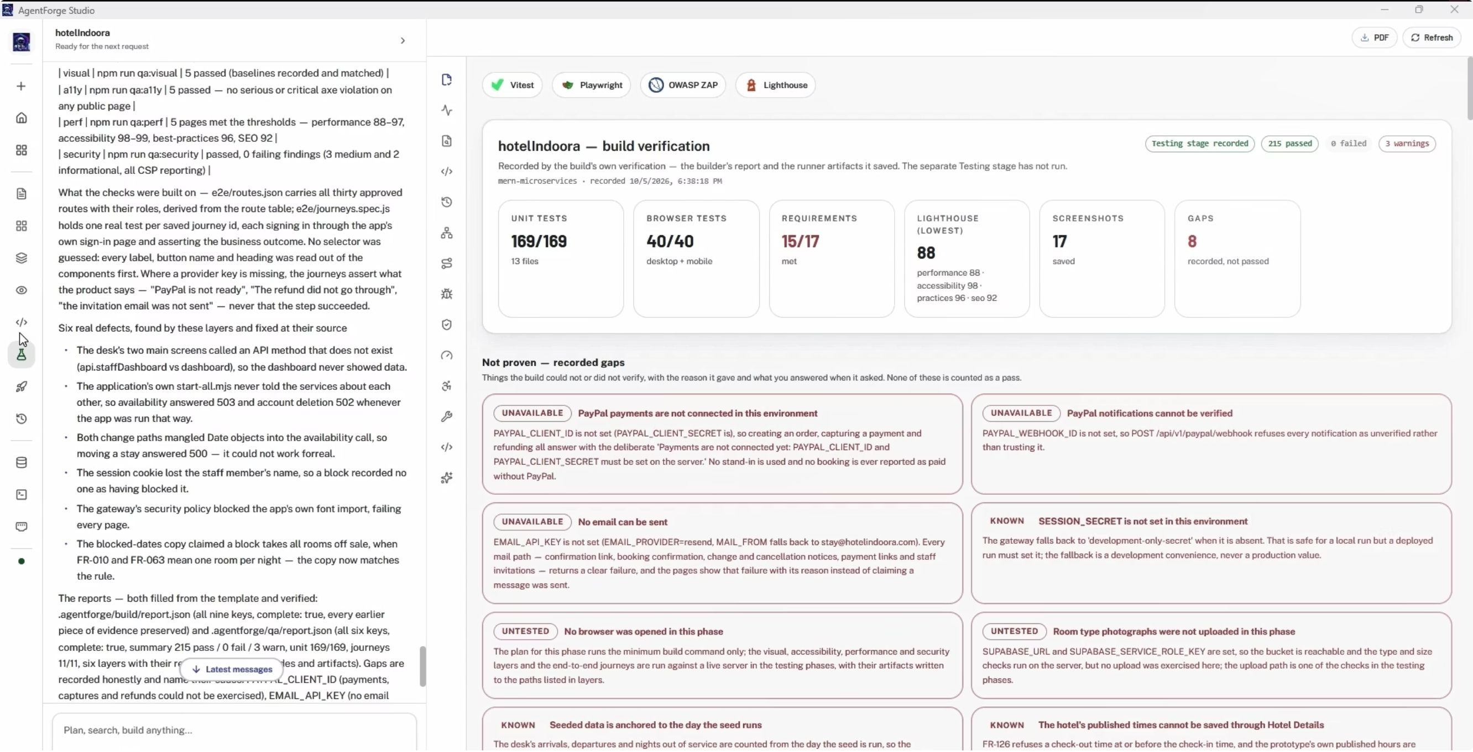




19
AGENTFORGE
AGENT 4 · TOOLKIT
QA agent: tools and their evidence
Tool | What it does → evidence file
Vitest | Runs focused unit tests on business rules → .agentforge/qa/vitest.json
Playwright | Drives a real browser through SRS journeys; streams it live → test-results/results.json · screenshots
axe-core | Finds WCAG violations by rule, impact and element → accessibility section of qa/report.json
Lighthouse CI | Scores performance and page quality per route → .lighthouseci/summary.json
OWASP ZAP | Spider + passive scan of the isolated local app → .agentforge/qa/zap/summary.json
npm audit + probe | Dependency advisories; status of every route → .agentforge/qa/routes.json
Captured run: the Scaffold QA view — one of the Studio's 14 testing views — lists test totals beside unmet requirements and open gaps.
Vitest
Playwright
Lighthouse
OWASP ZAP
Notes:
Each QA tool leaves a machine-readable file, and the Studio's fourteen testing views read those files directly. The screenshot is a user-supplied capture of the Scaffold QA view; its numbers are values recorded by the interface, not an independent rerun.

Slide 20
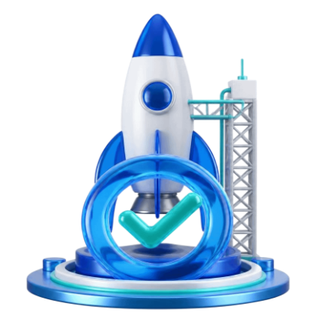
20
AGENTFORGE
AGENT 5 · DEPLOY
Deploy agent: plan, release, prove
01
02
03
04
05
PLAN
APPROVE
EXECUTE
PROBE
REPAIR
Reads the SRS handoff, build and QA records, app config and skill pages; measures the installed CLIs. No writes, no commands.
The customer reads the plan in chat and approves, revises it in their own words, or cancels.
Carried out with git, GitHub CLI and the target's own CLI; every command and exit code is recorded.
The Studio itself calls the public HTTPS address and every recorded check — not the agent's word.
A failed check returns with the repair skill: collect evidence, fix the root cause once, redeploy, re-verify.
RULES EVERY DEPLOYMENT FOLLOWS
REPOSITORY
SECRETS
DATABASE
Own GitHub repo under the customer's name: safe .gitignore, .env.example, meaningful commits, README on request.
Saved once in Settings and injected only into the deploy run's commands — never in chat, plans, logs or command lines.
Production data must be reachable from the host; a connection string pointing at this computer is refused.
DOMAIN AND HTTPS
SCALE, COST, ROLLBACK
DURABLE RECORD
Public HTTPS address verified; custom domains, DNS and certificates follow the target's skill page.
Capacity, paid choices and the way back are written into the plan before anything runs.
run.json and events: a reconnecting browser sees the live run; a stopped run can be resumed.
Notes:
Deployment is plan-first. Nothing leaves the computer while the agent plans, and nothing is deployed until the customer approves. After execution the Studio probes the public address itself; failures go back to the agent for up to two repair rounds before the run is reported as failed.

Slide 21






21
AGENTFORGE
AGENT 5 · TOOLKIT
Deploy agent: targets, sign-in, monitors
VERCEL
NETLIFY
AZURE
AWS EC2 / ECS
GITHUB
Next.js / Remix hosting via the vercel CLI
Web hosting via the netlify CLI
App Service via the az CLI
Virtual machines or containers via the aws CLI
Repository, Actions and releases via gh
MERN MICROSERVICES DEPLOY ONLY TO AWS EC2 / ECS OR AZURE — THEY RUN AS SEVERAL COOPERATING SERVICES
ONE-CLICK CLI SIGN-IN
LIVE READ-ONLY MONITORS
GitHub, AWS, Vercel, Netlify and Azure sign in through their own login in the browser (GitHub also by device code). Nobody pastes a token. The Studio shows which account a deployment will really use; a missing tool comes with its install command.
76 one-click, read-only commands — logs, health checks, scaling, deployments, CI runs, secret names — filled in from the deployment's own record. Output streams live with colour codes and secrets masked.
Azure: no service principal is created automatically — it changes the customer's tenant, so it stays their deliberate step.
GitHub 15 · Vercel 15 · Azure 12 · AWS ECS 11 · AWS EC2 9 · Netlify 8 · AWS account 6
Notes:
Targets come from the installed deployment skill pages: Vercel, Netlify, Azure, AWS EC2, AWS ECS and GitHub. Each still needs a compatible stack, the provider's CLI, a signed-in account and saved configuration. The monitor catalogue holds 15 GitHub, 15 Vercel, 12 Azure, 11 ECS, 9 EC2, 8 Netlify and 6 AWS-account commands, all read-only.

Slide 22

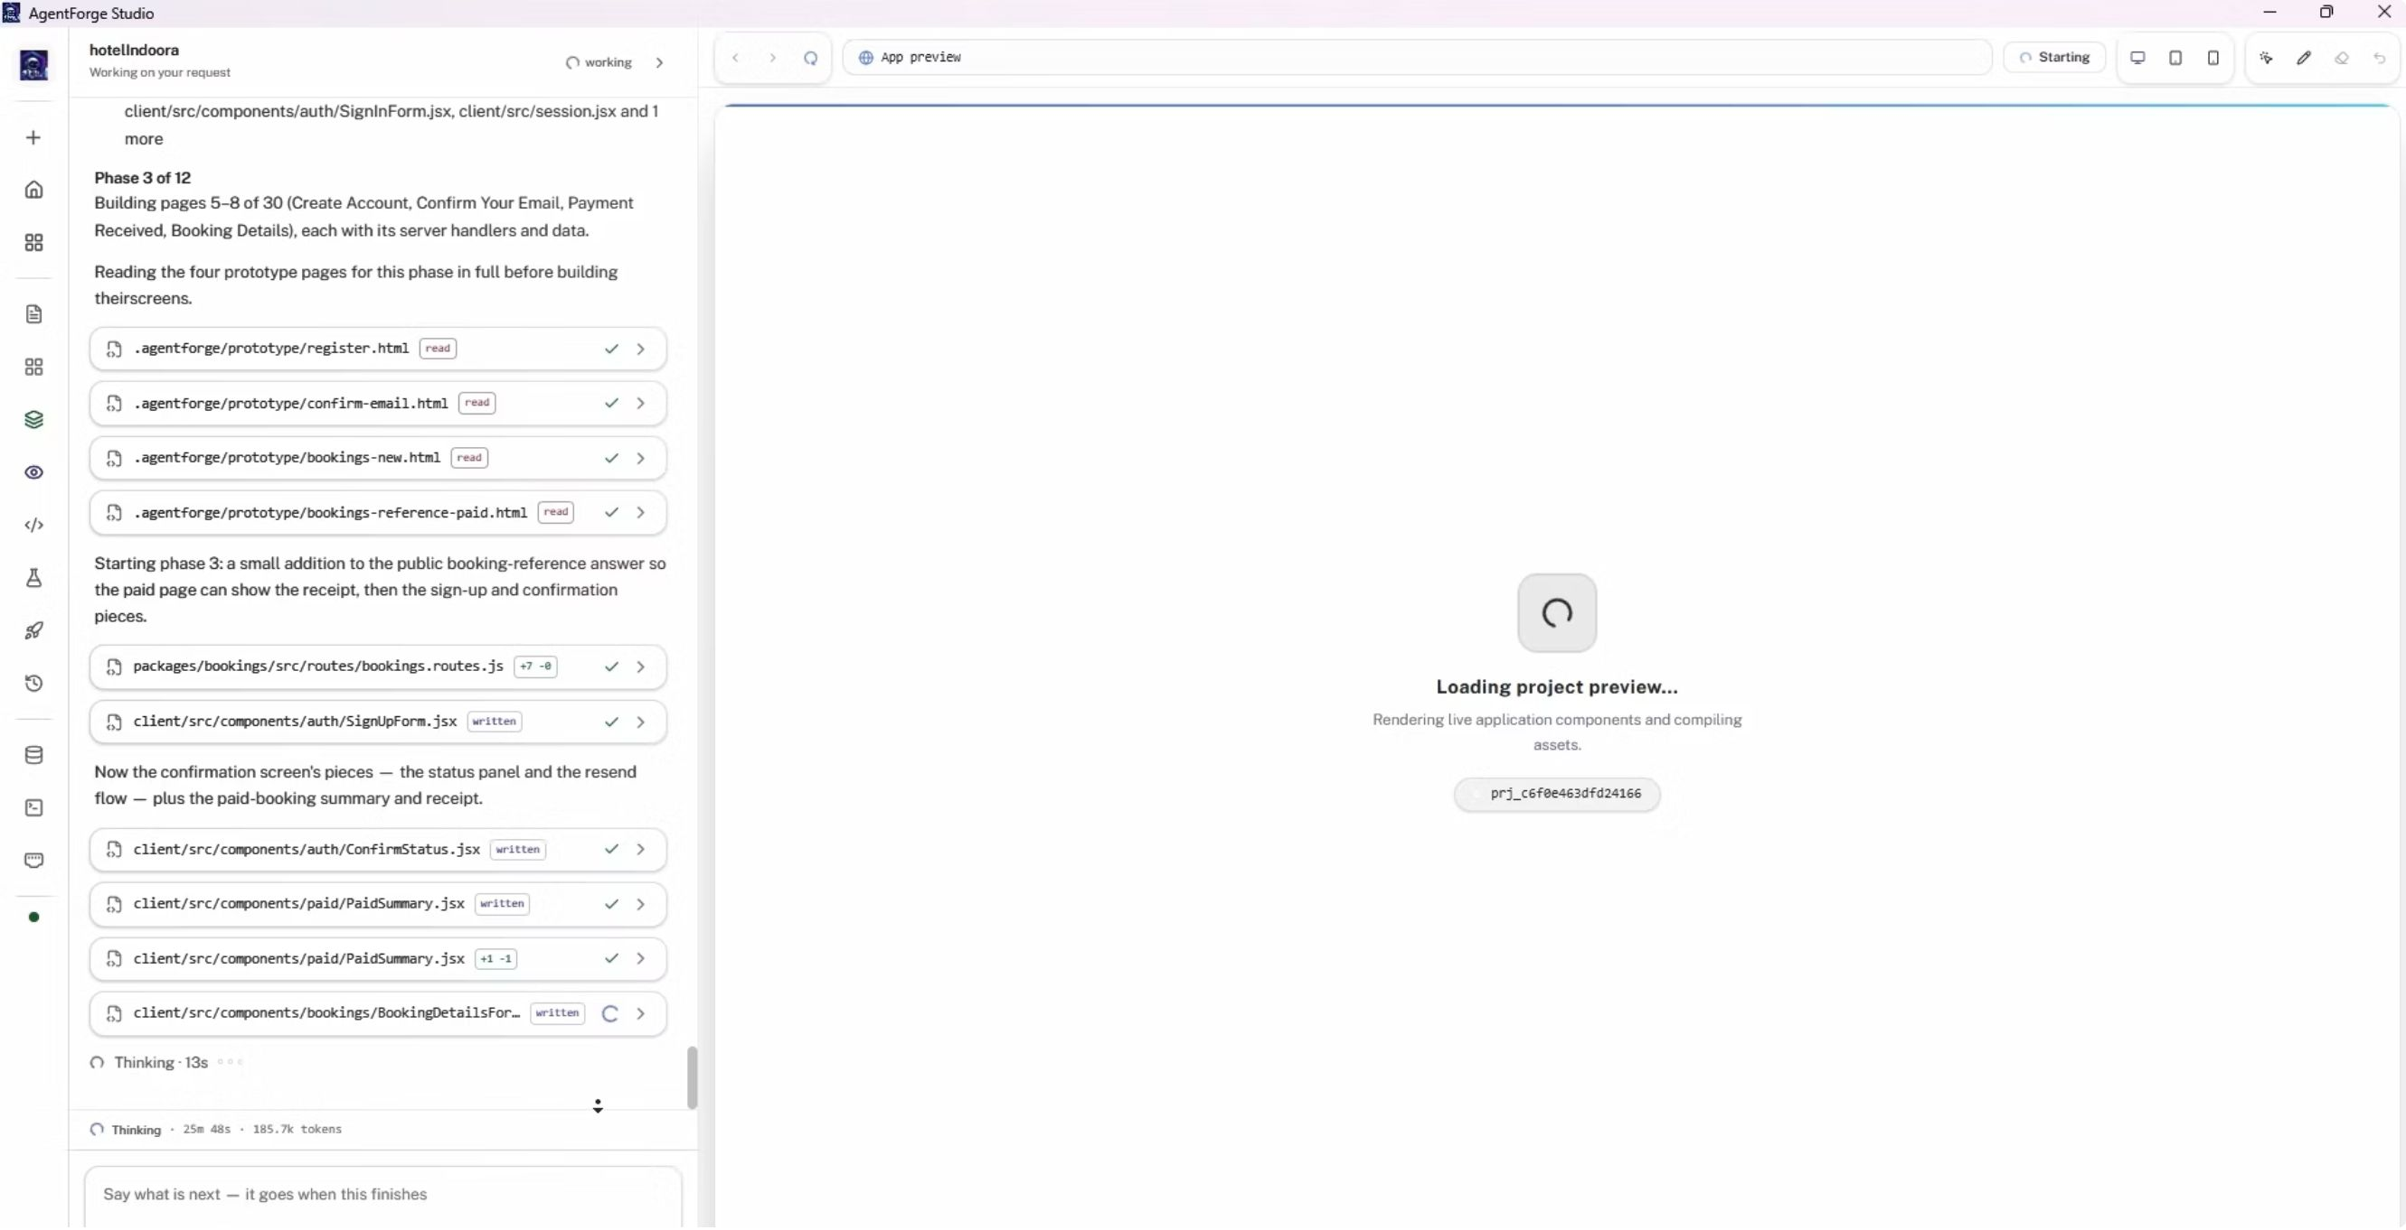
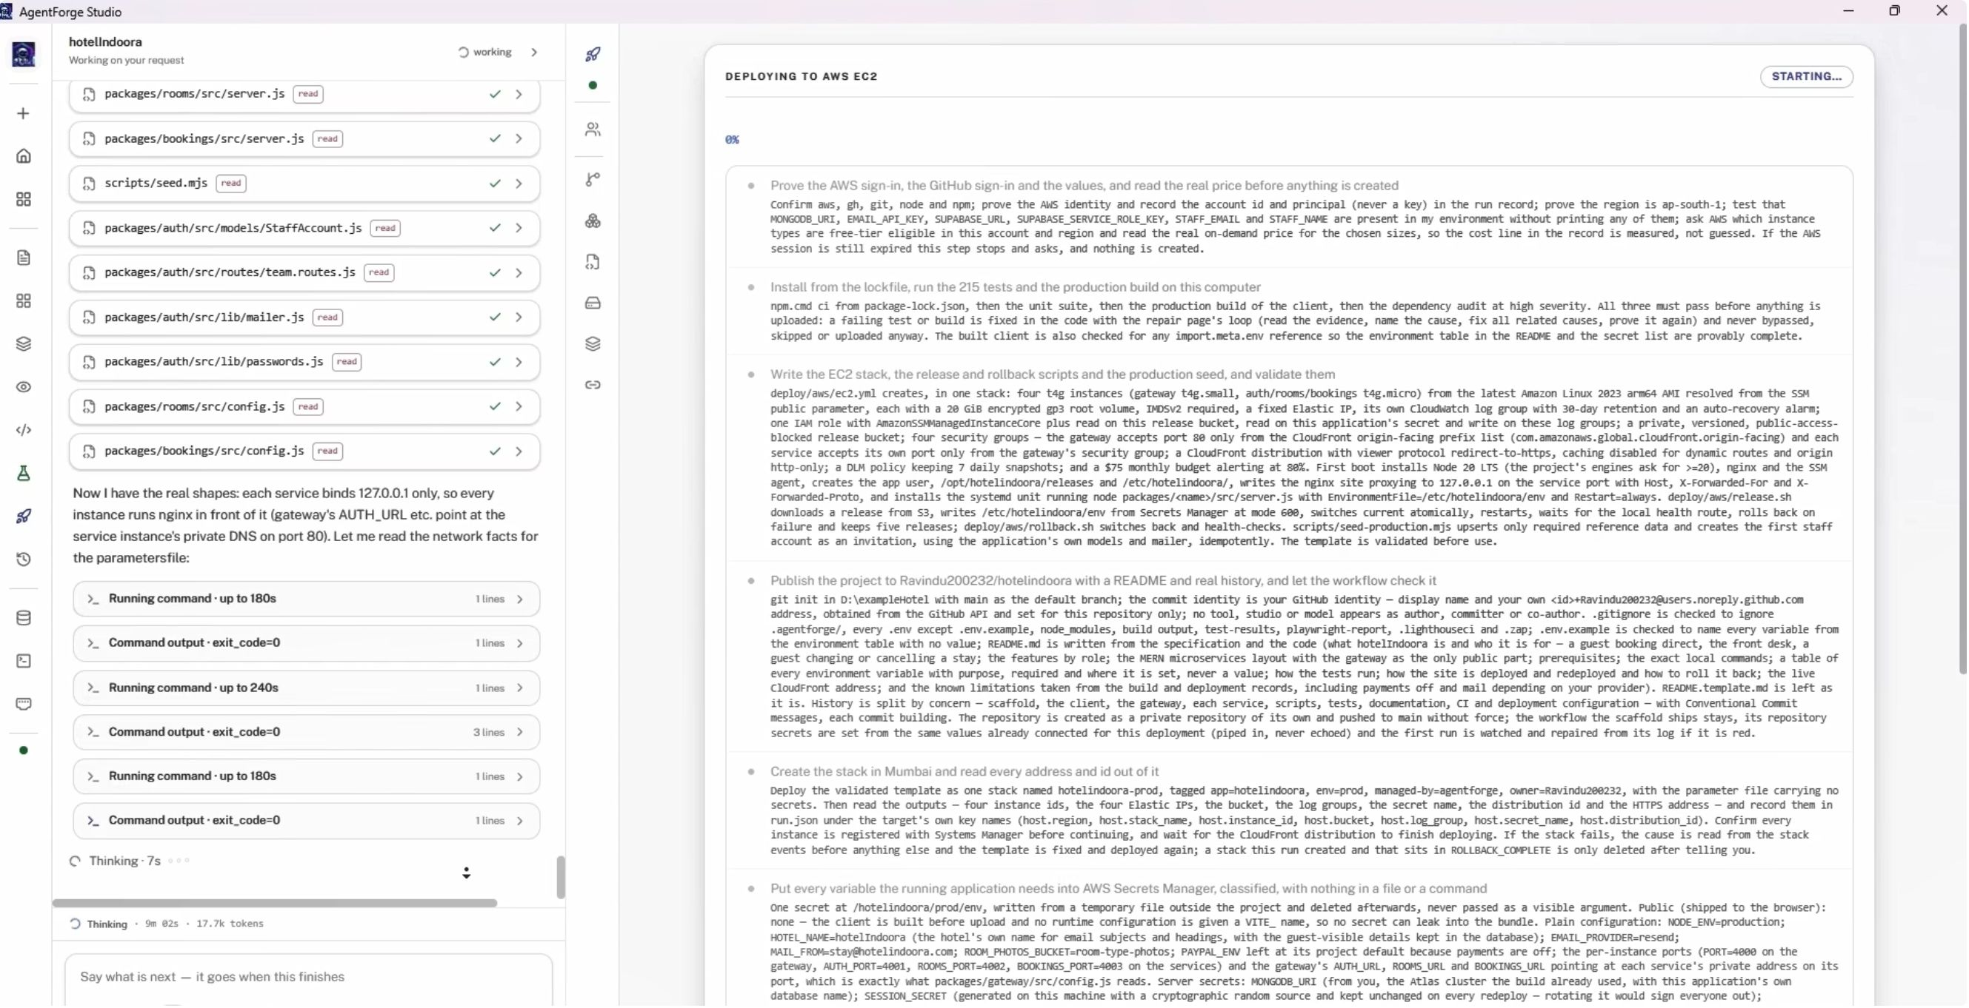
22
AGENTFORGE
AGENTS 3 & 5 · IN ACTION
Build and deployment in action
BUILD IN PROGRESS
DEPLOYMENT RUN
The builder re-reads each approved prototype page before coding it, then writes the matching components; the managed preview starts beside the stream.
Left: the deploy agent reads the project and runs commands, each with its exit code. Right: the approved AWS EC2 plan, step by step, as the run starts.
Notes:
Two captures of the Studio during a real project. The build stream shows prototype pages being read and application files being written. The deployment capture shows an approved AWS EC2 plan at the moment the run starts — it shows the flow working, not a completed public release.

Slide 23
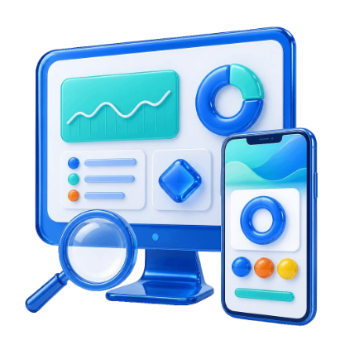
23
AGENTFORGE
PLATFORM FEATURES
One studio for the whole lifecycle
LIVE AGENT STREAM
PROJECTS AND IMPORT
MODEL CHOICE
Narration, file reads, a diff of every write and terminal output, as they happen — replayed after a reload.
Start from an idea or upload an existing codebase; every project resumes after a restart.
Any local Ollama model or Ollama Cloud, context size and thinking mode; switching models keeps the context.
SRS REVIEW SUITE
LIVE PREVIEW
CODE PANE
Overview counts, diagram viewer, wireframe grid, user-journey view, revisions and the approval dialog.
A managed server per stack, the prototype in an iframe, and the E2E browser streamed while tests run.
File tree and editor; a manual edit is recorded as a diff in the stream, like the agent's own.
VISUAL INSPECTOR
SITE PICTURES AND LOGO
TEST & DEPLOY DASHBOARDS
Point at an element to restyle, move, duplicate or delete it — breakpoints, states, undo and redo.
Upload brand images with usage notes; agents place them instead of placeholders.
14 testing views (unit, E2E, contracts, accessibility, performance, security, bugs, repairs…) and the Deploy panel.
Notes:
The Studio is the customer's single workspace. Every stage has its own view, and every action by an agent or a person is streamed and kept. These features are implemented in the Studio's components and the backend routes they call.

Slide 24
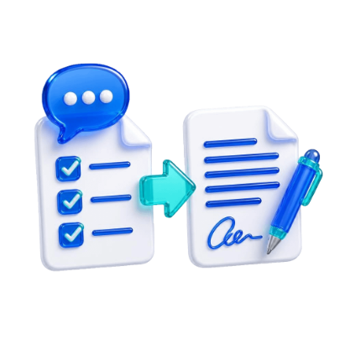

24
AGENTFORGE
ITERATION
Every change is planned and versioned
01
02
03
04
REQUEST
PLAN
DECIDE
EXECUTE
Type it in chat, ask for a new feature, or point at an element on screen.
Read-only: the agent maps the project, may ask a question, and shows a plan card.
Approve, revise in your own words, or cancel. Nothing changes before approval.
SRS, wireframes, prototype and code are updated where the request reaches them; focused tests run.
VERSION HISTORY
RESULTS PRESERVED
RESUME & SAFE CHAT
Each approved update becomes v1, v2… in JSON and Markdown: what was asked, the plan, files added, changed or removed, and test counts before and after.
Test records are copied before an update runs, so a change can never cost the project the results it already had.
Plans and questions survive restarts, and resume continues from where the project stopped. A pasted key or connection string is refused.
Notes:
A later request changes the existing project instead of starting over. The same plan-first flow is used for chat changes and deployments: plan read-only, show it, act only after approval, then record a version with the files touched and the test results before and after.

Slide 25
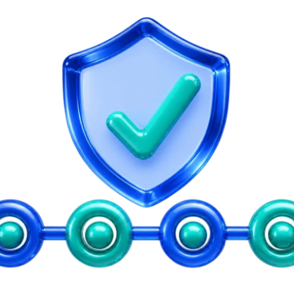
25
AGENTFORGE
TRUST AND SAFETY
Security by design
Guardrails are enforced in code, not only requested in prompts.
SANDBOXED FILES
SOURCE GUARD
PROCESS SAFETY
SECRET GUARD
Every path is resolved inside the project; a path that escapes it is refused.
AgentForge's own code is snapshotted around every command and restored if a project command changes it.
Agents cannot kill every Node process or run a dev server; only the preview's own PID is ever stopped.
Credentials typed into chat are detected and refused; command and monitor output is masked.
ENCRYPTED KEYS
DEPLOY VARIABLES
BROWSER SIGN-IN
PASSIVE SECURITY TESTS
Integration keys are encrypted per user (Fernet); the builder sees only a secret-free contract.
Saved once, shown only as names and last 4 characters, injected only into deploy commands.
Provider CLIs sign in through their own browser flow or GitHub's device flow — no long-lived token is pasted.
ZAP sends GET requests only, to the isolated local server — never to production or third-party hosts.
EACH GUARDRAIL IS ENFORCED BY THE BACKEND — NONE DEPENDS ON THE MODEL BEHAVING
Notes:
Because agents run real commands on the customer's machine, safety cannot depend on the model behaving. Each of these guardrails is implemented in the backend (tools, session, secrets_guard, deploy_vars, plugins, cli_signin and the ZAP scan script) and most are covered by the repository's test suites.

Slide 26
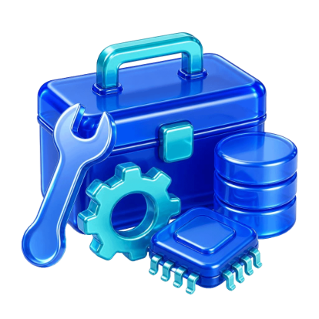

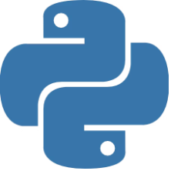



26
AGENTFORGE
TECHNOLOGY
Toolchain: what each tool does
Ollama
Python
Next.js
MongoDB
Vitest
Playwright
Lighthouse
OWASP ZAP
GitHub
Tool | What it does in AgentForge | Used by
Ollama (local or cloud) | Runs the LLM with native tool calling, web search and web fetch | All agents
Python · Pydantic · Fernet | Backend runtime, SRS schema validation, credential encryption | Platform · SRS
Next.js · React | The Studio interface for every stage | Platform
Mermaid CLI · Chromium | Renders the 11 diagram types to SVG | SRS
Next.js · Remix · Express · MongoDB | Bundled application scaffolds and data layer | Builder
Vitest | Unit tests for business logic | Builder · QA
Playwright · axe-core | E2E journeys, screenshots, live view, WCAG accessibility | Builder · QA
Lighthouse CI · OWASP ZAP · npm audit | Performance, passive security, dependency advisories | QA
git · GitHub CLI | Repository, commits under the customer's name, CI insight | Deploy
Vercel · Netlify · Azure · AWS CLIs | Provider sign-in, release and read-only monitors | Deploy
Notes:
This table answers 'what does each tool actually do'. Generic agent operations such as reading or editing files are deliberately left out — they are the engine's plumbing, not tools that give an agent its specialism.

Slide 27

27
AGENTFORGE
RESEARCH METHOD
How AgentForge will be evaluated
COMPLETENESS
CORRECTNESS
QUALITY
EFFORT AND COST
Share of planned screens, roles, records and features traced into SRS, prototype and built routes.
Build success, healthy runtime routes, unit pass rate, SRS journeys passing in Playwright.
axe violations by impact, Lighthouse scores, ZAP findings, dependency advisories.
Human interventions, repair rounds, tokens and time from idea to a probed live URL.
SOURCE
SOURCE
SOURCE
SOURCE
plan.json · srs.json · routes.json · build report
runner JSON · qa/report.json
QA artifacts per route
events.jsonl · versions · deploy run
STUDY DESIGN
CORPUS
BASELINES
ABLATIONS
MODELS
10+ projects spread across the 10 app types: POS, booking, e-commerce, SaaS, dashboard…
Single-prompt code generation, and a multi-agent pipeline with isolated contexts.
Remove the coverage gate, the shared context or the QA repair loop — one at a time.
Local open-weight versus cloud models, through the same Ollama interface.
Notes:
This is a prospective evaluation, not completed measurements. All four metrics can be collected from artifacts AgentForge already writes, so the same numbers can be gathered for every project and for each baseline and ablation.

Slide 28

28
AGENTFORGE
INTERPRETATION
Known limits and how they are handled
MODEL QUALITY
CONTEXT WINDOW
EXTERNAL SERVICES
Weaker local models need more repair rounds.
Long builds exceed the model's window.
Database, CLIs and cloud accounts must be ready.
MITIGATION
MITIGATION
MITIGATION
Gates and in-context repair; switching model keeps the context.
Summarised memory with a digest fallback; files stay the source of truth.
Machine facts are measured; the plan asks instead of assuming.
TEST COVERAGE
EVIDENCE BREADTH
TIME AND COST
A passing runner cannot prove a requirement it never tested.
Few complete end-to-end runs so far.
A full build with tests can take hours.
MITIGATION
MITIGATION
MITIGATION
Journey IDs come from the SRS; gaps are disclosed; missing ≠ pass.
Repeated runs across app types in the evaluation plan.
Selective reruns, parallel writes and resume after interruption.
Notes:
Automated checks improve the evidence but do not establish complete correctness. The model is chosen by the user, external services must be prepared, and broad outcome claims need repeated live runs.

Slide 29

29
AGENTFORGE
CONCLUSION
AgentForge makes every handoff inspectable
Five specialist LLM agents — SRS, prototype, builder, QA and deploy — work through one persistent project context. Deterministic gates, runner evidence and human approvals turn an idea into an application whose every step can be inspected.
C1 · SHARED-CONTEXT AGENTS
C2 · DETERMINISTIC GATES
Five roles, one conversation and one workspace, persisted across restarts.
Plan depth, schema, coverage and a Python-decided standards review.
C3 · EVIDENCE-FIRST QA
C4 · GOVERNED DELIVERY
Runner artifacts, honest gaps, and repair of only what failed.
Plan-first deployment with independent live verification.
NEXT: REPEATED END-TO-END RUNS WITH VERIFIED REQUIREMENTS COVERAGE AND A LIVE, PROBED RELEASE.
Notes:
The code joins five specialist agents through one persistent project context, with closed feedback loops for self-correction. Plans, SRS files, prototypes, build reports and QA evidence make each handoff inspectable. The next proof is repeated end-to-end runs and a successful live probe.

Slide 30

30
AGENTFORGE
THANK YOU
QUESTIONS?
Self-Optimized LLM Multi-Agent System for Software Engineering · PP2
OPEN FOR DISCUSSION
Shared-context architecture · quality gates · runner evidence · governed deployment · evaluation design
Notes:
Invite questions about the architecture, the validation gates, the evidence collected so far, the deployment flow or the evaluation design.

