Slide 1
VSL 360
T R A V E L I T I N E R A R Y
8 Days Tour in Sri Lanka
SRI LANKA
7
NIGHTS / 8 DAYS
Prepared for Mr. Shery Jain

Slide 2
OVERVIEW
DESTINATIONS
Your Journey
Colombo
2 nights
Embark on an unforgettable journey through Sri Lanka, the Pearl of the Indian Ocean. This carefully curated 8-day adventure takes you from the bustling streets of Colombo to the ancient cultural wonders of Kandy, through the misty tea plantations of Nuwara Eliya, and down to the pristine southern coast. Experience the perfect blend of cultural heritage, natural beauty, and authentic Sri Lankan hospitality.
Kandy
2 nights
Nuwara Eliya
2 nights
Galle
1 night
7 Nights | 8 Days
March 15, 2024 — March 23, 2024

Slide 3
ROUTE
At a Glance
Day 1
Day 2
Day 3
Day 4
Day 5
Colombo
Kandy
Nuwara Eliya
Galle
Colombo
8 days • 7 nights
Curated experiences across each destination

Slide 4
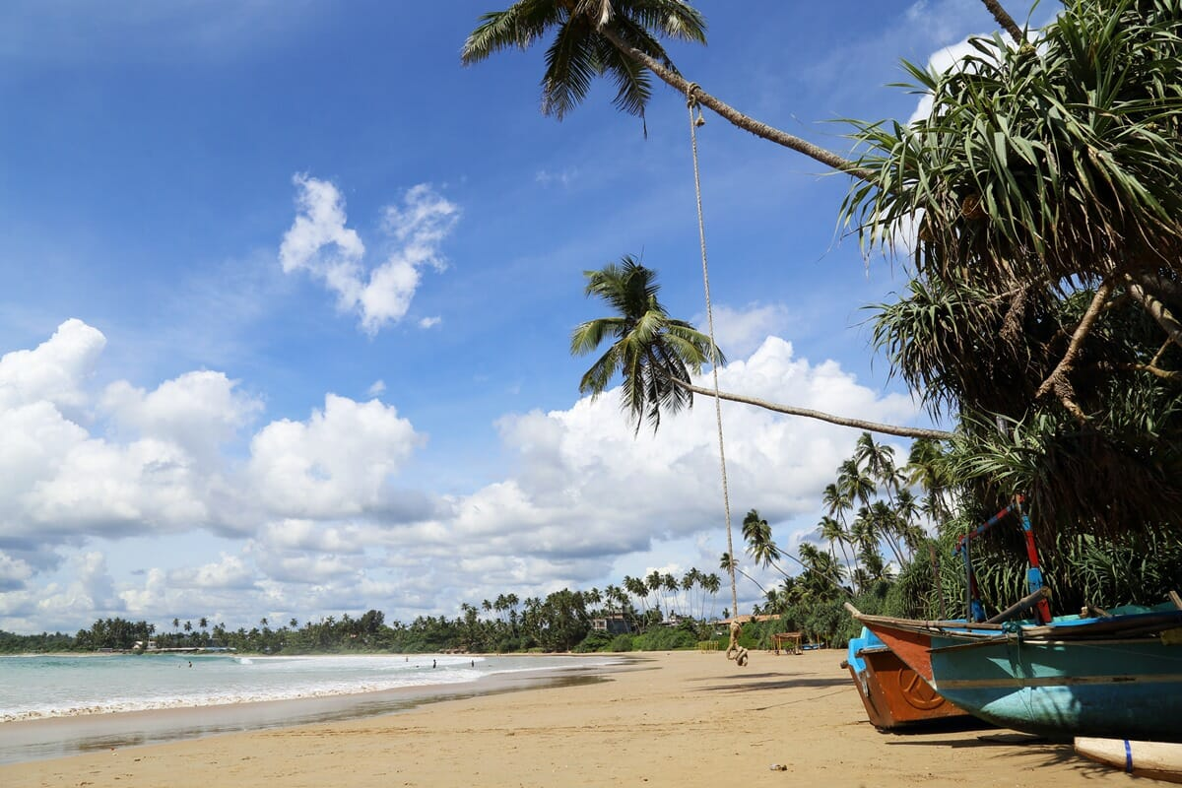
1
DAY
COLOMBO
Welcome to Sri Lanka
Arrive at Bandaranaike International Airport
Meet and greet by VSL 360 representative
Transfer to hotel in Colombo (30 mins)
Check-in and freshen up
Welcome dinner featuring traditional Sri Lankan cuisine
Travel: 30 minutes • Distance: 35 km • Overnight: Colombo

Slide 5
2
DAY
COLOMBO
Discovering Colombo
Breakfast at hotel
Guided city tour: Galle Face Green, Independence Square & colonial buildings
Visit Gangaramaya Temple - Buddhist temple complex
— image —
Lunch at Ministry of Crab (famous seafood restaurant)
Colombo National Museum - explore Sri Lankan history
Shopping at Barefoot Gallery and Odel
Evening at leisure
Distance: City tour • Overnight: Colombo

Slide 6
3
DAY
KANDY
Journey to the Cultural Capital
Breakfast and check-out
Scenic drive to Kandy through lush landscapes
— image —
En-route visit: Pinnawala Elephant Orphanage
Watch elephants bathing in the river
Arrive in Kandy and check-in to hotel
Evening visit to Temple of the Sacred Tooth Relic (UNESCO Site)
Attend traditional Kandyan dance performance
Travel: 3.5 hours • Distance: 115 km • Overnight: Kandy

Slide 7
4
DAY
KANDY
Kandy & Royal Botanical Gardens
Breakfast at hotel
Visit Royal Botanical Gardens at Peradeniya (147 acres)
Walk among orchid collections and giant bamboo groves
— image —
Lunch at garden restaurant
Ceylon Tea Museum and working tea plantation visit
Tea tasting experience with panoramic views
Sunset walk around Kandy Lake
Travel: 30 minutes • Distance: 15 km • Overnight: Kandy
Optional: Evening spa treatment at hotel (additional cost)

Slide 8
5
DAY
NUWARA ELIYA
Scenic Train to Hill Country
Early breakfast and check-out
Board famous Kandy to Nuwara Eliya train
— image —
Journey through tea plantations and mountain scenery
One of the world's most scenic train rides
Arrive in Nuwara Eliya - 'Little England' of Sri Lanka
Check-in to colonial-era hotel
City tour: Gregory Lake & Victoria Park
Travel: 4 hours • Distance: 80 km • Overnight: Nuwara Eliya

Slide 9
6
DAY
NUWARA ELIYA
Horton Plains & World's End
Very early breakfast box (4:30 AM)
Drive to Horton Plains National Park
Trek to World's End viewpoint - breathtaking 4000ft drop
— image —
Visit Baker's Falls waterfall
Return to hotel for late brunch
Visit working tea factory - learn Ceylon tea production
High tea at Grand Hotel - colonial tradition
Travel: 1.5 hours • Distance: 35 km • Overnight: Nuwara Eliya

Slide 10
7
DAY
GALLE
Coastal Beauty of Galle
Breakfast and check-out
Scenic drive to southern coast through hill country
— image —
Lunch at beachside restaurant
Explore UNESCO-listed Galle Fort
Walk through Dutch colonial architecture
Visit lighthouse and fort ramparts
Sunset photography along the fort walls
Travel: 5 hours • Distance: 175 km • Overnight: Galle

Slide 11
8
DAY
COLOMBO
Farewell Sri Lanka
Breakfast at hotel
Morning at leisure - optional beach time
Check-out and drive to Colombo airport
— image —
Last-minute shopping if time permits
Departure from Bandaranaike International Airport
End of memorable Sri Lankan journey
Travel: 3 hours • Distance: 145 km • Overnight: N/A

Slide 12
ACCOMMODATION
Where You'll Stay
Property
Location
Room Type
Nights
The Kingsbury Hotel
Colombo
Deluxe Ocean View
Night 1-2
The Kandy House
Kandy
Luxury Suite
Night 3-4
Jetwing St. Andrew's
Nuwara Eliya
Colonial Room
Night 5-6
Amangalla
Galle Fort
Heritage Suite
Night 7

Slide 13
PACKAGE DETAILS
What's Included
INCLUDED
NOT INCLUDED
7 nights accommodation in 4 & 5 star hotels
International and domestic airfare
Daily breakfast at all hotels
Sri Lankan visa fees (ETA)
Welcome dinner on Day 1
Travel insurance
3 lunches at select restaurants
Lunches and dinners not mentioned in itinerary
All entrance fees to monuments and sites
Optional activities and spa treatments
English-speaking professional guide throughout
Personal expenses and shopping
Private air-conditioned vehicle for all transfers
Tips for guides and drivers
Airport meet and greet service
Camera fees at certain sites
Train tickets for Kandy to Nuwara Eliya scenic route
Any services not mentioned in inclusions
All activities mentioned in itinerary
High tea at Grand Hotel Nuwara Eliya
Bottled water during transfers
Investment Per Person: ₹48,500

Slide 14
Thank You
8 Days Tour in Sri Lanka
Your journey begins here.
VSL 360

