Slide 1
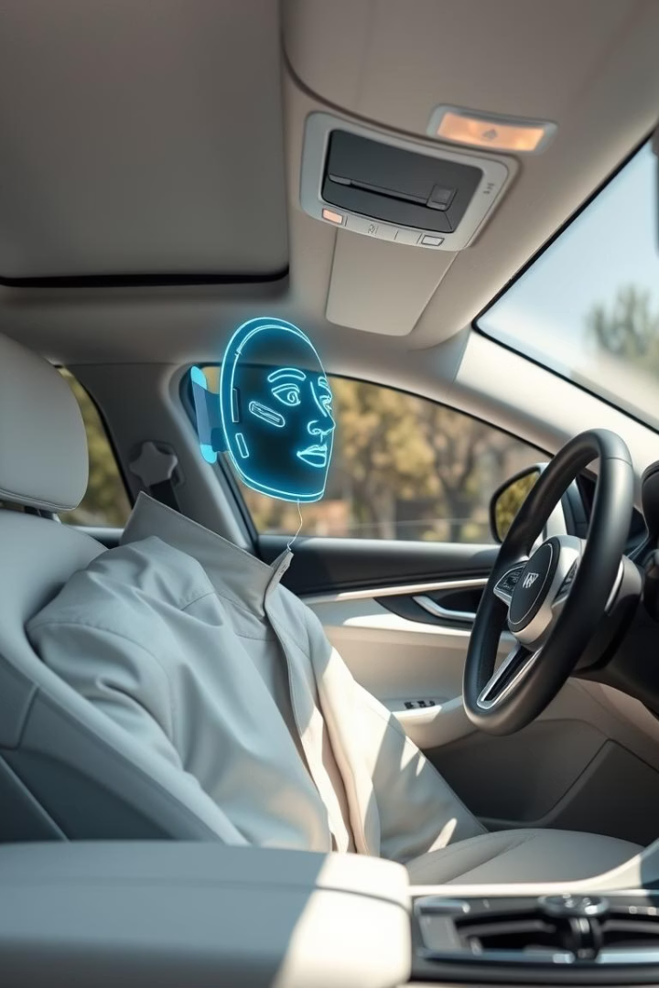
Automatic Seat Adjustment Using Face Recognition
An intelligent system for personalized, touchless driver seat tuning enhancing comfort and ergonomics.
H.M.I.S. HERATH E/20/135
H.M.R.D.HERATH E/20/140
M.V.J. JAYASANKA E/20/167
L.D.N.S. KARUNARATHNE E/20/190

Slide 2


Motivation Behind the Project
Manual seat adjustment drawbacks
Lack of automatic identity recognition
Time-consuming, inconvenient, especially for elderly and disabled
Current memory seats don’t recognize drivers automatically
Rising smart personalization demand
Our solution
Increasing expectation for automated, hygienic vehicle settings
Touchless, face recognition-based automatic seat adjustment

Slide 3
Project Overview and Significance
Significance
Core Functionality
Bridges automation with personalized comfort
Real-time driver face recognition
Enhances driving safety & ergonomics
Retrieves stored seat profile settings
Improves hygiene by touchless control
Auto adjusts seat height, distance, recline
Integrates AI, image processing, embedded systems

Slide 4

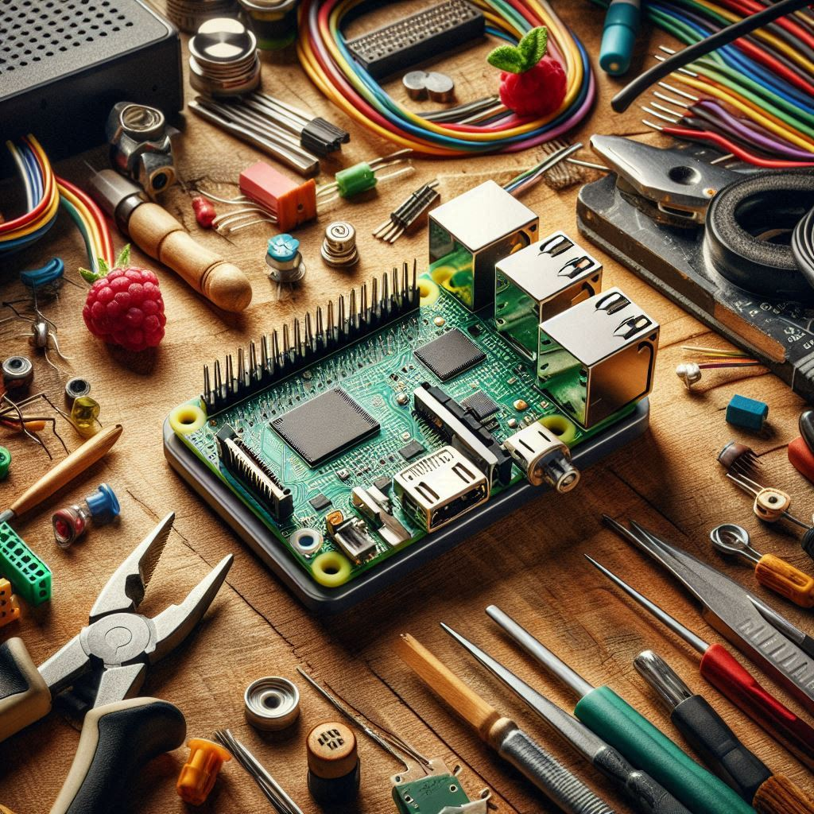




Methodology and Technical Approach
Control Unit
ESP32 or Raspberry Pi for system management
Face Detection
Camera plus OpenCV / MediaPipe for real-time recognition
Motor Commands
Microcontroller adjusts seat via motor actuators
Safety Interlocks
Locks seat adjustment when vehicle is moving
Testing
Prototype validation on accuracy, latency, usability

Slide 5
System Features Breakdown
Automatic Driver Identification
Personalized Seat Adjustments
Multi-user Profile Management
Touchless, Hygienic Operation
Safety Lock Mechanism
Scalable Vehicle Controls
Mirrors, steering, A/C integration potential

Slide 6
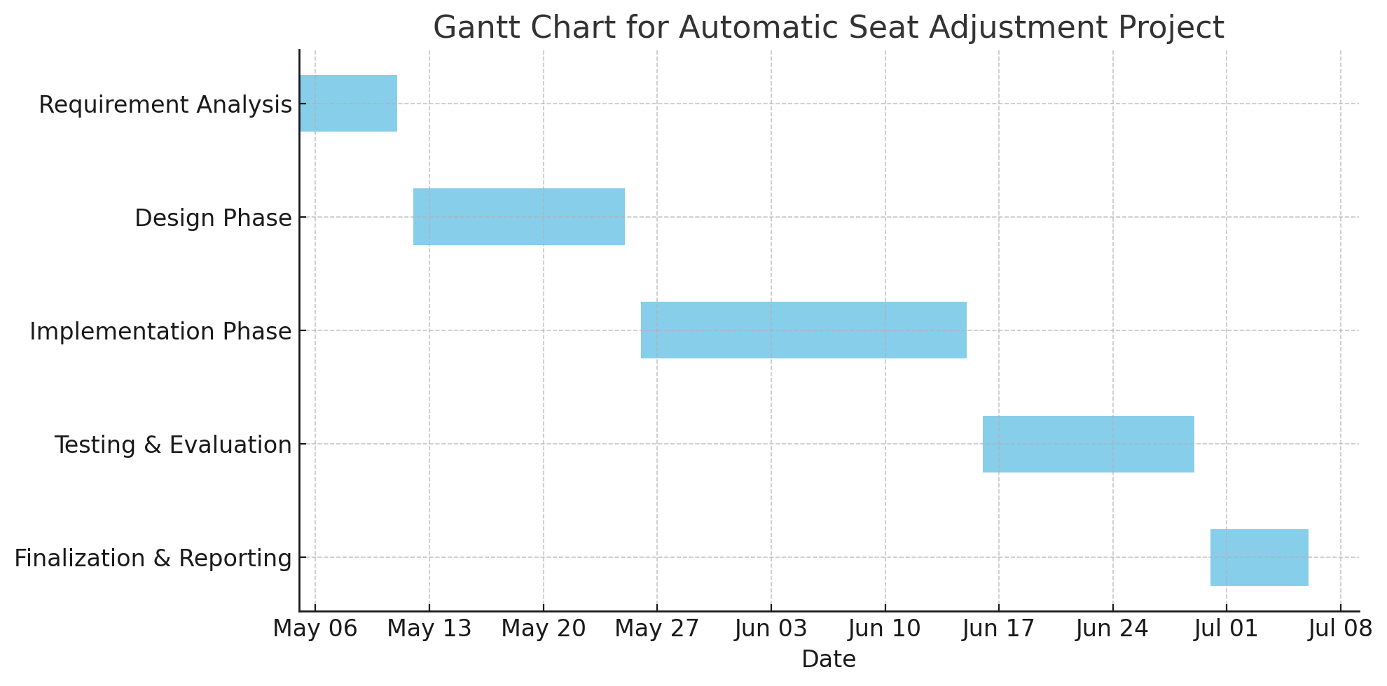
Project Timeline and Milestones
Week 1
Requirement Analysis
Literature review, scoping
Weeks 2-3
Design Phase
System architecture, dataset, motor selection
Weeks 4-6
Implementation
Model coding, microcontroller interfacing
Weeks 7-8
Testing & Evaluation
Prototype tests, performance analysis
Week 9
Finalization
Documentation, proposal updates

Slide 7




Hardware & Software Components
Hardware
Software
Raspberry Pi or ESP32 microcontroller
Python with OpenCV and MediaPipe
High-resolution camera module
Visual Studio Code IDE
Seat adjustment motors (3 units)
Arduino IDE for microcontroller code
LCD display & wiring components

Slide 8
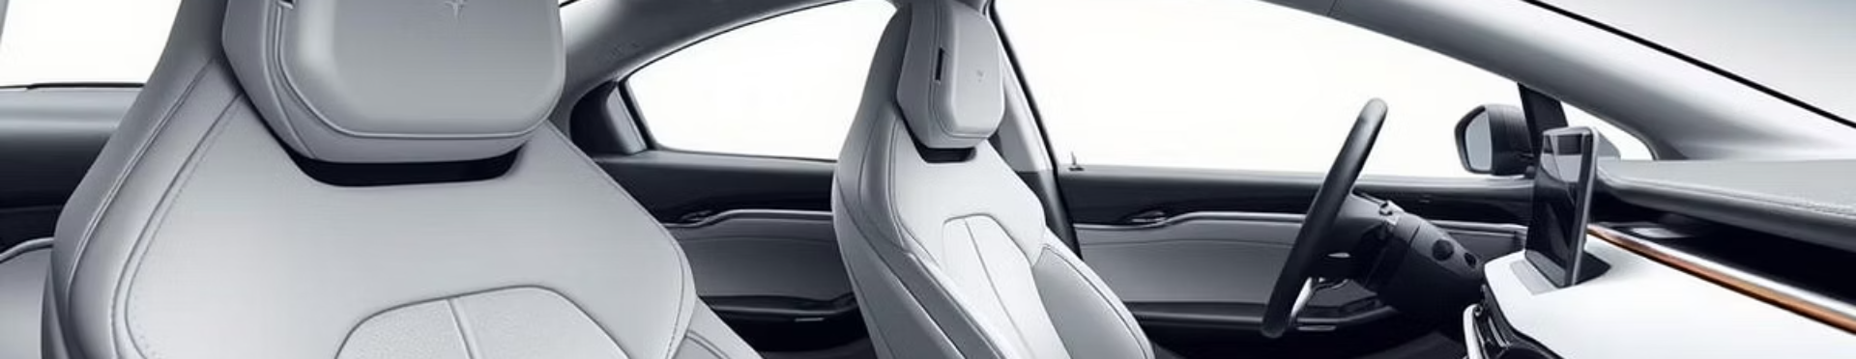
Conclusion & Future Directions
Extended Control Scope
Aftermarket & OEM Potential
Add mirrors, steering wheel & A/C settings
Innovative Ergonomics
Practical AI-driven seat personalization
Adaptable for future smart vehicles

Slide 9
Q & A

