Slide 1
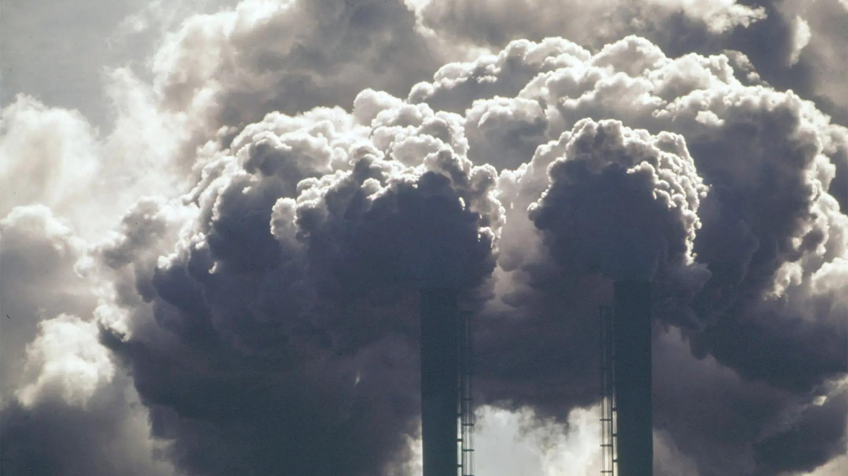
ToGMoS
CO2 and Other Toxic Gases Monitoring System Using Terahertz Communication

Slide 2



Meet the Team
Ravindu Pushpakumara
Department of Biomedical Engineering
Vishagar Arunan
Department of Electronic and Telecommunication Engineering
Hansa Marasinghe
Department of Biomedical Engineering

Slide 3
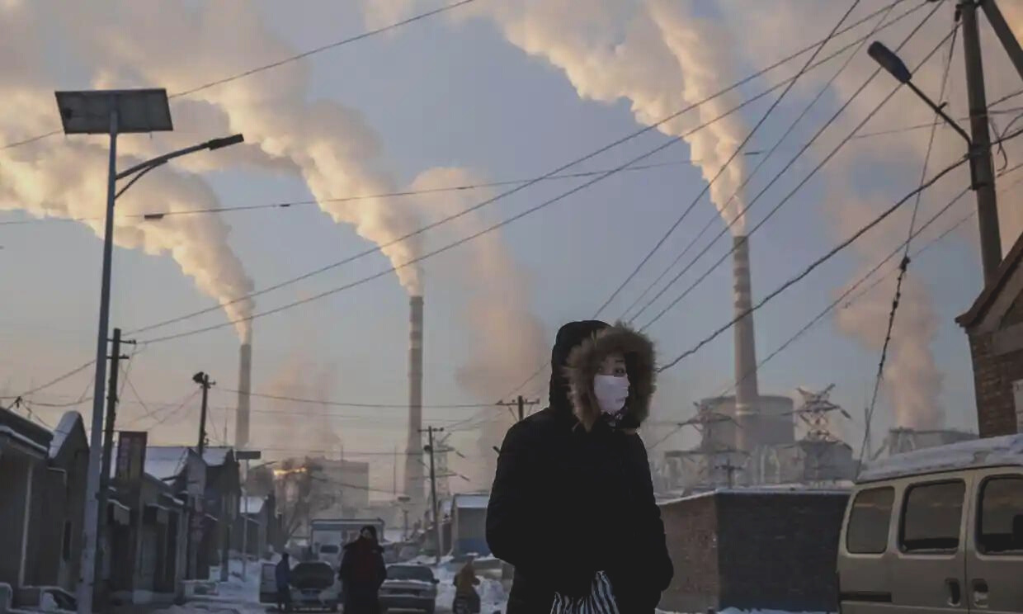

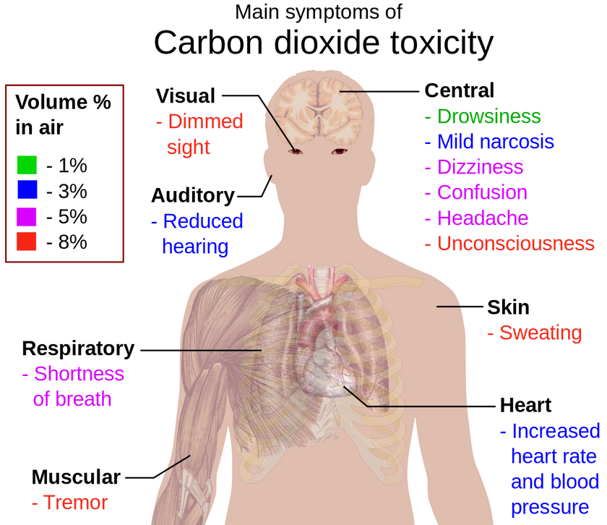
Why TogMos?

Slide 4

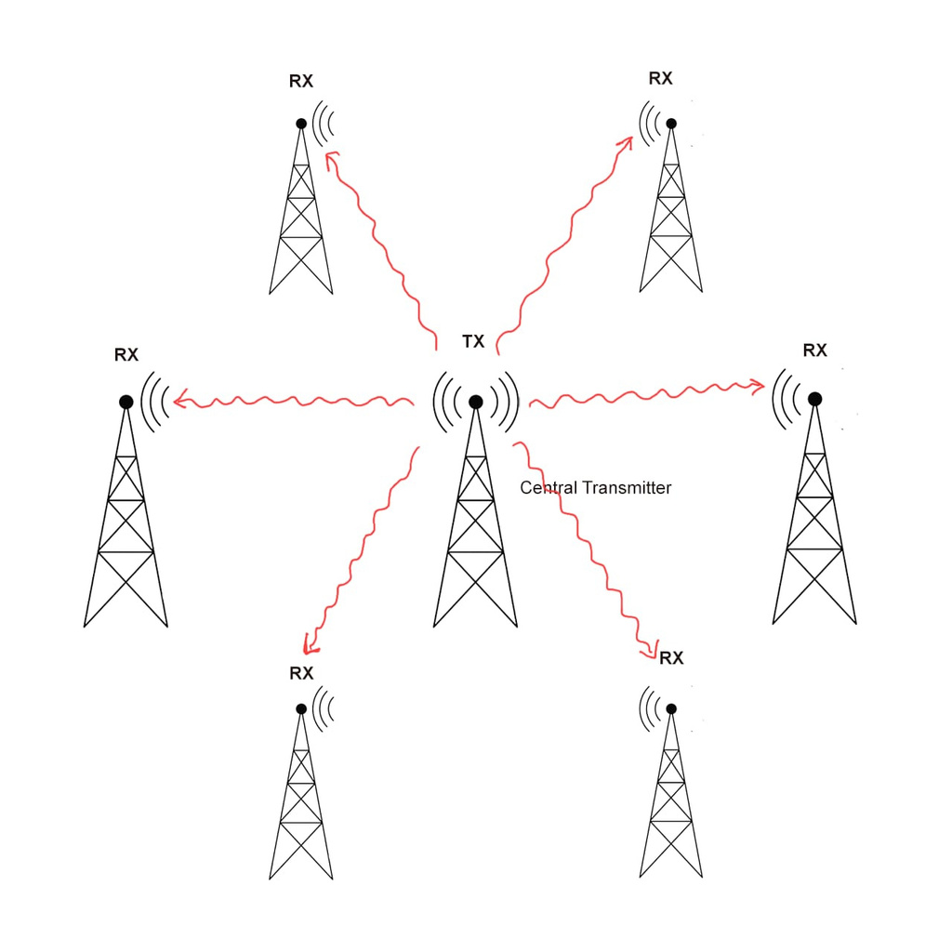
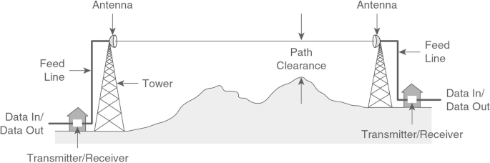
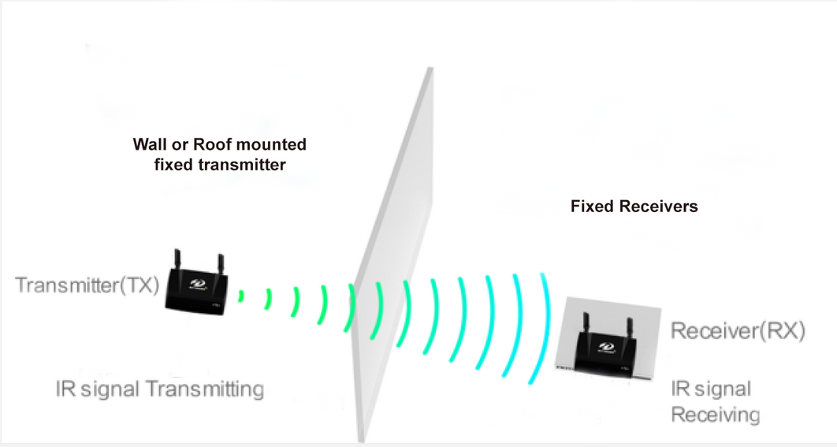

Slide 5
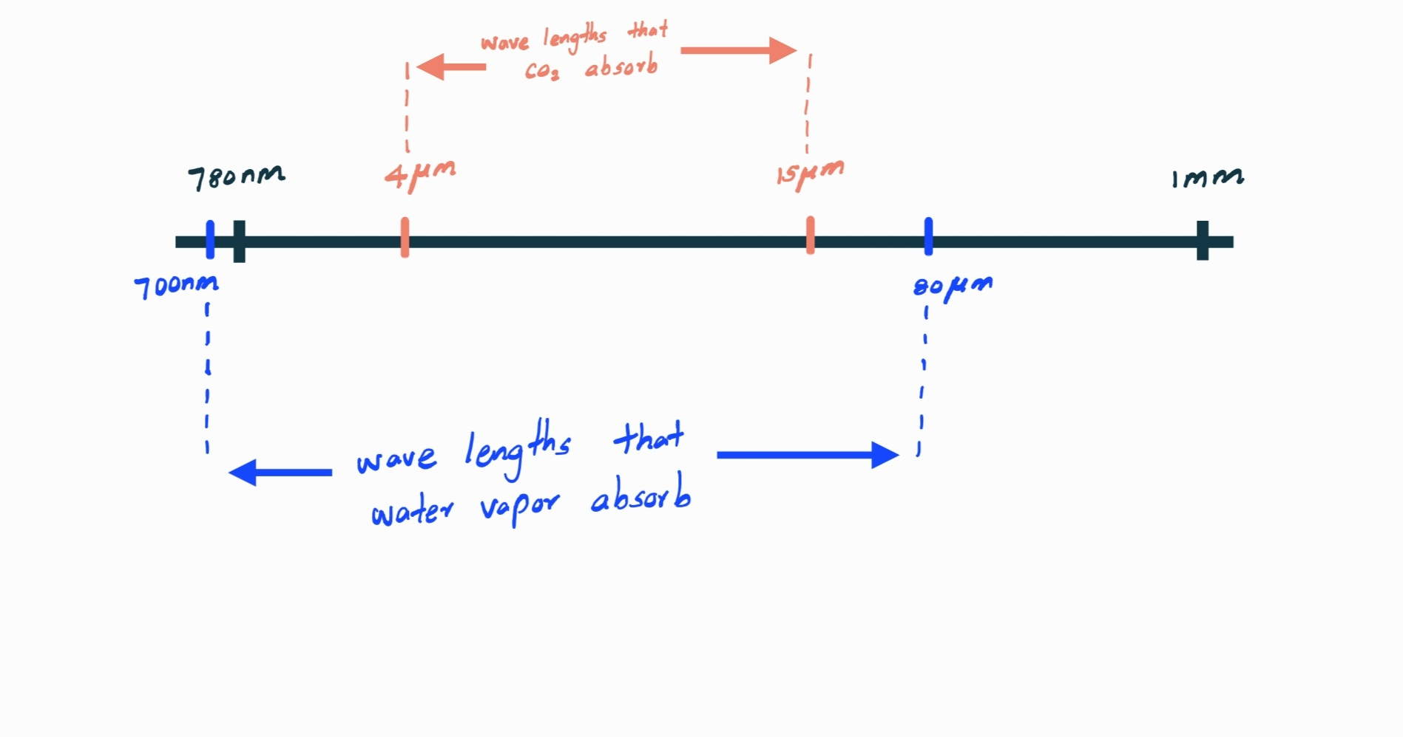
Spectrum Realization

Slide 6
Business Plan
Phase 1
Phase 2
Phase 3
Phase 4
Mass production
&
foreign
Launching
with a trial period
Introducing
Outdoor system
Initial Introduction

Slide 7
Estimated Cost and Revenue
Product | Estimated Cost | Estimated Selling Price
Indoor Monitoring system | 25,000 LKR | 40,000 LKR
Outdoor Monitoring System | Under developing | Not yet confirmed

Slide 8
Team 1.0
Thank you!
Let's make different

