Slide 1
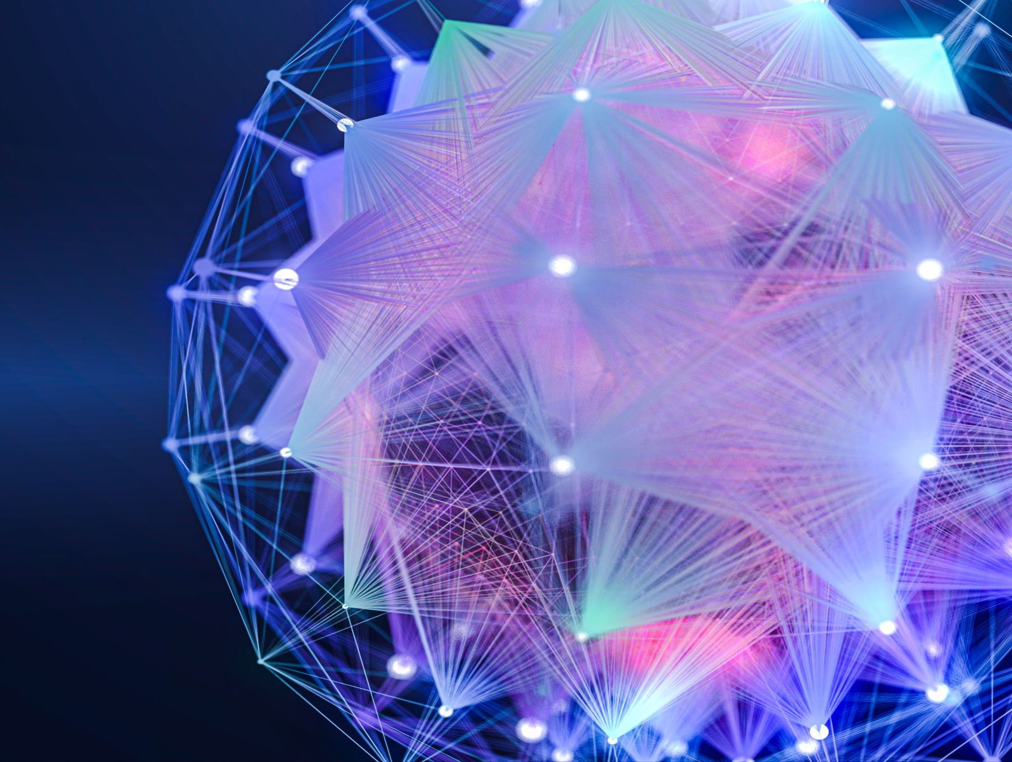
Advanced Laser mining array (alma)
Fiber Laser (FBL) using Ytterbium (Yb) doped fiber cable
Jacob R. Romeo

Slide 2
Purpose and Plan for ALMA
Main purpose will be to prove that the FBL could mine ice on the moon and NEOs.
This involves making a downsized, low powered model to confirm the design.
After, run Mathematical Models to know what we need to make the scaled version.
Possibly getting funding for an up-scaled version.

Slide 3
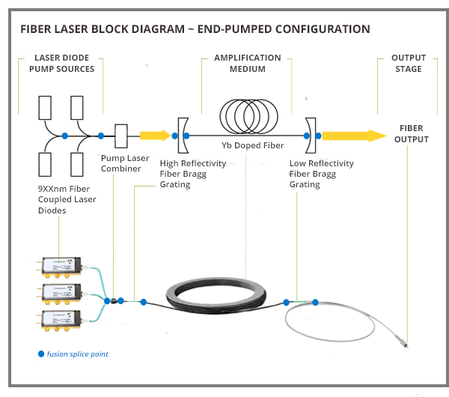
Design
The Fiber Laser is pumped with a diode (976nm).
The diode is coupled to the fiber cable.
The doped, Yb core of the fiber cable uses stimulated emission to amplify the output.

Slide 4
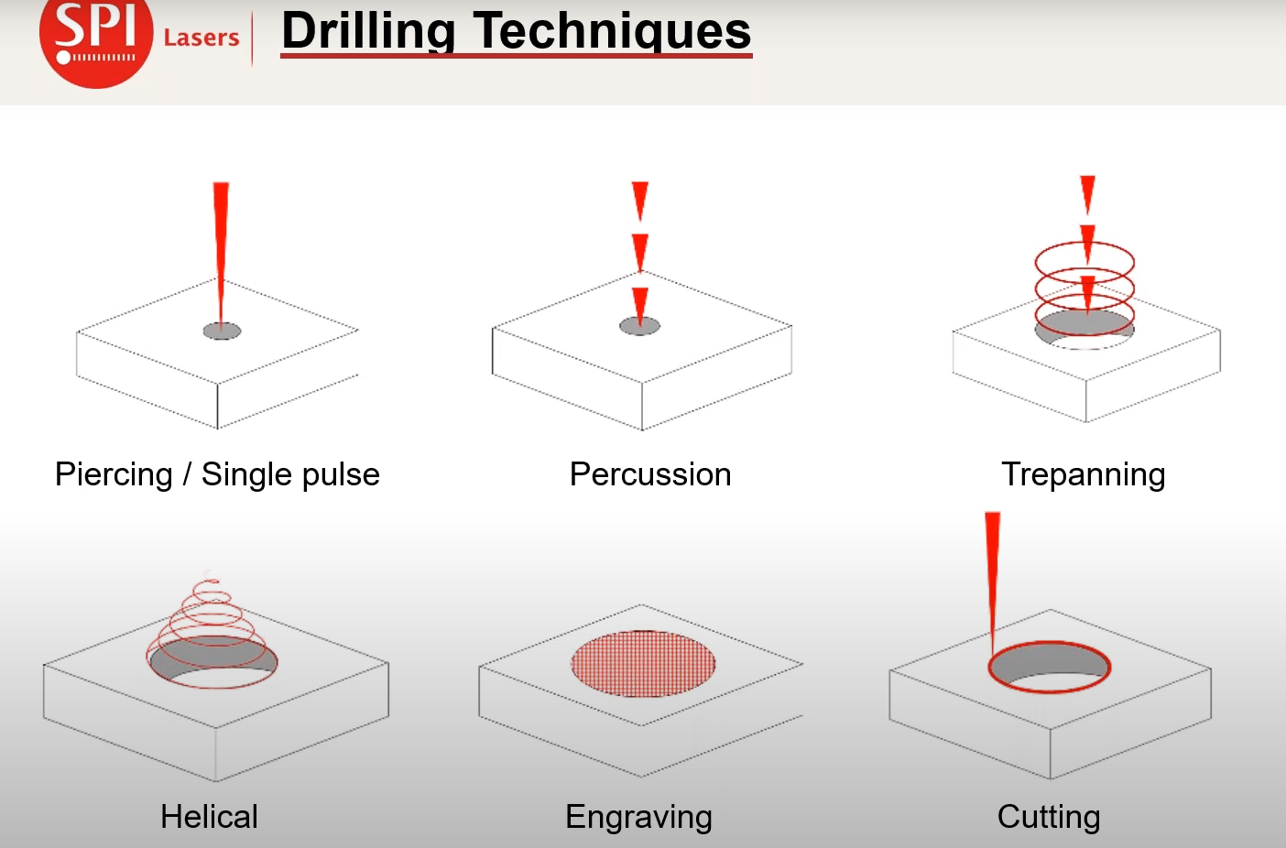
Drilling Technique
Different techniques are used for different applications.
For our purposes, we want a large area with high energy impulses.
Possibly using more than one output fiber to get a larger area of effect.

