Slide 1
Rapidly Oscillating Ap Stars
Supervisor: Dr. Stephen Gillam
Researcher: Jacob Romeo

Slide 2
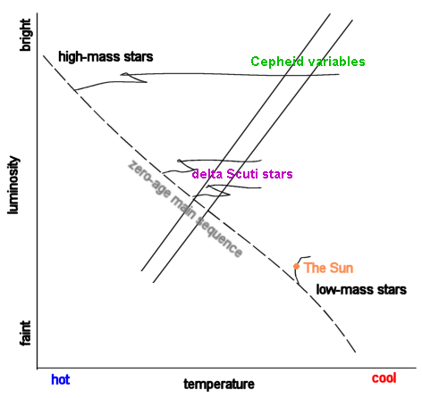
What is an roAp?
Fig. 1
roAp stands for a rapidly oscillating Ap star
These lie on the δ-Scuti instability strip (Fig. 1)
Are A and F class stars, about 2-1 solar masses
roAp’s are chemically peculiar, with Sr, Eu, Cr, and Si in their atmospheres.
EX: HD 134214 with spectral type Ap SrEu(Cr), magnitude 7.46 with period 5.6 minutes.

Slide 3
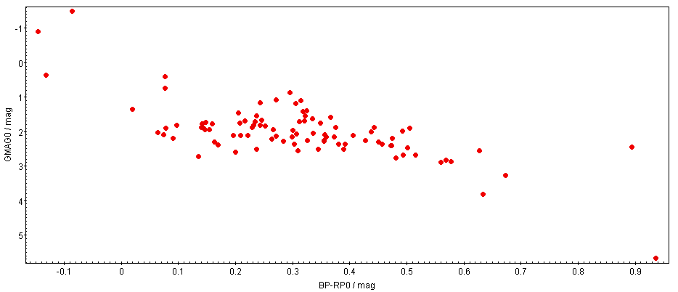
Known roAp’s
Fig. 2
Using TESS observations on ~200 roAp’s to identify each in Gaia
Concatenating each table into a database, pair matching with starhorse
Fig. 2 of a HRD showing the instability strip (GMAG vs. BP-RP0)

Slide 4
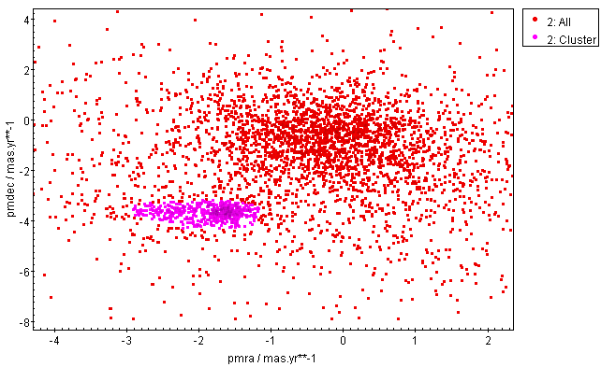
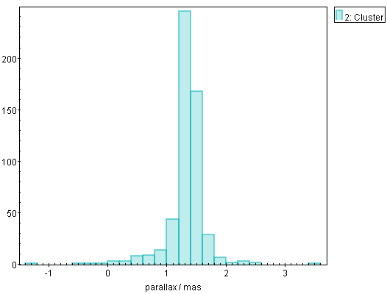
NGC 2264
Fig. 3
Selecting the smaller, dense, pink, group of stars (Fig. 3, which is a pm plot)
Selecting stars with parallaxes within a range of (0.6,2) from the pink group (Fig. 4, a histogram); making a new group
Fig. 4

Slide 5
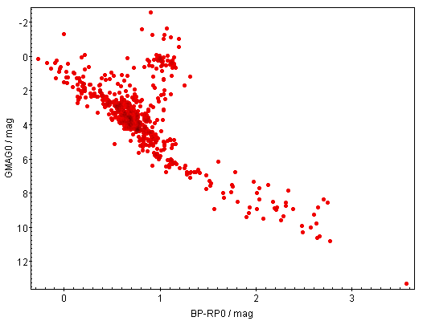
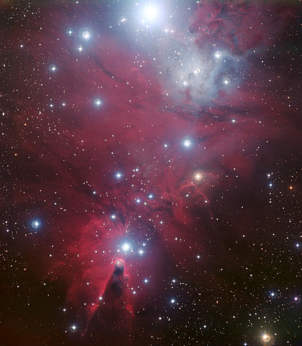
Continue: NGC 2264
Fig. 5
Fig. 6
Plotting the HRD of the final group (Fig. 5, the stars in NGC 2264)
Fig. 6 A pretty picture of NGC 2264, which we cannot guarantee right now, is centered with Fig. 5

Slide 6
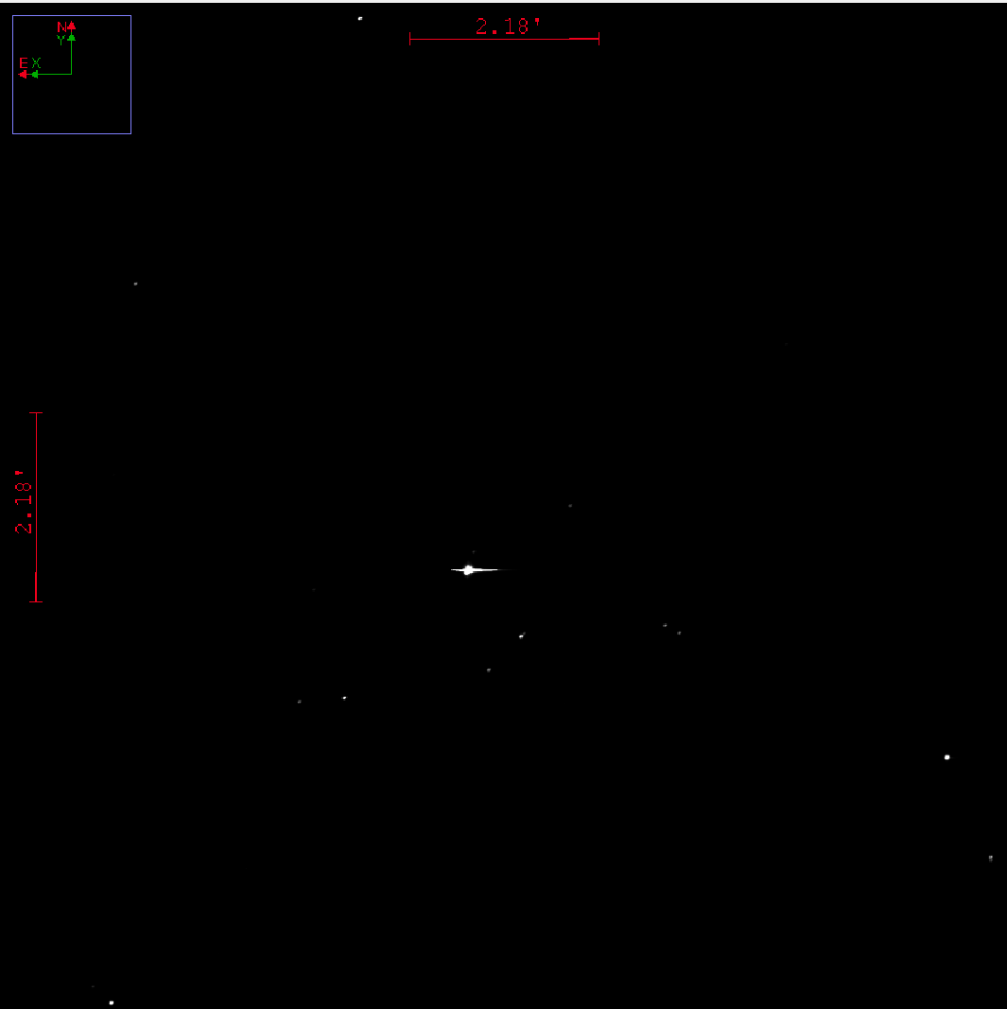
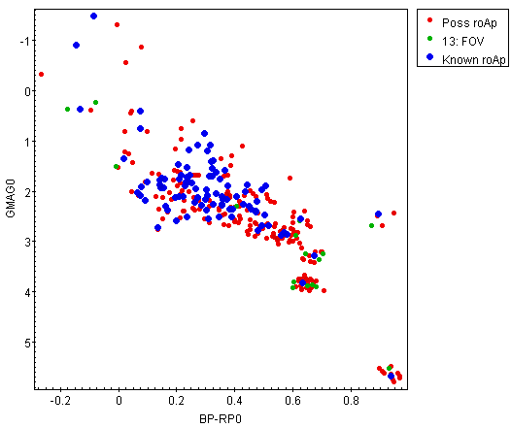
Conclusion
Fig. 8
Fig. 7
The HRD including known field roAp’s and roAp candidates in NGC 2264 (Fig. 7)
The green dots are in the FOV of our current data, Fig. 8

Slide 7
Table of Known roAp’s in FOV
# | Gaia designation | Identifier | RA;DEC
1 | 3326709559553987840 | NGC 2264-153 | 06 41 03.374;+09 40 44.986
2 | 3326711487994693504 | NGC 2264-169 | 06 41 07.778;+09 44 02.995
3 | 3326714752169858944 | Cl* NGC 2264 RMS 1872A | 06 40 11.682;+09 45 55.699
4 | 3326715297630893184 | Cl* NGC 2264 SBL 1534 | 06 40 21.434;+09 48 04.741
5 | 3326716397142282240 | Cl* NGC 2264 SBL 226 | 06 40 55.183;+09 50 49.753
%6 | 3326736811121849216 | HD 262066A | 06 41 30.092;+09 49 48.324
%7 | 3326737051640013952 | HD 262108 | 06 41 34.613;+09 51 37.917
8 | 3326743614350027008 | Cl* NGC 2264 SBL 392 | 06 41 31.989;+10 00 24.443
9 | 3326928882059976576 | Cl* NGC 2264 SBL 204 | 06 40 50.862;+09 55 53.029
10 | 3326929393158941056 | V* V358 Mon | 06 41 03.939;+09 58 09.453

