Slide 1
Rapidly Oscillating Ap Stars
Supervisor: Dr. Stephen Gillam
Researcher: Jacob Romeo

Slide 2
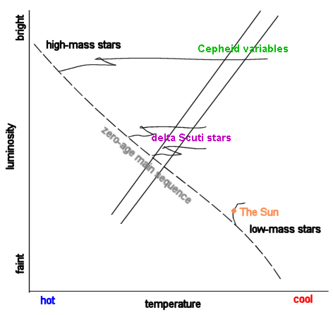
What is an roAp?
Fig. 1
roAp stands for a rapidly oscillating Ap star, where A is the spectral type and p stands for peculiar
These lie on the δ-Scuti instability strip (Fig. 1) along the 0-age main sequence.
All the known roAp's are A and F type stars, about 2-1 solar masses
roAp’s are chemically peculiar, with Sr, Eu, Cr, and Si in their atmospheres.
EX: HD 134214 with spectral type Ap SrEu(Cr), magnitude 7.46 with period of ~5.6 minutes
roAp’s do not oscillate via the entire surface, but on small sections of their surface, having multiple frequencies

Slide 3
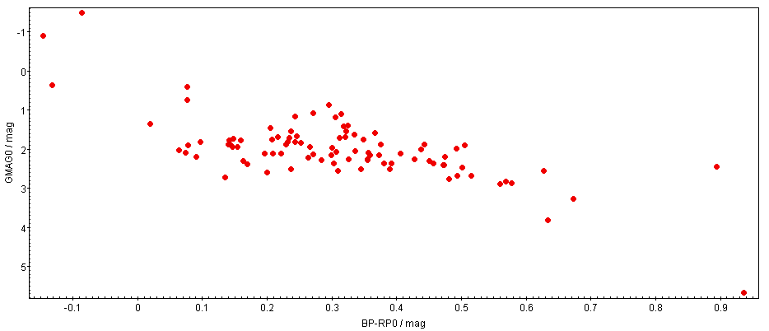
Known roAp’s
Fig. 2
Using TESS observations on ~200 roAp’s to identify them with Gaia Archive in TopCat
Using a Cone search with radii 2”
Concatenating each table (each star) into a database, pair matching with starhorse
Accounting for dust extinction
Fig. 2 of a HRD showing the instability strip (GMAG vs. BP-RP0) of the known roAp’s

Slide 4
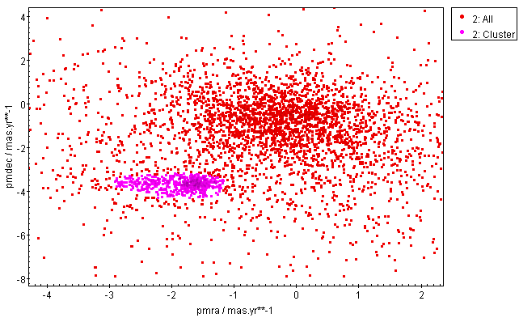
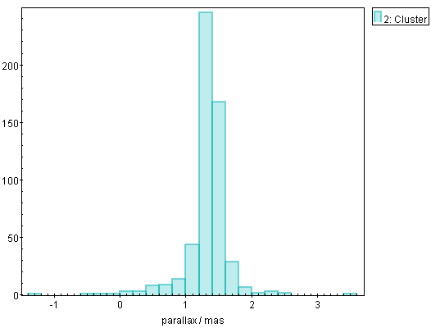
NGC 2264
Fig. 3
Selecting the smaller, dense, pink, group of stars (Fig. 3, which is a pm plot with FOV 13’)
Leaving out the galactic interlopers in the galactic disk
Selecting stars with parallaxes within a range of (0.6,2) from the pink group (Fig. 4, a histogram); making a new group
Doing this b/c I want stars within proximity of one another
This new group is the NGC 2264 open cluster inside the monoceros constellation
Fig. 4

Slide 5
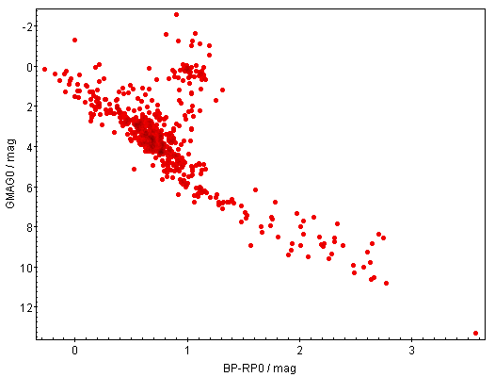
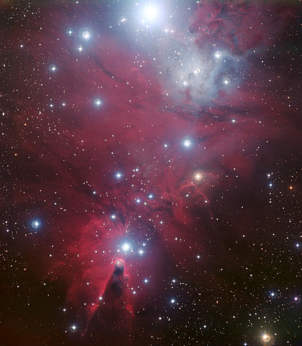
Continue: NGC 2264
Fig. 5
Fig. 6
Plotting the HRD of the final group, the pink group (Fig. 5, the stars in NGC 2264)
Fig. 6 A pretty picture of NGC 2264, which we cannot guarantee right now, is centered with Fig. 5

Slide 6
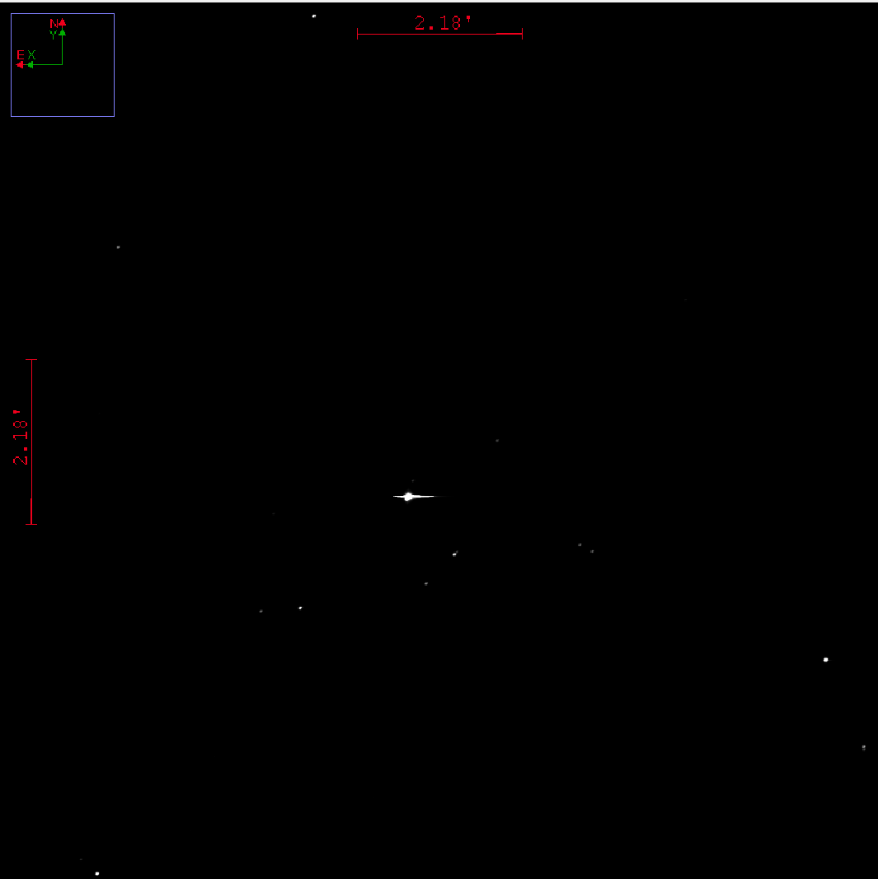
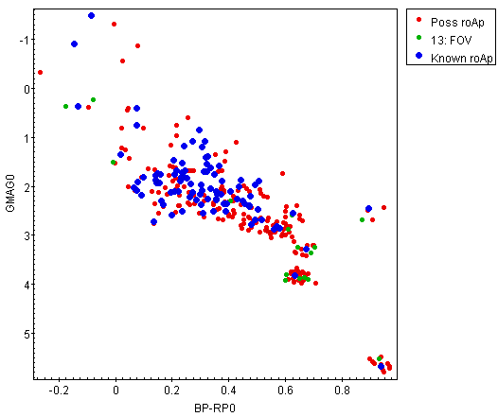
Conclusion
Fig. 8
Fig. 7
The HRD including known field roAp’s (Fig. 2) and roAp candidates in NGC 2264 from Fig. 5 (Fig. 7)
The green dots are in the FOV of our current data, Fig. 8 is an example image

Slide 7
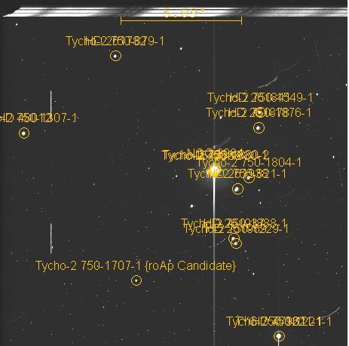
roAp Candidate
In the current data we have, the only visible roAp candidate is TYC 750-1707-1 or NGC 2264 196
The rest are too dim, thus we need longer exposure images
This is a F5 star
This is the same image from the last slide of NGC 2264

