Slide 1


Outbrain Click Prediction
Sweta Bajaj
Yogita Jain
Antariksh Sharma

Slide 2
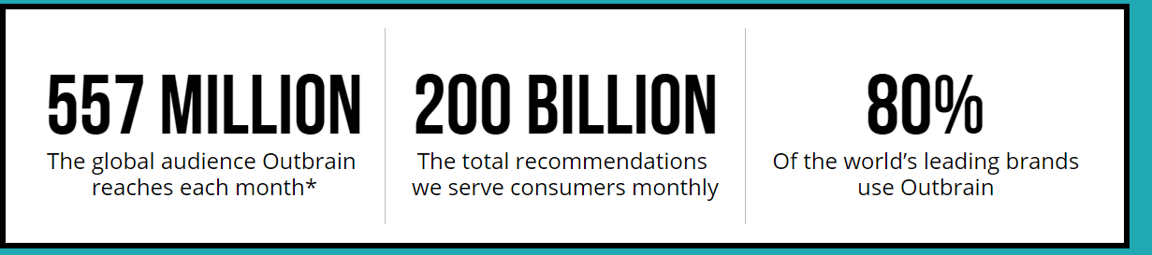
OutBrain
Outbrain pairs relevant content with curious readers in about 250 billion personalized recommendations every month across many thousands of sites
Millions of user use social network for surfing, visiting countless websites and clicking on countless ads/recommendations on these website.
Knowing what the users are interested in and what the users are using in real world would be of great significance for future recommendations used by marketing team to attract potential users as well as ad placements and real time bidding

Slide 3
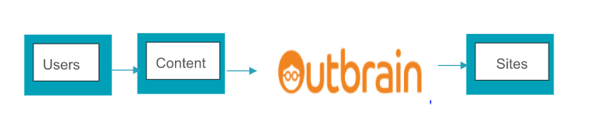
End User Persona
End User

Slide 4
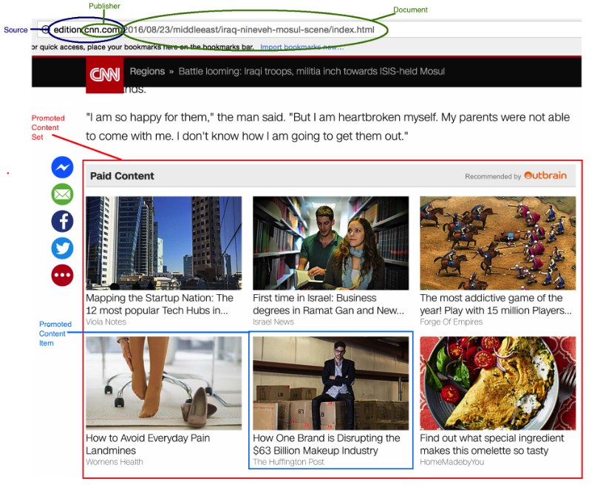
PROBLEM STATEMENT
Predicting the likelihood of users clicking on a particular content
Ranking the recommendations in each group by decreasing predicted likelihood of being clicked

Slide 5
Project Process
INPUT/OUTPUT PARAMETERS BASED ON PREDICTION
DATA MINING AND VALIDATION
DATA EXPLORATION
CHOSING THE BEST MODELS TO USE FOR PREDICTION
PREDICTING THE DELIVERABLES
COMPARING OUR SCORE TO KAGGLE BENCHMARK

Slide 6
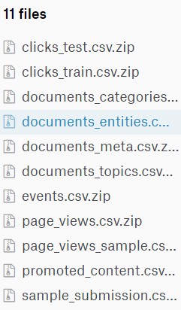
DATASETS To Be USED:
The dataset contains a sample of users’ page views and clicks, as observed on multiple publisher sites in the United States between 14-June-2016 and 28-June-2016. Each viewed page or clicked recommendation is further accompanied by some semantic attributes of those documents. For full details, see data specifications below.

Slide 7
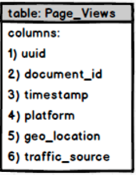
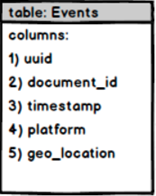
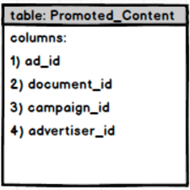
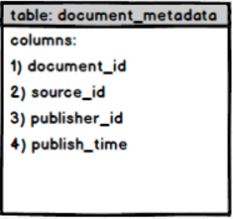
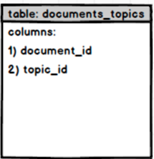
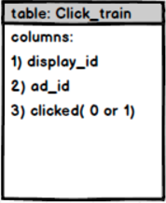
METADATA Modelling
6) display_id

Slide 8
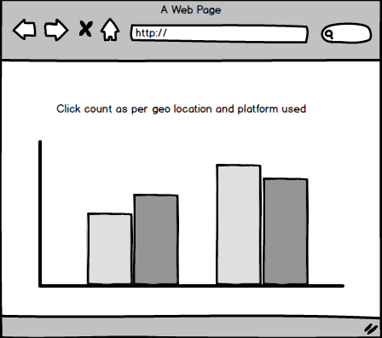
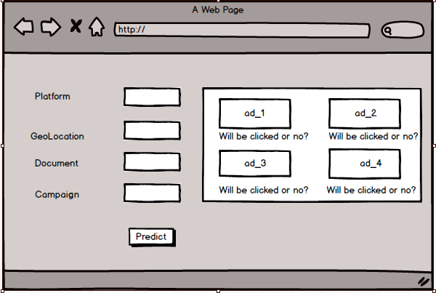
User Interface
Exploratory Analysis
End User Output Page

Slide 9
REFERENCES:
http://www.outbrain.com/about/company
https://www.kaggle.com/c/outbrain-click-prediction

