Slide 1
ADS- FINAL PROJECT
TEAM 8 - OUTBRAIN CLICK PREDICTION

Slide 2
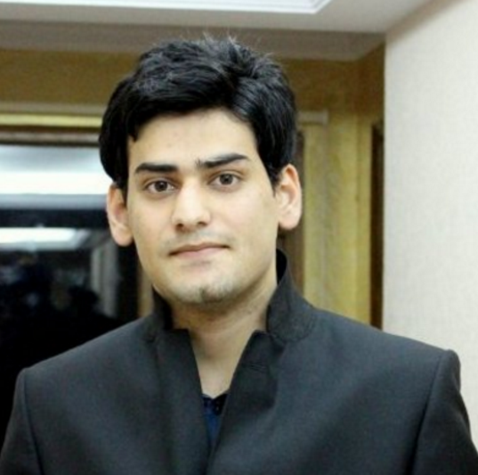


TEAM MEMBERS
ANTRIKSH ANTRIKSH
YOGITA JAIN
SWETA BAJAJ

Slide 3
PROBLEM STATEMENT:
Millions of user use social network for surfing, visiting countless websites and clicking on countless ads/recommendations on these website.
Knowing what the users are interested in and what the users are using in real world would be of great significance for future recommendations used by marketing team to attract potential users as well as ad placements and real time bidding
Predicting the likelihood of users clicking on a particular content
Ranking the recommendations in each group by decreasing predicted likelihood of being clicked

Slide 4
Tech Stack
R – Rstudio, RShiny
Python – Jupyter Notebook (Luigi)
Azure ML Studio
AWS EC2 Instance
S3 for Storing Files
Tableau
Docker
IBM DataScience

Slide 5
Process FLOW
Metadata Modelling
Scrape Data
File Validations
Individual Ad Click Prediction
Classification Algorithms
Compared Random Forest, Neural Network, Logistic Regression, SVM
Decreasing Probability Click Prediction
Classification Algorithms
Compared XGBoost, Random Forest, Logistic Regression
Business Data Model
Feature Engineering
Ran Best Model on Azure ML
Created API’s
Ran Best Model on Azure
Made Kaggle Submissions
Created API’s
Data Exploration
Made Web Page in R Shiny and deployed Link on R Server
Pipe Lined the entire Flow

Slide 6
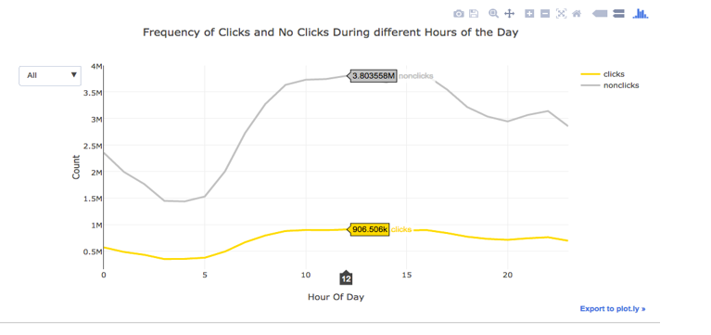
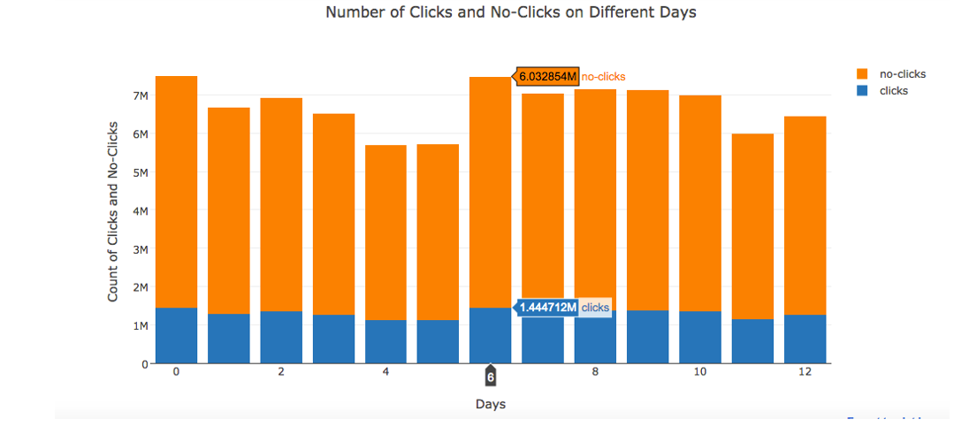
Data Exploration

Slide 7
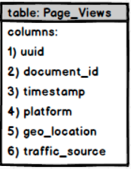
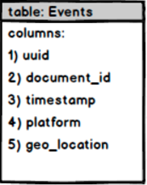
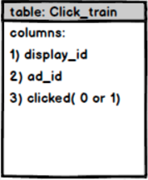
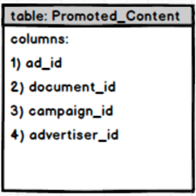
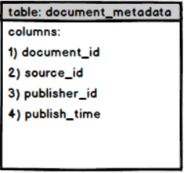
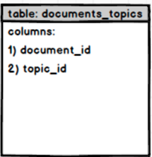
METADATA Modelling
6) display_id

Slide 8
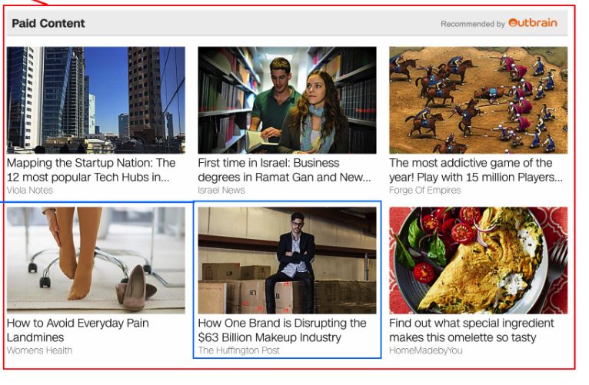
GOALS AND OBJECTIVE
DISPLAY LIST OF ADVERTISEMENT ID’S FOR PARTICULAR DISPLAY ID IN DECREASING ORDER OF PROBABILITY

Slide 9
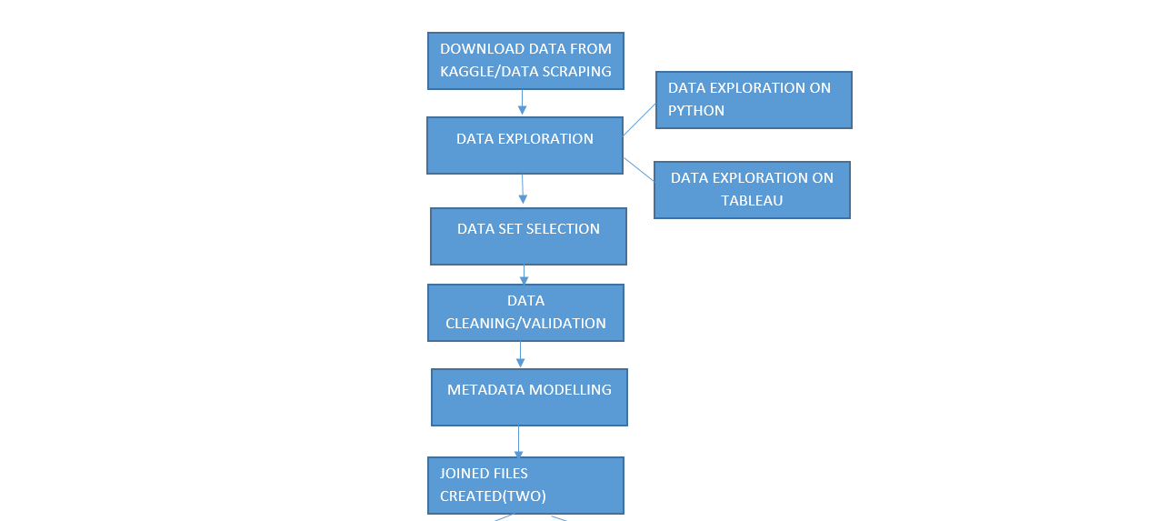
WORK FLOW I – Data Modelling

Slide 10
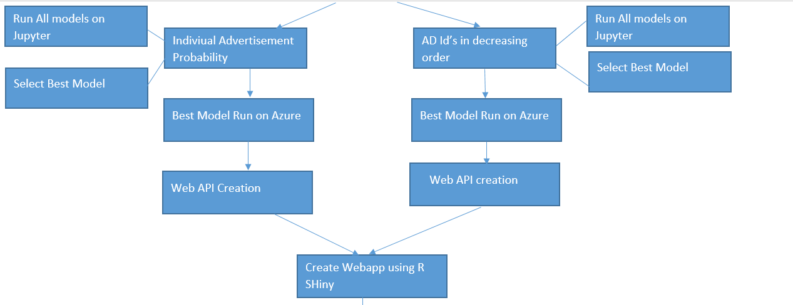
Work FLOW – II – Models and Deployment

Slide 11
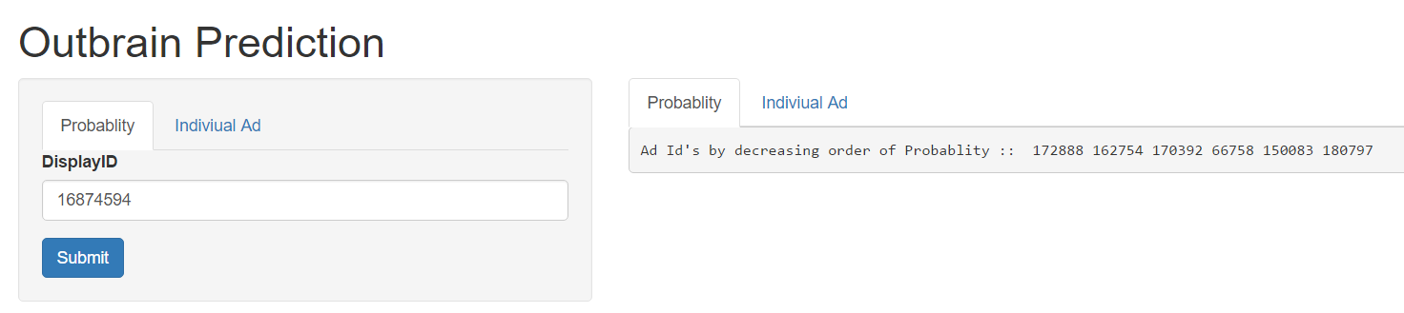
Web Deployment I
https://outbrainproject.shinyapps.io/WebOutBrain/

Slide 12
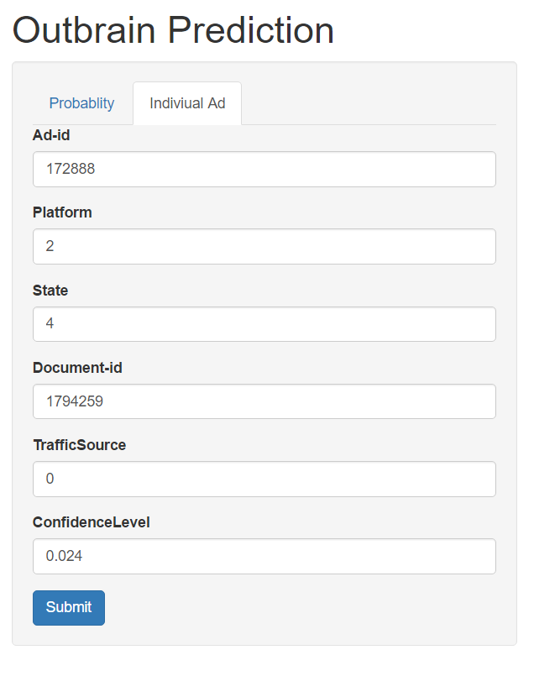
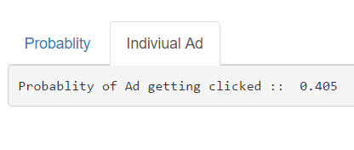
Web Deployment - II

Slide 13
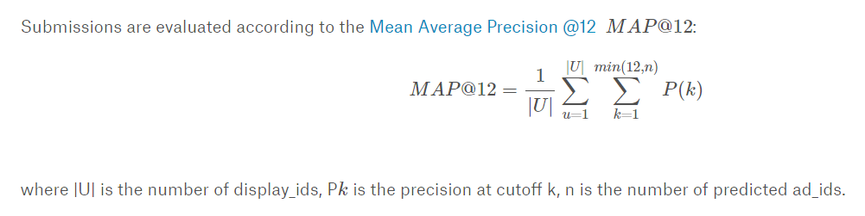
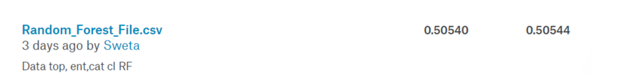
Evaluation Metric

Slide 14
REFERENCES:
http://www.outbrain.com/about/company
https://www.kaggle.com/c/outbrain-click-prediction

