Slide 1

International Trade
UNIT 2

Slide 2
International Trade – Unit 2
Topics Covered:
International Trade
International Trade Theory
Mercantilism
Theory of Absolute Advantage
Theory of Comparative Advantage
Factor Mobility Theory
Regional Economic Integration
WTO
European Union

Slide 3
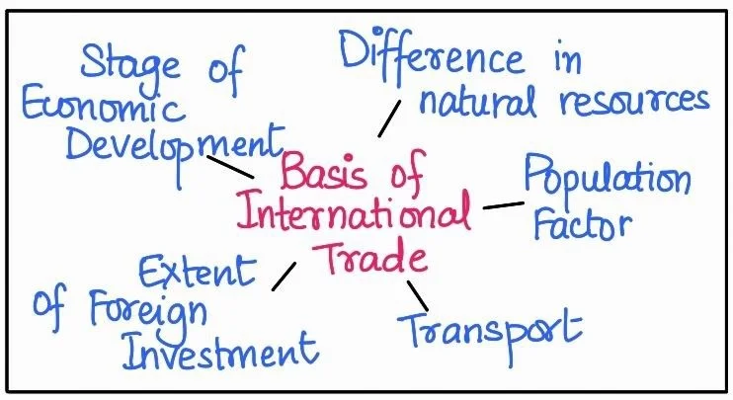
Introduction to International Trade
International trade refers to the exchange of goods and services between different countries. It enables nations to access products that are not available domestically or that can be produced more efficiently in other countries.
International trade helps improve economic growth and promotes cooperation among nations.
Example: India exporting textiles and importing crude oil.

Slide 4
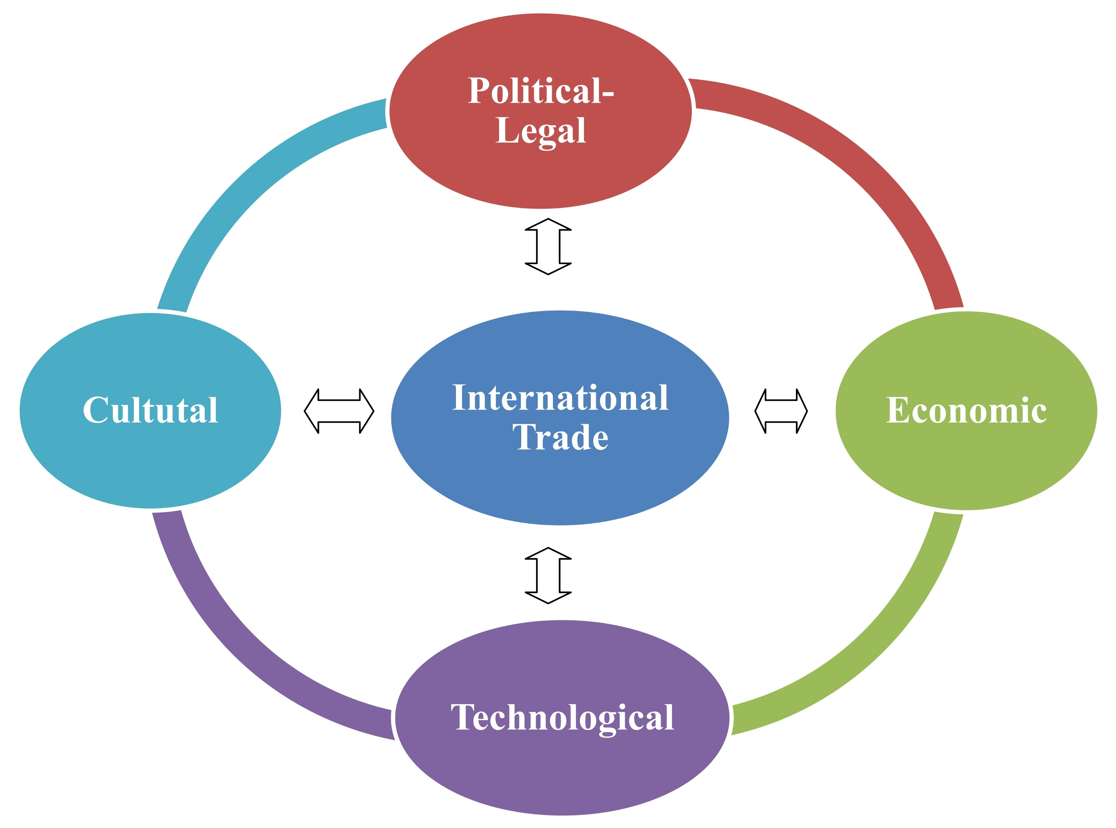
Meaning of International Trade
International trade refers to the exchange of goods, services, and capital between different countries. It involves the buying and selling of products across national borders through activities such as exports and imports. Countries participate in international trade to obtain goods that they cannot produce efficiently or to sell products in which they have a production advantage.
International trade allows countries to specialize in producing goods and services based on their resources, technology, and skills. By trading with other nations, countries can improve economic growth, increase productivity, and provide consumers with a wider variety of products. It also strengthens economic relationships and cooperation among countries.
Example: India exporting software services to the United States and importing crude oil from Middle Eastern countries is an example of international trade.

Slide 5

Importance of International Trade
Expansion of Markets – Businesses can sell their products in international markets, increasing sales and growth opportunities.
Efficient Use of Resources – Countries specialize in producing goods where they have advantages, improving productivity.
Economic Growth – International trade contributes to national income, employment opportunities, and overall economic development.
Access to Technology and Innovation – Countries gain access to modern technology and advanced production techniques through international trade.
Improved Product Variety for Consumers – Consumers can access a wide range of goods from different countries.
Strengthening International Relations – Trade encourages cooperation and stronger economic relationships between nations.

Slide 6
International Trade Theory
International trade theory refers to the set of economic ideas and principles that explain why countries engage in trade with each other and how they benefit from it. These theories analyze how differences in resources, labor, technology, and productivity influence the production and exchange of goods and services between nations. International trade theory helps economists, governments, and businesses understand global trade patterns and develop strategies for participating in international markets.
International trade theories also emphasize the concept of specialization, where countries focus on producing goods that they can produce more efficiently than others. By specializing and trading with other nations, countries can improve productivity, reduce production costs, and increase the availability of goods and services in global markets. These theories provide the foundation for understanding modern international trade practices and policies.

Slide 7
Mercantilism – An early theory suggesting that countries should export more than they import to accumulate wealth.
Theory of Absolute Advantage – Proposed by Adam Smith, stating that countries should specialize in goods they can produce more efficiently than others.
Theory of Comparative Advantage – Developed by David Ricardo, explaining that countries should specialize in goods with the lowest opportunity cost.
Factor Mobility Theory – Explains how the movement of labor, capital, and technology across countries influences international trade.
Example: Countries with advanced technology may export high-tech products, while countries with abundant natural resources may export raw materials.
Main International Trade Theories:

Slide 8
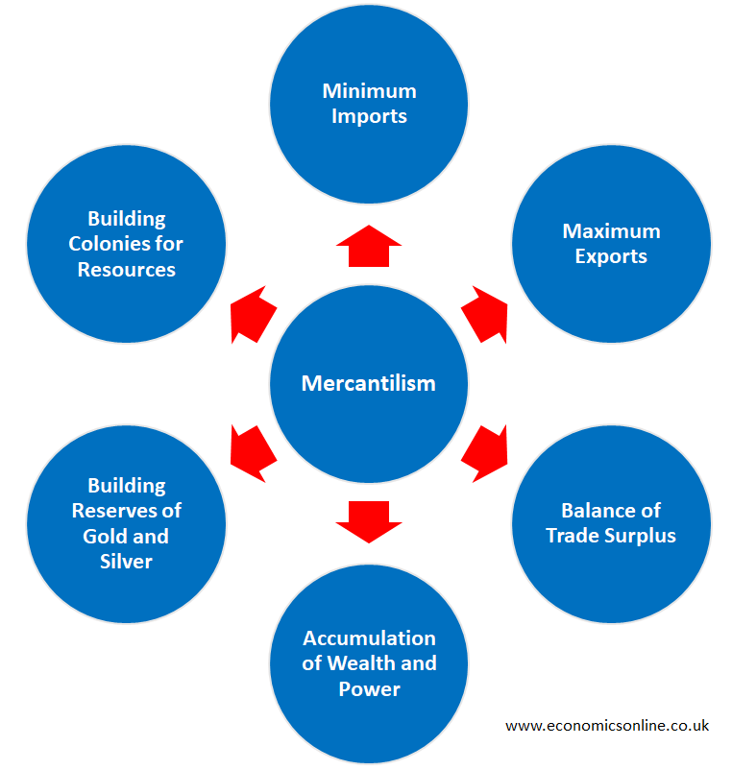
Mercantilism
Mercantilism is one of the earliest international trade theories that developed in Europe during the 16th and 17th centuries. According to this theory, the wealth and power of a nation were measured by the amount of precious metals such as gold and silver it possessed. Mercantilist thinkers believed that a country should export more goods than it imports so that it can accumulate wealth from other nations. To achieve this, governments encouraged exports and restricted imports through tariffs, quotas, and strict trade regulations.
Under mercantilism, governments played an important role in controlling international trade to maintain a favorable balance of trade. Countries focused on developing strong manufacturing industries and expanding colonies to obtain raw materials. Colonies were often used as sources of raw materials and markets for finished goods produced by the colonizing country.
Example: During the colonial period, Britain followed mercantilist policies by importing raw materials such as cotton and spices from its colonies like India and exporting finished goods such as textiles back to those colonies. This helped Britain accumulate wealth and strengthen its economy.

Slide 9
Limitations of Mercantilism
Encourages Trade Restrictions Mercantilism promotes high tariffs, quotas, and strict trade policies to reduce imports and increase exports. These restrictions limit free trade and reduce the benefits countries could gain from open international markets. Example: In the colonial period, Britain imposed heavy taxes on imported goods to protect its domestic industries and encourage local production.
Creates Conflicts Between Countries Since mercantilism encourages countries to export more and import less, nations compete with each other to control trade routes, markets, and resources. This often leads to economic and political conflicts between countries. Example: European colonial powers such as Britain, France, and Spain competed for control over colonies and global trade routes.
Ignores Mutual Benefits of Trade Mercantilism assumes that one country’s gain is another country’s loss, meaning trade is viewed as a zero-sum game. However, modern trade theories show that international trade can benefit all participating countries through specialization and cooperation. Example: When two countries trade goods such as machinery and agricultural products, both countries benefit from better resource utilization.
Focuses Only on Precious Metals Mercantilism considers national wealth mainly in terms of gold and silver reserves. It ignores other important factors such as technological development, productivity, and human resources that contribute to economic growth. Example: Spain accumulated large amounts of gold and silver from its colonies in the Americas, but it did not invest enough in developing industries, which eventually weakened its economy.
Limits Economic Growth By restricting imports and limiting competition, mercantilism can slow innovation and reduce efficiency in production. This can negatively affect long-term economic development. Example: Countries that restrict foreign products may prevent domestic industries from improving their quality and competitiveness.

Slide 10

Theory of Absolute Advantage
The Theory of Absolute Advantage was developed by the economist Adam Smith in 1776 in his famous book The Wealth of Nations. According to this theory, a country has an absolute advantage when it can produce a good more efficiently than another country using fewer resources or less labor. The theory suggests that countries should specialize in producing goods in which they have absolute advantage and trade with other countries for goods they cannot produce as efficiently.
By specializing in the production of goods where they are most efficient, countries can increase overall production and benefit from international trade. This specialization allows countries to use their resources more effectively, reduce production costs, and improve economic growth. When countries trade with each other based on their absolute advantages, both countries can enjoy higher output and better access to goods.
Example: Suppose Country A can produce 10 units of wheat with the same resources that Country B uses to produce only 5 units of wheat. Country A has an absolute advantage in wheat production. If Country B can produce cloth more efficiently than Country A, both countries can specialize in their respective products and trade with each other to benefit mutually.

Slide 11
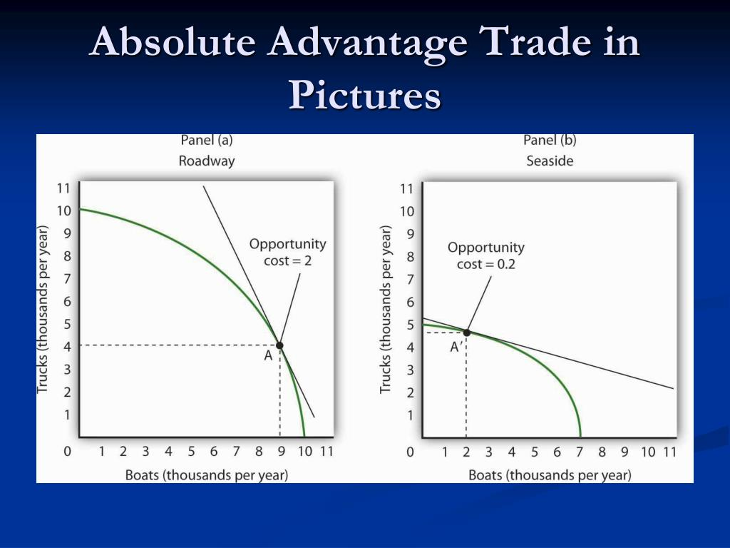
Advantages of Absolute Advantage
Encourages Specialization Countries specialize in producing goods that they can produce more efficiently than other countries. This specialization allows them to focus on industries where they have the best skills, resources, or technology. Example: Brazil has favorable climate and land for coffee production, so it specializes in producing and exporting coffee to other countries.
Improves Productivity When countries focus on producing specific goods where they are most efficient, productivity increases because resources and labor are used more effectively. Example: Germany specializes in manufacturing automobiles such as BMW and Mercedes-Benz due to its advanced technology and skilled workforce.
Increases Global Production Specialization based on absolute advantage increases the total production of goods globally because each country produces goods efficiently. Example: China produces electronics efficiently while Saudi Arabia produces oil efficiently, increasing global production of both goods.
Promotes International Trade Countries trade the goods they specialize in with other countries, which improves economic cooperation and expands international markets. Example: Japan exports automobiles and electronic products while importing raw materials from other countries.
Better Utilization of Resources Countries use their natural resources, labor, and technology more efficiently when they produce goods where they have an advantage. Example: Saudi Arabia uses its large oil reserves to produce and export petroleum products while importing machinery and food from other countries

Slide 12
Theory of Comparative Advantage
The Theory of Comparative Advantage was developed by David Ricardo in the early 19th century. According to this theory, countries should specialize in producing goods in which they have the lowest opportunity cost, even if they are not the most efficient producers. This means that a country can benefit from international trade by focusing on goods that it can produce relatively more efficiently compared to other goods.
The theory explains that international trade can benefit all countries involved because each nation can specialize in producing goods where it has a comparative advantage and import other goods from countries that can produce them more efficiently. By doing so, countries can increase total production, reduce costs, and improve economic welfare. The theory of comparative advantage is considered one of the most important principles in international trade because it demonstrates that mutual benefits from trade are possible even when one country is more productive in all goods.
Example: Suppose Country A is more efficient than Country B in producing both wheat and cloth. However, if Country A sacrifices fewer resources to produce wheat compared to cloth, it has a comparative advantage in wheat production. Country B may have a comparative advantage in cloth production because it sacrifices fewer resources to produce cloth than wheat. By specializing and trading these goods, both countries can benefit from international trade

Slide 13
Benefits of Comparative Advantage
The Theory of Comparative Advantage, developed by David Ricardo, explains that countries can benefit from international trade by specializing in producing goods in which they have the lowest opportunity cost. By focusing on these goods and trading with other countries, nations can increase production efficiency and gain access to a wider variety of products.
Efficient Use of Resources Countries use their resources such as labor, capital, and natural resources more efficiently by producing goods where they have comparative advantage. Example: India specializes in IT and software services because it has a large skilled workforce.
Increased Global Production When countries specialize based on comparative advantage, the total production of goods and services increases globally. Example: China focuses on manufacturing electronics while Saudi Arabia focuses on oil production.
Lower Production Costs Specialization allows countries to produce goods at lower costs, which reduces prices for consumers and increases competitiveness in global markets. Example: Vietnam produces textiles at lower costs due to cheaper labor.
Expansion of International Trade Countries trade specialized goods with each other, increasing global trade and strengthening economic cooperation. Example: Japan exports automobiles and imports natural resources from other countries.
Improved Standard of Living International trade based on comparative advantage increases economic growth and provides consumers with more product choices. Example: Consumers can buy electronics, cars, and clothing from different countries at competitive prices.

Slide 14
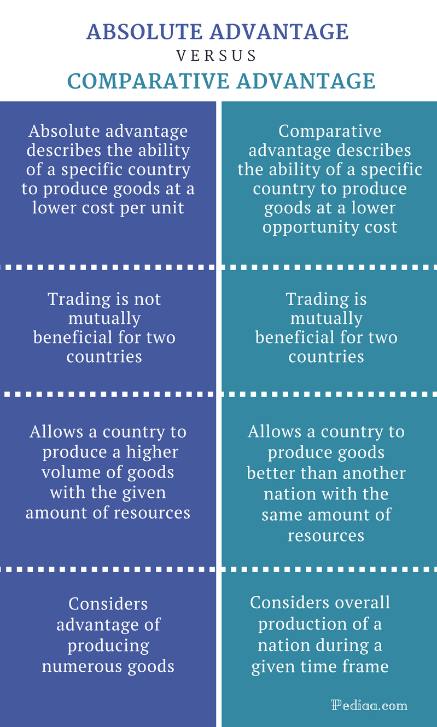
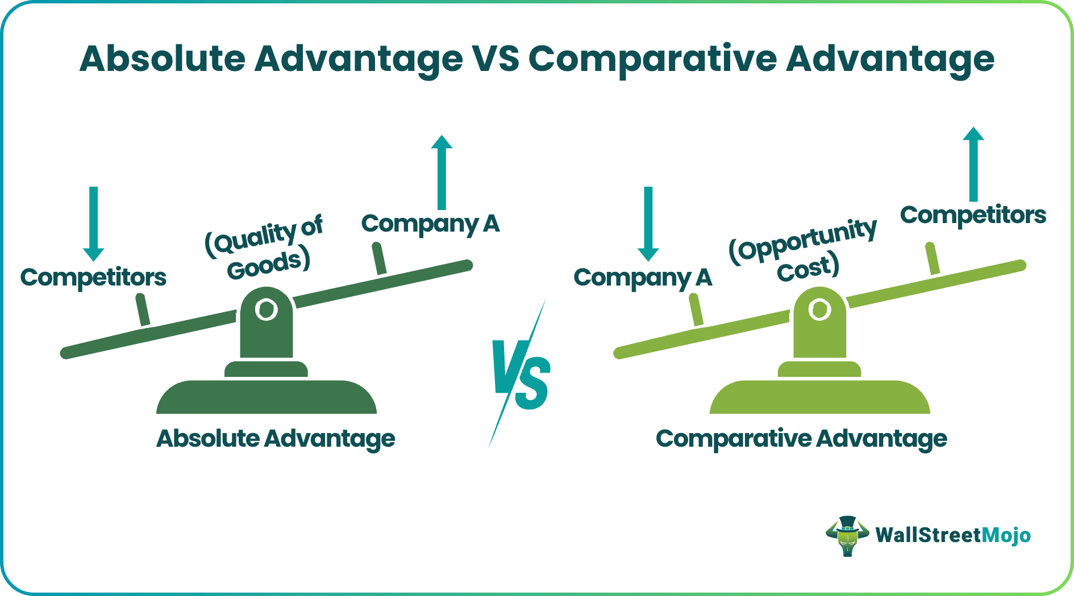
DIFFERENT BETWEEN Absolute Advantage & Comparative Advantage

Slide 15

Factor Mobility Theory
Factor Mobility Theory explains how the movement of factors of production such as labor, capital, technology, and entrepreneurship between countries influences international trade and global business activities. According to this theory, when these factors move freely across national borders, businesses can locate production where resources are available at lower cost or higher efficiency. This movement helps improve productivity and allows countries to benefit from global economic integration.
Factor mobility occurs when workers migrate to other countries for better job opportunities, companies invest capital in foreign markets, or technology is transferred across borders. This movement helps countries utilize resources more effectively and encourages economic development. However, factor mobility can also create challenges such as labor migration issues and unequal economic development between countries.
Example: Many multinational companies establish manufacturing plants in countries where labor costs are lower. For instance, companies like Apple manufacture many of their products in China because of the availability of skilled labor and lower production costs. This is an example of capital and technology moving across countries to improve production efficiency.

Slide 16

Regional Economic Integration
Regional Economic Integration refers to an agreement among countries within a particular geographic region to reduce or eliminate trade barriers such as tariffs, quotas, and restrictions in order to promote economic cooperation and increase trade among member countries. The main objective of regional economic integration is to create a larger market where goods, services, capital, and sometimes labor can move more freely between countries.
Regional economic integration helps improve economic growth by increasing trade opportunities, encouraging foreign investment, and strengthening economic relationships between member countries. By working together, countries can benefit from shared resources, improved market access, and better economic stability.
Example: The European Union (EU) is a well-known example of regional economic integration. Member countries such as Germany, France, and Italy allow free movement of goods, services, capital, and people among themselves, which increases trade and economic cooperation within the region.

Slide 17
Types of Regional Economic Integration
Free Trade Area (FTA) In a free trade area, member countries remove tariffs and trade barriers among themselves but maintain their own trade policies with non-member countries. This allows free trade within the region while each country controls its external trade independently. Example: The North American Free Trade Agreement (NAFTA) between the United States, Canada, and Mexico.
Customs Union A customs union not only removes trade barriers among member countries but also establishes a common external tariff for goods imported from non-member countries. This means all members follow the same trade policies toward other countries. Example: The Southern African Customs Union (SACU).
Common Market A common market allows free movement of goods, services, capital, and labor among member countries. In addition to removing trade barriers, workers and investments can move freely across member states. Example: The European Union (EU) initially operated as a common market.
Economic Union In an economic union, member countries not only allow free movement of goods, services, capital, and labor but also coordinate their economic policies such as taxation, monetary policies, and regulations. Example: The European Union, where many countries share common economic policies and currency (Euro).
Political Union A political union represents the highest level of integration, where member countries combine their political and economic systems under a common government. Example: The United States, where individual states operate under a single federal government.

Slide 18
Benefits of Regional Economic Integration
Increase in Trade Regional economic integration removes trade barriers such as tariffs and quotas between member countries, making it easier for them to trade with each other. Example: Countries in the European Union trade goods freely without paying tariffs.
Economic Growth and Development Increased trade and investment opportunities help member countries grow economically and improve their industries and infrastructure. Example: Developing countries in regional trade agreements attract more foreign investment.
Larger Market Access Businesses gain access to a larger market with more consumers, which helps increase production and sales. Example: Companies within the European Union can sell products across all member countries.
Improved Resource Utilization Countries can specialize in producing goods and services where they have advantages and trade with other member countries for other products. Example: Agricultural countries export food products while importing industrial goods.
Increased Competition and Efficiency Free trade among member countries encourages competition, which helps businesses improve quality, innovation, and efficiency. Example: Companies improve their products to compete in regional markets.
Stronger Political and Economic Cooperation Regional integration strengthens relationships among countries and promotes peace and cooperation. Example: The European Union encourages cooperation among European nations.

Slide 19

World Trade Organization (WTO)
The World Trade Organization (WTO) is an international organization that regulates and supervises global trade between countries. It was established in 1995 to promote free and fair trade across the world. The WTO replaced the General Agreement on Tariffs and Trade (GATT) and works to ensure that international trade flows smoothly, predictably, and freely between nations. The organization provides a platform where member countries can negotiate trade agreements and resolve trade disputes.
The main objective of the WTO is to reduce trade barriers such as tariffs, quotas, and other restrictions so that countries can trade more easily with each other. The WTO also monitors trade policies, promotes transparency in trade practices, and encourages economic cooperation among nations. By creating a stable and predictable global trading system, the WTO helps countries expand trade, improve economic growth, and strengthen international economic relationships.
Example: If two countries have a trade dispute regarding import tariffs or trade restrictions, the WTO provides a dispute settlement mechanism to resolve the issue according to international trade rules.

Slide 20
Functions of WTO
Regulates International Trade Rules The WTO establishes and monitors rules that govern international trade among member countries. These rules help ensure fair competition and transparency in global markets. Example: WTO agreements regulate tariffs, subsidies, and trade policies between countries.
Settles Trade Disputes The WTO provides a dispute settlement system where countries can resolve conflicts related to trade policies or trade barriers in a peaceful and structured manner. Example: If one country accuses another of unfair trade practices, the WTO helps resolve the dispute.
Promotes Free and Fair Trade The organization works to reduce trade barriers such as tariffs, quotas, and restrictions to encourage smoother trade between countries. Example: WTO negotiations often focus on reducing import duties between member countries.
Monitors Trade Policies of Member Countries The WTO regularly reviews and monitors the trade policies of its member countries to ensure transparency and compliance with international trade rules.
Provides a Platform for Trade Negotiations WTO organizes meetings and negotiations where countries discuss trade agreements and policies to improve global trade cooperation.
Supports Economic Development The WTO helps developing countries participate more effectively in global trade by providing technical assistance and training programs.

Slide 21
European Union (EU)
The European Union (EU) is a political and economic union of countries located mainly in Europe. It was created to promote economic cooperation, free trade, and political stability among European nations. The European Union allows the free movement of goods, services, capital, and people among its member countries, which helps strengthen economic integration and improve trade within the region. The EU also works to create common policies in areas such as trade, agriculture, transportation, and environmental protection.
The European Union was established to improve economic development and cooperation after World War II. By forming a single market, member countries can trade more easily without tariffs or restrictions. Many EU countries also share a common currency known as the Euro, which further simplifies trade and financial transactions within the region.
Example: Countries such as Germany, France, Italy, Spain, and the Netherlands are members of the European Union. A company in Germany can easily export products to France or Italy without facing trade barriers, which encourages business growth and economic cooperation among member nations.

Slide 22

Objectives of European Union
The European Union (EU) was established to promote economic cooperation, political stability, and social development among European countries. The main objective of the EU is to create a unified market where member countries can trade freely and work together to improve economic growth and living standards. By reducing trade barriers and encouraging cooperation, the EU helps strengthen economic relationships among member nations.
Promote Economic Integration The EU aims to integrate the economies of member countries by creating a single market where goods, services, capital, and labor can move freely. Example: Companies in Germany can sell products in France without trade restrictions.
Encourage Free Trade Among Member Countries The EU removes tariffs and trade barriers between member states to increase trade and economic cooperation. Example: Businesses in Italy can export products to Spain without paying import duties.
Strengthen Political Cooperation The EU encourages member countries to work together on political, social, and economic issues to maintain peace and stability in the region. Example: EU countries cooperate on policies related to security, environment, and trade.
Improve Economic Growth and Stability By creating a larger market and promoting investment, the EU helps member countries achieve stronger economic growth and stability.
Promote Social and Regional Development The EU supports the development of less developed regions by providing financial assistance and development programs. Example: EU funds help improve infrastructure and education in developing regions of Europe.

Slide 23
Example from International Trade
International trade allows countries to specialize in producing goods and services based on their resources, skills, and technological capabilities. Countries often export products that they can produce efficiently and import goods that are difficult or expensive to produce domestically. This specialization helps improve economic efficiency and benefits both producers and consumers.
Example: Saudi Arabia has abundant oil resources, so it specializes in producing and exporting petroleum products to many countries around the world. At the same time, it imports machinery, vehicles, and technological equipment from industrialized countries such as Germany and Japan. This exchange of goods demonstrates how countries benefit from international trade by focusing on their strengths and trading with other nations.

Slide 24
Case Study: China's Growth Through International Trade
China provides one of the most significant examples of how international trade can contribute to economic growth and development. Over the past few decades, China has focused on developing its manufacturing industries and exporting a wide range of products such as electronics, textiles, machinery, and consumer goods to countries around the world. By specializing in manufacturing and utilizing its large labor force, China has become one of the largest exporters in the global market.
China’s participation in international trade organizations, especially the World Trade Organization (WTO), has further strengthened its position in global trade. After joining the WTO in 2001, China reduced many trade barriers and increased its exports to international markets. Many multinational companies also established manufacturing facilities in China due to its skilled labor and relatively low production costs.
As a result, international trade has played a major role in China's economic development, creating millions of jobs, increasing foreign investment, and improving technological capabilities. This case study demonstrates how countries can benefit from international trade by specializing in industries where they have advantages and by participating actively in global trade systems.

Slide 25

Discussion Questions
Why did China focus on manufacturing industries to expand its international trade?
How did joining the World Trade Organization (WTO) help China increase its global trade?
What role did China's large labor force play in its success in international trade?
Why do multinational companies establish manufacturing units in countries like China?

Slide 26


