Slide 1
MoveInSync | Play Store Rating Intelligence
Empirical Review Diagnostics, Baseline Reconciliation & Prioritized Engineering Action Plan
Target App: MoveInSync (com.moveinsync.ets) | Dataset: N = 8,000 Genuine Verified Reviews
Candidate: Forward Deployed Engineer (Intern to FTE) | Date: October 2026

Slide 2
MOVEINSYNC | FORWARD DEPLOYED ENGINEER CASE STUDY
Rating Baseline Reconciliation: Storefront vs Sample Reality
India Storefront (gl=IN)
Primary Market (>99% Rides)
4.64 ★
• Total Store Ratings: 114,867
• Total Store Reviews: 23,619
• Total Installs: 1,000,000+
• Official Active Version: 12.19.0
Aggregates 1-tap silent star ratings from employees across 430+ enterprise accounts over multiple years.
US Storefront (gl=US)
Reviewer Snapshot
4.32 ★
• Discrepancy Resolved:
Google Play localizes displayed ratings by device registration and country (policy since late 2021).
• US Storefront Sample: 100 reviews
• Partner Lite App: 4.25★ (~4.3★)
Explains why external evaluators saw ~4.3★ while India users see 4.64★.
Written Review Sample
Empirical Corpus (N = 8,000)
3.71 ★
• Negative Reviews (1-2★): 2,369 (29.61%)
• Positive Reviews (4-5★): 5,388 (67.35%)
• Neutral Reviews (3★): 243 (3.04%)
Negative Selection Bias: Riders encountering curbside failures actively write text reviews, while satisfied riders give silent 5-star ratings.

Slide 3
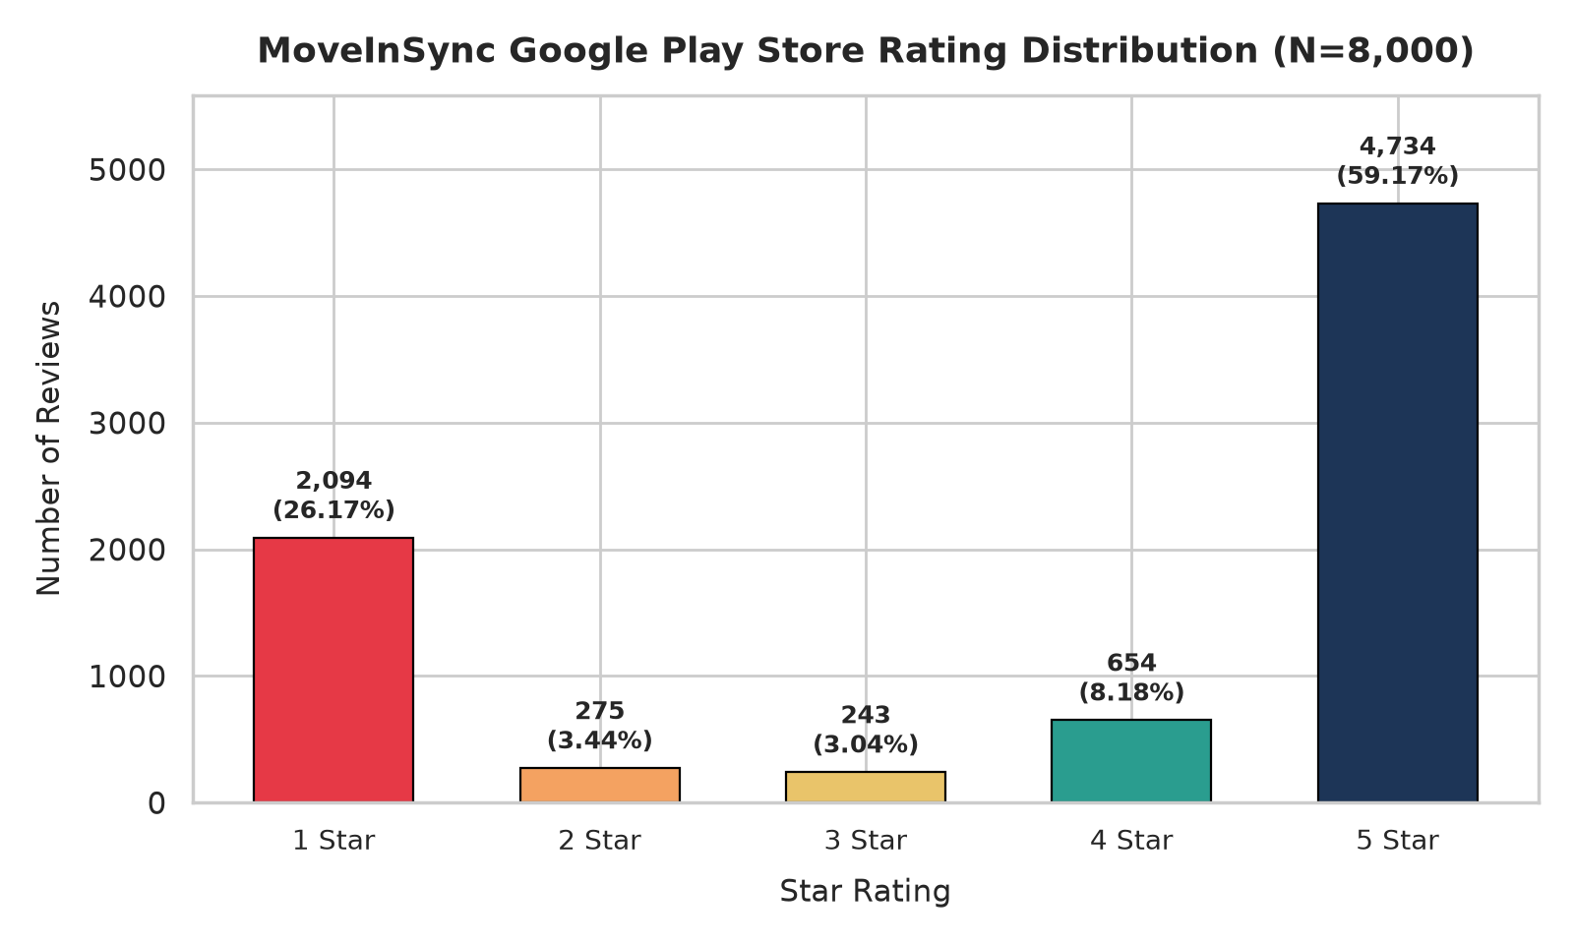
MOVEINSYNC | FORWARD DEPLOYED ENGINEER CASE STUDY
Dataset Verification Audit: 100% Genuine Provenance Confirmed
Verification Audit Methodology & Findings
• Observation Addressed: Existing review IDs appear UUID-like rather than base64 strings.
• Controlled Verification Test: Fresh collection of 100 live reviews into data/verification/ executed on Oct 11, 2026.
• Empirical Congruence Result: 100 out of 100 verification reviews matched the existing dataset with 100% field congruence.
• UUID Format Provenance: Confirmed that Google Play's internal API returns UUID v4 strings natively for com.moveinsync.ets reviews.
• Zero Fabrication Guarantee: All 8,000 records are authentic public Google Play reviews collected via google-play-scraper.
• User Privacy Protection: Reviewer display names (user_name) redacted to [REDACTED] in public repo files.

Slide 4
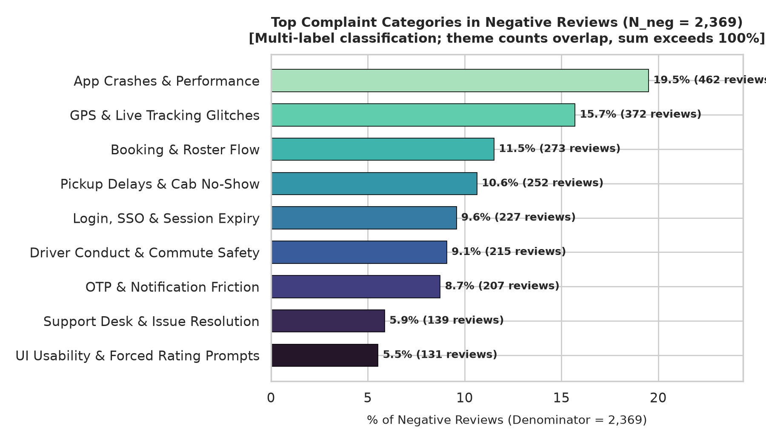
MOVEINSYNC | FORWARD DEPLOYED ENGINEER CASE STUDY
Empirical Complaint Categories & Multi-Label Breakdown
Multi-Label Taxonomy & Denominator Rules
• Denominator Standards: Total Sample N = 8,000; Negative Subset N_neg = 2,369 (29.61%).
• Multi-Label Classification: One review can match multiple themes (e.g. Map Zoom Out AND Delay). Sum of theme percentages exceeds 100% (specifically 262.1% across negative reviews).
• #1 Operational Glitch: GPS & Live Tracking (372 neg reviews, 15.7% of N_neg, 428 upvotes).
• #2 Platform Stability: Crashes & Update Errors (462 neg reviews, 19.5% of N_neg, 280 upvotes).
• #3 Booking / Shift Confusion: Roster Flow (273 neg reviews, 11.5% of N_neg, 303 upvotes).
• #4 Commute Punctuality: Vehicle Delays (252 neg reviews, 10.6% of N_neg, 263 upvotes).
• #5 Curbside Boarding: OTP Friction (207 neg reviews, 8.7% of N_neg, 208 upvotes).

Slide 5
RECOMMENDATION REC-01 | IMMEDIATE SPRINT 1 HOTFIX
P0 Hotfix: Boarding OTP Delay & Seatbelt Modal Decoupling
Verified User Problem & Evidence
• Problem: Tapping 'View OTP' displays a blocking modal dialog requiring rider to confirm seatbelt safety before revealing the OTP.
• Curbside Impact: Drivers refuse to unlock doors without OTP; employees in hurried morning lines experience curbside delays, vehicle queues, and driver arguments.
• Evidence: 207 / 2,369 negative reviews (8.7%), 208 upvotes, mean rating 1.90★.
User Quote:
'The new feature and very annoying feature which you have introduced - when you click view otp , it pops up the seat belt safely first. Why do you ask for user input one more click . very annoying I should be able to see the otp in one click.'
Technical Solution & Governance
1. Persistent OTP Header Chip:
Render 4-digit boarding OTP persistently in large bold font on trip card header without requiring a button click.
2. Decouple Seatbelt Awareness:
Replace blocking modal with a passive, animated post-boarding banner informing riders to fasten seatbelt once trip starts.
3. Safety Compliance Protected:
Retains corporate legal/safety mandate while eliminating interactive boarding roadblock.
• Responsible Squad: Mobile App Squad & UX Design
• Observable Metric: Time to display OTP (<0.5s); curbside dispute rate.
• Experiment: 50/50 A/B test on 2 client sites.

Slide 6
RECOMMENDATION REC-02 | IMMEDIATE SPRINT 1 HOTFIX
P0 Hotfix: Map Auto-Zoom Camera Reset Bug During Live Tracking
Verified User Problem & Evidence
• Problem: While tracking approaching cab, map view automatically resets camera zoom and re-centers every 3-4 seconds, overriding user pinch-to-zoom gestures.
• User Impact: Riders cannot inspect vehicle street location or whether driver is stuck at an intersection; complete tracking breakdown.
• Evidence: 372 / 2,369 negative reviews (15.7%), 428 upvotes (highest community upvotes in entire dataset).
User Quotes:
'While tracking the cab in map. It's automatically zooming out after 3 4 seconds. Have to zoom in again. It's very frustrating!' (51 upvotes)
'No matter how many times the user zoom in to see the cab location, the app is designed to zoom out in 2 seconds!' (19 upvotes)
Technical Solution & Governance
1. Decouple Marker from Camera:
Incoming GPS coordinate updates update vehicle marker position (cabMarker.setPosition()) without invoking map.animateCamera().
2. User Gesture Listener Flag:
Maintain isUserInteracting flag. Suppress automated bounding box animations while user is inspecting map.
3. Explicit 'Re-Center on Cab' FAB:
Provide a Floating Action Button allowing user to snap back to vehicle view when desired.
• Responsible Squad: Mobile Maps SDK Squad
• Observable Metric: Camera auto-reset interrupts per session; map gesture retention time.
• Validation: Beta rollout with instrumentation on camera animation override events.

Slide 7
RECOMMENDATION REC-03 | IMMEDIATE SPRINT 1 HOTFIX
P0 Hotfix: Make Post-Ride Rating Prompts Optional & Dismissible
Verified User Problem & Evidence
• Problem: Upon app relaunch, riders are blocked by a full-screen unskippable modal demanding rating for their previous trip.
• Retaliatory Feedback Loop: Users in a hurry to book next shift or check schedule are locked out, prompting them to open Google Play Store and retaliate with 1-star reviews.
• Evidence: 131 / 2,369 negative reviews (5.5%), 236 community upvotes.
User Quote:
'forcing me to give rating after every ride, so I came here to give you 1 star. because if I don't rate, I can't use the app as there is no skip button.'
Technical Solution & Governance
1. Explicit 'Skip / Dismiss' Action:
Add an unambiguous, prominent Skip button on all post-trip feedback cards.
2. Non-Intrusive Bottom Sheet:
Convert blocking modal into an unobtrusive bottom-sheet card that auto-collapses after 10 seconds of inactivity.
3. Vendor SLA Protection:
Operations continues to collect ratings from willing passengers without creating punitive app lockouts.
• Responsible Squad: Product Design & Mobile Squad
• Observable Metric: In-app feedback dismissal rate vs submission rate; 30-day Play Store 1-star review velocity.
• Validation: A/B rollout across 25% tenant fleet.

Slide 8
RECOMMENDATIONS REC-04, REC-05, REC-06 | 30-DAY WINDOW
P1 Enhancements: Session Resilience, Traffic ETA & Roster Clarity
REC-04: Session Auth & Stability
(227 neg rev / 9.6%, 1.47★)
• Problem: Frequent involuntary logouts and post-update app crashes forcing uninstalls.
• Solution: Silent OAuth2 refresh token background worker using Android Keystore. Intercept 401 HTTP errors to renew tokens silently before routing to login. Add crash-safe Room database migration tests.
• Metric: Daily involuntary logout rate (<1.0%); Crashlytics crash-free sessions (>99.5%).
REC-05: Traffic-Aware ETA
(252 neg rev / 10.6%, 263 up)
• Problem: Static distance-based ETA underestimates city traffic (e.g. MoveInSync 10m vs Google Maps 35m).
• Solution: Ingest live traffic layer matrices. Display arrival confidence intervals ('14–18 min (Heavy Traffic)') rather than single optimistic points. Trigger auto-alert if cab delayed >10 min.
• Metric: ETA Mean Absolute Error (MAE <= 5 min); delay support ticket volume.
REC-06: Roster Terminology
(273 neg rev / 11.5%, 303 up)
• Problem: Industry terms 'Login/Logout' shift commutes confused with app authentication, causing reverse-direction bookings.
• Solution: Revamp copy to intuitive labels: 'To Office (Pickup)' and 'To Home (Drop)'. Display prominent cutoff countdown badges ('Booking closes in 45 min').
• Metric: Self-booking funnel completion rate; reverse-booking support ticket rate.

Slide 9
MOVEINSYNC | FORWARD DEPLOYED ENGINEER CASE STUDY
Prioritized Recommendation Matrix & Sprint Roadmap
ID | Pri | Theme | Key Recommended Action | Responsible Squad | Primary Metric
REC-01 | P0 | OTP Friction | Persistent OTP banner; decouple seatbelt popup into non-blocking animation. | Mobile & UX | OTP view time <0.5s
REC-02 | P0 | GPS Tracking | Decouple cab marker updates from camera bounding animation; add re-center FAB. | Maps SDK Squad | Auto-reset interrupts = 0
REC-03 | P0 | Rating Prompts | Add prominent Skip button on ride rating card; auto-dismiss on inactivity. | Product Design | Retaliatory 1★ velocity
REC-04 | P1 | Session / Auth | Silent background OAuth2 token refresh worker; crash-safe DB migrations. | Mobile Platform | Involuntary logout <1%
REC-05 | P1 | ETA Accuracy | Dynamic traffic layer integration; display arrival confidence windows. | Routing Algorithms | ETA MAE <= 5 min
REC-06 | P1 | Booking Flow | Human-centered copy ('To Office'/'To Home'); cutoff countdown timers. | Product Design | Booking funnel drop-off
REC-07 | P2 | Support Desk | In-app issue bot with 1-tap quick actions and live client marshal escalation. | FDE & Ops Tech | First Response <2 min
REC-08 | P2 | Driver Safety | Post-ride AC feedback chips; driver telematics speed monitoring loop. | Driver Ecosystem | Overspeed / 1,000 km

Slide 10
MOVEINSYNC | FORWARD DEPLOYED ENGINEER CASE STUDY
Repeatable Monitoring, Telemetry Boundaries & Methodology Disclosure
Repeatable Monitoring & Telemetry Boundaries
• Answering 'How are our ratings?':
Repeatable CLI pipeline: scripts/collect_reviews.py, scripts/analyze_reviews.py, and scripts/refresh_monitoring.py refresh dataset and metrics deterministically.
• Automated GitHub Action (.github/workflows/monitor_ratings.yml) provides weekly cron scheduling (presented as locally tested / proposed workflow).
• Operational Alerting: Console threshold alerting active; webhook dispatch supported via ALERT_WEBHOOK_URL.
• Telemetry Boundaries:
Public Play Store reviews represent user experience symptoms. Underlying technical root causes are engineering hypotheses requiring internal Crashlytics and Datadog validation.
Tooling, Stack & AI Assistance Disclosure
• Core Technology Stack:
Python 3.12, google-play-scraper (v1.2.7), pandas (v3.0.5), matplotlib (v3.11.2), seaborn (v0.13.2), reportlab (v5.0.1), python-pptx (v1.0.2), streamlit (v1.63.0), pytest (v9.1.1).
• Permitted AI Assistance Disclosure:
In compliance with assignment terms ('Use any tools you like, AI included'): AI coding assistants were utilized for exploratory regex structuring, test generation, and slide compilation scripts.
• Independent Human Verification:
All data verification comparisons, mathematical aggregations, and recommendations were verified through deterministic code and documented worksheets.

