Slide 1


Project Title – Healthcare Analysis for Doctor Visits TIRTC
Student Name:- Ravi Ranjan Kumar
College – Cluster Innovation Centre,
University of Delhi
Student ID - STU6a5e48692fb9c1784563817

Slide 2

PROBLEM STATEMENT
Analyse healthcare data to identify patterns in doctor visits.
Examine the influence of demographic, socioeconomic, and health-related factors.
Apply Exploratory Data Analysis (EDA) and data visualization.
Predict doctor visits using Linear Regression and Random Forest.
Compare model performance using MAE, RMSE, and R².

Slide 3
Project Description
This project focuses on analysing healthcare data to identify patterns, trends, and relationships in doctor visits. It involves data cleaning, preprocessing, descriptive statistical analysis, and exploratory data analysis (EDA) to examine demographic, socioeconomic, and health-related factors associated with healthcare utilization. Various data visualization techniques, including histograms, box plots, scatter plots, and correlation heatmaps, are used to explore distributions, compare groups, detect patterns, and identify relationships among variables. The analysis aims to derive meaningful insights into healthcare utilization and support data-driven decision-making.
Linear Regression and Random Forest Regression are used to predict doctor visits, with model performance evaluated using MAE, RMSE, and R² score. Furthermore, Linear Regression and Random Forest Regression are implemented to predict the number of doctor visits. Model performance is evaluated using Mean Absolute Error (MAE), Root Mean Squared Error (RMSE), and R² score. The project aims to generate meaningful insights that can support healthcare analysis, resource planning, and data-driven decision-making.

Slide 4


WHO ARE THE END USERS?
Healthcare Providers: To understand patient visit patterns and healthcare utilization.
Hospital Administrators: To support resource allocation and service planning.
Healthcare Analysts: To identify trends and relationships in healthcare data.
Public Health Authorities: To support healthcare planning and policy development.
Researchers and Academicians: To study healthcare utilization patterns using data analytics.
Insurance Companies: To understand healthcare service utilization trends for planning and analysis.

Slide 5
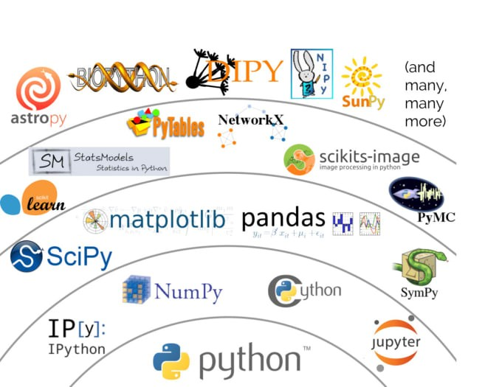
Technology Used
Python – Core programming language for data analysis and prediction.
Google Colab – Cloud-based environment for executing Python code.
Pandas – Data manipulation and cleaning.
NumPy – Numerical computations.
Matplotlib – Data visualization.
Seaborn – Statistical analysis and visualization.
Scikit-learn – Machine learning and model evaluation.
Linear Regression – Predicting the number of doctor visits.
Random Forest Regression – Modelling complex patterns in healthcare data.
CSV – Healthcare dataset storage and export format.

Slide 6
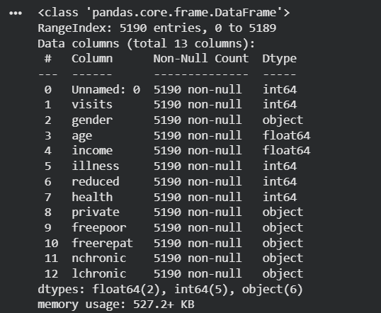
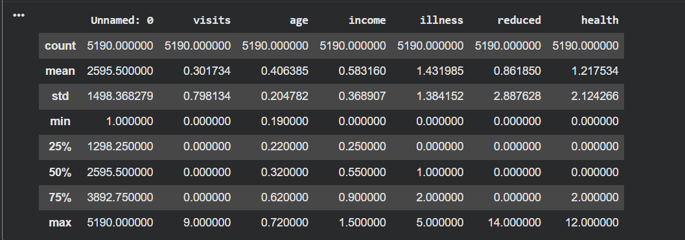
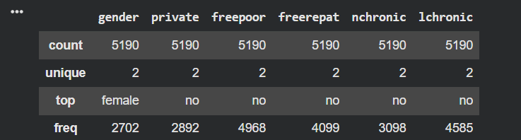
RESULTS
Demo Link:-
https://github.com/Raviranjan02112006/Heathcare-Analytics-Doctor-Visits.git

Slide 7
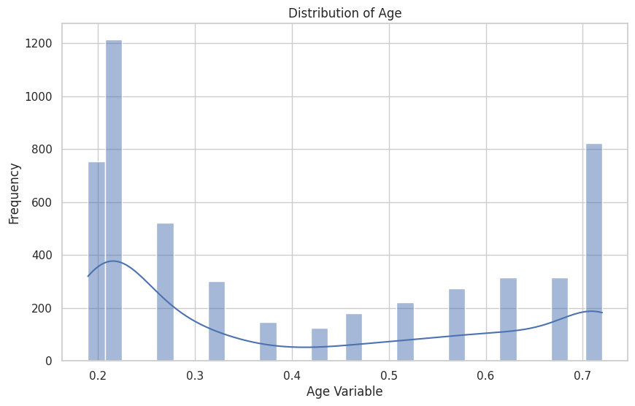
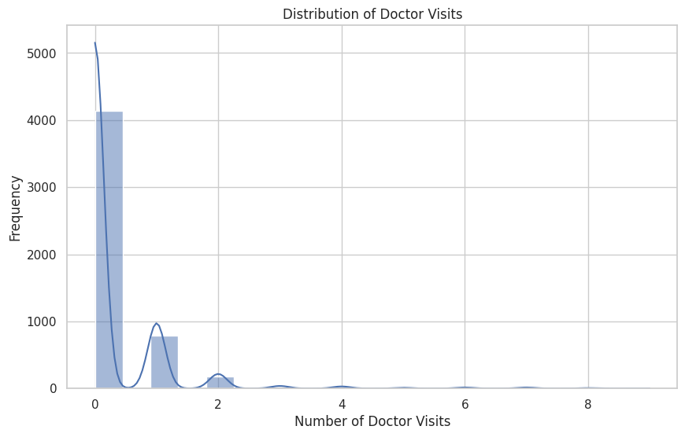
RESULTS
Demo Link:-
https://github.com/Raviranjan02112006/Heathcare-Analytics-Doctor-Visits.git

Slide 8
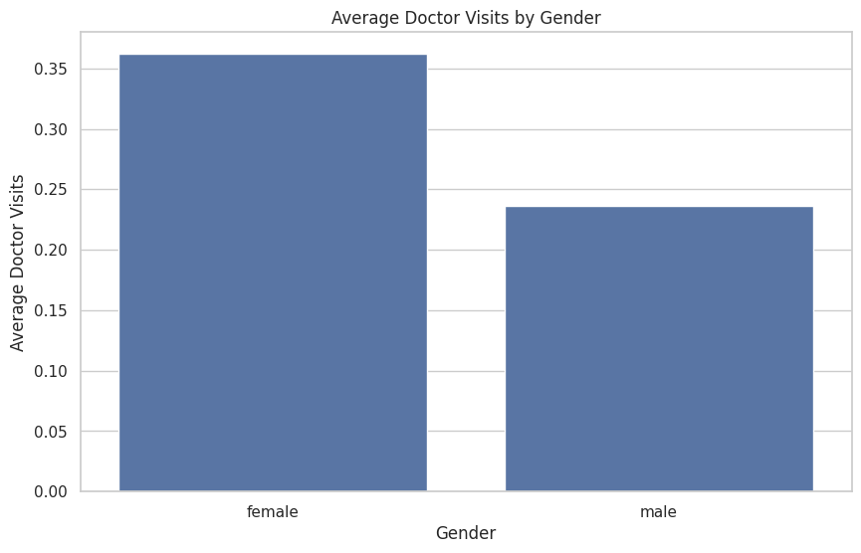
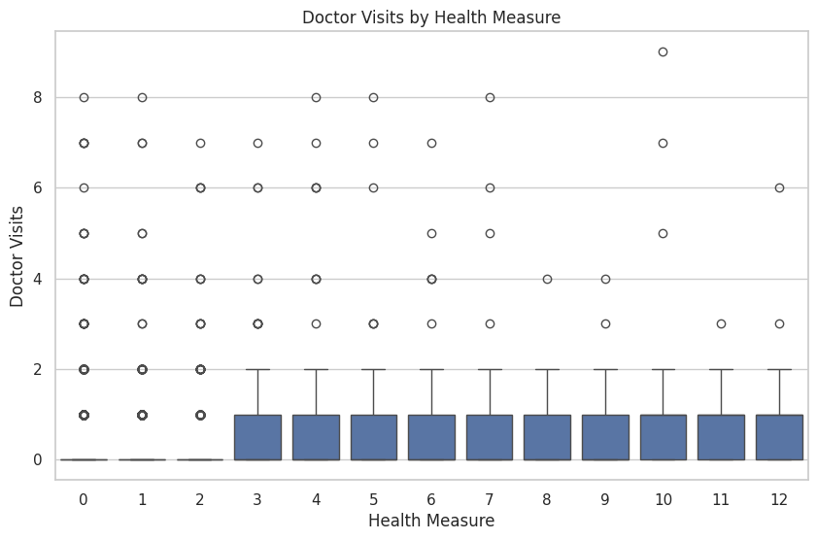
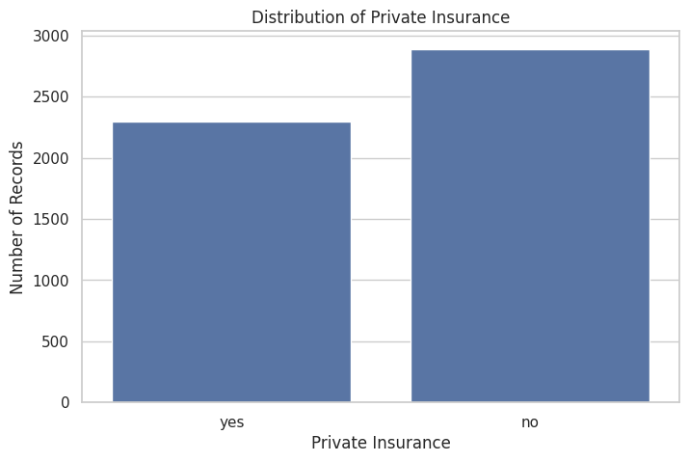
RESULTS
Demo Link:-
https://github.com/Raviranjan02112006/Heathcare-Analytics-Doctor-Visits.git

Slide 9
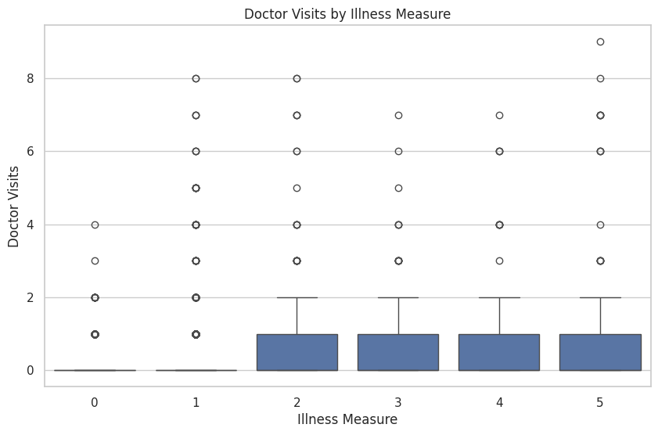
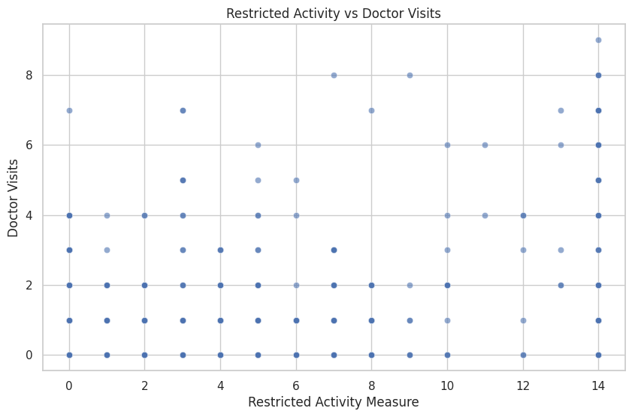
RESULTS
Demo Link:-
https://github.com/Raviranjan02112006/Heathcare-Analytics-Doctor-Visits.git

Slide 10
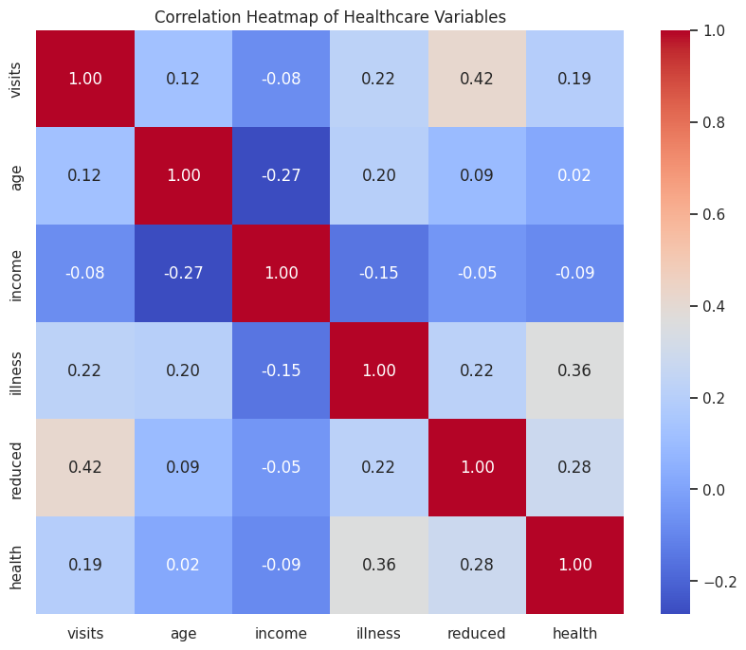
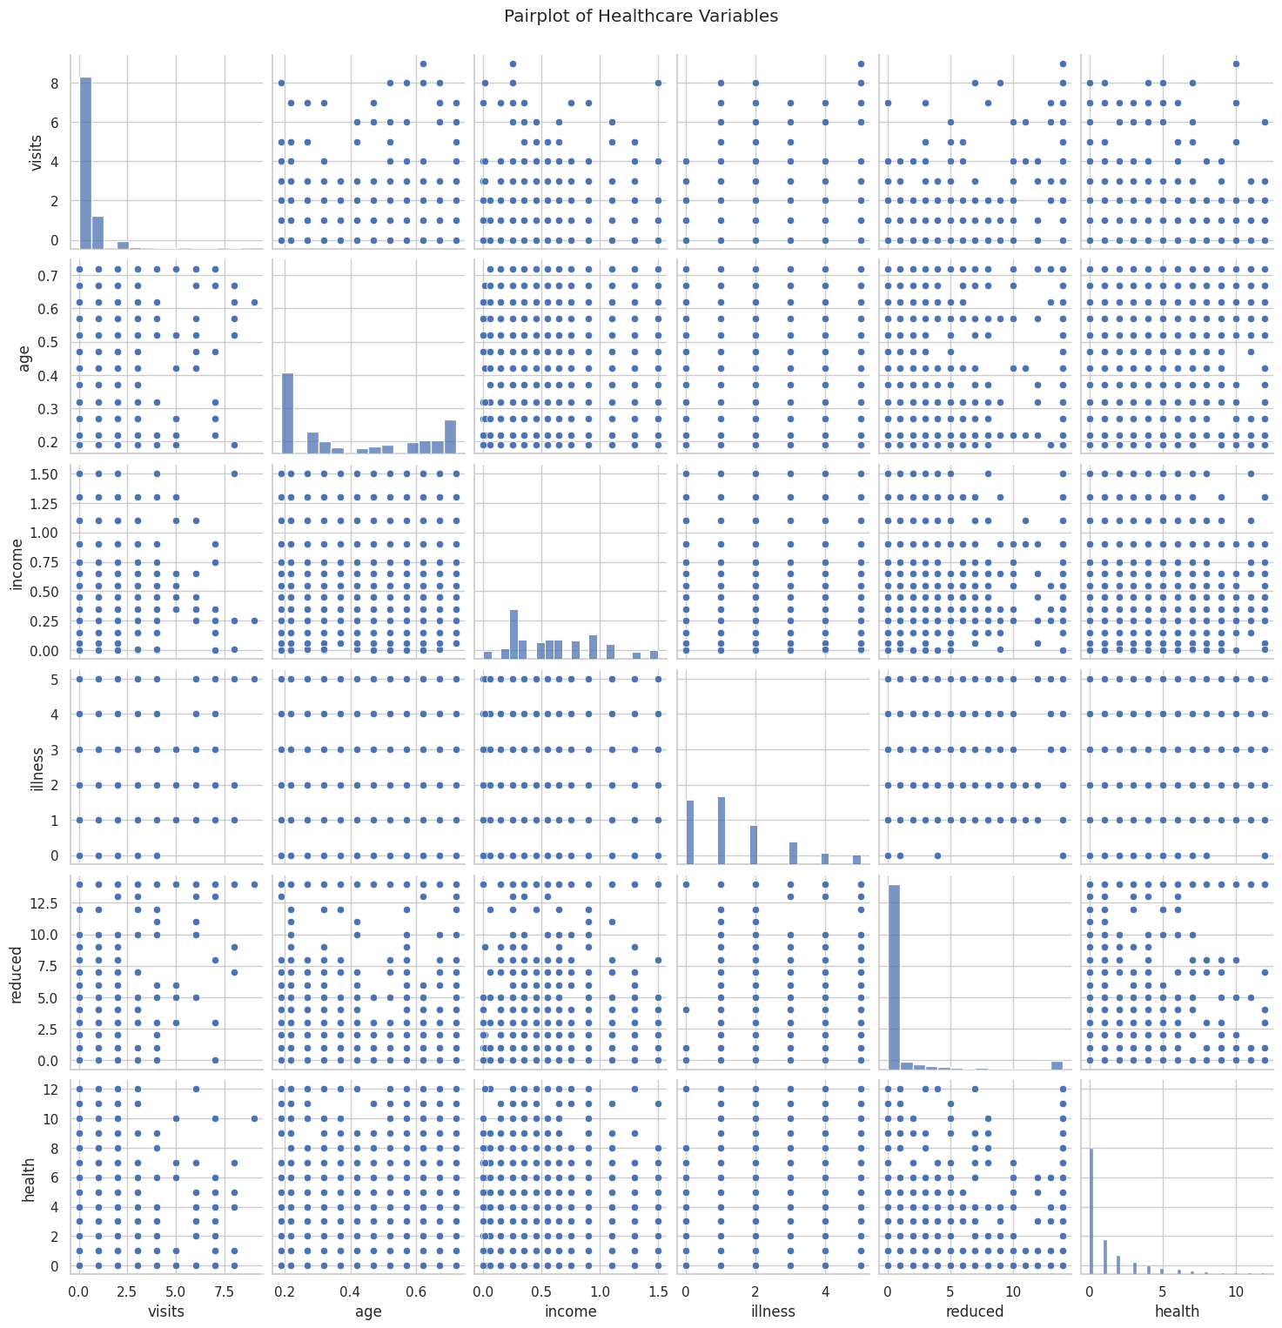
RESULTS
Demo Link:-
https://github.com/Raviranjan02112006/Heathcare-Analytics-Doctor-Visits.git

Slide 11

Thank you
.
.

