Slide 1


Project Title – Healthcare Analysis for Doctor Visits TIRTC
Student Name:- Ravi Ranjan Kumar
College – Cluster Innovation Centre,
University of Delhi
Student ID - STU6a5e48692fb9c1784563817

Slide 2

PROBLEM STATEMENT
Analyse healthcare data to identify patterns in doctor visits.
Examine the influence of demographic, socioeconomic, and health-related factors.
Apply Exploratory Data Analysis (EDA) and data visualization.
Predict doctor visits using Linear Regression and Random Forest.
Compare model performance using MAE, RMSE, and R².

Slide 3
Project Description
[write detail description about your project ]

Slide 4


WHO ARE THE END USERS?
Healthcare Providers: To understand patient visit patterns and healthcare utilization.
Hospital Administrators: To support resource allocation and service planning.
Healthcare Analysts: To identify trends and relationships in healthcare data.
Public Health Authorities: To support healthcare planning and policy development.
Researchers and Academicians: To study healthcare utilization patterns using data analytics.
Insurance Companies: To understand healthcare service utilization trends for planning and analysis.

Slide 5
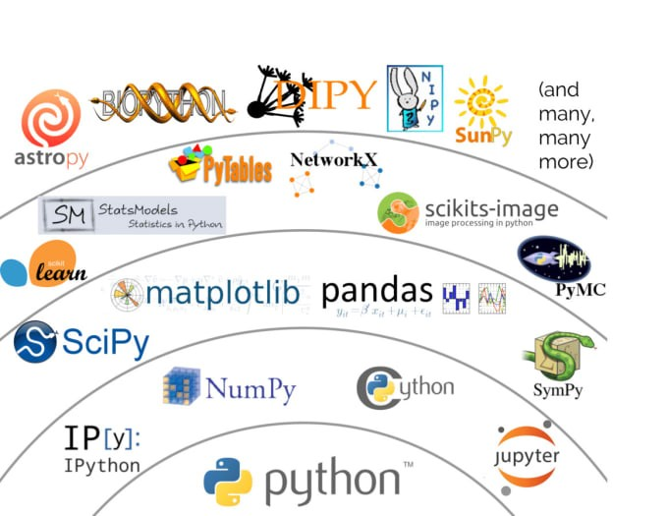
Technology Used
Python – Core programming language for data analysis and prediction.
Google Colab – Cloud-based environment for executing Python code.
Pandas – Data manipulation and cleaning.
NumPy – Numerical computations.
Matplotlib – Data visualization.
Seaborn – Statistical analysis and visualization.
Scikit-learn – Machine learning and model evaluation.
Linear Regression – Predicting the number of doctor visits.
Random Forest Regression – Modelling complex patterns in healthcare data.
CSV – Healthcare dataset storage and export format.

Slide 6
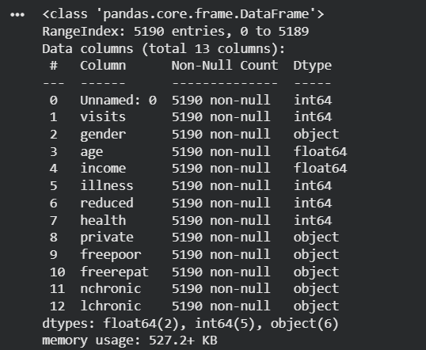
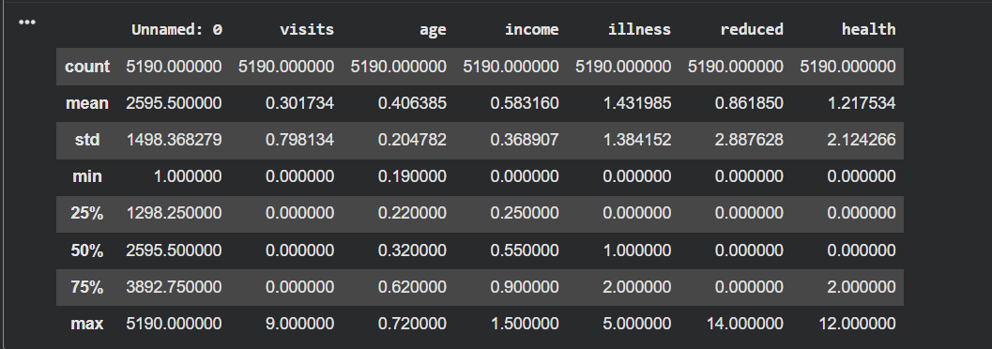
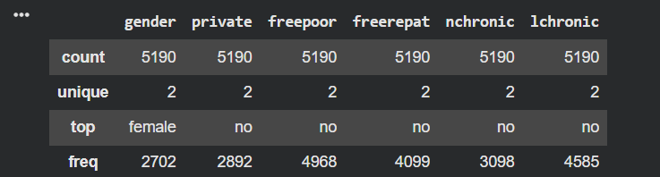
RESULTS
Demo Link:-
https://github.com/Raviranjan02112006/Heathcare-Analytics-Doctor-Visits.git

Slide 7
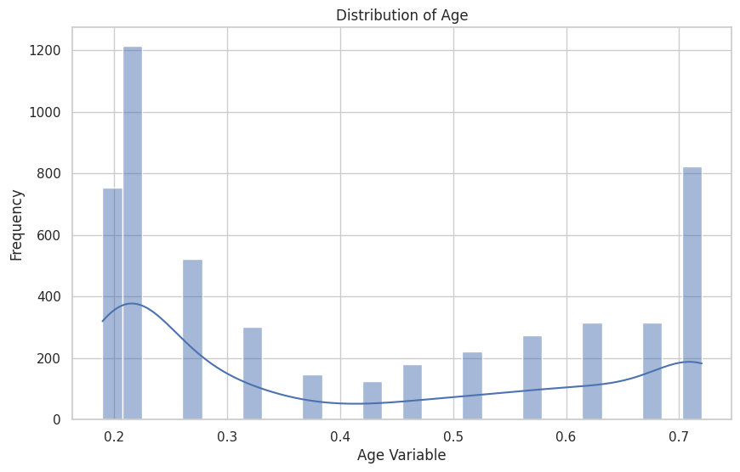
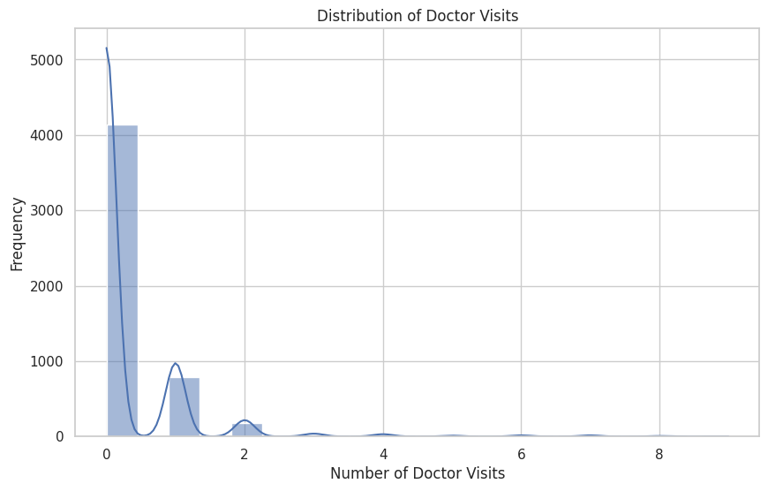
RESULTS
Demo Link:-
https://github.com/Raviranjan02112006/Heathcare-Analytics-Doctor-Visits.git

Slide 8
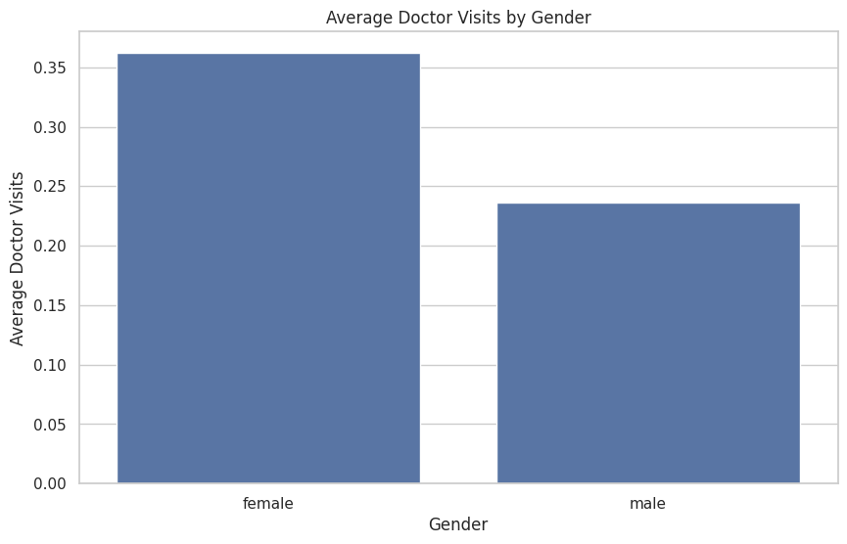
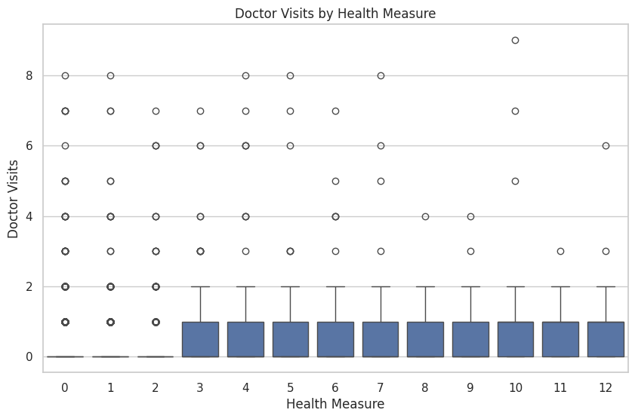
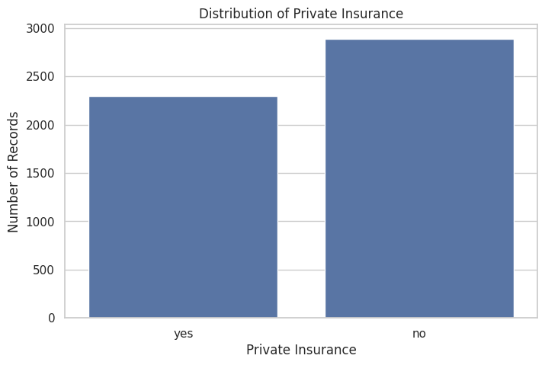
RESULTS
Demo Link:-
https://github.com/Raviranjan02112006/Heathcare-Analytics-Doctor-Visits.git

Slide 9
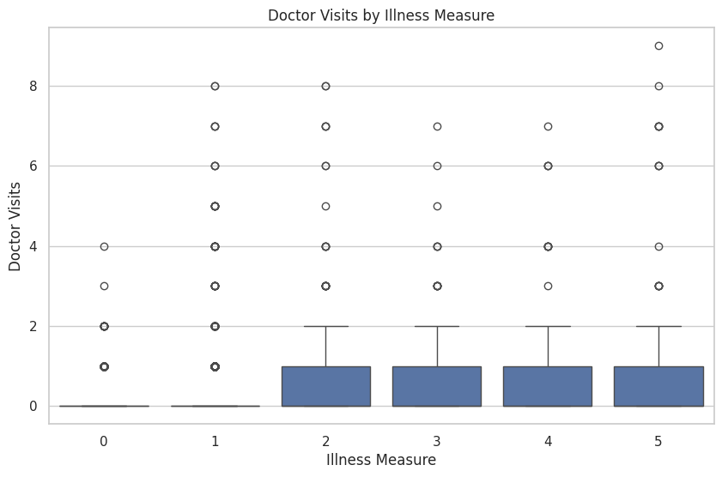
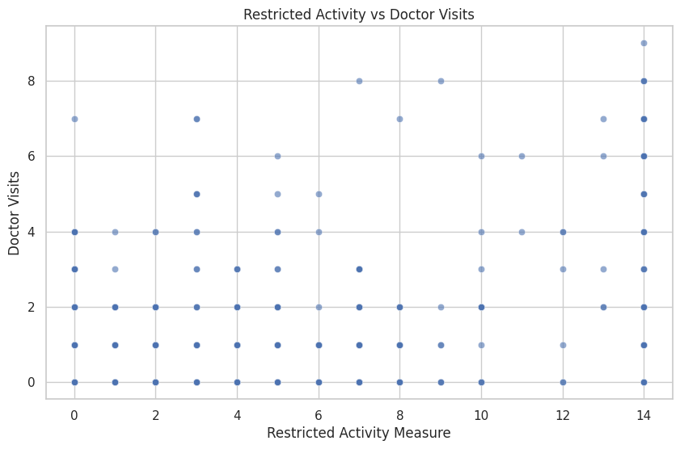
RESULTS
Demo Link:-
https://github.com/Raviranjan02112006/Heathcare-Analytics-Doctor-Visits.git

Slide 10
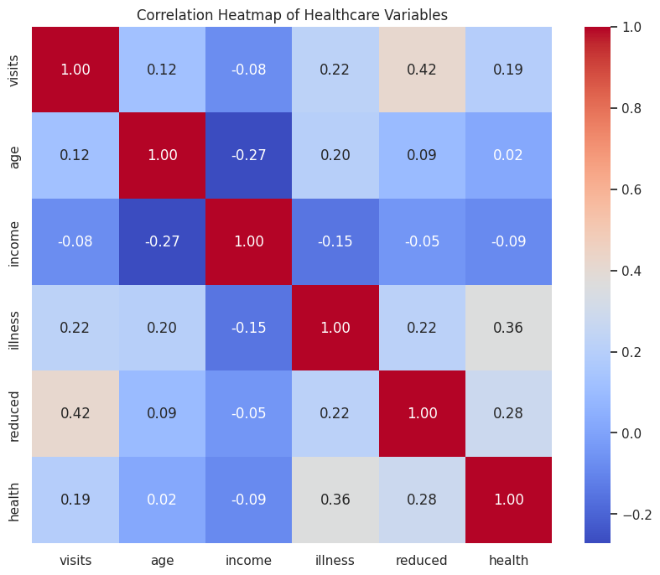
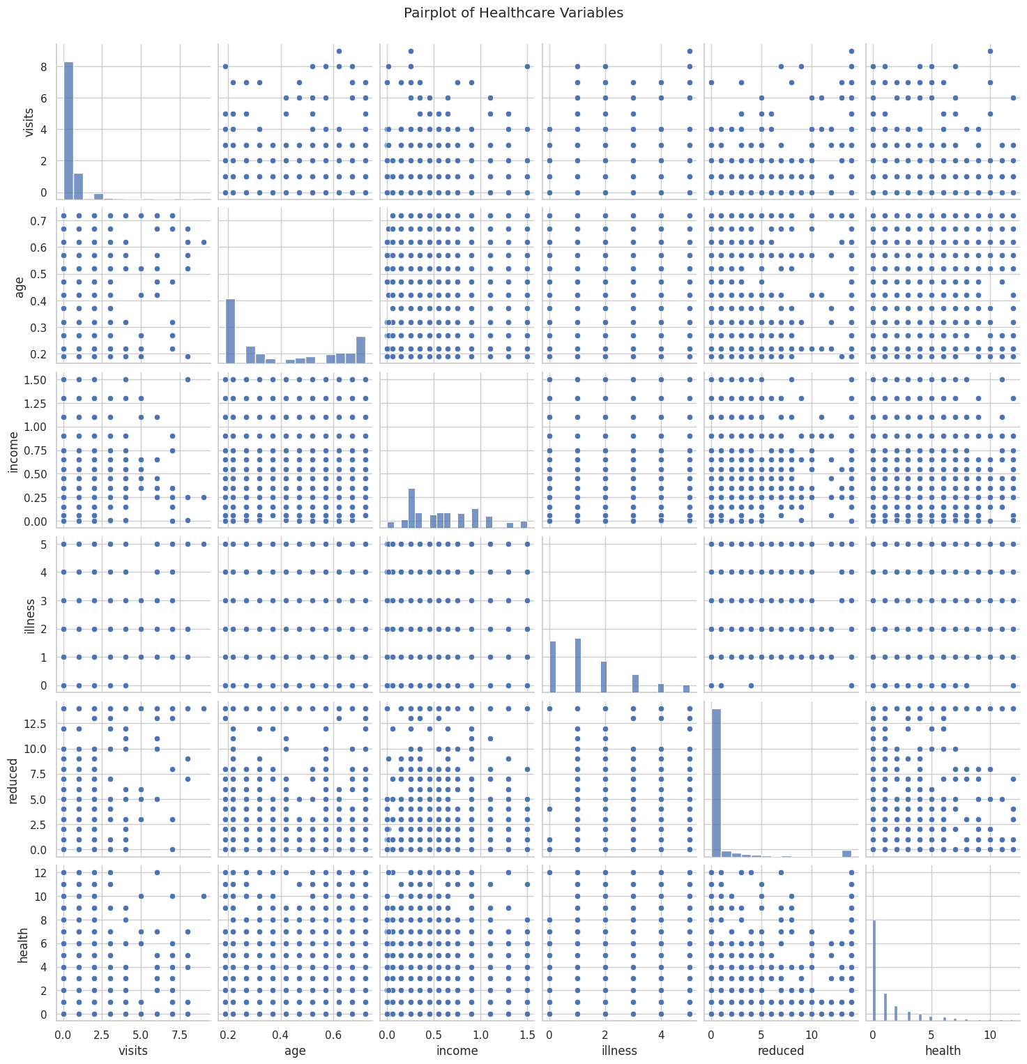
RESULTS
Demo Link:-
https://github.com/Raviranjan02112006/Heathcare-Analytics-Doctor-Visits.git

Slide 11

Thank you
.
.

