Slide 1





SQL – Finance and Supply Chain Analytics of AtliQ Hardware

Slide 2
About AtliQ Hardware and Problem Statement
AtliQ Hardware is a leading hardware company specializing in PC, Mouse, Keyboard and Printers etc with a global reach.
The expanding size of excel file has led to performance problem, resulting in unresponsiveness and inefficiency. AtliQ hardware has launched a project to tackle this issue by assembling a team of data analyst. They will utilize MySQL as their database management system to extract meaningful insights from the data. These insights will empower the company to enhance the decision-making and optimize operations , ultimately boosting overall performance.

Slide 3
Project Overview
This Project is designed to analyse and extract valuable insights from database. The database contains information about sales, products, customers and market for AtliQ Hardware. My aim to extract useful insights like sales report, market analysis, customer behaviour and supply chain forecasting.

Slide 4
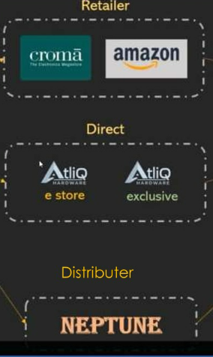
AtliQ Hardware – Business Model
Customers
Customer Platforms
Customer Chanel
Croma
Brick & Mortar
E - Commerce
Best Buy
Croma
Beast Buy
Flipkart
Amazon
Staples
Flipkart

Slide 5
Datasets
Database – gdb0041
Tables
dim_customer
fact_sales_monthly
dim_product
fact_freight_cost
fact_gross_price
fact_manufacturing_cost
fact_forecast_monthly
fact_pre_invoice_deductions
fact_post_invoice_deductions

Slide 6
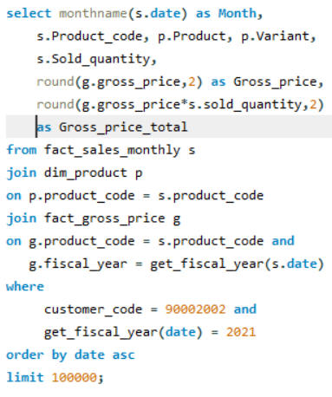
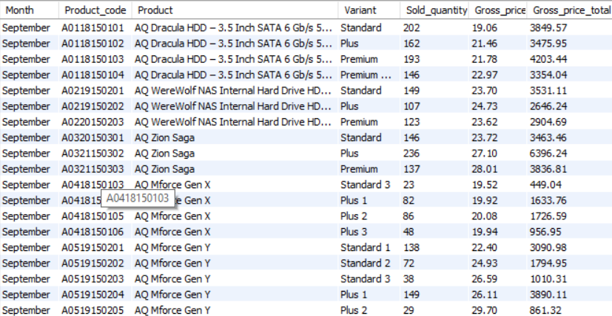
Croma India product wise sales report for fiscal year - 2021
SQL-Query
Output-Sheet

Slide 7
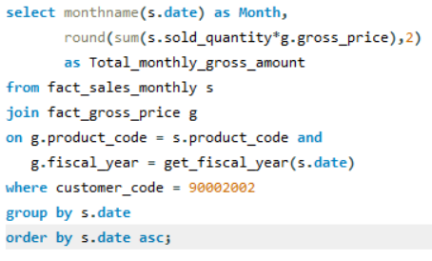
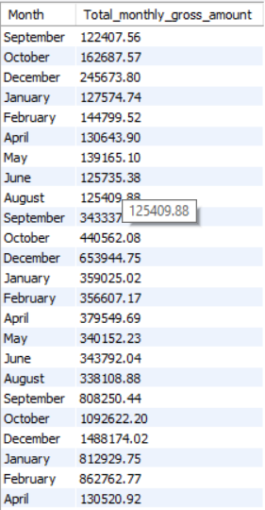
Gross monthly total sales report for Croma
SQL-Query
Output-Sheet

Slide 8
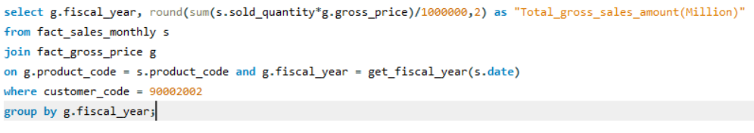
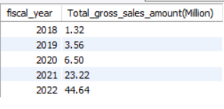
Yearly gross sales report for Croma India
SQL-Query
Output-Sheet

Slide 9
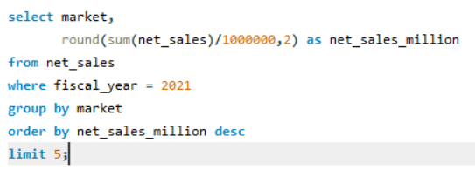
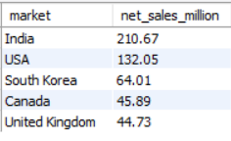
Top markets, products, customers for financial year - 2021 ( by net sales)
Top Market
SQL-Query
Output-Sheet

Slide 10
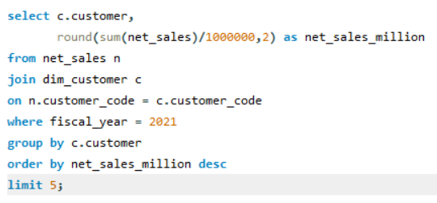
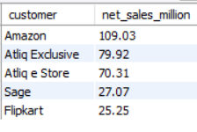
Top markets, products, customers for financial year - 2021 ( by net sales)
Top Customer
SQL-Query
Output-Sheet

Slide 11
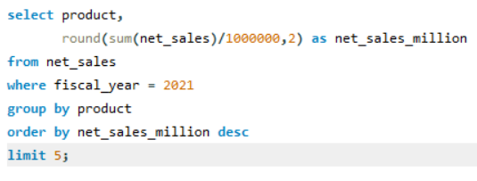
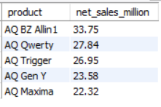
Top markets, products, customers for financial year - 2021 ( by net sales)
Top Product
SQL-Query
Output-Sheet

Slide 12
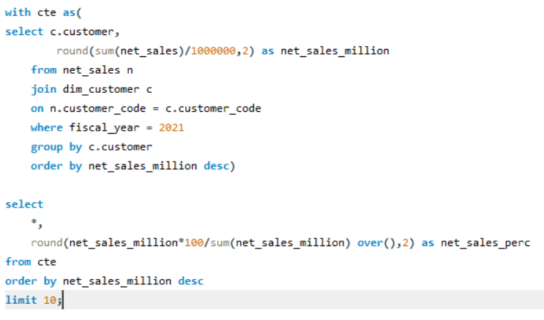
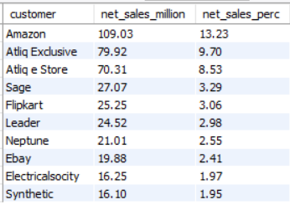
Net Sales % share global by customer
SQL-Query
Output-Sheet

Slide 13
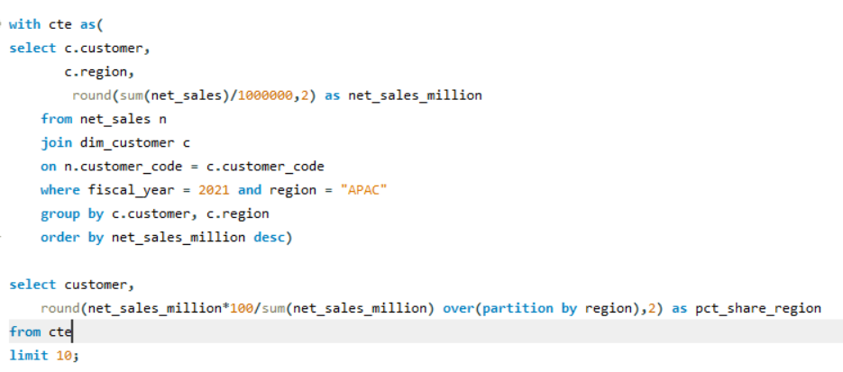
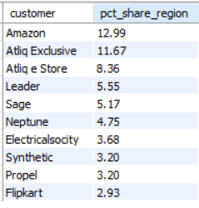
Net Sales % share by region – “APAC”
SQL-Query
Output-Sheet

Slide 14
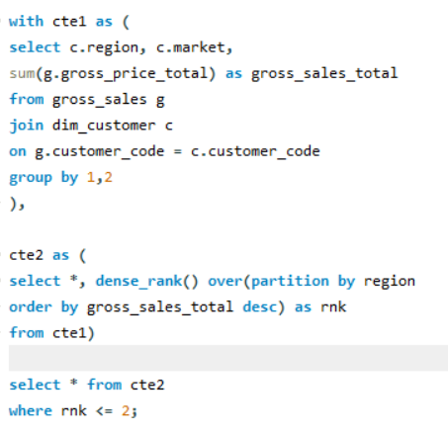
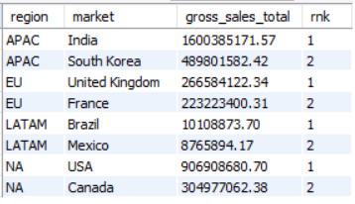
Top 2 market in every region by their gross sales amount
SQL-Query
Output-Sheet

Slide 15
Thank You

