Slide 1

RECONSTRUCTION AND DENOISING OF THE EEG SIGNAL USING THE ADMM​
Ravishanmugam K -- CB.SC.U4AIE24347 ​
Sharvesh Sivaganam -- CB.SC.U4AIE24355​
Sri Harini MP -- CB.SC.U4AIE24358​
Vignes VM -- CB.SC.U4AIE24359
GROUP-14

Slide 2
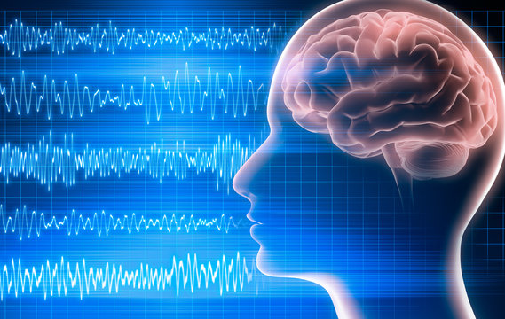
Introduction
EEG signals, which capture the brain’s weak electrical activity, are often corrupted by noise such as equipment interference and motion artifacts. To analyze them effectively, it is essential to reconstruct and denoise the signals without losing important details.
Traditional methods like compressed sensing can recover EEG signals from fewer samples but often lack accuracy and efficiency.
This work applies the Alternating Direction Method of Multipliers (ADMM) to overcome these issues. ADMM breaks complex optimization problems into smaller, iterative subproblems, enabling precise and efficient signal reconstruction.
Using EEG data from PhysioNet, the study reconstructs signals from limited observations using an ℓ₁-regularized objective and soft-thresholding to enhance sparsity.
Additional denoising under Gaussian and Laplacian noise is achieved through a Lasso-based ADMM approach.
Group-14

Slide 3
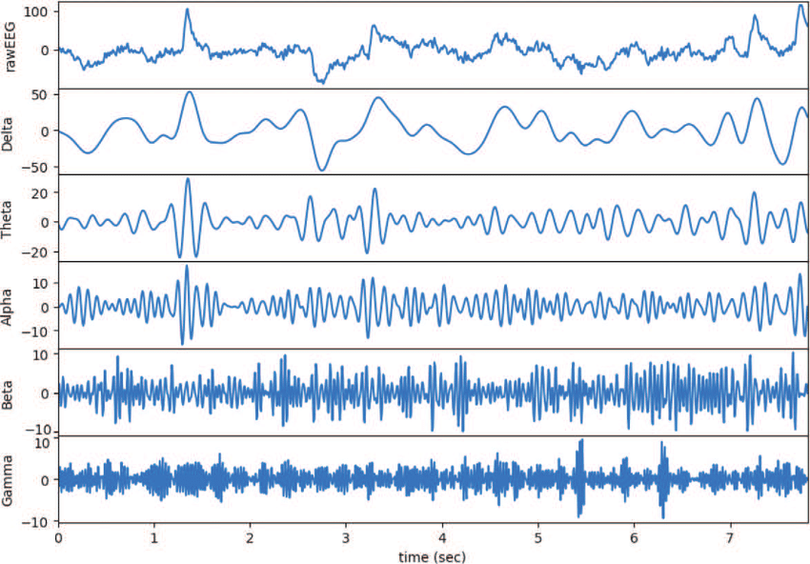
Dataset Description
EEG During Mental Arithmetic Tasks from the Physionet.​
36 Subjects from age 16 to 26, both female and male.​
Performed both good and bad quality mental expression.​
EEG were recorded monopolarly using Neurocom EEG 23-Channel system(Ukraine, XAI-MEDICA).​
The EEGs were recorded monopolarly using Neurocom EEG 23-channel system (Ukraine, XAI-MEDICA). The silver/silver chloride electrodes were placed on the scalp according to the International 10/20 scheme. All electrodes were referenced to the interconnected ear reference electrodes.​
The data files with EEG are provided in EDF (European Data Format) format. ​
with "_1" suffix -- the recording of the background EEG of a subject (before mental arithmetic task)​
with "_2" suffix -- the recording of EEG during the mental arithmetic task.​
Group "G" (24 subjects) performing good quality count (Mean number of operations per 4 minutes = 21, SD = 7.4).​
Group "B" (12 subjects) performing bad quality count (Mean number of operations per 4 minutes = 7, SD = 3.6).​
Group-14

Slide 4
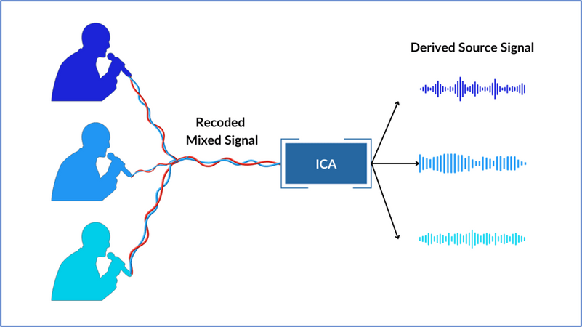
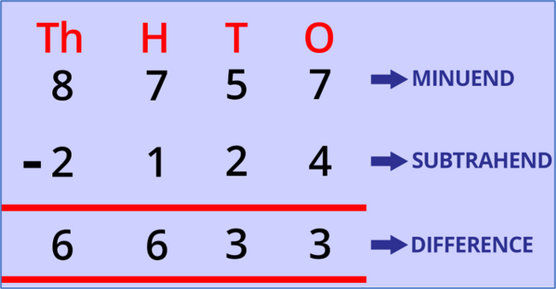


Inbuilt Preprocessing
EEG signals naturally capture not just brain activity but unwanted noise—like blinks (eye artifacts), muscletension, and even heartbeats.
ICA is a statistical technique used to separate mixed signals into independent components.
In this context, ICA was applied to the raw EEG data to isolate and remove these non-brain signals—enhancing the clarity and reliability of the cognitive EEG segments.​
Arithmetic task was the serial subtraction of two numbers. Each trial started with the communication orally4-digit (minuend) and 2-digit (subtrahend) numbers (e.g. 8757 and 24).
Group -14

Slide 5
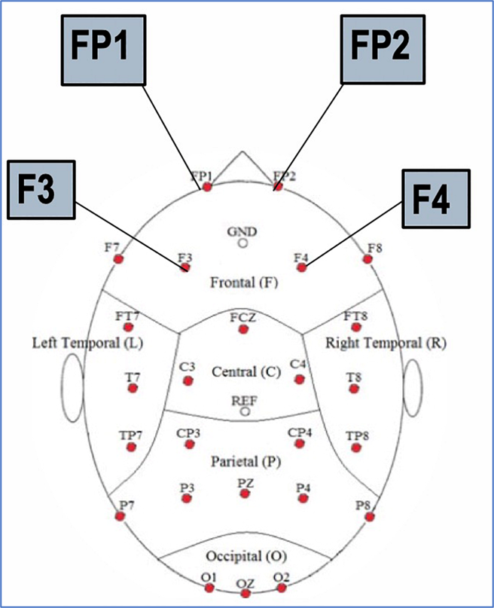
Neurocom monopolar EEG 23-channel system​
Fp1, Fp2
F3, F4, Fz, F7, F8
frontal
frontal
P3, P4, Pz
O1, O2
parietal
occipital
C3, C4, Cz
T3, T4, T5, T6
central
temporal
Silver/silver chloride electrodes were placed on the scalp at symmetrical anterior.
Recording sites according to the International 10/20 scheme.​

Slide 6
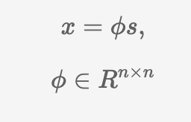

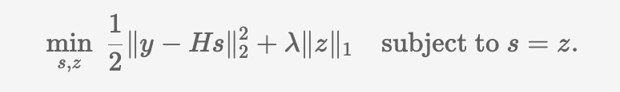

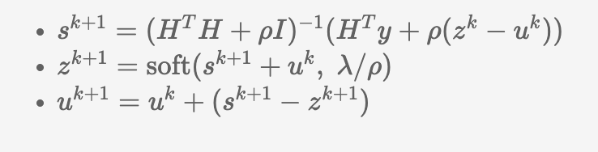
Reconstruction using ADMM

Slide 7
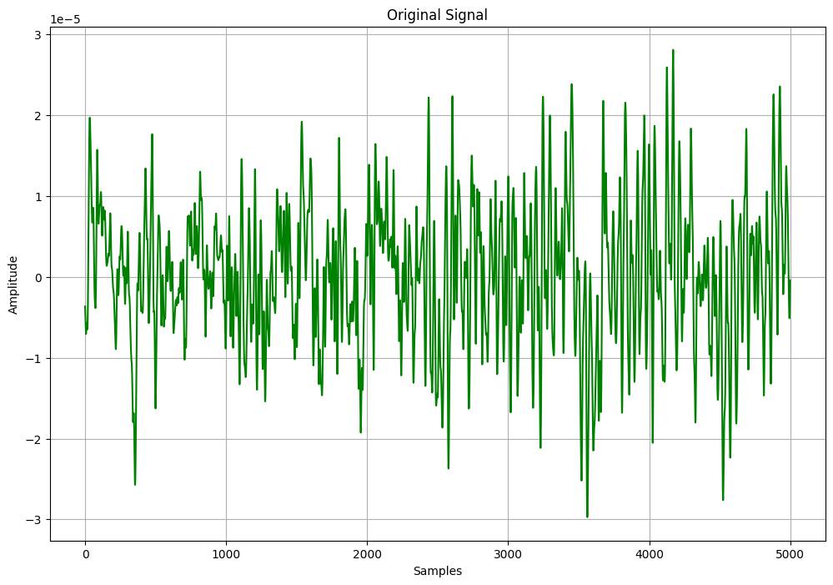
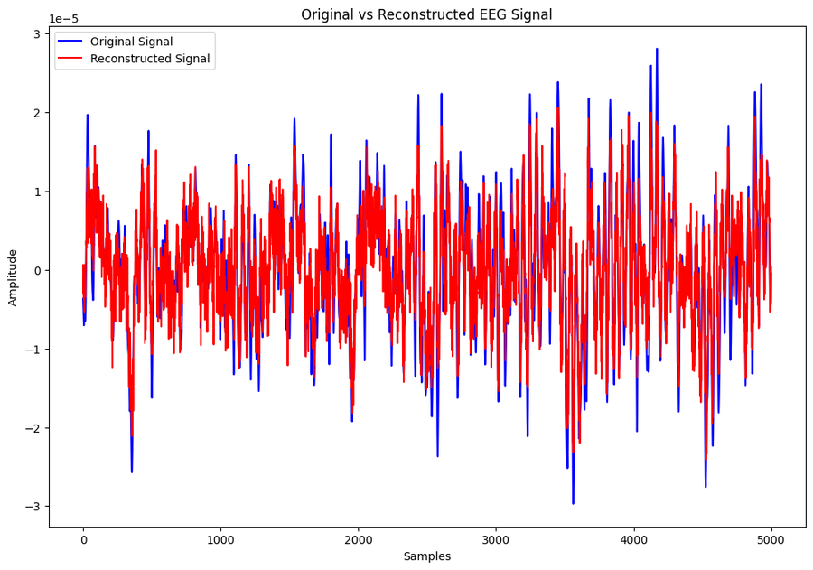
Original signal
Reconstructed
Group -14

Slide 8
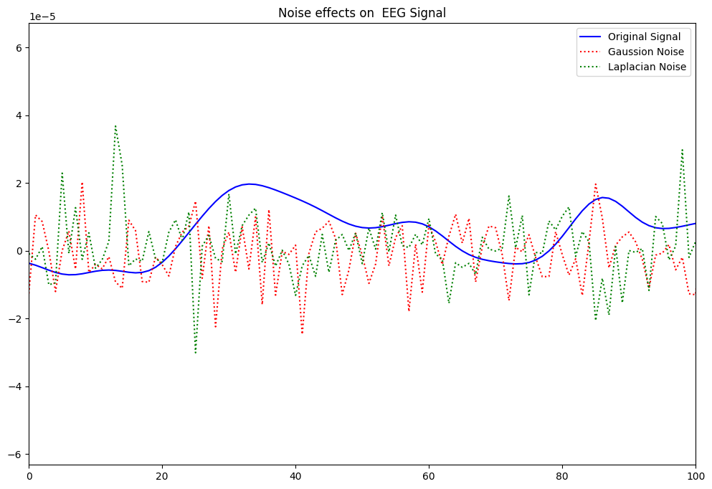
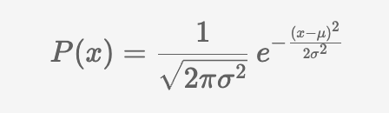
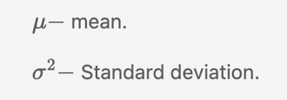
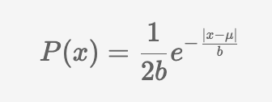
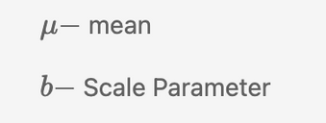
Adding Noise
Gaussian Noise
|
Laplacian Noise
|
Group -14

Slide 9
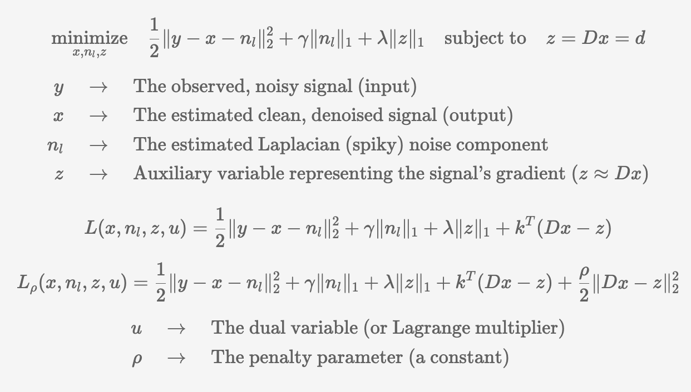
Denoising using ADMM
Group -14

Slide 10
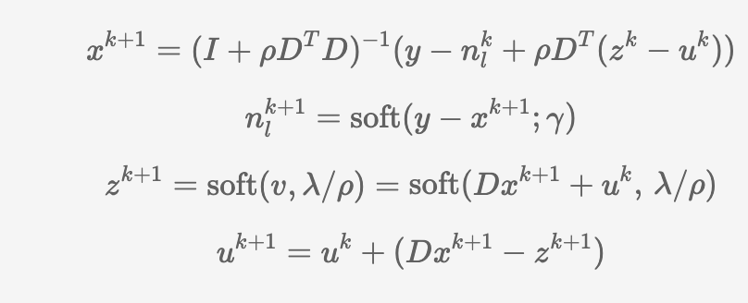
Updated equation summary
Group -14

Slide 11
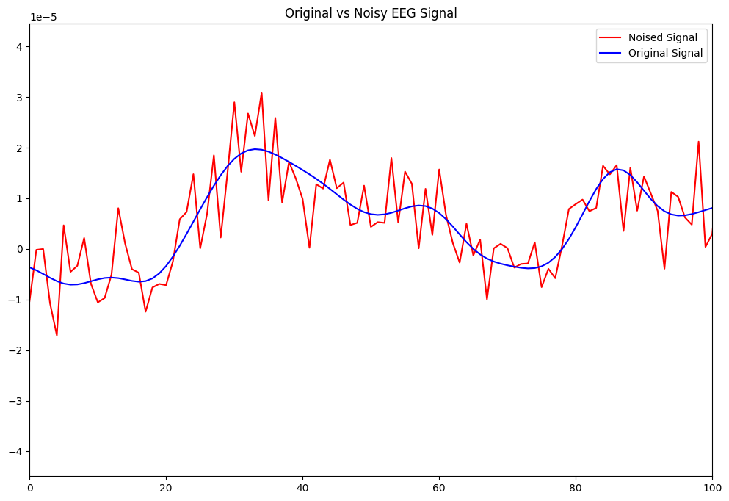
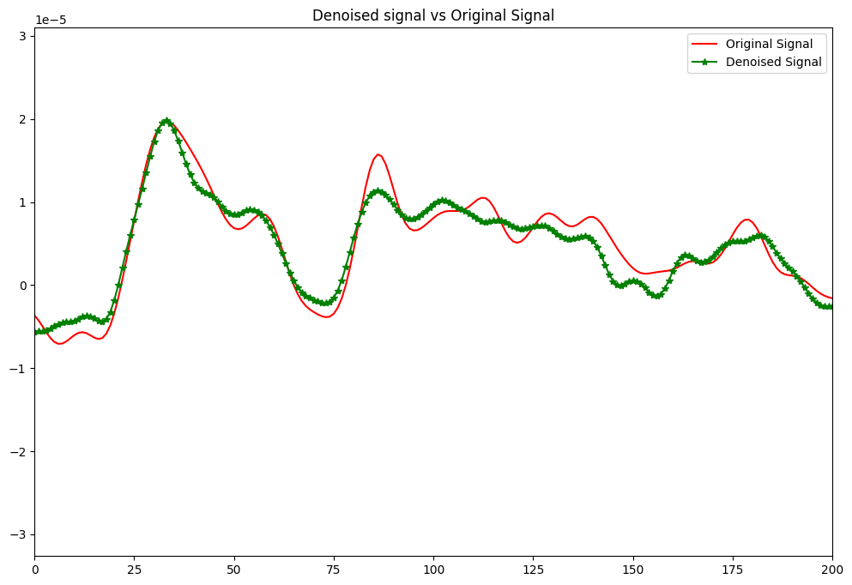
Noised signal
Denoised signal
Group -14

Slide 12
Thank you very much!

