Slide 1



Smart City RTOS and Performance Monitoring Platform Using QNX Neutrino RTOS
State Level Hackathon
Kernel Knights | Vijayawada
Real-time health, fault detection and analytics for smart-city nodes

Slide 2
Problem Synthesis & Scenario
The Scenario
Smart-city nodes (traffic, grid, sensors) need 24/7 watching
A silent node failure goes unnoticed until service breaks
3 s
Heartbeat timeout
90 %
CPU overload limit
Criticality
Late fault detection can cascade into a city-service outage
Deterministic IPC and scheduling give a predictable detection time
2000 µs
IPC latency limit
1 Hz
Report rate to dashboard
Success Metric
Detect any fault within one 1 s monitor cycle
Live 0-100 health score per node on the dashboard

Slide 3
QNX Architectural Approach
Node Threads
3 simulated nodes
write
Shared State
g_nodes + mutex
read
Monitor Loop
Fault detect + analytics
UDP JSON
PC Dashboard
Python GUI + charts
MsgSend: IPC latency
Echo Server
MsgReceive / MsgReply
Microkernel Strategy
Nodes run as QNX threads
IPC latency timed every 500 ms
Resource Isolation
Mutex-guarded shared state
Monitor works on a copy of node data
Priority Setup
Threads at default QNX priority
Node loop 500 ms, monitor 1s

Slide 4
Technical Execution (Logic)
1 Sense
node_sim.c
CPU, task, heartbeat, IPC
2 Detect
fault_detector.c
Rule-based fault check
3 Analyze
analytics.c
EMA + health score
4 Publish
monitor.c
JSON over UDP :5005
5 Visualize
Dashboard.py
Cards, charts, log
Fault Rules (checked in order)
Heartbeat silent > 3 s: HEARTBEAT_LOST
Task state FAILED: TASK_FAILED
CPU > 90 %: CPU_OVERLOAD
IPC > 2000 µs: IPC_LATENCY
Health Score (0-100)
Start at 100; smooth CPU and IPC with EMA (α = 0.2)
CPU avg > 50 %: minus 0.8 per point
IPC avg > 500 µs: minus 1 per 50 µs
Blocked: -15, active fault: -40
Interfaces: software-simulated nodes on QNX target; no GPIO yet. Dashboard states: HEALTHY ≥ 75, DEGRADED ≥ 40, CRITICAL, DOWN.

Slide 5
Resilience & "The Hack" Response
Injected Stress
Detected As
System Response
Node 1: heartbeat silenced for 8 s (every 40 s)
HEARTBEAT_LOST
Flagged after 3 s timeout
Node 2: CPU spike to 95 % for 6 s (every 55 s)
CPU_OVERLOAD
Flagged above the 90 % limit
Node 0: task FAILED 5 s, then BLOCKED 3 s (every 70 s)
TASK_FAILED
Health -40, then -15 when blocked
Node 2: 3 ms stall in IPC path (4 s every 90 s)
IPC_LATENCY
Flagged above 2000 µs
Mitigation Strategy
Detect, classify, log; node keeps being monitored
Recovery Data (RTO)
Detection ≤ ~4 s; recovery flagged ≤ ~1.5 s

Slide 6
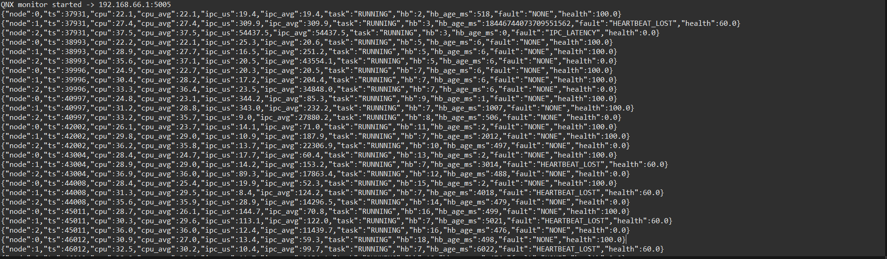
Performance Proof (The Profiler Slide)
QNX Momentics System Profiler
Insert screenshot here: CPU usage and thread timing
500 ms
Node sampling
1 s
Monitor / report period
2000 µs
IPC latency limit
90 %
CPU limit
Analysis: IPC is timed with real MsgSend() round trips, and thresholds flag only the node under stress.

Slide 7
Future Scalability & Conclusion
Innovation Arbitrage: Scale-Up Path
Real nodes on RPi 4/5 over CAN or Ethernet
QNX HAM to auto-restart failed services
CPU sets, affinity priorities
Persistent logs and alerting (MQTT / cloud)
Predictive faults from the health trend
Learning Outcome
Timing IPC with native MsgSend
Thresholds + EMA to cut false alarms
Thread-safe shared state
Conclusion
A smart city that watches its own health in real time: deterministic, observable, recoverable.

